Slide 1
The Caribbean Sustainable Finance Architecture June 2nd, 2020 Coral triangle Initiative Webinar

Slide 2
Caribbean Challenge Initiaive – CCI
Goal 1 - “20-by-20” – To conserve and effectively manage at least 20% of the marine and coastal environment by 2020.
Goal 2 – Sustainable Finance- To put in place fully functioning finance mechanisms that provide long-term, reliable funding to ensure a healthy marine and coastal environment into the future.

Slide 3
Caribbean Challenge Initiative – CCI
GUY
CUB
DOM
CCI
1
2
20 by 20
$$$
Financial Architecture
JAM
CBF + NCTFs
PR
DR
BVI
BAH
GRE
A&B
HAI
SVG
SLU
USVI
SCN
Notes:
.

Slide 4
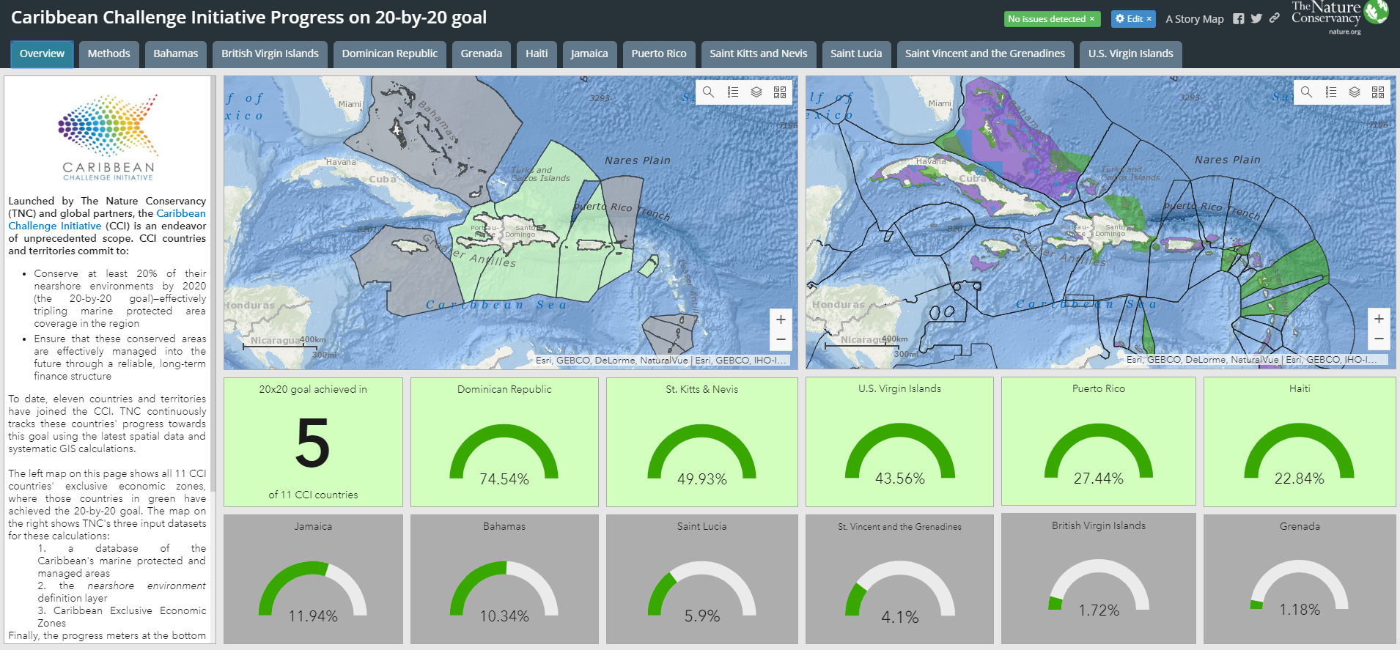
Goal 1 – “20 by 20”
https://arcg.is/5uS5i

Slide 5
Strategic Plan 2016 – 2020
Strategies
1 – International targets
2 – Institutional structures
Goals
1
3 – Partnerships
Build structures
Mission
4 – Visibility
2
Expand programs
5 – More themes
Vision
6 – More geographies
3
Increase funding
7 – Financial sustainability goals
8 – Support NCTFs funding

Slide 6
The Caribbean Sustainable Finance Architecture
Other $
CBF
Eligible Finance Mechanisms
MEPA
BPAF
Endowment
National projects
gov. agencies
NGOs
CBOs
academia
private sector
MARENA
GSDTF
KfW, TNC, GEF/WB/ UNDP
NCTFJ
SCNCF
Regional projects
SLUNCF
SVGCF
EbA
Facility

Slide 7
CBF Financial Instruments
Endowment
Fund
Year of Establishment: 2012
Donor commitments to date: 69.5M USD
Pending Deposits: 0.75M USD
Donors: KfW, TNC, GEF/WB, GEF/UNDP

Slide 8
CBF Endowment Resources 2019 Pledges per country (USD Million)

Slide 9
CBF Endowment Eligibility Policy
Purpose: The purpose should be aligned with the purpose of the CBF
Board composition: Broad composition and representation, majority civil society board membership
Civil society board members: Should not be solely selected by the government
Asset control: Well-designed and independent asset control
Audit requirements: Well-defined audit requirements
Grants: Ability to make grants to both government and civil society entities
Match: Ability to generate 1:1 match funding

Slide 10
CBF Match Requirement Policy
CBF Payments | NCTF Match Requirement
Payment 1 | 0
Payment 2 | 0
Payment 3 | 25% of Payment 2
Payment 4 | 50% of Payment 3
Payment 5 | 75% of Payment 4
Payment 6 | 100% of Payment 5

Slide 11
NCTFs Dashboard - 2015
NCTFs Status | Legally Established | Functional Board | Pre-Financing Agreement | By-laws | OM (Board Approved) | Staff Hiring | CBF Eligibility Request | Partnership Agreement Negotiations | First CBF Payment
MEPA Trust
BPAF
Fondo MARENA |  |  | Not applicable
GSDTF
NCTFJ
SCNCF
SLUNCF
SVGCF
Complete
In progress
Not initiated yet
N/A at the moment

Slide 12
NCTFs Dashboard – Jan. 2020
NCTFs Status | Legally Established | Functional Board | Pre-Financing Agreement | By-laws | OM (Board Approved) | Staff Hiring | CBF Eligibility Request | Partnership Agreement Negotiations | First CBF Payment
MEPA Trust
BPAF |  |  | Not applicable
Fondo MARENA |  |  | Not applicable
GSDTF
NCTFJ
SCNCF
SLUNCF
SVGCF
Complete
In progress
Not initiated yet
N/A at the moment

Slide 13
Milestones of CTF phases by Pillar
Phase I
Start-up
Phase II
Early operations
Phase III
Consolidation
Governance
Purpose and design
Initial Board operational
Constitutive documents
Core governance docs
Constitutive docs updated
Board trained in core areas
Policies and procedures
Fulfilment of mandate
Board continuity
Constitutive docs updated
Critical planning docs
Operations
Fund registered
Initial staff hired
Basic admin systems in place
Permanent staff
Initial grant-making
Core operational docs with filing system
Expanded staffing
Grant-making program
Strong M&EL process
Track record
Finance
Start-up costs
Reporting systems
Core operational costs
Resource Mobilization Plan
Financial management system
Core operational costs
Increased capital
Strengthened financial mgt and investment policies
~
2 to 4 years
+3 years
+3 years

Slide 14
CBF Financial Instruments
Fondo Adaptación
EbA
Facility
Year of Establishment : 2016
Donor commitments to date: 50M USD
Pending Deposits: 0
Donors: KfW

Slide 15
CBF EbA Facility
KfW awarded a USD 26.5M grant to establish a 5-year EbA Facility sinking fund (December 2016)
USD 22M were added in December 2019
The EbA Facility will award grants to support a wide range of EbA actions across the Caribbean, in eligible countries.
Grants range from 250K to 2 million USD.
USD 12M committed to date.
A&B
CUB
DOM
DR
GRE
HAI
JAM
SLU
SVG

Slide 16
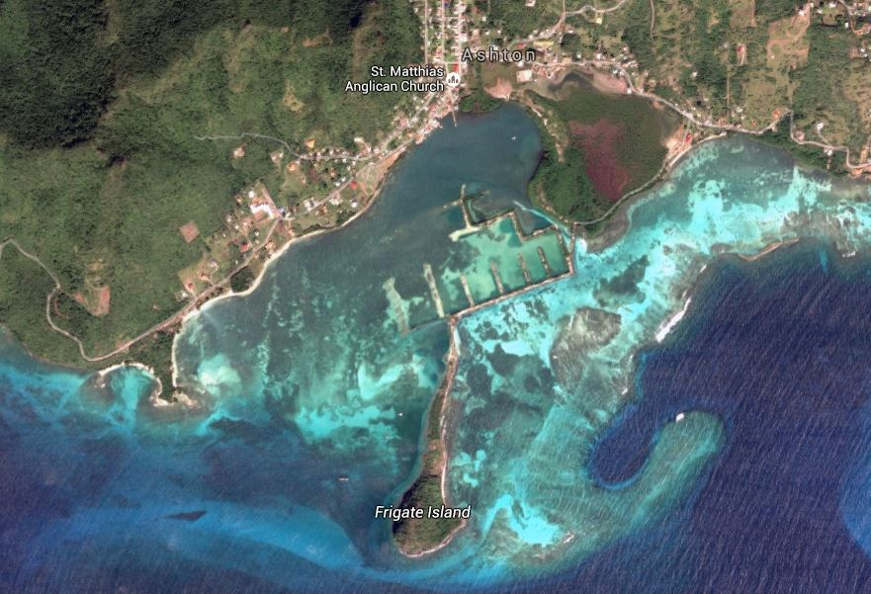
CBF EbA Facility
Support effective climate change adaptation measures in the insular Caribbean,
through replicable models, scale-up and scale-out of projects
focused on the use of biodiversity and ecosystem services
to help people adapt
to off-set the effects of climate change, reduce disaster risk, and build resilient ecosystems and economies

Slide 17
Common Climatic and Technical Issues
Increasing temperatures
Changed rainfall patterns: floods and droughts
Sea level rise, storm surges
Severe storms (increased frequency & intensity)
Ocean acidification
Lack of awareness and behaviour inconsistent with level of knowledge
Uncontrolled development; unsustainable livelihoods
Land-based pollution (liquid and solid)

Slide 18
Lessons Learned and Challenges
Fondo Adaptación
Expanded and diversified funding sources: there is a need for technical support to establish Financial Mechanisms and mobilize other financial resources.
Ensured core operational costs: ongoing, reliable funding is required to cover all costs but especially core operational costs (office, initial staff, accounting, etc.). Funds should conduct financial needs assessments — applying a common methodology — to have a precise idea of the current gap to cover these costs. This challenge is also linked to the challenge above.
Effective Governance: all NCTFs have public-private Boards with limited experience on trust funds management. Training and experiences exchange are required on best practices for Boards management, establishment of Board committees, fiduciary responsibilities and autonomy and independence of the fund.

Slide 19
Lessons Learned and Challenges
Fondo Adaptación
Effective grant-making: the NCTFs are now designing their grant-making programs, including the definition of conservation priorities and criteria for projects selection. Review and refinement of each country’s program, to optimize effectiveness, will require support.
Strong communications and outreach: a strong communications and outreach program is needed for transparency and accountability, and to support a range of operational activities, such as fundraising, announcements of calls for proposals, and outreach and networking involving grant applicants.

Slide 20
Lesson Learned

Slide 21
Thank you! Yabanex Batista, CEO ybatista@caribbeanbiodiversityfund.org

