Slide 1
SOM14
14th Senior Officials’ Meeting
12 - 13 December 2018
Manila, Philippines
SESSION 11.3: SCIENTIFIC ADVISORY GROUP & UNIVERSITY PARTNERSHIP
Presented by Regional Secretariat
Place here Country Logo

Slide 2
Outline
SOM13 Decisions
Background and Updates
Activities in 2018
SOM14 Recommendations

Slide 3
SOM13 DECISIONS Scientific Advisory Group (SAG)
Appreciated and acknowledged the progress made by the Regional Secretariat with regards to the establishment of the Scientific Advisory Group (SAG) based on the SOM-12 decision;
Recognized the proposed Terms of Reference (TOR) for the establishment of SAG based on the developed mechanism of the utilization of experts;
Endorsed the CTI-CFF Experts Form; and
Endorsed the 2018 Workplan.

Slide 4
SOM-13 Decisions University Partnership
Acknowledged and recognized the efforts made by the Regional Secretariat in reaching out to potential entities in its effort to seek additional / alternative funding sources;
Urged the Regional Secretariat to be more strategic in pursuing cooperation to secure more funding and technical support;
Urged the Regional Secretariat to share and disseminate to NCCs the signed copies of Memorandum of Understandings (MOUs);
Tasked the Regional Secretariat to furnish the NCCs with draft MOUs in the pipeline for assessments and evaluation to ensure that the content of the MoU is in line with RPOA and NPOA goals;
Encouraged the Regional Secretariat to strategize and identify the institutions / universities before initiating cooperation arrangements; and
Tasked the Regional Secretariat to determine a mechanism framework for going into signing of Memorandum of Understandings.

Slide 5
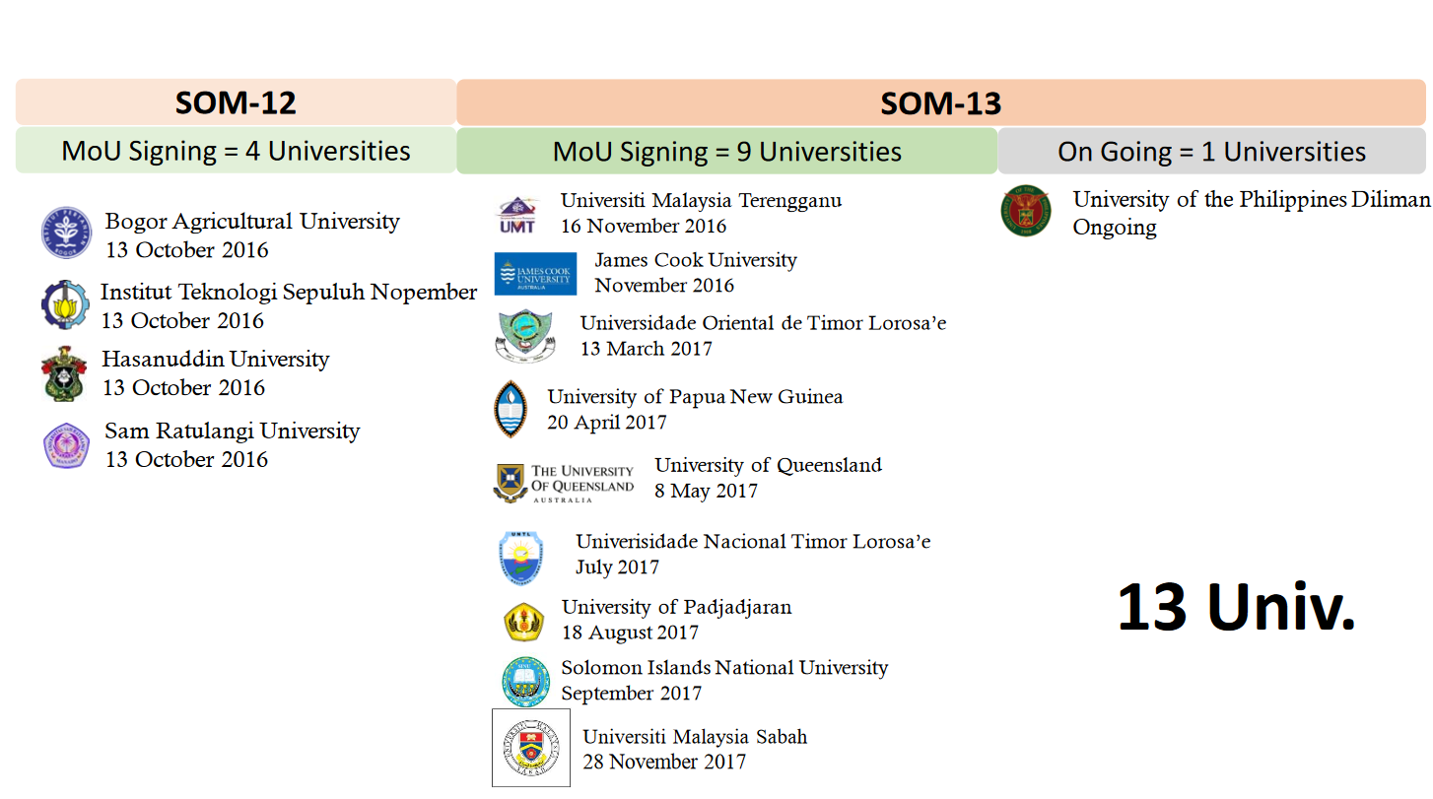
UNIVERSITY PARTNERSHIP CURRENT MEMBERS

Slide 6
Constraints in implementation (2018)
Scientific Advisory Group (SAG)
University Partnership
Funds not allocated in RS 2018 budget.
Blanket budget was imposed (Jan – July 2018).
Transition period staff not sufficient to implement proposed activities
Funds not allocated in RS 2018 budget.
Blanket budget was imposed (Jan – July 2018).
Transition period staff not sufficient to implement proposed activities

Slide 7
University Partnership 2018 Activities
Managing Reef Resilience Under Climate Change in the Sulu Sulawesi Marine Ecoregion (SSME), Manado, Indonesia (7-9 May 2018)
Managing Reef Resilience Under Climate Change in the Bismarck Solomon Marine Ecoregion (BSME), Brisbane, Australia (13-15 August 2018)

Slide 8
Proposed establishment of the SAG
SOM10 Decisions
Tasked the Regional Secretariat to develop a list of experts in the field of coral reefs, fisheries and food security and allied fields of discipline pertaining to the RPOA goals or expertise within Coral Triangle area.
Tasked the Regional Secretariat to formulate a mechanism to use and optimize the pool of experts and present the proposed mechanism in the next SOM.
Propose to emulate other TWGs, e.g. MPA & TSWG pool of experts; OR
Similar to IOC OceanExpert Database (proposed added feature in CT Atlas) – no additional cost implication

Slide 9
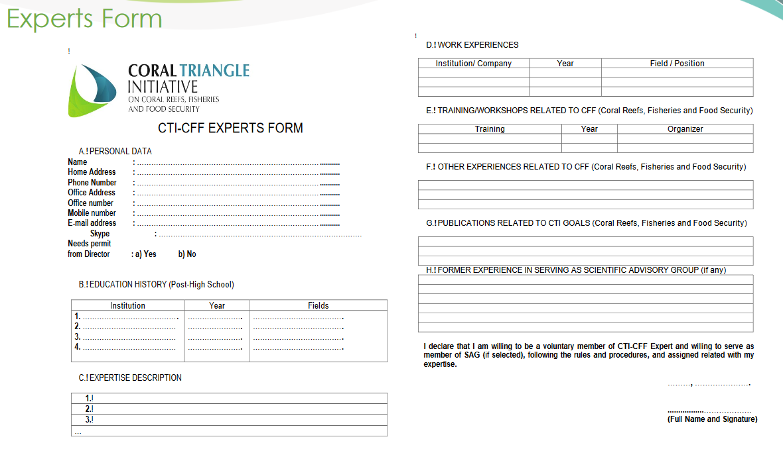

Slide 10
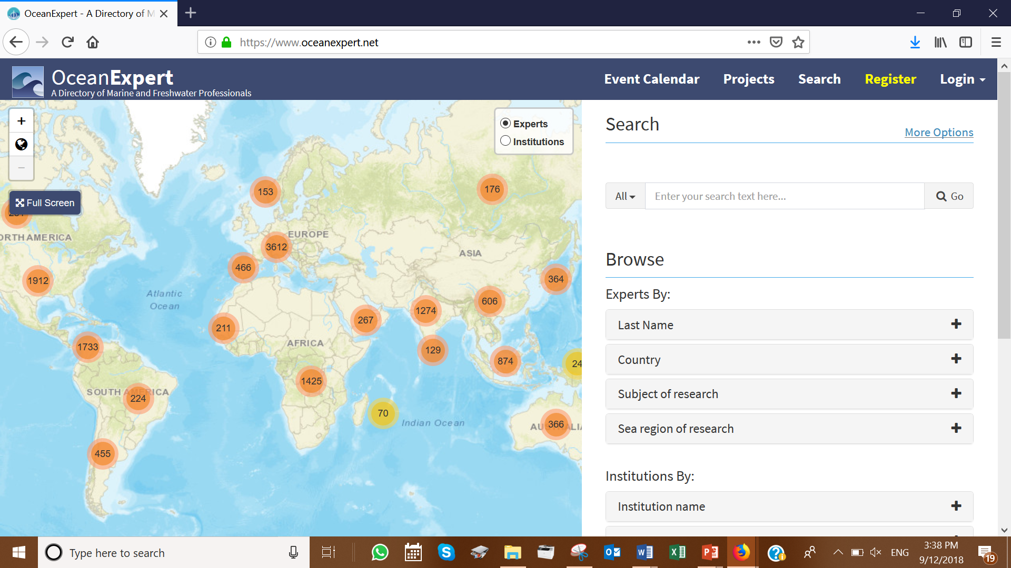
Notes:
Propose to consider free database of pool of experts, as done by

Slide 11
2019 WORKPLAN
Using existing proposal for membership qualification presented in SOM13, review membership criteria and approval mechanisms (consult with NCCs, TWGs and University Partnership), for example:
NCCs, University Partnership and TWGs may nominate members for SAG based on the approved criteria and to go through the approval mechanism.
Seek CSO’s approval for the membership criteria and approval mechanism.
Ensure the development of the SAG database is part of the redesign of CT Atlas program; and
Request for Regional Secretariat to assist SAG/UP to be recognized in NCCs.

Slide 12
SOM14 Recommendations
Acknowledge and appreciate University Partnership’s effort and contribution in the transboundary workshops for SSME and BSSE, as supported by the Australian Government;
Task RS to recall SOM-10 to develop a list of experts in the field of coral reefs, fisheries and food security and allied fields of discipline pertaining to the RPOA goals or expertise within Coral Triangle area, subject to CT Atlas funding approval;
Task Regional Secretariat to coordinate with NCCs in establishing SAG before the 2nd Leaders’ Summit;
Task Regional Secretariat to communicate with NCCs University Partnership with regards to research collaborations and training opportunities;
Task Regional Secretariat to develop guidelines for any transboundary project conducted under the auspices of the CTI includes provision for appropriate collaborative research by countries concerned in support of project objectives;
Task the Regional Secretariat to provide to NCCs the status of implementation status of each MOU signed under the University Partnership;
Task the Regional Secretariat to furnish the NCCs with draft MOUs in the pipeline for assessments and evaluation to ensure that the content of the MoU is in line with RPOA and NPOA goals;
Task the Regional Secretariat to provide status of the University Partnership in terms of how it operates within the CTI-CFF structure and mechanism.
Notes:
Recommend a principle that any transboundary project conducted under the auspices of the CTI includes provision for appropriate collaborative research by countries concerned in support of project objectives;

Slide 13
Terima Kasih - Maraming Salamat Tank Iu- Obrigado Tagio Tumas
Photo credits: Pixabay & IYOR Bank/JayneJenkins/FabriceDudenhofer/Yen-YiLee

