Slide 1
SOM14
14th Senior Officials’ Meeting
12 - 13 December 2018
Manila, Philippines
SESSION 11.2: MARITIME LOCAL GOVERNMENT NETWORK
Presented by Chair of MARITIME LGN
Place here Country Logo

Slide 2
Outline
∙ SOM13 RECOMMENDATIONS: 1. ACTIVITIES IMPLEMENTED 2. CTI-CFF ALIGNMENT
∙ WORKPLAN AND PROPOSED BUDGET 2019
∙ AGREEMENT ON SOM-14 RECOMMENDATIONS
MARITIME LGN VISION: By 2020, we see ourselves as resourced, innovative, informed, and effective local governments collaborating, sharing information, experience, and expertise, and advocating policies to achieve the goals of the Coral Triangle Initiative on Coral Reefs, Fisheries and Food Security.
MARITIME LGN MISSION: A network of local government champions identified and empowered who promote and implement the goals of the CTI-CFF at the community level through collaboration and partnership.

Slide 3
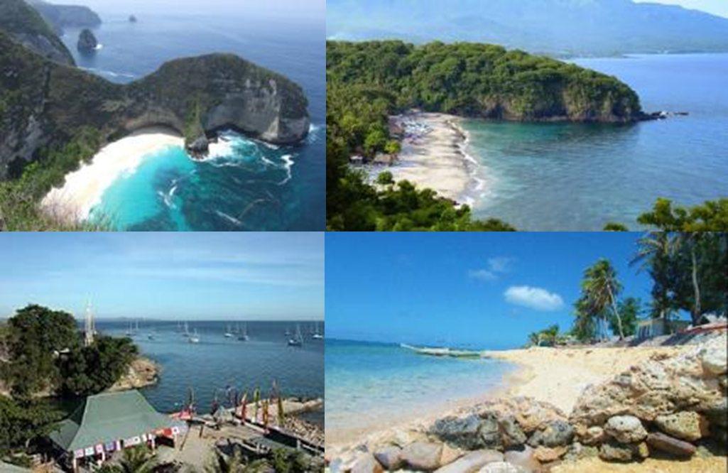
SOM-13 Recommendations
⇒ Endorsed the Maritime Local Government Network’s Workplan 2018 funded by USAID-DOI ⇒ Endorsed the LGN to increase the membership from LG members (as full member) and partners (as associate member) ⇒ Agreed to include LGN as part of the review of the RPOA process ⇒ Regional Secretariat to provide support in strengthening the position of LGN in relevant events in CT6 countries ⇒ The NCCs recommend local government champions to promote LGN in CT6 countries ⇒ Recommend TWGs to involve LGN in program development and activities
1. ACTIVITIES IMPLEMENTED
▪ Established the Maritime Local Government Network Secretariat Office
▪ Hired the secretariat staff (Program Development Specialist, Coordinator, Assistant for Admin and Logistics)
▪ Registration of Legal Entity of Maritime LGN Purpose: To be able to access external funding (i.e. funding agencies, partners and LGN members
▪ Received membership applications from Indonesia and Philippines local governments
a. Karangasem Regency, BALI - INDONESIA b. Klungkung Regency, BALI - INDONESIA c. Kupang City, EAST NUSA TENGGARA (NTT) INDONESIA d. Corcuera Municipality, ROMBLON - PHILIPPINES

Slide 4
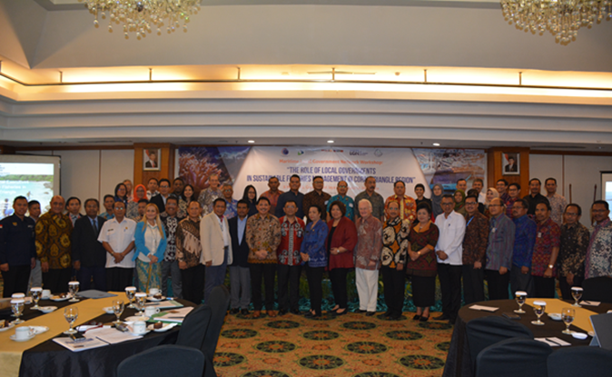
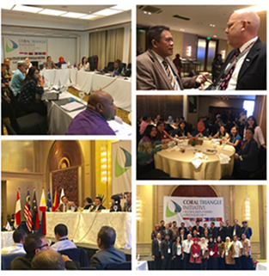
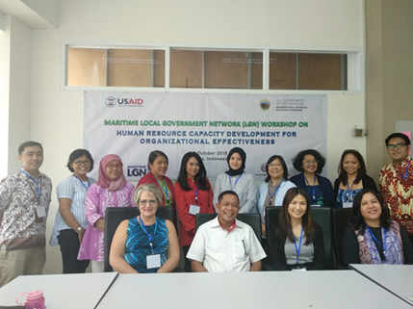
▪ Capacity Development of Local Governments in aligning the local program and CTI-CFF Goals and Plans
Side Meeting of Maritime LGN to align Local Government and their programs in accordance to the RPOA and respective NPOAs during the CTI-CFF SOM-13, 28 November 2017, Manila, Philippines Supporting Institutions/ Organizations: ∙ CTI-CFF Regional Secretariat ∙ USAID-RDMA ∙ USDOI ∙ Coral Triangle Center (CTC)
The Maritime Local Government Network Workshop on Human Resource Capacity Development for Organizational Effectiveness, 1-3 October 2018, Jakarta, Indonesia Supporting Institutions/Organizations: ∙ USAID-RDMA ∙ USDOI ∙ The Ministry of Marine Affairs and Fisheries, Indonesia ∙ NCC CTI-CFF Indonesia ∙ Coral Triangle Center (CTC)
The Maritime Local Government Network Workshop on The Role of Local Governments in Sustainable Fisheries Management in Coral Triangle Region, 8 May 2018, Jakarta, Indonesia RESULT: ∙ JAKARTA JOINT STATEMENT ∙ DRAFT LOCAL GOVERNMENT PLAN OF ACTION (LgPOA) Supporting Institutions/Organizations: ∙ The Coordinating Ministry for Maritime Affairs, Indonesia ∙ The Ministry of Marine Affairs and Fisheries, Indonesia ∙ CTI-CFF Regional Secretariat ∙ USAID-RDMA ∙ USDOI ∙ Coral Triangle Center (CTC)
∙ WWF Indonesia ∙ TNC Indonesia ∙ RARE Indonesia

Slide 5
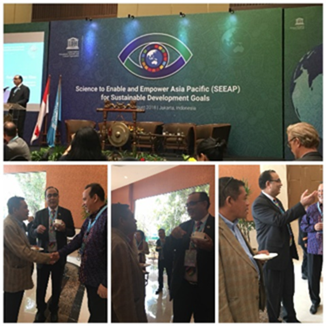
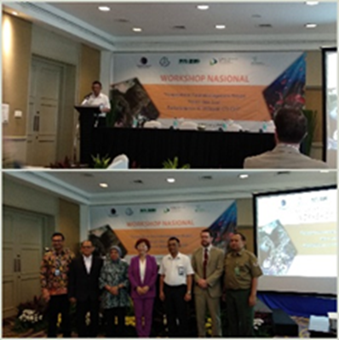
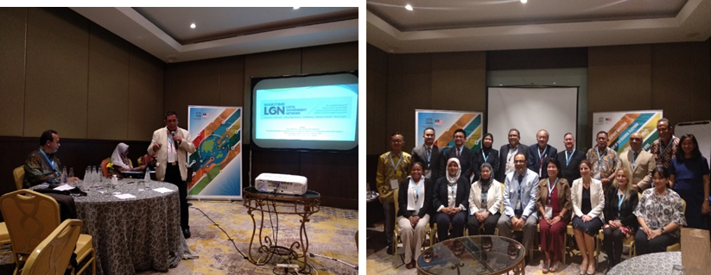
▪ Membership Strengthening
EXISTING MEMBERS OF MARITIME LGN :
INDONESIA | MALAYSIA | PAPUA NEW GUINEA | PHILIPPINES | SOLOMON ISLANDS | TIMOR LESTE
1. Ambon City 2. Buleleng Regency 3. Wakatobi Regency 4. Southeast Sulawesi Province 5. Gianyar Province 6. Fakfak Regency | 1. Sabah | 1. Manus Province 2. Balopa LLG 3. Nali Sopat Penabu LLG 4. Bialla LLG 5. Alotau Urban Local Level Government 6. Milne Bay Province | 1. Calbiga Municipality 2. Cortes Municipality 3. Lubang Municipality 4. Ubay Municipality 5. Municipality of Mabini, Batangas | 1. Central Islands Province 2. Western Province 3. Choiseul Province 4. Isabel Province | 1. Atauro Sub-district 2. Bobonaro District 3. Lautem District
▪ Participation and Representation at partners’ events/meetings
UNESCO’s Regional Strategic Coordination Meeting “Science to Enable and Empower Asia and the Pacific for SDGs”, 30 July-1 August 2018, Jakarta, Indonesia
National Workshop on Management of Coastal and Marine Biodiversity, 30 July 2018, Jakarta, Indonesia, organised by the Coordinating Ministry for Maritime Affairs of the Republic of Indonesia
UNESCO’s Expert Meeting on Establishment of the Regional Platform on the Member State’s SETI Capacity for the Implementation of SDGs in UNESCO Site, 17-18 October 2018, Jakarta, Indonesia

Slide 6
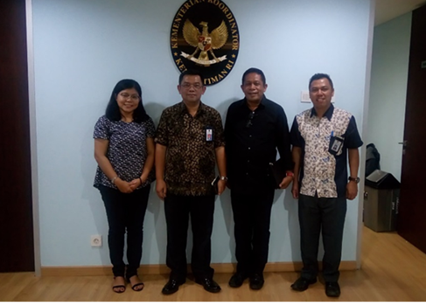
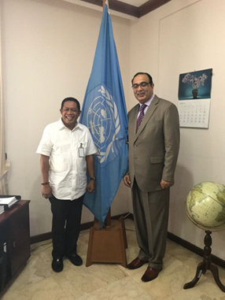
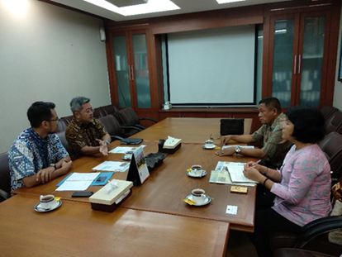
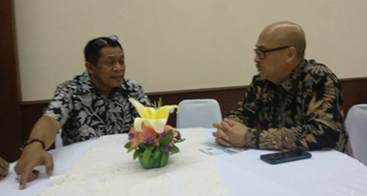
▪ Partnership Strengthening
Indonesia Climate Change Trust Fund/ICCTF (31 July 2018)
The Coordinating Ministry for Maritime Affairs of the Republic of Indonesia (4 April 2018)
The Ministry of Foreign Affairs of the Republic of Indonesia (5 October 2018)
UNESCO Jakarta (30 May 2018)
2. CTI-CFF ALIGNMENT
(1) Regional Secretariat to provide support in strengthening the position of Maritime LGN in relevant events in CT6 countries (2) The NCCs to recommend local government champions for promotion of the Network in CT6 countries (3) TWGs to involve LGN in program development and activities

Slide 7
WORKPLAN AND PROPOSED BUDGET 2019
Proposed Activities | Expense/ Budget Estimation
Activity 1. Institutional Framework Development of Maritime Local Government Network Secretariat
1.1. Establishment of Maritime LGN Secretariat Office | 38,144
1.2. Expert Consultancy for institutional strengthening of the Maritime LGN* | 0
1.3. 2nd General Assembly | 18,500
Activity 2. Development of Partnership Program among Local Governments
2.1. 3rd Executive Committee Meeting** | 8,500
Activity 3. Capacity Development of Local Government in aligning the local program and CTI-CFF goals
3.1. SEA-Local Government Network Meeting: Strengthening the Leadership Role and Capacity of Local Governments to Promote Marine Conservation and Sustainable Fishing (Focused Area: Indonesia FMA-715 – Maluku, North Maluku & West Papua)*** | 0
3.2. Regional Workshop on Measuring the Responsiveness of local program/project to Sustainable Development Goals (SDGs) | 21,500
A. TOTAL EXPENSES | US$ 86,644
B. AVAILABLE BUDGET/Grant Funds Remaining (USDOI-ITAP Project) | US$ 28,032
C. PENDING AVAILABLE BUDGET (A – B) | US$ 58,612

Slide 8
SOM-14 Recommendations
Acknowledge the following:
Financial support from USAID-USDOI will end in August 2019. The Maritime LGN needs to explore potential external funding (e.g. joint project proposal with partners)
Maritime LGN to continue to advocate for support of local governments in the goals and objectives of CTI members and partners and seeking voluntary budget from members, partners, and supporting countries.
The conduct of election for new chairmanship of Maritime LGN (2019-2022) to take place in 2019 Approval of new members of Maritime LGN
Endorse the Local Government Plan of Action (LgPOA) for effective implementation of CTI-CFF Goals and Plans at local level
Endorse the proposed Maritime Local Government Network’s Work Plan 2019 supported by USAID-USDOI and Others (LGN Members & Partners): TOTAL EXPENSES/BUDGET ESTIMATION : US$ 86,644 AVAILABLE BUDGET : US$ 28,032 PENDING AVAILABLE BUDGET : US$ 58,612
Encourage NCCs to recommend local government champions for promotion of Maritime LGN in CT6 countries and to support the activities/programs of Maritime LGN;
The CTI-CFF Regional Secretariat to support the activities and programs planned by Maritime Local Government Network for the year 2019 and to strengthen the position of Maritime LGN in relevant events in CT6 countries;
The CTI-CFF Regional Secretariat to involve Maritime LGN in TWG’s program development and activities recommended in SOM13th, be endorsed.

Slide 9
TERIMA KASIH - MARAMING SALAMAT TANK IU- OBRIGADO TAGIO TUMAS
Photo credits: Pixabay & IYOR Bank/JayneJenkins/FabriceDudenhofer/Yen-YiLee

