Slide 1
SOM14
14th Senior Officials’ Meeting
12 - 13 December 2018
Manila, Philippines
SESSION 8: TECHNICAL WG
SEASCAPES WORKING GROUP
Ir. Suharyanto M. Sc
Chair of CTI-CFF Seascapes Working Group

Slide 2
Outline
Focal Points & Supporting Organisations/Institutions
Status on Decisions Endorsed by SOM 13
Updates on the Goals and Targets of SWG
Activities since SOM13
Achievements to Date
Challenges
Work Plan for 2019
Recommendations for SOM14 Consideration

Slide 3
Focal Points
Member Country | Focal Points
Indonesia (Chair) | Suharyanto, Director of Marine Spatial Planning, MMAF / Okto Irianto, Deputy Assistant for Marine Service , Coordinating Ministry of Maritime Affairs
Philippines (Co-Chair) | Crisanta Marlene P. Rodriguez, Director of Biodiversity Management Bureau, DENR / Nilda Baling, Biodiversity Management Bureau, DENR
Malaysia | Norasma Dacho, Assistant Director for Conservation and International Office, DOF-Sabah
Papua New Guinea | Yvonne Tio, Executive Manager, CEPA
Solomon Islands | Agnetha Vave-Karamui, Chief Conservation Officer, MECDM
Timor-Leste | Antonio de Jesus, Program Officer, MAF

Slide 4
Supporting Organisations / Institutions
Role | Organisations / Insitutions
Technical Assistance | CI, TNC, WWF, WCS, RARE, GIZ
Funding Support | Government of Australia, USAID Oceans, BMU

Slide 5
Status on Decisions Endorsed by SOM 13
Decisions Endorsed by SOM 13 | Status
Adopt the CTI-CFF Seascapes General Model and Regional Framework for Priority Seascapes which contains Seascapes Monitoring and Evaluation Indicators | Completed
Acknowledge the support of the partners in the development of the CTI-CFF Seascapes General Model and Regional Framework for Priority Seascapes | Completed
Task the SWG to facilitate the socialization of the General Model and Regional Framework in each member state for adoption and implementation | Completed

Slide 6
Status on Decisions Endorsed by SOM 13
Decisions Endorsed by SOM 13 | Status
Support each member state to establish national and transboundary seascapes and provide for an operational coordinating mechanism | Completed
Support the continued progress of the Lesser Sunda Seascape and the Bismarck Solomon Sea Seascape towards “priority seascape” nomination. | Completed
Task the Seascapes Working Group to finalize the Updated Rules and Procedure in time for SOM14 | Completed
Approve the 2018 SWG Work Plan | Completed

Slide 7
Updates on the Goals and Targets of SWG
GOAL 1: Priority Seascapes Designated and Effectively Managed
Target 1: Priority Seascapes designated with investment plans completed and sequenced | Status
RA 1: Through regional collaboration, conduct Rapid Seascape Assessments for the entire region, in order to delineate seascapes and identify priority seascapes for investment | Completed
RA 2: Develop investment plans for all identified priority seascapes, including joint investment plans for those seascapes involving two or more countries. | Not initated

Slide 8
Updates on the Goals and Targets of SWG
GOAL 1: Priority Seascapes Designated and Effectively Managed
Target 2: Marine and coastal resources within all “priority seascapes” are being sustainably managed | Status
RA 1: Adopt a general ‘model’ for the sustainable management of seascapes | Completed
RA 2: Establish seascape capacity-building and learning mechanisms | Completed
RA 3: Through joint and single-country efforts, start to mobilize the financial resources necessary to support ‘priority seascape’ programs (based on Seascape Investment plans) | Ongoing
RA 4: Conduct periodic monitoring and evaluation of priority seascape programs | Not initiated

Slide 9
Activities since SOM13
Activities | Venue | Date | Participant | Funding Support
Multilateral Meeting on the Nomination of Lesser Sunda and BSSE as Priority Seascapes | Jakarta, Indonesia | 20 April 2018 | Indonesia Malaysia Papua New Guinea Timor Leste Solomon Islands Development partners | Government of Indonesia
Sulu-Sulawesi Seascape Regional Convergence Meeting | Cebu, Philippines | 3-6 July 2018 | Indonesia Malaysia Philippines Development partners | USAID Oceans and Fisheries Partnership CI Philippines The Sulu-Sulawesi Seascape Project GIZ
The 5th CTI-CFF Seascapes Working Group Meeting | Banten, Indonesia | 18-19 Oct 2018 | Indonesia Malaysia Philippines Timor Leste Solomon Islands Development partners | Government of Indonesia Government of Australia

Slide 10
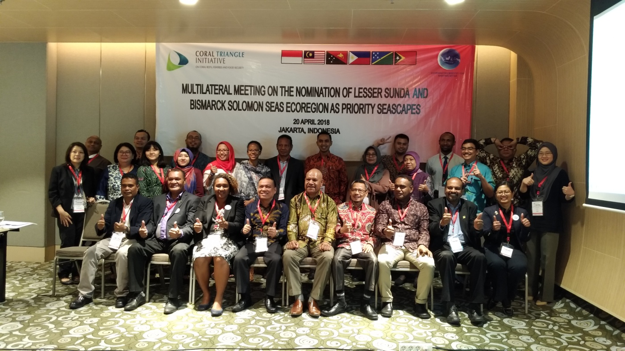
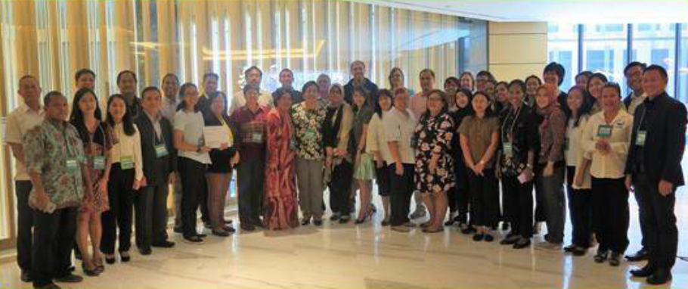
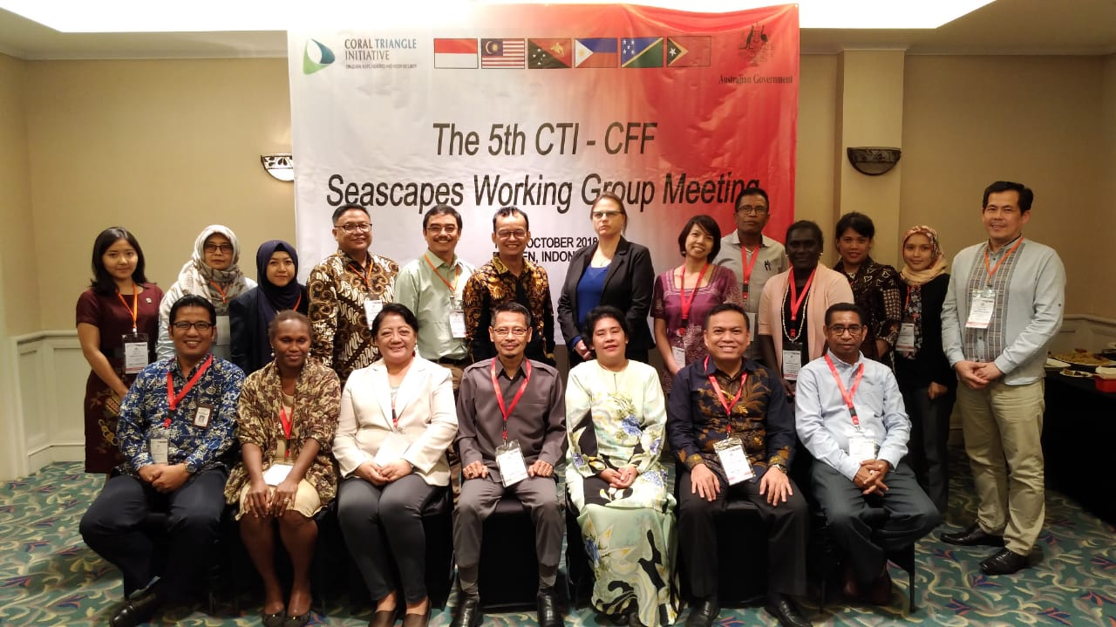
Activities since SOM13
Multilateral Meeting on the Nomination of Lesser Sunda and BSSE
as Priority Seascapes, 20 April 2018
Sulu-Sulawesi Seascape Regional Convergence Meeting, 3-6 July 2018
The 5th CTI-CFF Seascapes Working Group Meeting, 18-19 Oct 2018

Slide 11
Achievements to Date
Translation & printing and socialization of the Seascapes Document

Slide 12
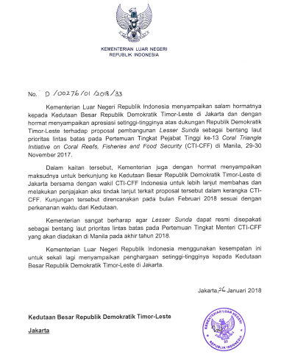
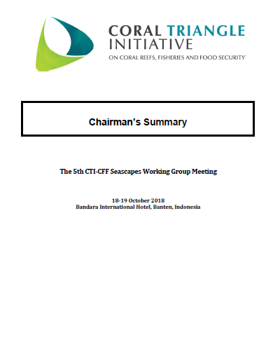
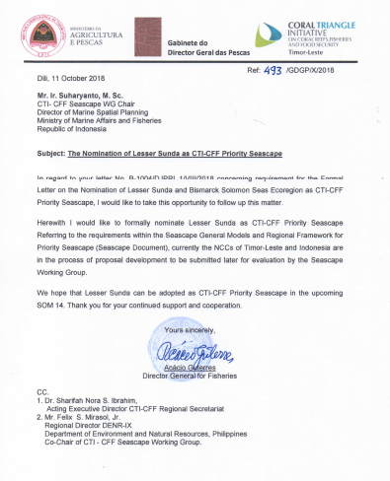
Achievements to Date
Progress and endorse Lesser Sunda and BSSE
as CTI-CFF priority seascapes

Slide 13
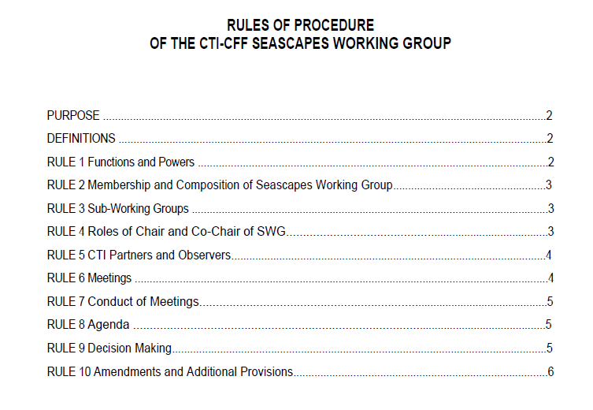
Achievements to Date
Finalize the Rules of Procedures of the CTI-CFF Seascapes Working Group, including the development of sub-working groups of priority seascapes under the CTI-CFF Seascapes Working Group

Slide 14
Challenges
Finding effective communication channel among SWG members and get high engagement
Effective coordination among the TWGs on Seascapes concerns and/or issues
Identifying funding resources to support the SWG to strengthen and/or initiate seascapes related activities, particularly those related to Priority Seascapes

Slide 15
Work Plan for 2019
Activities | Timeframe
Work with RS and CT6 to integrate and update SWG targets and goals into RPOA 2.0 development and process | Q1
Establish the sub-working groups for each priority seascape, including the TOR | Q2
Initiate the planning of each priority seascape (Sulu-Sulawesi, Lesser Sunda, Bismarck Solomon Seas) | Q3
The 6th CTI-CFF Seascapes Working Group Annual Meeting | Q4
Identify suitable partners to collaborate for financial mechanism on the management of priority seascapes | throughout 2019
Work with other TWGs, Partners, and University Partnership in the management of priority seascapes | throughout 2019

Slide 16
Recommendations for SOM14 Consideration
Recognize and appreciate the leadership of Indonesia and Philippines as Chair and Vice Chair of the SWG; 2009-2018;
Adopt Lesser Sunda and Bismarck Solomon Sea Ecoregion (BSSE) as CTI-CFF Priority Seascapes, and progress discussions with donors, collaborators and partners;
Adopt the Rules of Procedure of the CTI-CFF Seascapes Working Group;
Approve the sub-working groups of Sulu-Sulawesi, Lesser Sunda, and BSSE under the structure and coordination mechanism of CTI-CFF Seascapes Working Group;
Acknowledge the support of partners in the finalization of the Rules of Procedure of the CTI-CFF Seascapes Working Group;
Call on development partners to support the management of priority seascapes, including collaborative programs and activities involving related countries;

Slide 17
Recommendations for SOM14 Consideration
Task the SWG to work with other TWGs and University Partnership program in the management of priority seascapes;
Task the NCCs of Indonesia, Malaysia, and Philippines to review the proposed project on Transboundary Sulu-Sulawesi Seascape climate change and reefs fisheries
Support the recommendation of the SWG to turnover the Chairmanship from Indonesia to Malaysia and the turnover of the Co-Chairmanship from Philippines to Solomon Islands based on the provisions stipulated in the Rules of Procedure of the CTI-CFF Seascapes Working Group;
Acknowledge the successful implementation of Sulu-Sulawesi Seascapes Project supported by BMU in partnership with the Government of Indonesia, Malaysia and Philippines, CI Philippines and CTI-CFF Regional Secretariat;
Approve the 2019 SWG Work Plan, subject to the availability of funding support.

Slide 18
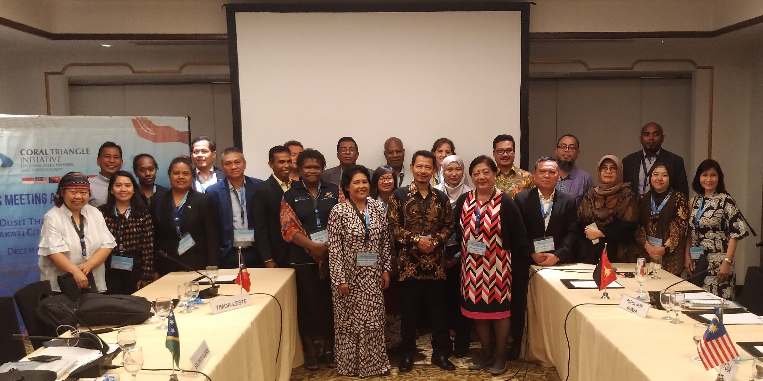
Terima Kasih - Maraming Salamat Tank Iu- Obrigado Tagio Tumas

