Slide 1
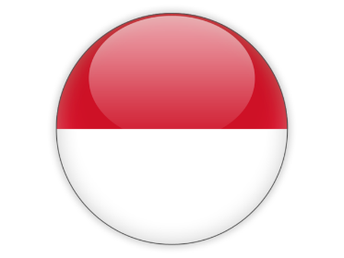
INDONESIA
Andi Rusandi
Director of Marine Conservation and Biodiversity, MMAF

Slide 2
Outline
National Focal Points
Progress/Accomplishments towards National Plan of Action
Challenges/Constraints Affecting Implementation of Activities
National Roadmap 2020
Potential Regional Programs and Support Requires
Documents/Publications
Other Remarks

Slide 3
National Focal Points
WG | Focal Point
Seascapes | Mr. Suharyanto Director of Marine Spatial Planning, MMAF Mr. Okto Irianto Deputy Assistant for Marine Service, Coordinating Ministry of Maritime Affairs
EAFM | Mr. Syahril Abdul Raup Acting Director of Fish Resources Management, MMAF Mr. Waluyo Sejati Abutohir Director of Fisheries Research Center, MMAF
MPA and TSWG | Mr. Andi Rusandi Director of Marine Conservation and Biodiversity, MMAF
CCA | Ms. Sri Tantri Arundhati Director of Climate Change Adaptation, MOEF
FRWG | Mr. Andre Omer Siregar Director of Intra Regional Cooperation on Asian, Pacific and Africa, MoFA
IRC | Mr. Agus Dermawan Secretary Directorate General for Marine Spatial Management, MMAF
MEWG | Ms. Lily Aprillia Pregiwati Director for Public Relation and International Cooperation, MMAF
Partners | WWF Indonesia, TNC, CTC, WCS, RARE, Reefcheck, Yayasan Terangi

Slide 4
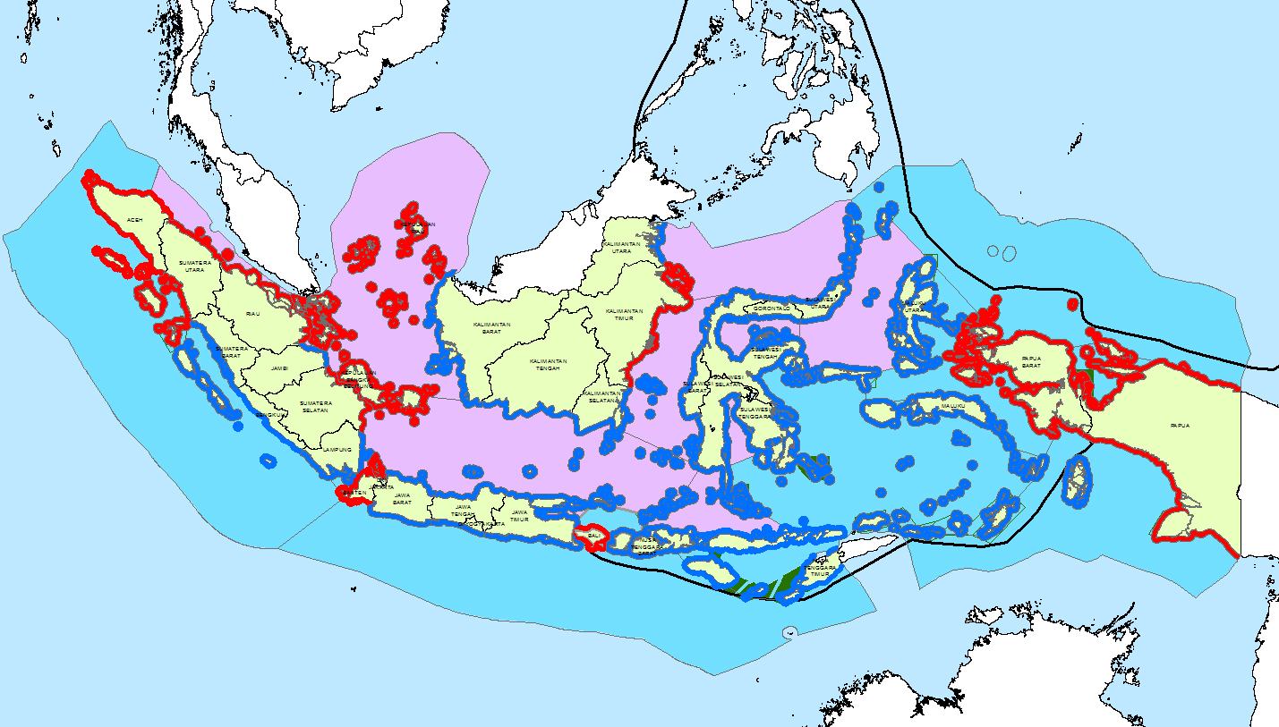
I. Progress/Accomplishments towards National Plan of Action
SEASCAPES
Total Action | Completed | On-Going | Not Started
8 | 7 | 1 | 0
Completion Target of national levels MSP until 2019
1 National MSP
9 of 20 MSPs of Inter-Regional Areas (Bay, Strait, Sea)
51 (in 19 clusters) of 111 MSPs of Particular National Strategic Areas
14 of 38 MSPs of National Strategic Areas
22 Provincial MSP Regulation
12 Provinces are Preparing MSP Regulation
Notes:
Managing the Ocean
In managing ocean, we need planning at the first place that will lead the way on how this ocean management will be conducted. Basically, there are two types of planning, namely spatial planning and non-spatial planning/generic planning.
MSP as a Management tools
Marine Spatial Planning (MSP) as a Management tools in Indonesia, answer the question where the activities will be taken place and also consider the spatial compatibility of activities.
Benefit of MSP
Reduce spatial use conflicts, optimize resource use, provides legal certainty and as the basis for permits.
Legal basis:
Indonesian Law No. 27/2007 on Management of Coastal and small Islands
Indonesian Law No. 32/2014 on Marine Affairs
Indonesian Government Regulation No. 32/2019 on Marine Spatial Plan
Guideline:
Minister of MMAF Regulation No. 23/2016 on Planning for Management of Coastal Areas and small Islands
Achievements:
Activity Total Action Completed On-Going Not Started
National MSP 1 1 0 0
Inter-Region MSP 20 0 9 11
Particular National Strategic Area MSP 111 4 47 60
National Strategic Area MSP 38 0 15 23
Provincial MSP 34 22 12 0
Seascape can play the role as the geographical scope of MSP. On the other hand, MSP can play the role as the tools for achieving the Seascape goals and objectives. Thus, the relationship between Seascape and MSP can go either way.
Priority Seascape and 5 TWGs CTI-CFF
The activities of the 5 CTI - CFF TWGs is expected to be focused on these 3 priority seascapes, (Sulu Sulawesi Seascape, Lesser Sunda Sescape, Bismarck Solomon Sea Ecoregion).
What Indonesian Offer
Capacity building for MSP.

Slide 5
EAFM
Total Action | Completed | On-Going | Not Started
10 | 5 | 5 | 0
Regulation to support EAFM implementation
Indonesia Fisheries Management Area (FMA): 11 FMAs
Fish stock status (MSY, TAC and Utilization Level)
Fishing Logbook
Enforcement of IUU Fishing regulation
Enforcement and punishment : drowning >550 unit illegal vessel
Sustainable Tuna Management
Fisheries Management Plan for coastal tuna in FMA 713, 714 and 715
Adoption international and regional rules & regulation into national tuna management scheme
Sustainable Reef Fish Management
Initial draft of Grouper and Snapper Fisheries Management Plan and Harvest Strategy
Coastfish Program
Fishers Insurance; Fishers land rights certificates; Fishers access to funding support; Fishers small scale enterprises development and diversification
Progress/Accomplishments towards National Plan of Action
Notes:
Regulation to support EAFM implementation
Indonesia Fisheries Management Area (FMA): 11 FMAs
Fish stock status (MSY, TAC and Utilization Level) in each FMA
Protection and empowerment small scale fishers
Fisheries Management Plan in 11 FMAs
Fisheries Management Council in 11 FMAs
Fishing Logbook (including innovation to digitalize fishing logbook implementation through electronic logbook/e-logbook)
NPOA IUU Fishing
Enforcement of IUU Fishing regulation
Joint patrol program:
Enforcement and punishment : drowning >550 unit illegal vessel
Implementation, and evaluation on fishing logbook compliance
Sustainable Tuna Management
Fisheries Management Plan for coastal tuna in FMA 713, 714 and 715
Harvest Strategy (HS) Framework for Yellowfin Tuna, Bigeye Tuna and Skipjack in FMA 713, 714 and 715
Adoption international and regional rules & regulation into national tuna management scheme: Indonesia observer on-board program for tunas has been acknowledge by RFMOs;
Increasing Indonesia compliance level on fulfilling RFMOs Resolution and Conservation & Management Measures (CMM) for last 2 years (77% of IOTC resolution & 80%> of WPCFC CMM have been fulfilled by Indonesia);
The first time Marine Stewardship Council (MSC) certification for Indonesia has been awarded to an Indonesia Tuna Exporter company, PT. Citra Raja Ampat Canning
FAIR TRADE certification for tuna product of small scale fishers in Maluku and North Maluku Provinces (Buru, Seram , Sanana, and Morotai Island).
Sustainable Reef Fish Management
Initial draft of Grouper and Snapper Fisheries Management Plan
Initial draft of Harvest Strategy for Grouper and Snapper Fisheries in FMA 713
Coastfish Program
Fishers Insurance; Fishers land rights certificates; Fishers access to funding support; Fishers small scale enterprises development and diversification; Revamping of fishers village

Slide 6
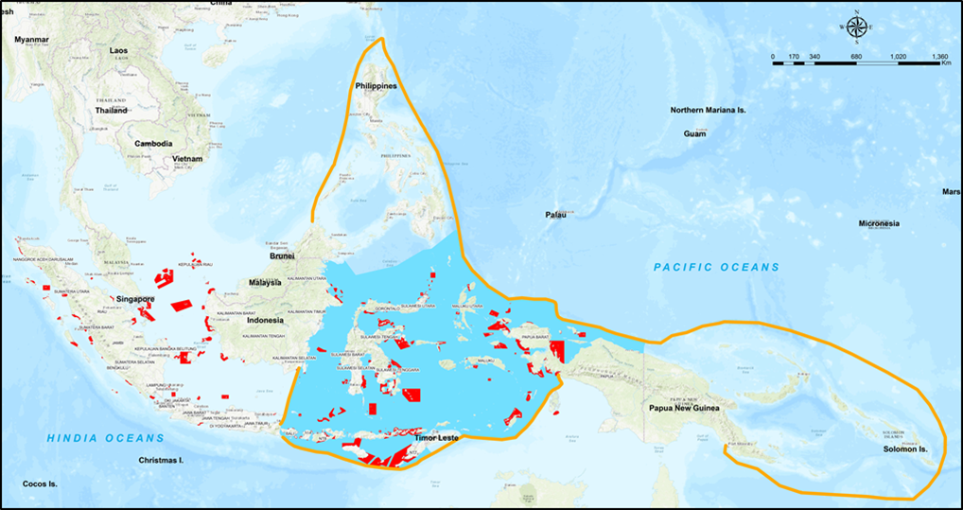
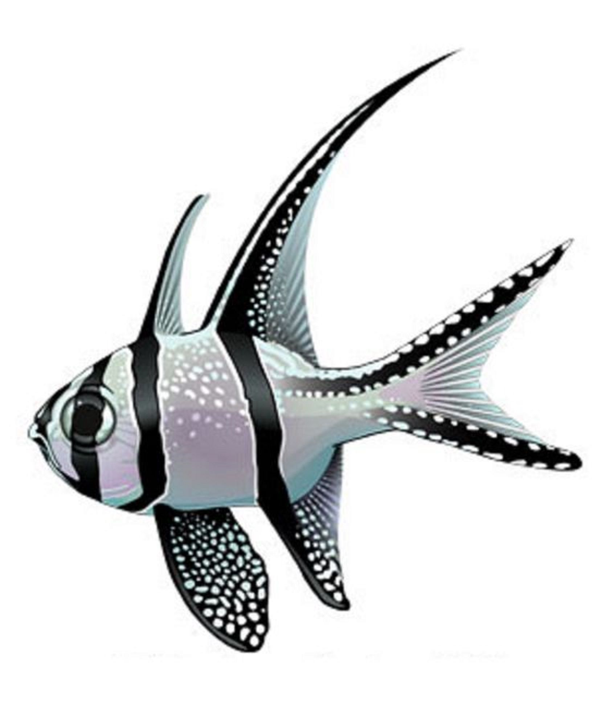
MPA
Global Mandates
Total Action | Completed | On-Going | Not Started
7 | 6 | 1 | 0
AICHI TARGET, SDG 14 : 10% of marine area as MPA
Legends
Coral Triangle Boundary line
Marine Protected Area
Indonesia Marine Area in CTI-Region
Sea Turtle
Cetaceans
Dugong
Manta ray
Sharks
Mola-mola/ Sun Fish
Banggai Cardinal Fish
Indonesia Marine Areas | Global Target 2030 |  | National Achievement MPA in 2019 |  |  |  | GAP
Total Area (Ha) | Total Area (Ha) | Percentage (%) | Total Number | Total Area (Ha) | Percentage (%) | Coral Cover Protect by MPA | Ha | Percentage (%)
325 million | 32,5 million | 10 | 195 | 22,68 million | 6,98 | 40 % | 9,9 million | 3,02
Indonesia CTI-CFF Marine Areas | Global Target 2030 |  | CTI Regional Achievement MPA in 2019 |  |  |  | GAP
Total Area (Ha) | Total Area (Ha) | Percentage (%) | Total Number | Total Area (Ha) | Percentage (%) | Coral Cover Protect by MPA | Ha | Percentage (%)
256 million | 25,6 million | 10 | 117 | 16,28 million | 6,37 | 49 % | 9,3 million | 3,02
Progress/Accomplishments towards National Plan of Action
Notes:
Indonesia committed to adopted the global mandates such as Aichi Target 11, CBD, and SDG 14.5 to preserve 10% of country Marine Area as Marine Protected Area (MPA).
The total of marine territorial area in Indonesia is 325 Million Hectare. Thus, if following to Global mandates Indonesia must to conserve 10 % of marine territorial areas as MPA which equal to 32.5 Million Hectare.
Until 2019, Indonesia was establish 195 MPAs with the total area 22,68 Million Hectare or equal to preserve 6,98 % of Marine Area.
Indonesia committed to achieve 32.5 Million Hectare of MPA in 2030. Thus, in the next decades, Indonesia must develop 9,9 million hectare marine area to develop as MPA.
To overcome this challenge, Indonesia has develop the analysis of the potential marine location that appropriate for new MPAs.
Currently, the result of analysis was adopted by National Roadmap Development Plan on MPA in achieving 32.5 Million Hectare of MPA in 2030 and SDG 1.54 target.
Meanwhile, in term of MPA in CTI region, Indonesia already contributed 117 MPAs with total area 16.28 million hectare, and it consist protect 49% of coral reef. (more than half of MPAs in Indonesia located in CTI boundary)
Beyond to protect marine coastal ecosystem, MPAs that existed also have functions for protection of various marine endangered and threatened species, that are: Sea Turtle, Cetaceans, Dugong, Manta Ray, Dugong, Sharks, Mola-mola, and Banggai cardinal fish.
Therefore, with regard the MPA commitment, Indonesia commit to achieve global mandates and also CTI CFF goals in order to support sustainable marine environment and sustainable fisheries.

Slide 7
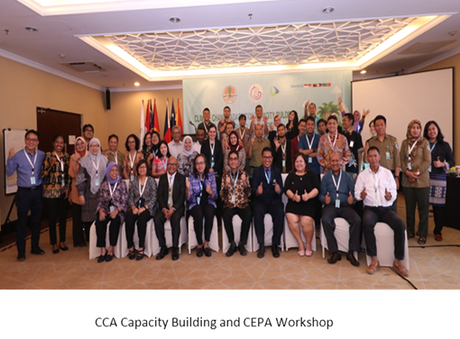
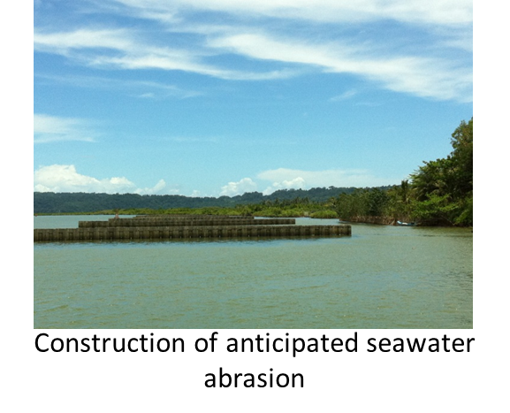
CLIMATE CHANGE ADAPTATION
CCA Capacity Building (Capacity Building on Blue Carbon
CEPA Workshop
Development of draft ToR Executive Course
Development of Draft Communique
Coastal PROKLIM
Indonesian Coastal Education (SPI)
Building locally permeable dam (Hybrid Engineering) and Center for Mangrove Restoration and Education as application of ecosystem based adaptation (EbA)
Mangrove Adaptation to Climate Change, Developing of indicators of mangrove ecosystem vulnerability
Initiation of Roadmap about Mitigation and Adaptation of Land Subsidence in Coastal Lowland
Development of Ocean Health Index
Establishment of Indonesia Mangrove Society
Climate Change Adaptation Capacity Building (Capacity Building on Blue Carbon) and CEPA Workshop attended by 80 participant from CT6 Countries
Coastal PROKLIM about 232 location by 2019
9 Location by 2019 (3 of 9 located in CTI CFF boundary: Palu, Bone, and North Lombok)
Total Action | Completed | On-Going | Not Started
11 | 8 | 3 | 0
Progress/Accomplishments towards National Plan of Action
Notes:
PROKLIM since 2012 (CCA Program that encompasses all type ecosystems and communities). Coastal Proklim is located in the coastal villages and the number tends to increase each year.
Indonesian Coastal Education: since 2012; awareness movement the communities towards coastal and marine environment
Mangrove Adaptation to Climate Change: Info Brief and Policy recommendation that supports ecosystem based adaptation (EbA) and climate action on national level (RAN-API)
Initiation of Roadmap about Mitigation and Adaptation of Land Subsidence in Coastal Lowland : Reducing disaster risk of land subsidence in coastal lowlands area
Ocean Health Index: Increasing health of ocean in order to solve climate change problem
Indonesia Mangrove Society: Accelerating of mangrove rehabilitation activity and Increasing economic income for coastal communities

Slide 8
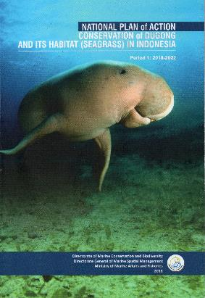
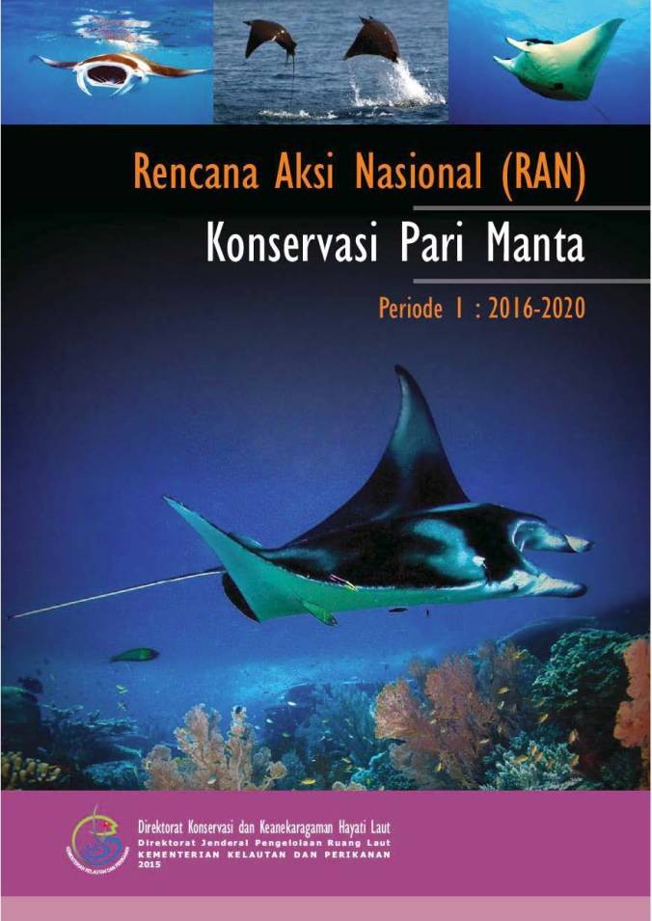
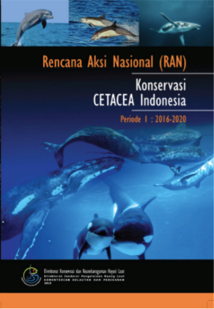
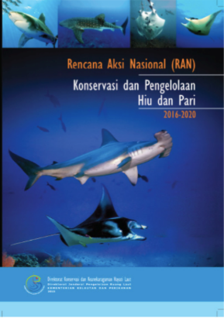
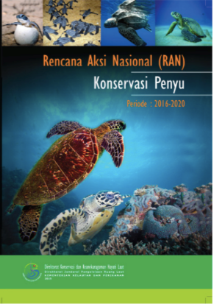
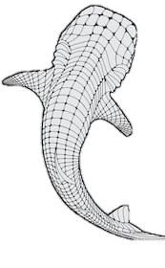
THREATENED SPECIES
Total Action | Completed | On-Going | Not Started
4 | 3 | 1 | 0
DUGONG
NPOA*
Started in 2018
2015-2019: 95% baby turtle
MANTA RAYS
NPOA
CETACEAN
NPOA
2018-2019: 96% Survival rate
SHARKS & RAYS
NPOA
SEA TURTLE NPOA
Annual income to the village:
US$14.500
COMING SOON IN 2019
WHALE SHARKS NPOA
On going progress
Fully protected
ecotourism
Partly protected
Progress/Accomplishments towards National Plan of Action
Notes:
Indonesia is home to 35 species of marine mammals that are entirely protected under the government law. That means any kind of direct use of the species is prohibited. Likewise, of 5 species of sea turtles reported land in the country, all of which are entirely protected.
However, with regard to sharks and rays. Of 117 species identified sharks and more than 200 known rays inhabiting Indonesian waters, it is only the whale sharks and manta rays that to date are entirely protected under national law. Yes, that our national legislation have allowed us to even harder implement the international concern toward threatened species though manta rays and whale sharks is actually listed under appendix 2 of CITES.
Most of strategy/programs listed in the NPOA have been accomplished, except for Dugong NPOA that started in 2018 through a UNEP-assisted program called the dugong and seagrass conservation project. In addition, we are now on our way to complete the development of Whale sharks national plan of action.
The implementation of the national action plans have certainly contributed to the sustainability of the threatened species. For instance, it is reported that thousands of sea turtles individuals have been released to the oceans in Sulawesi, on of CTI Hotspot for sea turtles. Of these numbers, 95% are baby turtles that will ensure the sustainability of this wild animals.
Our national first response actions to handle the stranded marine biota have also helped marine mammals to sustain their lives. In cooperation with veterinarians community (the flying vet) we found fact that across 2018-2019, 96% of stranded biota which found alive in coastal area have been successfully released back to the oceans.
Despite the full protection status, it is important to note that community based ecotourism maybe developed in order to improve coastal community income. A good example of whale sharks ecotourism is shown in Saleh Bay, west nusa tenggara where the village can derived additional income as much as US$14.500 last year. A quite number of income for the local community!
A number of guideline for the 3 groups of threatened species (sharks n rays, marine mammals and sea turtles) have also been developed. Including bycatch mitigation guideline for sea turtles and etc

Slide 9
Progress/Achievements Towards NPOA
40 | 30 | 10 | 0
Total Actions | Completed | On Going | Not Started
OVERALL IMPLEMENTATION STATUS
Progress/Accomplishments towards National Plan of Action

Slide 10
II. Challenges/Constraints Affecting Implementation of Activities
Local Issues
Local community support, participation and compliance, and co-management
Public awareness towards threatened species remains low, particularly in (some) remote area
National Issues
Communication and coordination among stakeholders
Synergize program/activities between tematic WG
Population increase in coastal areas
Harmonize regulations and authorities among sectors and government levels
Regional Issues
Marine debris and pollution (i.e. plastic, oil spill)
Support from research findings in CTI issues
CTI CFF contributions to other International Initiatives (eg. UNFCCC, UNEA, ICRI, etc)
Alternative financing to support implementation of NPOA

Slide 11
III. National Roadmap 2020
A. CTI-CFF National Programs
WG | Activities
Seascapes | Hosting The 7th CTI-CFF Seascapes Working Group Meeting Design to Develop Seascape Diagnostic Analysis and it's strategic Action Plan (LSS and BSSE)
EAFM | Implementation of e-Logbook for small scale fisheries;
MPA | Develop 700 thousand hectares of marine area as new MPA Develop and finalize document zoning and management plan document
CCA | Coastal Ecosystem Adaptation to Climate Change
TSWG | In-situ population monitoring (marine mammals, sea turtles, sharks & rays) Conservation awareness-raising program First response program for marine mammals stranding
National | Implement SOM 15 Decisions RPJMN 2020 – 2024, coastal and fisheries is a priority development sector Develop National Roadmap 2020 after the endorsement of RPOA 2.0 Funding Resources Workshop Public awareness and campaign Capacity Building in Marine and Fisheries Sector

Slide 12
III. National Roadmap 2020
B. Programs/projects/activities related to CTI-CFF goals (but not directly budgeted under CTI-CFF programs)
WG | Activities
Seascapes | Development Provincial Marine Spatial Plans for Papua and West Papua (BSSE). Preparation 6 Inter-Regional Marine Spatial Plan at West Sumatera Sea, (Banda Sea, North Papua Sea, Halmahera Sea = BSSE), (Bali Sea, Sawu Sea = Lesses Sunda Seascape)
EAFM | Hosting Bali Tuna Conference and Annual IOTC Meeting 2020 Continues COASTFISH implementation
MPA | Fulfilment the infrastructures for MPA management Develop and harmonize regulation for MPA Enhance MPA database system
CCA | Climate Village Program, Coastal Resilience Program, Indonesian Coastal Education
TSWG | Satellite tagging for whaleshark and leatherback turtle Community Based-Conservation of Dugong and Seagrass Habitat
National | Indonesia Aid Program Hosting the 6th International Tropical Marine Ecosystem Management Symposium (ITMEMS)

Slide 13
IV. Potential Regional Program and Support Required
WG | Activities
Seascapes | Develop regional Program and funding mechanism for BSSE and Lesser Sunda Seascape TOR and mechanism for Seascapes sub – working group
EAFM | Develop and Implement Regional COASTFISH Program Workshop on EAFM Evaluation Tools
MPA | Completion of CTMPAS Certification Process for Category 1, 2, and 3 Develop activities that integrate with other TWG in Priority MPA Sites
CCA | Executive Course on Climate Change Adaptation Mapping of Coastal Vulnerability towards Climate Change (Workshops, Training)
TSWG | Development of threatened species regional handbook/guideline on marine mammals stranding Training on sea turtles/marine mammals/sharks and rays stranding/by-catch
National | CT Atlas Training Establishment of shipping lanes in the Coral Triangle Area International Training on Marine Debris Elimination

Slide 14
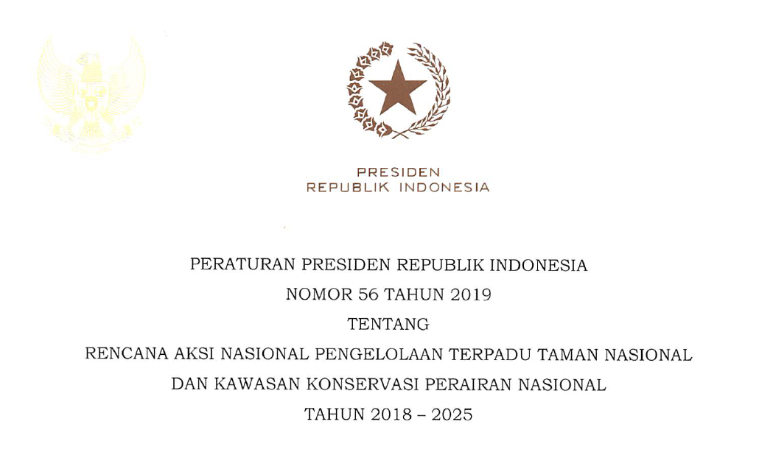
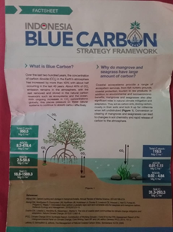
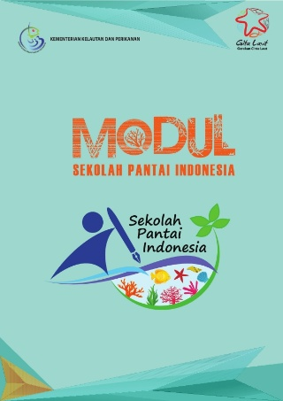
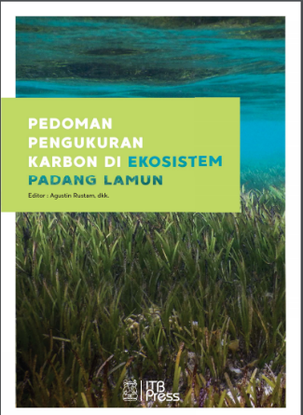
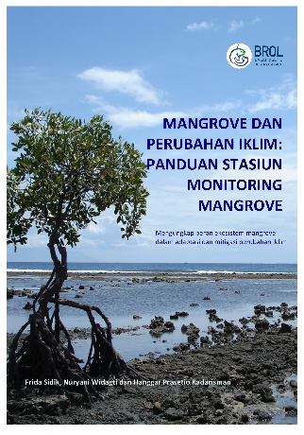
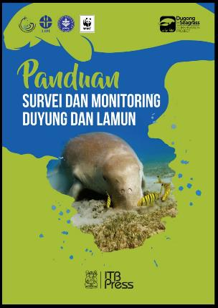
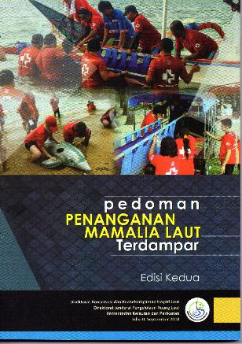
V. Documents/Publications
MMAF
Government Decree Number: 32 Year 2019 on Marine Spatial Planning;
Guideline for Survey and Monitoring Dugong and Seagrass, Guideline for Measuring Carbon in the Seagrass Ecosystem, Guideline for Handling Stranded Marine Mammals, Videos on Guideline for Dugong Stranded Event
Manual Book Of Indonesian Coastal Education/Modul Sekolah Pantai Indonesia
Mangrove and Climate Change: Guidelines of Mangrove Monitoring Station
Coordinating Ministry of Maritime Affairs and Investment
President Decree Number 56 Year 2019 on National Plan of Action Integrated management 7 National Marine Park and 10 National MPA Years 2018-2025;
Roadmap about Mitigation and Adaptation of Land Subsidence in Coastal Lowland Document
MoEF
The Third National Communication (TNC) Document (web : http://ditjenppi.menlhk.go.id/)
Sondaken, Raprap, and South Minahasa Vulnerability Assessment of Climate Change document
South East Sulawesi and Maluku Adaptation and Resilience to Climate Change document (https://www.dai.com/our-work/projects/indonesia-apik-adaptasi-perubahan-iklim-dan-ketangguhan-or-climate-change-adaption)
Strategic Planning and Action To Strengthen Climate Resilience of Rural Communities (SPARC) document (https://adaptation-undp.org/projects/sccf-indonesia)

Slide 15
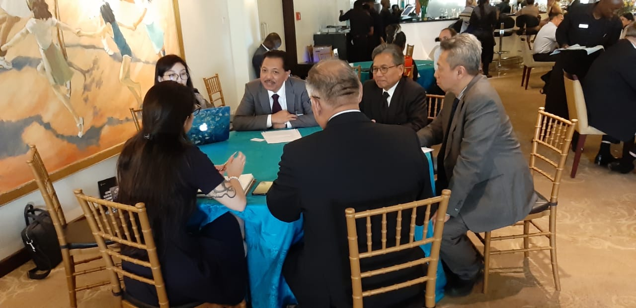
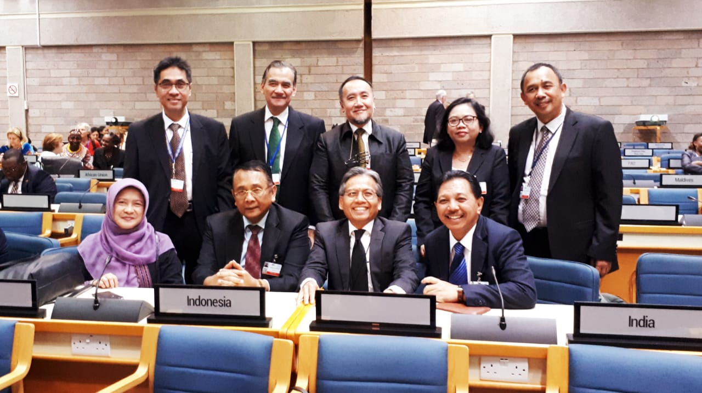
Sustainable Coral Reefs Management Resolution - submitted by Indonesia and Monaco in UNEA 4 is accepted (co-sponsor: Rep. of Korea, Philippines, Mexico)
Enhanced streamlining and coordination of the numerous international policy instruments supporting the conservation and sustainable management of coral reef ecosystems
Consider the findings in member states efforts to sustainably manage coral reef ecosystems
Produce the global report on the status of coral reefs in 2020;
Develop and strengthen the GCRMN, including integrated monitoring and new technologies to understand and communicate the status and trends of coral reefs globally;
Build on the success of the IYOR 2018 and continue their efforts in strengthening awareness about the ecological, economic, social and cultural value of, and critical threats to, coral reefs and associated ecosystems

Slide 16
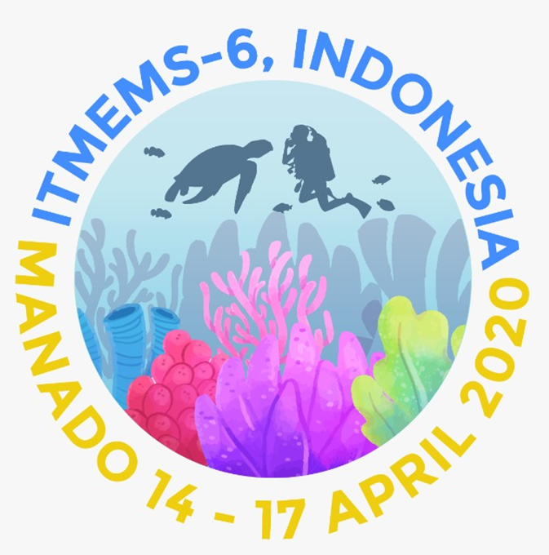
The 6th International Tropical Marine Ecosystem Management Symposium (ITMEMS-6)
Date : 14-17 April 2020 Venue : Novotel Kawanua, Manado, Indonesia
Objectives:
To expose relevant approaches in Sustainable Coral Reef management and related ecosystems.
Output:
To provide lesson learn and best practices in tackling Coral Reefs management
Hosted by:
MMAF RI and ICRI Secretariat
Participants:
MPA Managers, Local Leaders, Technical Advisors from ICRI members, Regional Organizations, UN Bodies, and NGOs
Website:
www.icriforum.org/ITMEMS6
Contact Person:
Fegi Nurhabni (fegi.nurhabni@kkp.go.id), Claire Rumsey (Claire.Rumsey@icriforum.org)

