Slide 1
Monitoring and Evaluation Working Group (MEWG)
Ms. Noor Afifah Abdul Razak
Chair of MEWG
November 2022

Slide 2
Outlines
MEWG and CT Atlas Focal Points
Actions taken for SOM-16 Decisions
Moving Forward with RPOA 2.0
Progress of CT Atlas
Update on Workplan and Budget by the Chair of MEWG for 2022
Workplan and Proposed Budget by the Chair of MEWG for 2023
Draft Recommendation for SOM 17

Slide 3
MEWG Focal Points
Member Country | Focal Points
Indonesia | Focal Point Mr. Ari Prabowo, Director of Public Relation and International Cooperation, Secretariat General, Ministry of Marine Affairs and Fisheries
Malaysia (Chair) | Focal Point: Ms. Noor Afifah Abdul Razak, Deputy Secretary General (Environment) Ministry of Environment and Water
Papua New Guinea (Co- Chair) | Focal Point: Ms. Yvonne Tio (Co-Chair), Executive Manager, Conservation Environment Protection Authority Alternate : Ms Lorel Dandava, Manager Inshore Fisheries
Philippines | Ms. Natividad Y. Bernardino, OIC Director, Biodiversity Management Bureau, DENR Alternate : Ms. Armida P. Andres, Chief Coastal & Marine Division, DENR-BMB
Solomon Islands | Ms. Nelly Kere, Chief Programme Officer, Ministry of Environment, Climate Change, Disaster Management & Meteorology, Solomon Islands Ms. Agnetha Vave-Karamui, National Coordinating Committee Focal Point, Chief Conservation Officer, Ministry of Environment, Climate Change, Disaster Management & Meteorology
Timor-Leste | Mr. Celestino da Cunha Barreto, National Director of Marine Spatial Planning, Catch and Aquatic Resources Management, Ministry of Agriculture and Fisheries Ms Inocencia Maria Belo, Technical Staff, Department of Capture and Post Harvest

Slide 4
CT ATLAS Focal Points
Member Country | Focal Points
Indonesia | Mr. Teguh Satria Gunawan Coastal Rehabilitation and Conservation Analyst Directorate of Marine Conservation and Biodiversity
Malaysia | Ms. Rimi Repin Assistant Director Sabah Parks | Mr. Adam Malik Masidi Marine Research Officer Sabah Parks
Papua New Guinea | Mr Bernard Suruman, Manager, Marine Protected Areas Branch, Marine Environment Division, Conservation and Environment Protection Authority Alternate : Ms. Phelameya Haiveta, Project Officer, Conservation Environment Protection Authority, PNG
Philippines | Mr. Septher Ian Salcedo Biodiversity Policy and Knowledge Management Division Biodiversity Management Bureau Ms. Amelia Abecina (assistant FP)
Solomon Islands | Peter Husiáu’ana Kenilorea Chief Fisheries Officer, Inshore Fisheries Division, Ministry of Fisheries and Marine Resources | Trevor Maeda Principal Conservation Officer, Environment and Conservation Division, Ministry of Environment, Climate Change, Disaster Management and Meteorology
Timor-Leste | Mr Fidelino Sousa Marques Chief Cabinet of General Directorate of Fisheries, Aquaculture and Marine Resource Alternate: Dominica Paula Jeronimo Guterres, Technical Staff under the Department of Marine Spatial Planning and Aquatic Resource Management

Slide 5
Actions taken for SOM 16 Decisions
Session 7: MONITORING & EVALUATION WORKING GROUP | Status
Acknowledged and accepted the report of Monitoring and Evaluation Working Group (Annex 24). | Done
Draft RPOA 2.0 Acknowledged and appreciated the progress of the draft RPOA 2.0 (Annex 25) and task the Regional Secretariat to conduct an online writeshop to finalise the content/narrative of the Regional Plan of Action 2.0. by 2nd quarter of 2022; | Done. 2 In-Situ Writeshop already conducted on June 7-8, 2022 and September 21-22, 2022
Acknowledged and appreciated the support statement by the CTI Partners during the Monitoring and Evaluation Working Group Meeting back-to-back with Regional Plan of Action 2.0 Writeshop and the Continuation of Regional Plan of Action 2.0 Writeshop. Noted the need for Financial Strategy and Communication Strategy to accompany the Regional Plan of Action 2.0; | Done
Tasked the Regional Secretariat to prepare a new Roadmap for the Completion of the RPOA 2.0 by 1st Quarter of 2022; | RS circulated a letter for proposing dates to resume Writeshop on Draft RPOA 2.0 (GWG/RS/3/22/71 dated 23 March 2022). In the same email thread, RS circulated the new Roadmap for the Completion of the RPOA 2.0, on March 24, 2022.

Slide 6
Actions taken for SOM 16 Decisions
Session 7: MONITORING & EVALUATION WORKING GROUP | Status
Tasked the Secretariat to continue the discussion with CT6 on the institutional set up of the RS by 2nd Quarter of 2022; and | In the In-Situ Writeshop on June 7-8, 2022; Institutional Setup already discussed, and drafted the Implementation Strategy, which circulated with CT6 on June 17, 2022
Recommended to launch the Regional Plan of Action 2.0 and a CTI-CFF Regional Conservation Trust Fund (RCTF) during the 2nd CTI Leaders’ Summit, and noted the intention of the Government of the Republic of Indonesia to launch the new Host Country Agreement in the said Summit. | Noted

Slide 7
Actions taken for SOM 16 Decisions
Session 7: MONITORING & EVALUATION WORKING GROUP | Status
Monitoring and Evaluation Approved the revised M&E Data Collection and Information Sharing Mechanism and M&E Plan Framework template (Annex 26.a. and Annex 26.b.) and tasked the Regional Secretariat to organize a webinar to fine-tune the draft M&E Data Collection and Information Sharing Mechanism and complete the M&E Plan Framework by 2nd Quarter to 3rd Quarter; and | Done. Finalized during the In-Situ Writeshop on September 21-22, 2022 CT6 to submit the baseline data and M&E targets for M&E Plan Framework.
Tasked the Regional Secretariat to conduct an online M&E Writeshop on M&E Plan framework, back-to back with the webinar on M&E Data Collection and Information Sharing Mechanism. | Done. The training already conducted on October 28, 2022, along with MEWG Back-to-back meeting.
CT Atlas Acknowledged and appreciated the update of the CT Atlas. (link: http://ctatlas.coraltriangleinitiative.org/); and encouraged NCCs and RS to utilize the platform. | Done
Acknowledged and appreciated the No Cost Extension (NCE) provided by the WorldFish for the agreement on CT Atlas migration, and the GIS expert assistance up to December 2020 for the correction/updating the MPA data on the CT Atlas Database for NCCs. | Done

Slide 8
Actions taken for SOM 16 Decisions
Session 7: MONITORING & EVALUATION WORKING GROUP | Status
SUFIA LCD Activity Acknowledged and appreciated the support of the USAID –SUFIA RTI in engaging with and seeking support from the private sector in the improvement of CT Atlas features and technologies; and | Done.
Noted and accepted the incorporation of SUFIA activities into the MEWG workplan 2022 for implementation. | Done. Conducted 2 online trainings on 21 and 22 June, 2022 Knowledge Management System MEL Data Management
Marine Litter Acknowledged the progress by WWF on proposed draft Terms of Reference and proposed draft Implementation Plan on CTI-CFF Marine Plastic Stocktake; | Done.
Noted the progress of the marine plastic pollution stocktake report by WWF (Annex 27) and acknowledged the Coral Triangle Plastic Pollution Stocktake report as a working draft; | Done.
Tasked the RS to circulate the working draft report to the NCCs and Strategic Partners for feedback by 31 March 2022; and | Done. RS circulated the working draft report on 27 January 2022 (MDL/RS/1/22/19)

Slide 9
Actions taken for SOM 16 Decisions
Session 7: MONITORING & EVALUATION WORKING GROUP | Status
Tasked WWF/RS to circulate the working draft and revise the working draft according to feedback submitted by 31 March 2022 and prepare the final stocktake report for publication and launch by 30 June 2022. | RS sent the reminder on March 24, 2022; and received feedbacks from 2 countries already. Updated report has been circulated on July 29, 2022. WWF will provide further explanation in Partners’ Update
MEWG Workplan Approved the 2022 Monitoring and Evaluation Working Group Work Plan (Annex 28). | Done
MEWG Change in Chair Endorsed the handover of the MEWG Chair from Philippines to Malaysia and Co-Chair from Malaysia to Papua New Guinea based on the provisions stipulated in the Terms of Reference of the CTI-CFF MEWG (Annex 29); and | Done Captured in the list of focal points
Acknowledged and appreciated the excellent chairship of Philippines as Chair and Malaysia as Co-Chair of the MEWG Working Group for the period of 2019-2021. | Done

Slide 10
Moving Forward with RPOA 2.0
SOM approval
Countries to share data for M&E Plan framework
1. LAUNCHING RPOA 2.0 AT LEADERS SUMMIT
2. DATA VERIFICATION FOR M&E PLAN FRAMEWORK
IMPLEMENTATION OF RPOA 2.0 AND TOOLS
NOVEMBER 2022
DECEMBER
2022
Q1 (JAN – MAR 2023)
Q1 2023 ONWARDS

Slide 11
Progress of CT ATLAS 2022
CT Atlas Expansion Private Sector Partnership Concept Note supported by SUFIA LCD
Received Data from ATSEA-2 Project
Finalized CT ATLAS Data Contribution Mechanism
Collaboration with ALLEN CORAL ATLAS
CT ATLAS Refresher Training

Slide 12
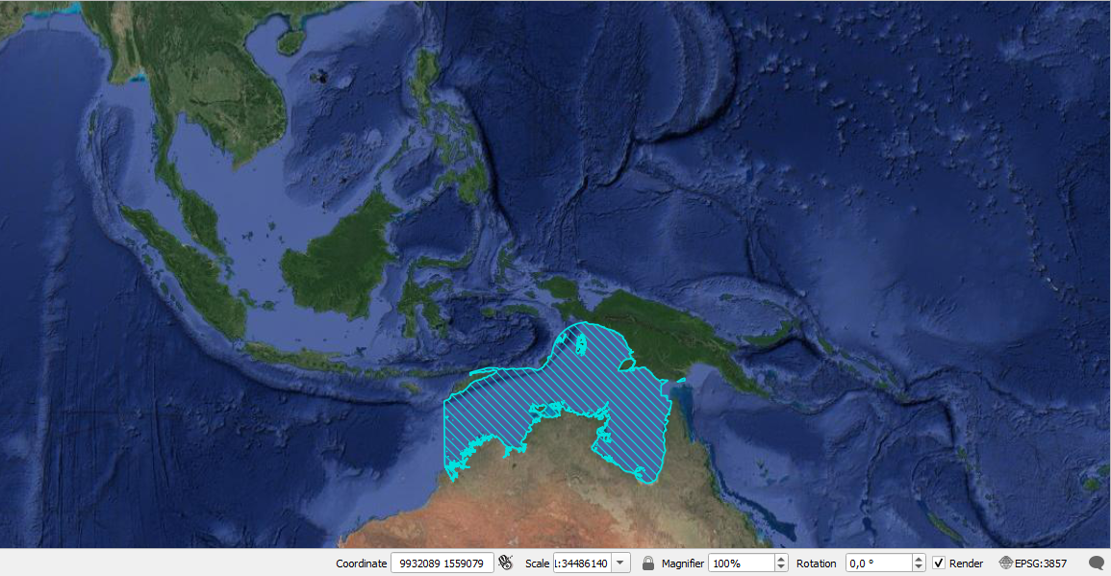
ATSEA-2 Data Contribution
The Arafura and Timor Seas (ATS) region geographical boundary is unique in terms of its ecology, geography and socio-political structure.
Shared by Australia, Indonesia, Papua New Guinea and Timor-Leste, this fertile corridor of tropical water traverses the North Australian Shelf Large Marine Ecosystem (LME), connecting the Pacific and Indian Oceans with the Coral Triangle.

Slide 13
CT Atlas Spatial Data Contribution Mechanism
Contributors submit the online spatial data contribution form
Auto
System notify administrator about the new submission
Auto
Administrator review the request & data
1 week
Administrator notify the user on rejection & reason
No
1st level approval
Yes
Technical Working Group review the request & data
3-4 weeks (Depend on the meeting availability)
No
2nd level approval
Administrator publish the data to CT Atlas:
Interactive map
Download section (depend on contributors preference)
Yes
Administrator notify the user on accepted request for publish online
Auto
1 week
Administrator process the data
(change to compatible format)

Slide 14
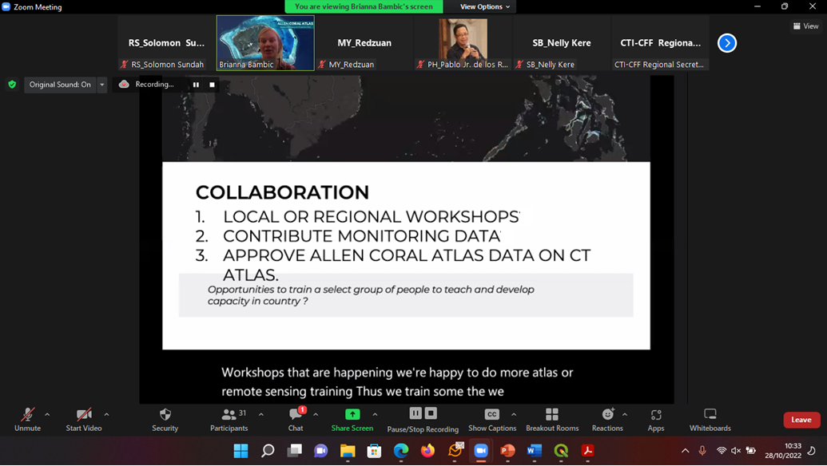
Collaboration with ALLEN CORAL ATLAS

Slide 15
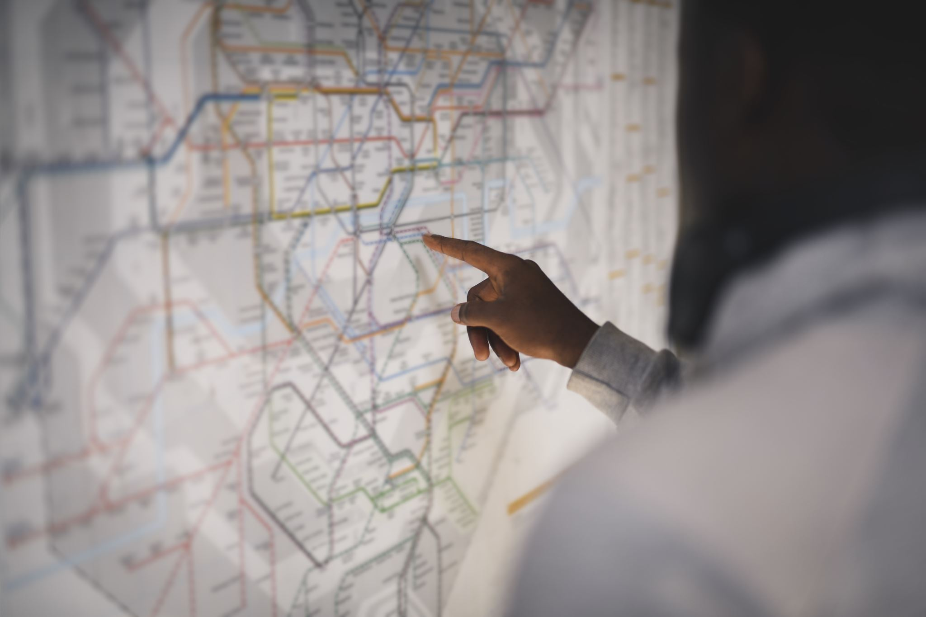
CT Atlas Workplan 2023
Incorporate Monitoring Indicator for RPOA 2.0 targets, regional activities, outcome, outputs into CT ATLAS.
Allen Coral Atlas collaboration, as well as training and capacity building

Slide 16
Update on MEWG Workplan and Budget for 2022
Activities | Time frame | Budget (Online) | Update
Monitoring & Evaluation Working Group (online meeting) | Q2-Q3 | 900 | Conducted on October 28, 2022
M&E training | Q2-Q3 | 600 | Conducted on October 28, 2022
RPOA 2.0 - Drafting of the text of RPOA 2.0 | Q2- Q3 | 28,400 | Done. 2 In-Situ Writeshops have been conducted: June 7-8, 2022 September 21-22, 2022
CT Atlas | Q2-Q3 | 1,920 | Concept note by SUFIA PSE Allen Coral Atlas ATSEA 2
Training on Knowledge Management System and Set-up and organize an efficient Knowledge Management System for Documents and Records Management and Storage | (Feb/March 2022-TBC) | Supported by SUFIA | Done. June 21, 2022. (Supported by SUFIA LCD)
Training on Program and Activity Results Reporting and Communication, including Gender Sensitive Reporting | (April 2022-TBC) | Supported by SUFIA | Done. April 19, 2022 and April 25, 2022. (Supported by SUFIA LCD)
Training on MEL Data Management and Designing and Conducting Value-Added Research/Develop MEL Data Management Manual including Procedures to monitor and evaluate project performance and achievements | (May 2022-TBC) | Supported by SUFIA | Done. June 22, 2022. (Supported by SUFIA LCD)
GIS training (re: for CT Atlas) – | TBC | Supported by SUFIA

Slide 17
MEWG Workplan and Proposed Budget for 2023
Activities | Time frame | Budget
Monitoring & Evaluation Working Group- Physical meeting, and the Monitoring and Evaluation training- Physical training. (Propose to be conducted in Pacific Countries, TBD in SOM 17) | Q2 | USD 8,500
RPOA 2.0 M&E Plan Framework (upon receive the data from CT6 then the M&E Plan Framework will be finalized) Online meeting prior – Physical meeting for finalization | Q1
CT Atlas – Track the progress Training and Discussions | Q2-Q3 | USD 8,500
GIS training (re: for CT Atlas) –
Activities from RPOA 2.0 Implement of M&E activities Development of a priority regional score card and dashboard Access and full operation of CT Atlas as an updated platform for regional information/data and for tracking implementation of the RPO 2.0 |  | RS will further discuss to get financial support from fund available from partners or future global fund which is currently peruse by RS

Slide 18
Recommendations for SOM 17
Acknowledged and accepted the report from Monitoring and Evaluation Working Group (Annex 1)
RPOA 2.0
Acknowledged and accepted the Regional Plan of Action 2.0 (RPOA 2.0) along with the implementation strategy, communication strategy and financial strategy (Annex 2A, Annex 2B).
Congratulated member countries and Regional Secretariat for the completion of Regional Plan of Action 2.0 (RPOA 2.0) and acknowledge the support from partners.
Encourage CT6 Countries to socialize, disseminate and adopt the Regional Plan of Action (RPOA 2.0)
Monitoring and Evaluation
Acknowledge and accepted the Monitoring and Evaluation (M&E) Data Collection and Information Sharing Mechanism and M&E Plan Framework template (Annex 3A, Annex 3B)
Agreed to complete the data for the M&E Plan Framework of RPOA 2.0 by 1st Quarter of 2023.
Encouraged CT6 to use M&E Data Collection and Information Sharing Mechanism and M&E Plan Framework template as tools to track the progress of implementation of RPOA 2.0
Agreed to hold MEWG meeting back-to-back with M&E Training by 2nd Quarter 2023
CT Atlas
Noted the interest of Allen Coral Atlas to collaborate with CT Atlas and RS to further follow up its mutual collaboration (Annex 4)
Agreed to organize and to conduct CT Atlas training by 2nd Quarter 2023

Slide 19
Recommendations for SOM 17
SUFIA Activity
Acknowledged and appreciated the support of USAID through the Sustainable Fish Asia (SuFIA) to the activities related to M&E Working Group (Annex 5);
Acknowledged and appreciated the conduct of the online Training on Program and Activity Results Reporting and Communication, including Gender Sensitive Reporting on 19 April 2022 organized by the SUFIA LCD and CTI-CFF Regional Secretariat
Acknowledged and appreciated the conduct of the online training on Knowledge Management System and Monitoring, Evaluation and Learning (MEL) Data Management on 21 and 22 June 2022 organized by the SUFIA LCD and CTI-CFF Regional Secretariat (Annex 6A, Annex 6B)
Marine Litter
Acknowledged and appreciated the support of WWF in producing the Stocktake Report on Marine Plastic Pollution and Its Sources In the Coral Triangle.
Acknowledged and accepted the final Stocktake Report for publication and launch in 1st Quarter of 2023 (Annex 7A, Annex 7B)
MEWG Workplan
Acknowledged and accepted the 2023 Monitoring & Evaluation Working Group Work Plan.

