Slide 1
Marine Litter in the Coral Triangle Status, Challenges & Actions
CTI-CFF Coral Triangle Day Webinar, 9 June 2020 Jackie Thomas, WWF Coral Triangle Program
© Troy Mayne / WWF

Slide 2
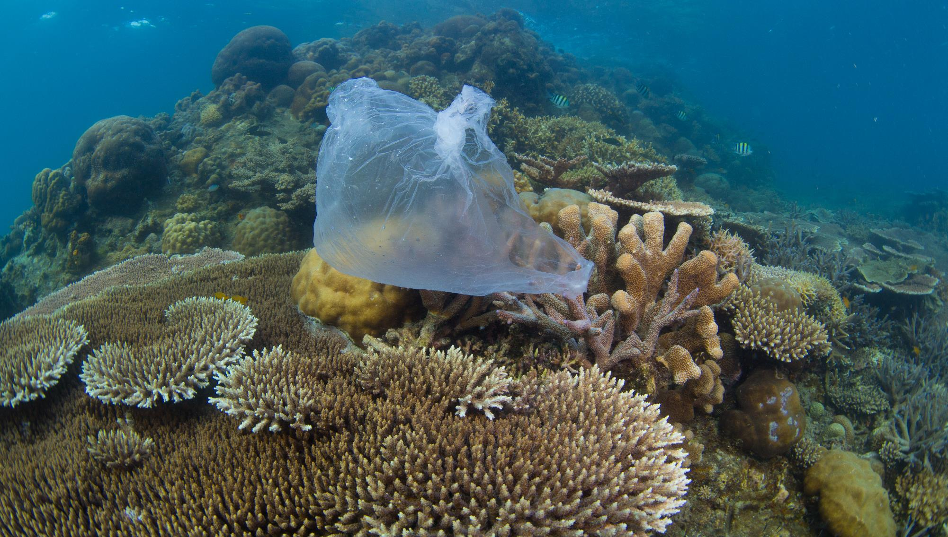
396M MT
of plastic produced in 2016 creating approximately 2B MT
of CO2 emissions.
Human health
Globally growing concerns around human health impacts at every stage of plastics life cycle
©Vincent Kneefel / WWF-Netherlands

Slide 3
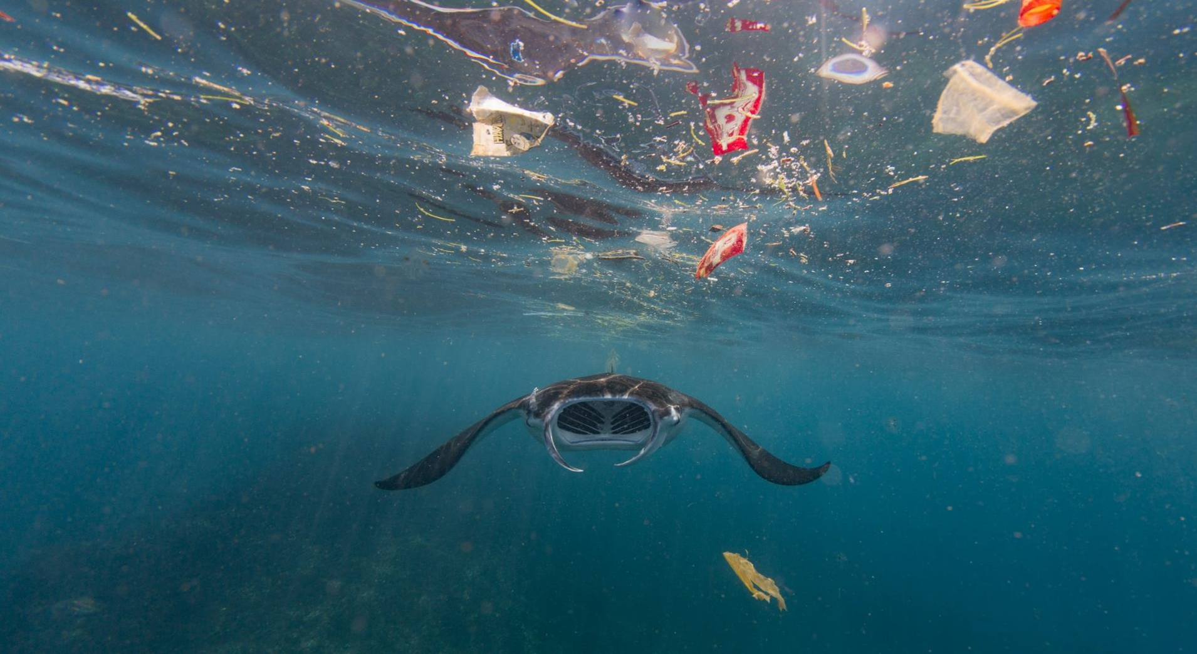
700
marine species are known to be impacted by plastic ingestion or entanglement
100 %
of sea turtle species show evidence of plastic ingestion or entanglement
Gall & Thompson 2015
Worm et al. 2017
©Vincent Kneefel / WWF-Netherlands

Slide 4
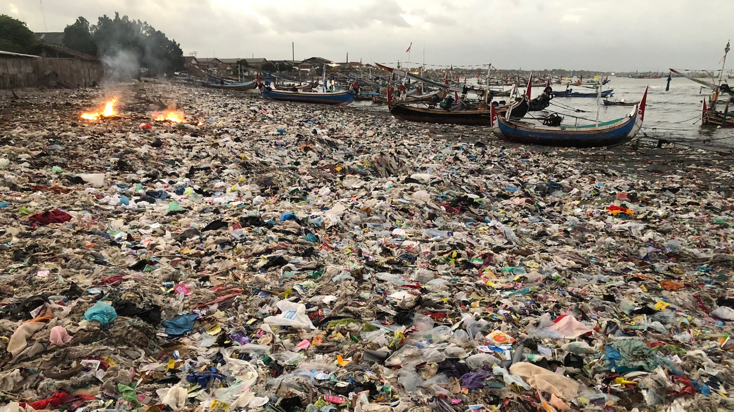
75%
of plastic leakage in the
ocean comes from
uncollected waste
McKinsey: Stemming the Tide Report 2015
©Vincent Kneefel / WWF-Netherlands

Slide 5
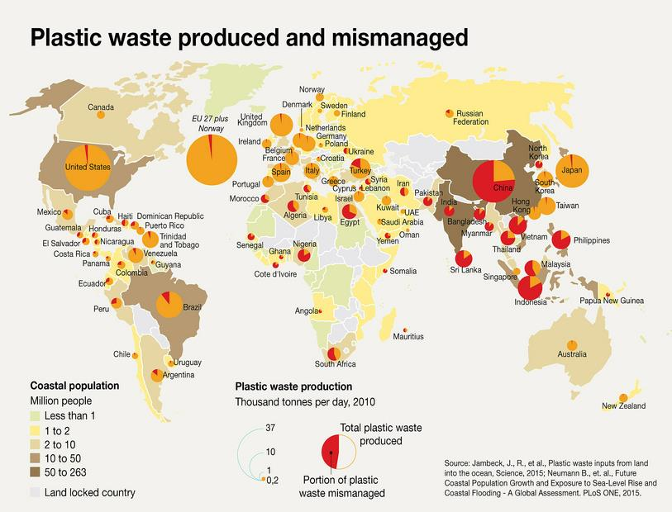

Slide 6
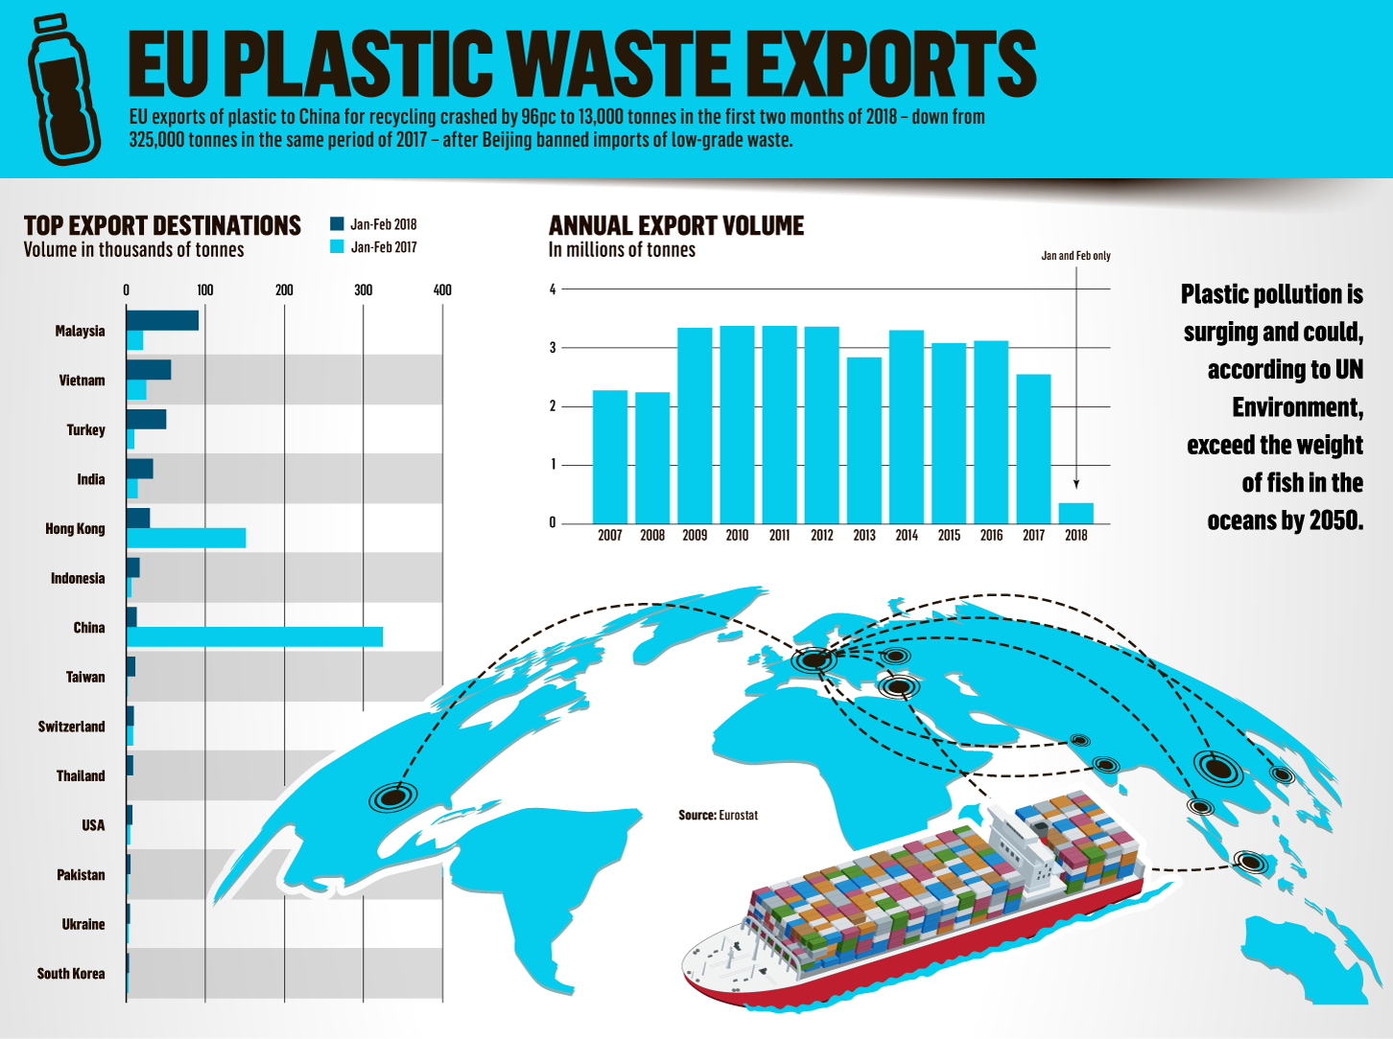
Global Challenge
Plastic waste is a global challenge but this is often masked by the export of plastic waste to developing countries
Social

Slide 7
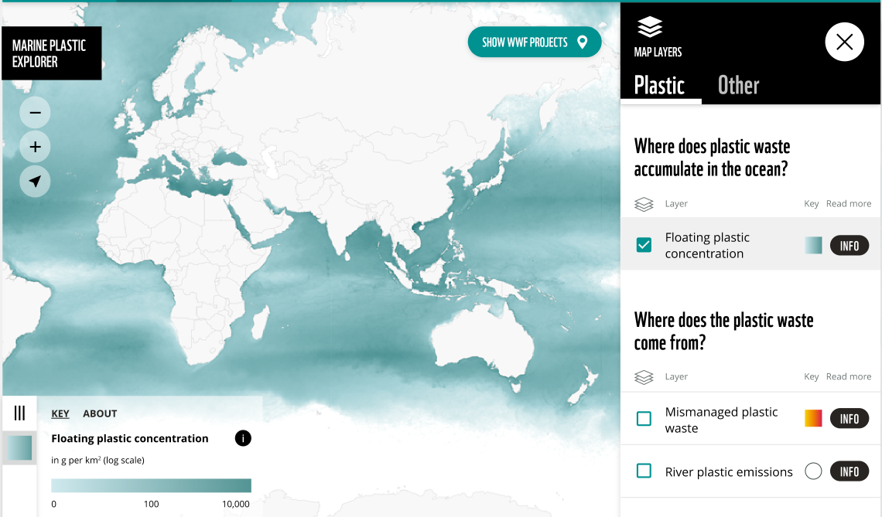
Map currents

Slide 8
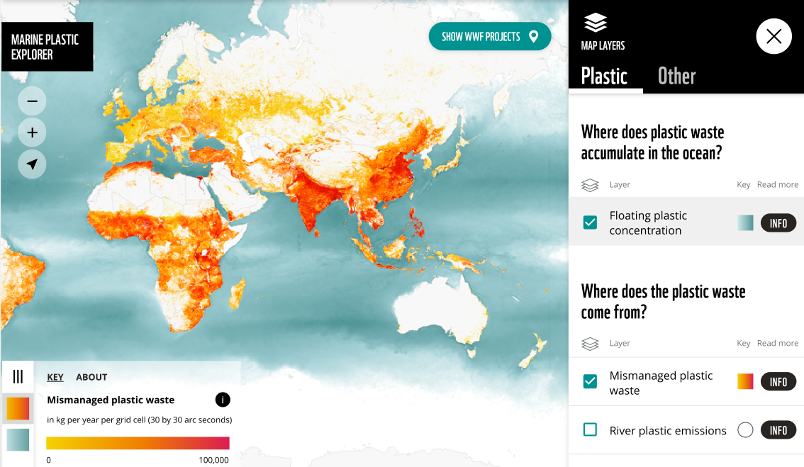
Map currents

Slide 9
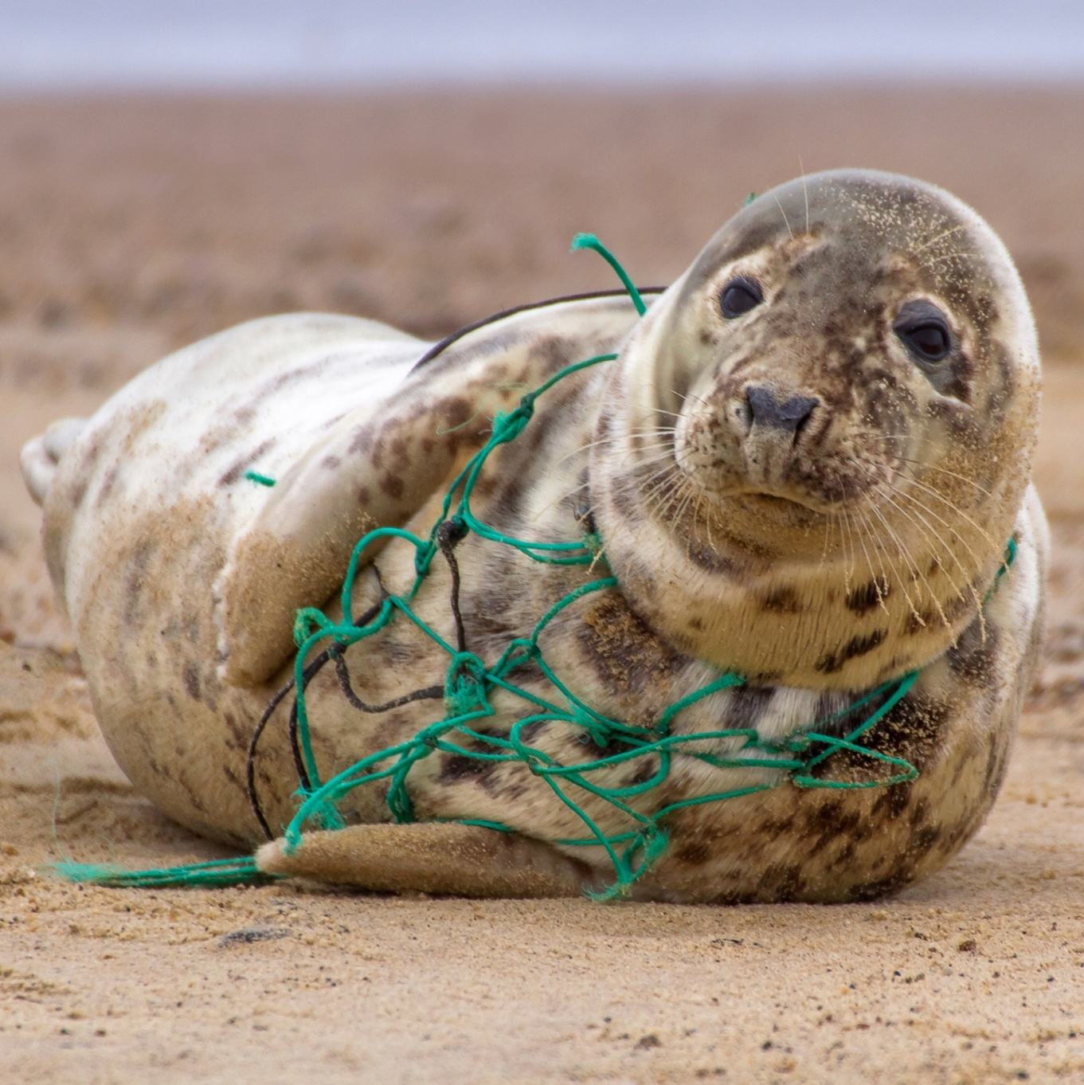
ALDFG - 10% of all marine litter entering oceans (UNEP, 2017) One of most impactful forms of marine debris for marine animals & habitats. Impacts maritime shipping Pollutes beaches & Damages reefs Causes economic losses to industry (e.g. fisheries & tourism.) ~640,000 Tns of ALDFG in oceans each year (FAO)
Abandoned, Lost, Discarded Fishing Gear (ALDFG)
Otherwise know as ghost gear
Notes:
In addition to plastic waste from land based sources, Abandoned, lost and discarded fishing gear is also one of the most impactful marine debris harming marine animals and habitats,.
The Food & Agriculture Organisation estimates that 640,000 tonnes of fishing gear is lost or abandoned in our oceans each year.
Not only does it harm marine ecosystems, it also affects shipping, washes up on beaches and on reefs and causes economic losses to fisheries, and other industries including tourism.

Slide 10
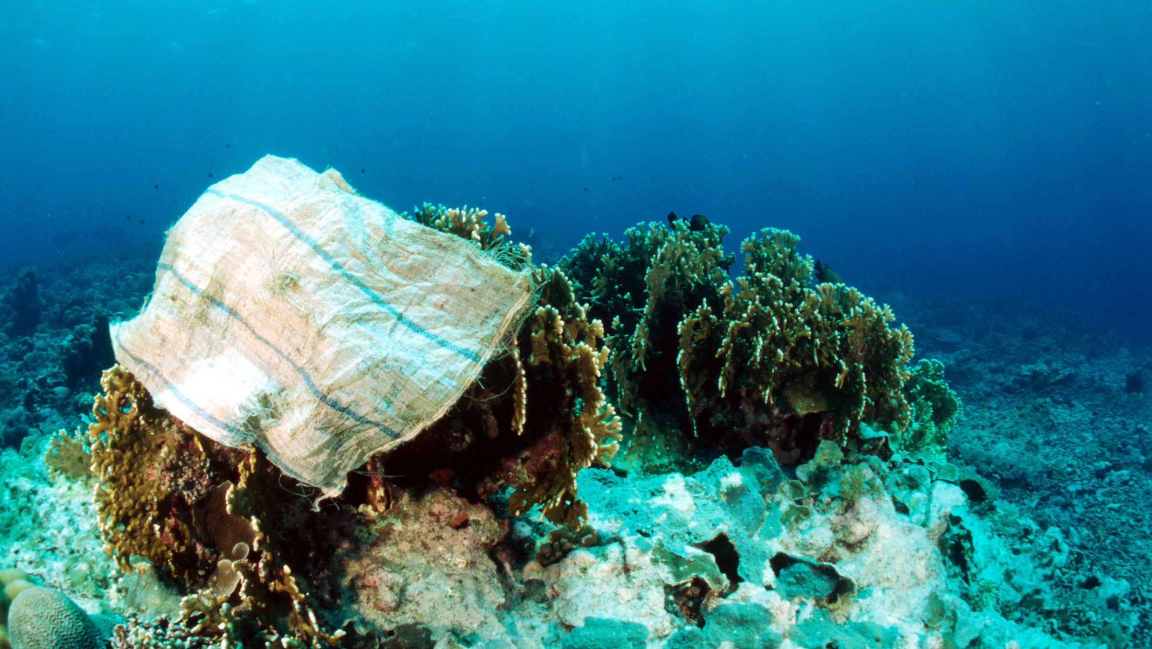
Coral reef health under threat
© Jürgen Freund / WWF.
Notes:
Research has recently identified that corals are mistaking microplastics for food, and seem to have a preference for eating them over real nutritious food: https://www.nationalgeographic.com/environment/2019/06/these-corals-choose-to-eat-plastic-over-food/

Slide 11
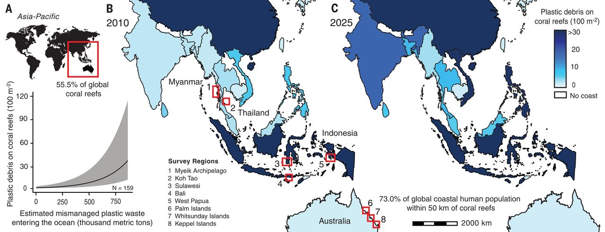
Estimated plastic debris levels on coral reefs
Joleah B. Lamb et al. Science 2018;359:460-462
Copyright © 2018, The Authors, some rights reserved; exclusive licensee American Association for the Advancement of Science. No claim to original U.S. Government Works

Slide 12
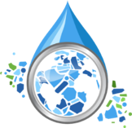
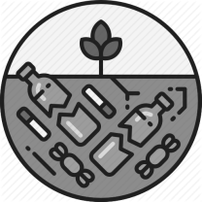
Plastic Pollution: A Serious Challenge to our Natural World, Society & Global Economy
Environmental Impacts
Social Impacts
Economic Impacts
Entanglement
Unregulated plastic
waste management
Fisheries
Ingestion
Human plastics ingestion
Maritime trade
Habitat damage
Soil and water contamination
Tourism
WWF-Dahlberg Report, 2019, citing various studies

Slide 13
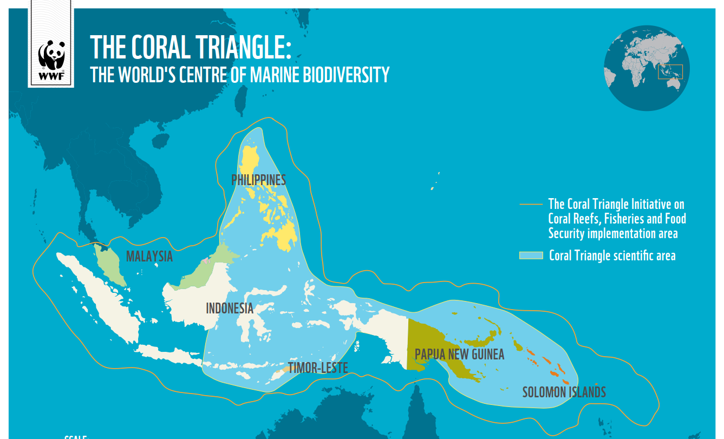

Slide 14
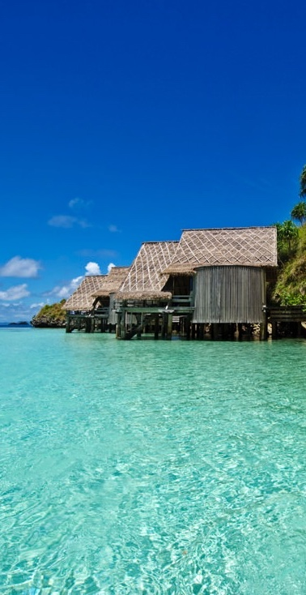
Tourism facing the impact of plastics
Tourism will be adversely affected by marine plastics
Economic value to Coral Triangle of Nature-based & Adventure Tourism – 15 to 25 Billion USD p.a. (pre Covid-19)
Predicted to be worth up to 148 Billion USD p.a. to the Coral Triangle by 2035
However, tourism is also part of the problem in terms of plastic pollution, and other forms of waste management issues.
Image © James Morgan |
Misool Eco Resort, Indonesia

Slide 15
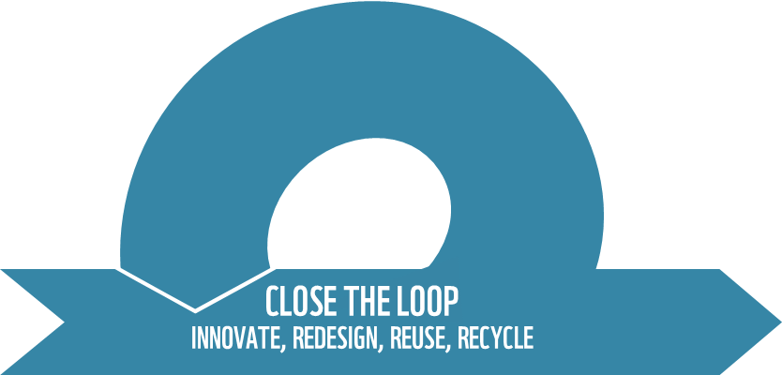
A Global Solution – A Vision for No Plastics in Nature (A systems approach)
Business:
Eliminate unnecessary plastics
Increase recovery and recycling
Shift to sustainable sources
Cities:
Address city-level waste management in key pilot cities
Showcase global best practice
Policy
Encourage accountability through Extended Producer Responsibility (EPR) programs
Create a global set of rules for plastic pollution
Notes:
Action Needs to be taken throughout the full life cycle of plastics, and by all key sectors at Global, regional, national and local levels.
WWF has a vision for No Plastic in Nature by 2030 and is working with industry and businesses on reforming practices, with plastic smart cities and with governments to support a new global treaty to address marine plastic pollution.

Slide 16
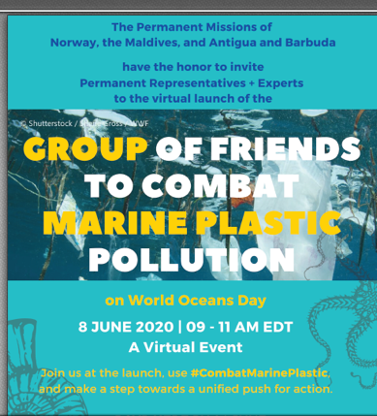
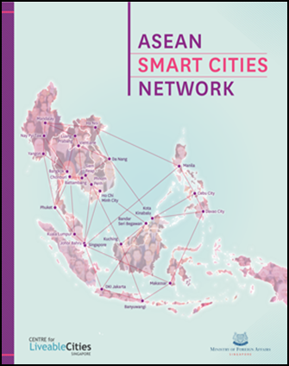
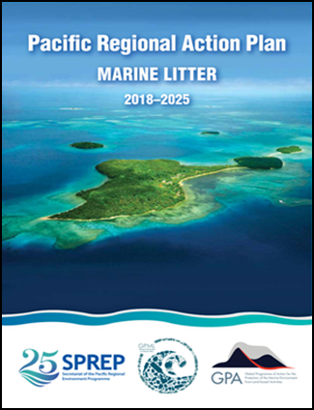
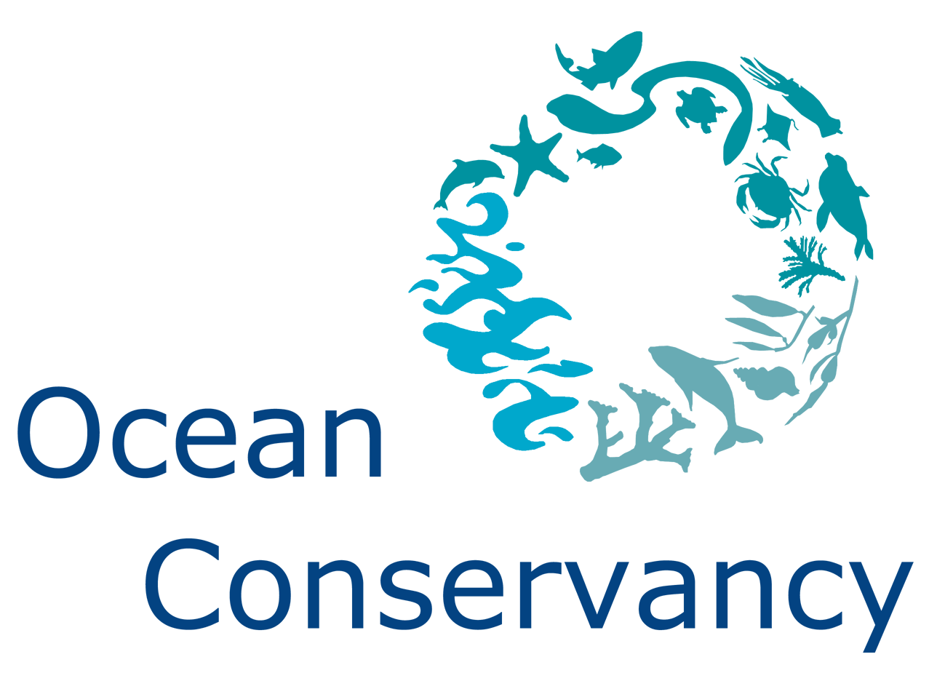
A global movement of people, organisations and alliances
to fight marine plastic pollution

Slide 17
CTI-CFF Mobilizes to address Marine Plastic Pollution
Mobilize Cross Cutting Initiatives
Strategic Partnership Opportunities:
CTMPAS & MPA management bodies
Regional/Global Organisations & Alliances e.g.:
ASEAN Centre for Biodiversity;
PEMSEA (Pollution & Waste Management)
IUCN (Plastic Waste Free Islands & MARPLASTICCs)
Secretariat of the Regional Pacific Environment Programme
Global Ghost Gear Initiative
Pacific Asia Travel Association
Strategic CTI-CFF Partners
University Partnerships
Women Leaders Forum
Sustainable Business Forum
Maritime Local Government Network

Slide 18
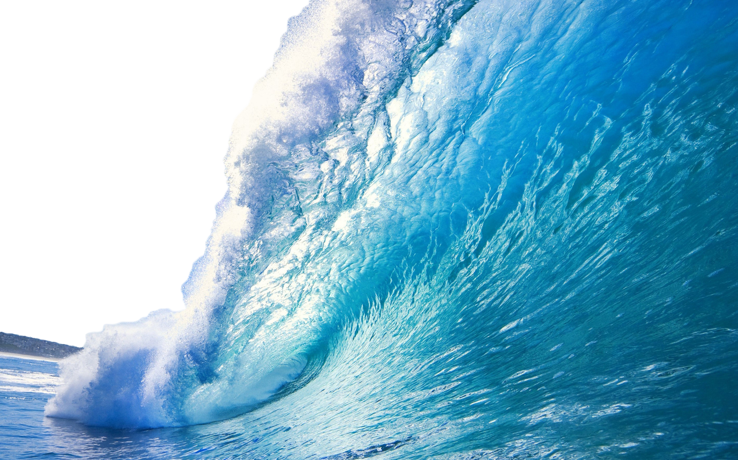
Scaling solutions
across the Coral Triangle
Identify and access the significant resources becoming available to tackle plastic pollution - for planning, partnerships and implementation towards stopping leakage of plastics in nature and our oceans.
CTI-CFF & WWF Stocktake of pollution & solutions in Coral Triangle
Identify innovation and livelihood opportunities for new businesses or social enterprises.
Identify appropriate scale solutions for priority coastal cities, towns or tourism centres located in areas critical to areas of high marine biodiversity.
Governments support a global legally binding agreement to address marine plastic pollution that involves every country in ending this crisis by 2030

Slide 19
WWF – Our Mission
To stop the degradation of the planet's natural environment and to build a future in which humans live in harmony with nature, by: conserving the world's biological diversity, ensuring that the use of renewable natural resources is sustainable, and promoting the reduction of pollution and wasteful consumption.
Plastics Campaign:
https://wwf.panda.org/get_involved/campaign_with_us/plastics_campaign_page/
Notes:
On behalf of WWF, Thank you for the opportunity to speak on this important topic and to recognise and celebrate Coral Triangle Day 2020.

