Slide 1
USAID Oceans and Fisheries Partnership
Key Data Elements for EAFM
June 2019

Slide 2
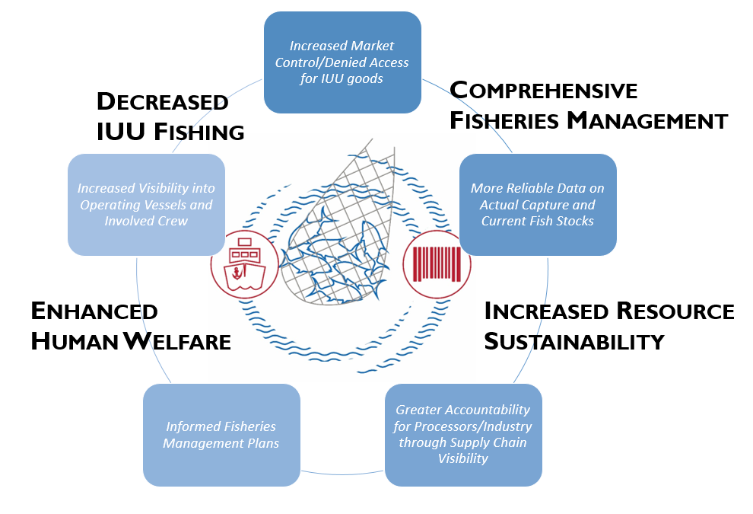
TRACEABILITY: BENEFITS AND IMPACTS

Slide 3
DEVELOPING eCDT SYSTEMS
Identify and establish Critical Tracking Events and Key Data Elements
Consolidate existing tracking and data systems to create a centralized exchange
Incorporate fisheries management and human welfare data elements for comprehensive approach
Develop partnerships with public and private sector to strength and sustain system
Critical Tracking Events (CTEs)
Points in time where data should be captured, noting that “something” has happened to a product
Key Data Elements (KDEs)
Support CTEs (unique identification, lot, date, location, species, weight)

Slide 4
eCDT contributes and receives data to variety systems for government and business
eCDT INFORMATION ARCHITECTURE
x
Dock
Domestic Market
Import
Port
At Sea Capture
Landing
On Land
Transport
Processing
Exporting
2nd
Processor
Import
GOVERNMENT
Sustainable Fisheries Management Plan
Combating IUU
Food Security
Food Safety
Stock Assessment
Harvest Level
Harvest Strategy
Logistic (Inputs)
Cold Storage
Distribution Nutritional Supply
HACCPP
GDP
Trade Balance
Customs Revenue
PSM
MCS
BUSINESS
Catch reporting
Fleet Management
Company Supply Chain
Enterprise Resources Planning
B2B Certification
(MSC, Fair Trade, SFW)
B2B and B2C Traceability
HUMAN
WELFARE

Slide 5
SAMPLE KEY DATA ELEMENTS
KDE | Ideal | WWF | U.S. | EU | ACDS | Oceans
Scientific Name (Species) | ● | ● | ● | ● |  | ●
Common Market Name |  |  | ● |  |  | ●
ASFIS #/Product Code |  |  | ● |  | ● | ●
Est. Weight |  |  |  |  | ●
Location of Catch | ● | ● | ● |  | ● | ●
Catch Description |  |  |  | ● |  | ●
Date of Departure
Catch Date & Time | ● | ● | Date Only | Date Only |  | ●
Date of Landing |  |  |  |  |  | ●
Gear/Method | ● | ● | ● | ● |  | ●
Name of Fisher(s) | ● |  |  |  |  | ●
Name of Captain/Master |  |  |  | ● | ● | ●
Nationality(ies) of Fishers/Crew |  |  |  |  |  | ●
Company Name | ● |  | ●
Notes:
After analyzing various regulation requirements, USAID Oceans determined the key data elements required for a minimally viable system that would be compliant with the majority of standard regulations. The list is not limited to, but includes some of these key data points.

Slide 6
eCDT AND IMPROVED FISHERIES MANAGEMENT
CDT Data
Fisheries Information System
Ecosystem Approach to Fisheries Management
Data captured from eCDT systems
feeds into
National Fisheries Information Systems
to inform
Ecosystem Approach to Fisheries Management Plans
for improved management and planning

Slide 7
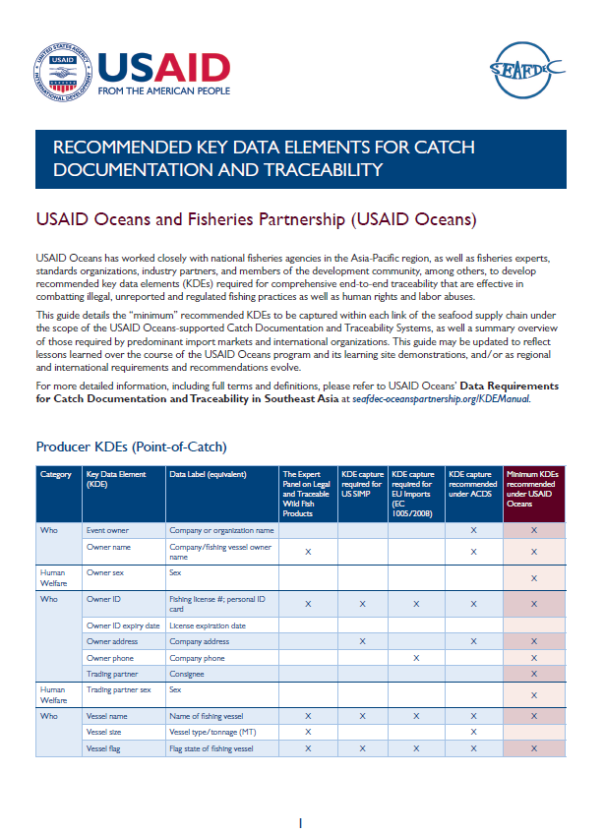
RESOURCES
www.seafdec-oceanspartnership.org

Slide 8
Farid Maruf,
USAID Oceans
Farid.Maruf@oceans-partnership.org
John Parks
USAID Oceans, Chief of Party
John.Parks@oceans-partnership.org
Cristina Vélez Srinivasan
USAID/Regional Development Mission for Asia
cvelez@usaid.gov

