Slide 1
Progress Report
Presented by Dr. Hendra Yusran Siry
CTI-CFF Executive Director Interim

Slide 2
Interim Executive Director’s Remarks
Appreciate the continued commitment from the CT6 Member Countries Parties towards achieving the goals and objectives Regional Plan of Action (RPOA) goals and objectives and support to the development of the renewal of the RPOA (RPOA 2.0);
Extend appreciation to the Development Partners – USAID, Australian Government, the Asian Development Bank, World Wide Fund for Nature (WWF), Coral Triangle Center, The Nature Conservancy (TNC) and Wildlife Conservation Society (WCS) for the support in the development of the RPOA 2.0;
Assure all stakeholders, that the Regional Secretariat is sincere in its effort to continuously improve operations towards better facilitation and coordination of CTI-CFF activities

Slide 3
Summary of activities
9 activities
7 activities
2 activities
Technical Working Groups
Governance Working Groups
Cross Cutting Initiatives
10 activities
13 events
7
(Exploring) Partnerships
Participation in International events
Communication Platforms
Corporate and Financial Management Activities

Slide 4
Outline
Technical Working Groups
Governance Working Group
Cross-Cutting Initiatives
Capacity Building Program for Regional Coral Triangle Network Officers (RCTNO)
Partnerships
Corporate and Financial Management Activities
Communication and Outreach Activities
Upcoming activities for November to December 2019 Activities

Slide 5
1
TECHNICAL WORKING GROUPS

Slide 6
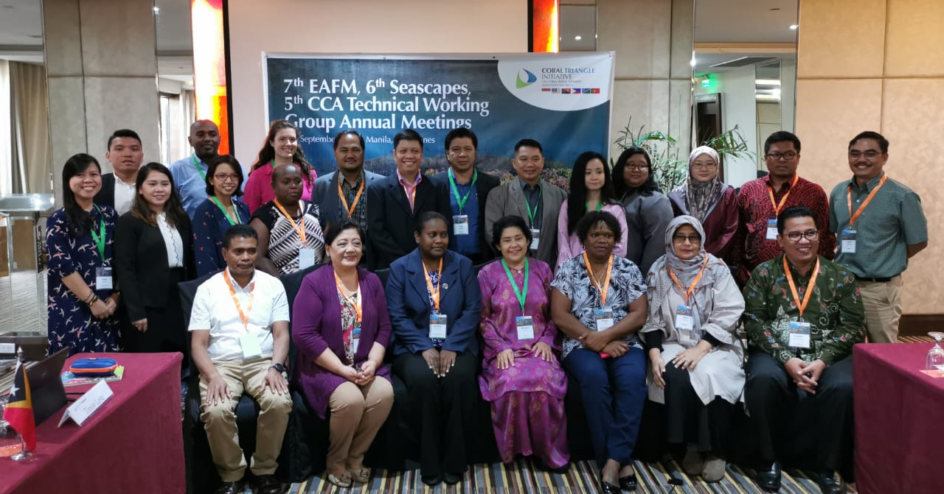
Seascape Working Group
6th Seascapes Working Group Meeting
September 3-4, 2019 | Manila, Philippines
Among the agreements:
Agreed that the Seascape Working Group will submit its position for the inclusion of the Seascape mechanism in the RPOA 2.0 through the Regional Secretariat
Agreed that the TOR for each sub-working group will be developed by each sub-working group and that the role of the Regional Secretariat as Coordinator at the regional level highlighting fundraising role is recognized in a later time in the process
Agreed in amending some items in the Rules of Procedures of the CTI-CFF Seascape Working Group for 15th Senior Officials Meeting endorsement (as highlighted in Chair’s Summary)
Participants of the 6th Seascapes Technical Working Group Meeting held in Manila, Philippines. Photo credit: CTI-CFF RS/A. Anggorojati

Slide 7
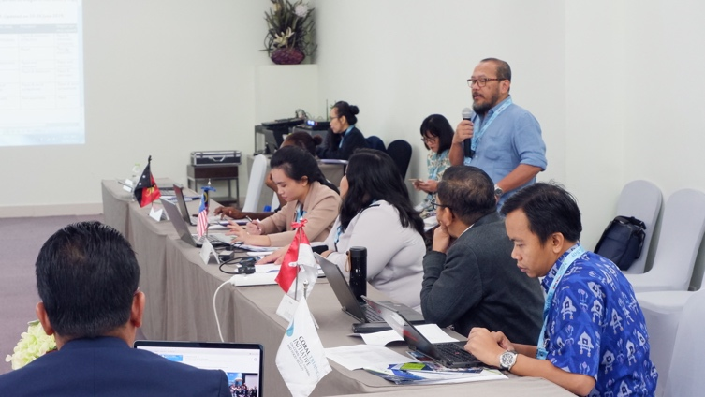
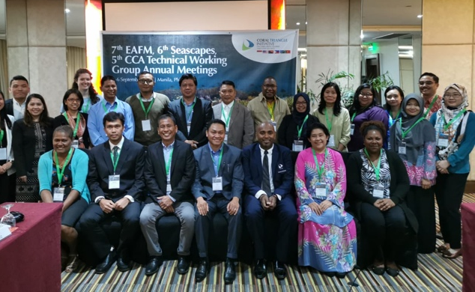
B. Ecosystem Approach to Fisheries Management (EAFM) Working Group
Workshop on Catch Documentation Traceability System Design and Development Based on EAFM in Timor-Leste June 25-26, 2019 | Dili, Timor-Leste
Among the agreements:
Realizing the need for experts on CDT in CT5 member countries, suggested for USAID Oceans use this gap as an opportunity to support future activities
CT countries to use and adapt resources and publications developed by USAID Oceans according to their respective needs
2. 7th Ecosystem Approach on Fisheries Management (EAFM) Working Group Meeting Manila, Philippines |September 2-3, 2019
Requested the Regional Secretariat to write an official letter to USAID RDMA and USAID Oceans regarding request for provision of an e-CDT Technical Guidance document for CTI
Participants of the EAFM TWG Meeting in Manila, Philippines. Photo credit: CTI-CFF RS/A. Anggorojati
Participants of the Workshop on CDT Systems in Dili, Indonesia.
Photo credit: CTI-CFF RS/J. Polita

Slide 8
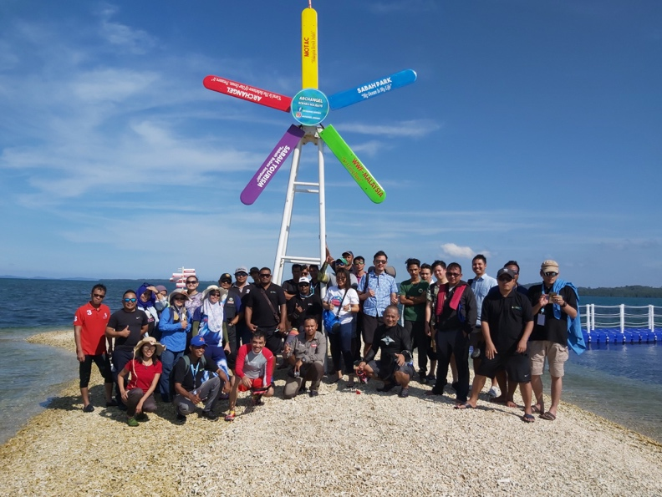
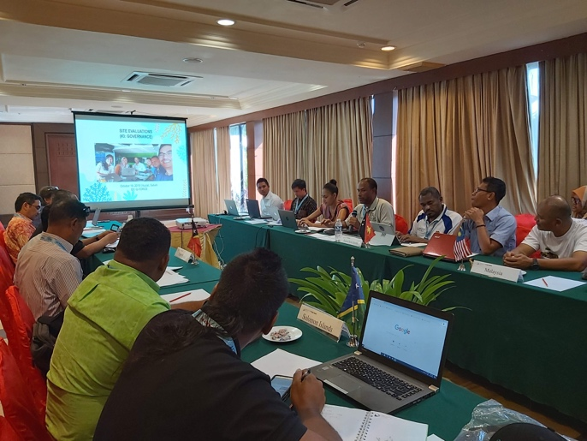
C. Marine Protected Areas Working Group
Workshop for the development of a protocol for the monitoring of Marine protected Areas September 27-October 4, 2019 | Gorgona, Colombia
The 5-day workshop was organized and fully supported by the Corredor Marino del Pacifico Este tropical (CMAR) as part of the joint work between CMAR and CTI-CFF to strengthen Regional initiatives aimed at the conservation and sustainable use of marine biodiversity in the Pacific Ocean region
2. MPA Regional Exchange
October 16-20, 2019 |Kota Kinabalu, Sabah, Malaysia
Among the agreements
Recommended Regional Secretariat and Task Force to provide support in the preparation of a guideline or outline for the concept paper of a joint roadmap of sustainable tourism for five years at prioritized community sites, and phasing into larger sites
Tasked Regional Secretariat to provide the Term of Reference (ToR) on Sustainable Marine Tourism Task Force to the MPA TWG with a formal letter requesting to identify the focal points, pilot community site(s) for immediate activities and higher-level site(s) for future planning.
Participants of the MPA REX and MPA TWG Meeting in Sabah, Malaysia. Photo credit: CTI-CFF RS/J. Polita

Slide 9
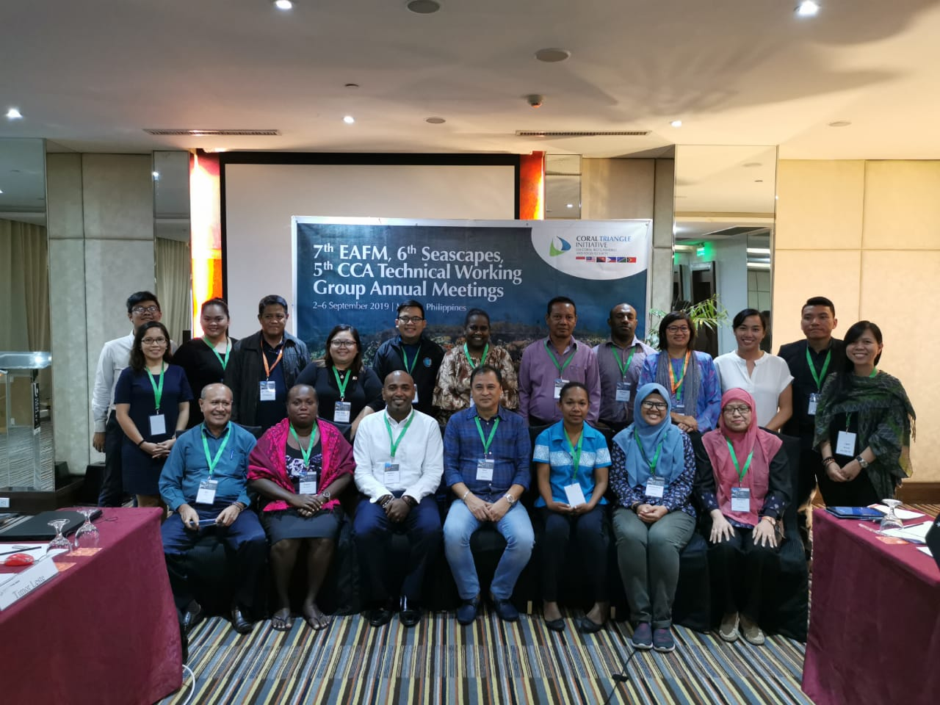
D. Climate Change Adaptation Working Group
1. Climate Change Adaptation Capacity Building in Coral Triangle Countries: Increasing Resilience and Adaptive Capacity of Coastal and Marine Ecosystem through Technical Communication, Education and Public Awareness (CEPA) Workshop
July 2-4, 2019 | Jakarta, Indonesia
Important outputs from the workshop is the Initial
Proposed Plan of Action of Climate Change Adaptation
2020 – 2024
2. 6th Climate Change Adaptation (CCA) Working Group Meeting
September 5-6, 2019 | Manila,Philippines
Realign the objectives based on recent developments i.e. RPOA 2.0, Blue Carbon, CEPA
Regional Secretariat to compile all the comments and present the same during the pre-SOM-15
Participants of the 6th CCA Technical Working Group Meeting held in Manila, Philippines. Photo credit: CTI-CFF RS/A. Anggorojati

Slide 10
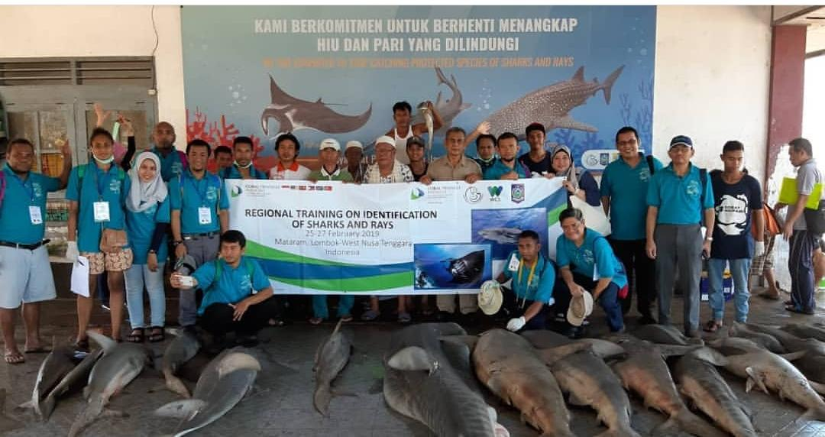
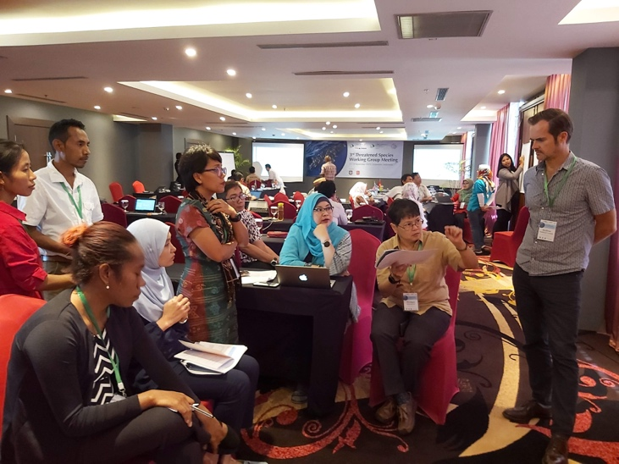
E. Threatened Species Working Group
Regional Training on Identification of Sharks and Rays
February 25-27, 2019 | Lombok, Indonesia
One of the important agreements was to compile baseline data of sharks and rays in CT6 member countries for future management use and generic information.
Participants of the Regional Workshop on the Identification of Sharks and Rays held in Lombok, Indonesia. Photo credit: MMAF
2. 3rd CTI-CFF Threatened Species Working Group
September 17-19, 2019 | Gorontalo, Indonesia
One of the important agreements was for CT6 member countries to submit their national conservation plan for marine mammals, sea turtles, sharks and rays to the Regional Secretariat for compilation by June 2020 and conduct a Writeshop of the Regional Assessment of Threatened Species and national conservation plan for marine mammals, sea turtles, sharks and rays in 2020.
Members of the TSWG together with the Development Partners discussing about M&E indicators

Slide 11
2
GOVERNANCE WORKING GROUPS

Slide 12
Financial Resources Working Group
FRWG Meeting
February 12, 2019 | Manado, North Sulawesi, Indonesia
The meeting highlighted the importance of strengthening and establishing collaboration with Development Partners by reactivating the Development Partners - CTI-CFF Regional Secretariat physical meeting (including potential donor country/agencies); engage and organize formal meeting where possible, with potential donors and supporters like China, Korea, Japan, Norway and Sweden, Monaco, New Zealand, India and other like-minded countries/institutions.
The FRWG Meeting was chaired by Dr. Nagulendran Kangayatkarasu from the Government of Malaysia Photo credit CTI-CFF RS/J. Polita

Slide 13
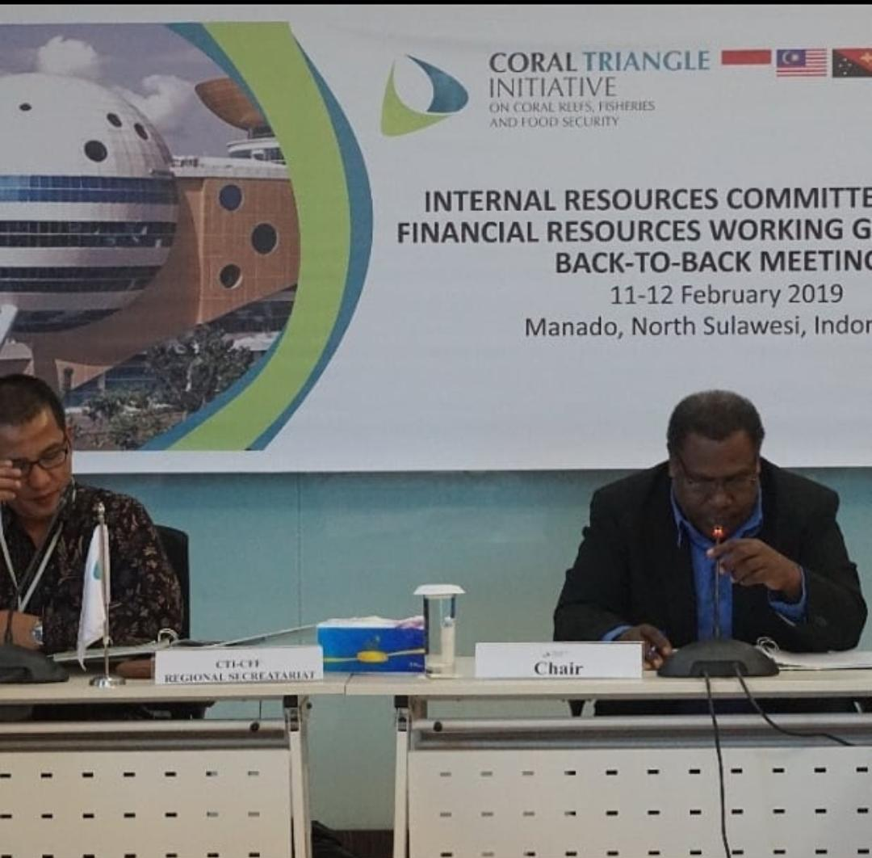
B. Internal Resource Committee
IRC Meeting
February 12, 2019 | Manado, Indonesia
The committee primarily met to review the internal operations and management of the CTI-CFF Regional Secretariat. Among the agreements from the meeting were:
Agreed on the proposed proposed amended Salary Scale of the CTI-CFF Regional Secretariat
Agreed on the proposal of the capacity building of CT6 Member Parties CT6 Countries through the six Regional Coral Triangle Network Officers and its term of reference;
Agreed to use part of the cash surplus of USD 951,168 (as per 2017 audit report) in the following
Recruitment costs of the Executive Director and Deputy Executive Director for Corporate Services

Slide 14
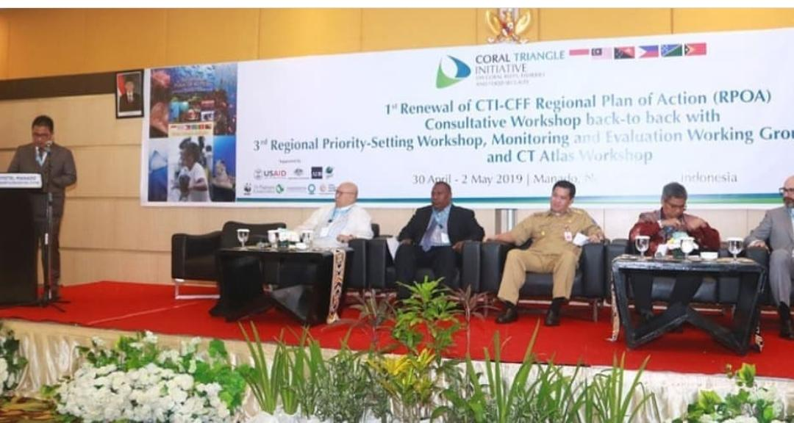
C. Monitoring and Evaluation Working Group
Monitoring and Evaluation Working Group (MEWG) Meeting
May 2, 2019 | Manado, Indonesia
The MEWG Meeting was conducted back-to-back with the conduct of the 1st Consultative Workshop on RPOA and the 3rd Regional Priority Setting Workshop in Manado, Indonesia. The meeting deliberated on RPOA 2.0, M&E indicators, emerging issues, Leaders’ Summit among others.
1st RPOA Consultative Workshop
Apr 29- May 2, 2019 | Manado, Indonesia
The workshop noted that the impacts of the RPOA 1.0 are increased attention to marine and coastal issues, regional cooperation relevant to international commitment, and nurtured cooperative linkages between Southeast Asia and Pacific countries.
CT Atlas, the Global Coral Reef Monitoring Network, Technical Working groups, governance working groups and cross-cutting initiatives were identified as important and instrumental platforms in achieving the RPOA
The Opening Ceremony of the 1st Consultative Workshop back-to-back with 3rd Regional Priority Setting Workshop, MEWG and CT Atlas Workshop. Photo credit: CTI-CFF/J. Polita

Slide 15
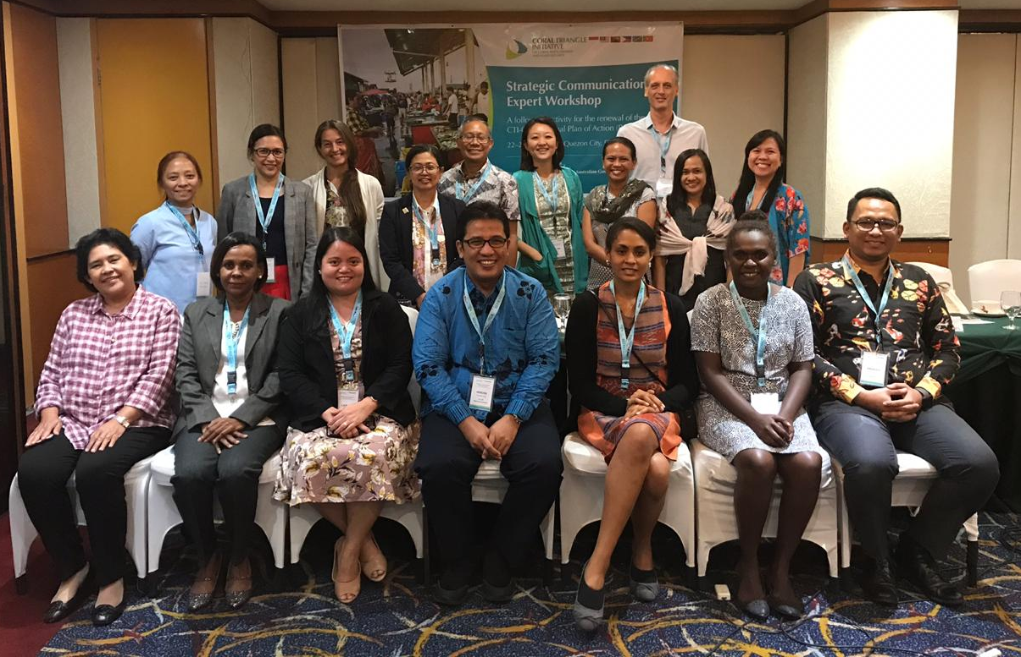
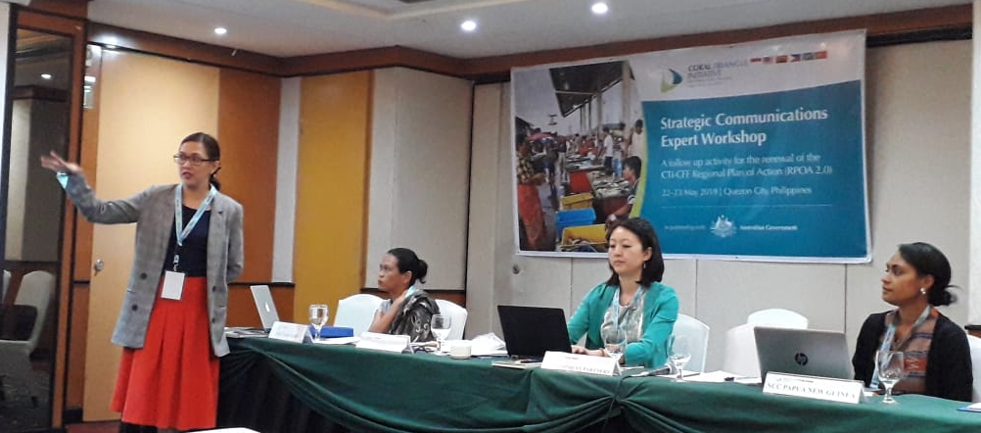
Strategic Communication Expert Workshop
May 22- 23 2019 | Manila, Philippines
Developed a draft Strategic Communication Plan Identified four communication goals
Identified target audiences:
Primary audiences: High ranking government officials from different Ministries, Global regional companies and International Development Partners
Secondary audiences: coastal communities and CT6 resource consumers; local government, like-minded civic organizations and academe
Developed 3 key messages
Identified strategies and tactics

Slide 16
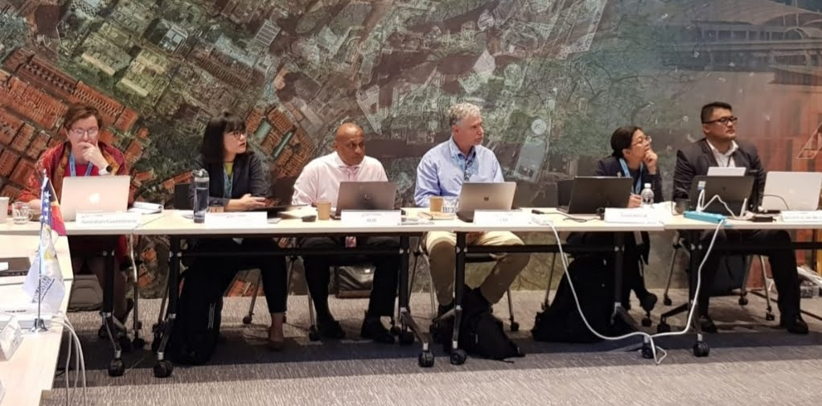
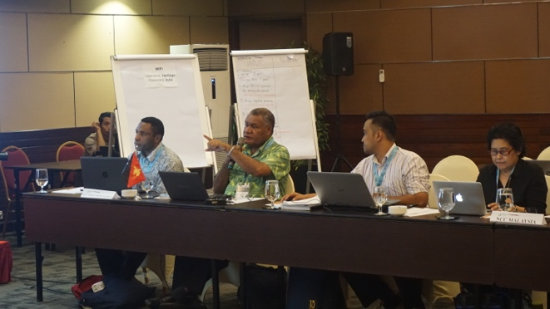
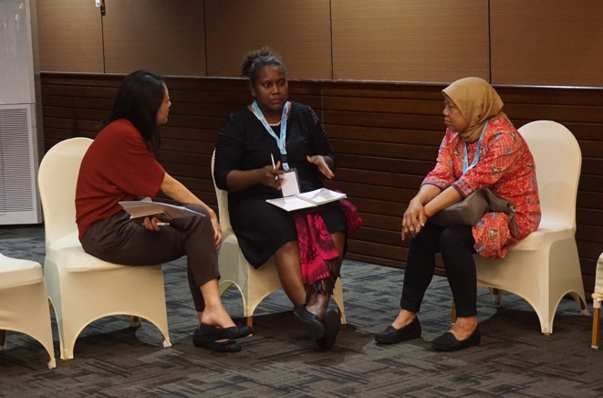
D. Financial Resource Strategy Expert Workshop
July 31- August 1,2019 | Singapore
Financial experts and senior officials from CT6 countries, financial institutions and international non-government organizations gathered for a two-day workshop in Singapore to help draft a financial resource mobilization plan in support of the renewal of the CTI-CFF Regional Plan of Action, most commonly referred as RPOA 2.0.
E. Institutional Change Framework Workshop and Writeshop for RPOA 2.0
August 13-15, 2019 | Bali, Indonesia
In this workshop, the participants identified short-term to long-term recommendations to strengthen CTI-CFF. The immediate recommendations were completing the RPOA 2.0 at the highest professional level; preparing and implementing an institutional plan for the Regional Secretariat; clear statement on the value- added of CTI; identifying cross-sectoral and synergies between and among Working Groups; explore ways to strengthen NCCs; and for the incoming leadership Executive Director to meet key leaders of CT6 Member Parties to explain the relevance of CTI.
The workshop was attended by financial experts from CT6 member countries and development partners to recommend a sustainable financial mechanism for CTI-CFF. Photo credit: CTI-CFF RS/W. Winarbo
The workshop participants from CT6 member countries and development partners discussed what they perceived the RPOA 2.0 should focused into. Photo credit: CTI-CFF RS/R. Wasturini

Slide 17
3
CROSS-CUTTING INITIATIVES

Slide 18
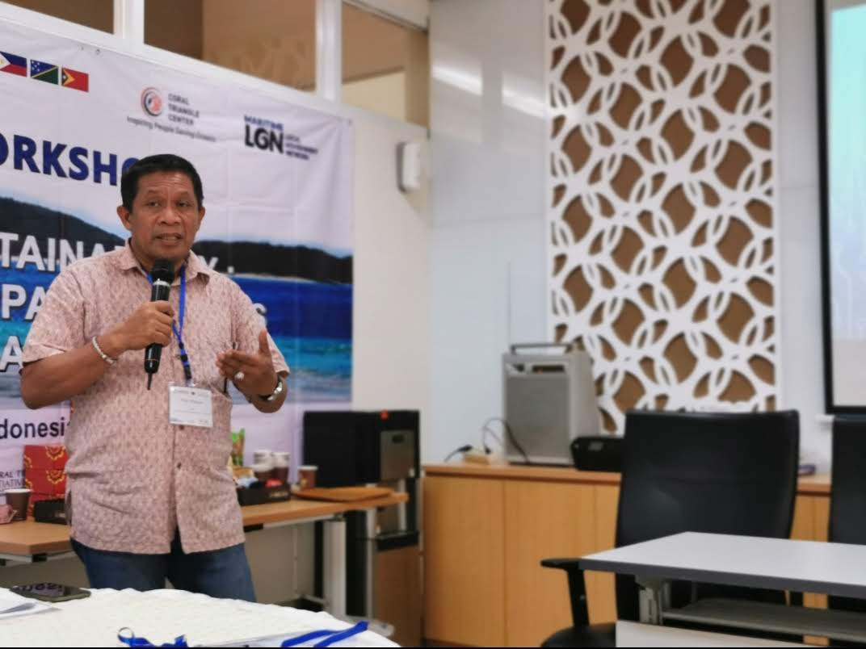
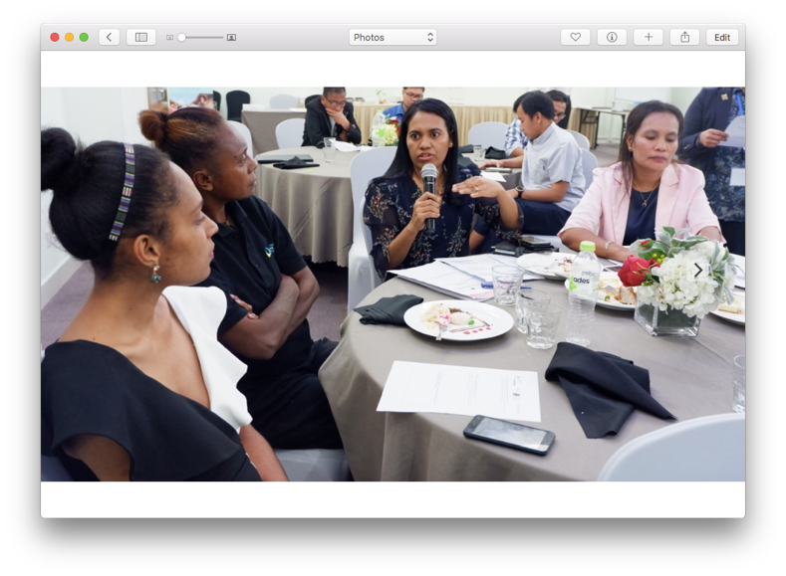
A. Local Government Network
Maritime Local Government Network roll up sleeves for Strategic Partnership and Resource Mobilization Planning
July 29-31, 2019 | Jakarta, Indonesia
The Regional Secretariat participated in the LGN workshop, that is working on an MOU with Indonesia’s Ministry of Home Affairs for strengthening the capacity and performance of coastal and maritime local governments in CT6 countries
B. Women Leaders Forum (WLF)
WLF Meeting
June 27, 2019 | Dili, Timor Leste
Gathered inputs from the participants to formulate draft gender policies/regulations matrix especially on the gaps and challenges, how women participation is included in planning and implementation process, gender equality integration. Further, the information will feed into the RPOA 2.0 process.
Mr. Hugua led the participants to revisit and review LGN’s strategic goals as well as determined its strategic priorities.
Photo Credit: CTI-CFF RS /A. Anggorojati
Participants from CT6 member countries and development partners gathered together for the WLF Dinner Meeting in Dili, Timor-Leste. Photo credit: CTI-CFF RS/J. Polita

Slide 19
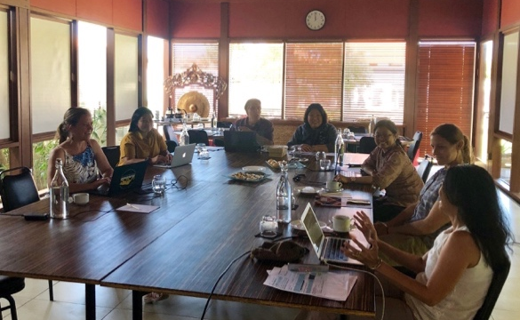
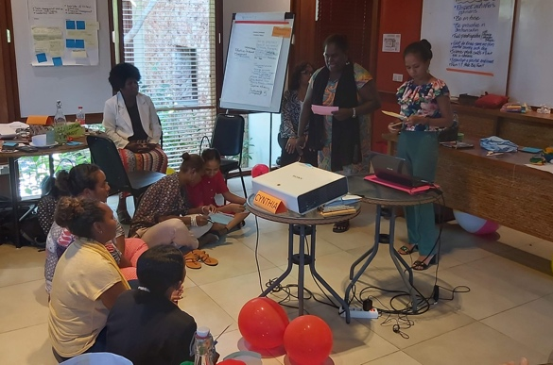
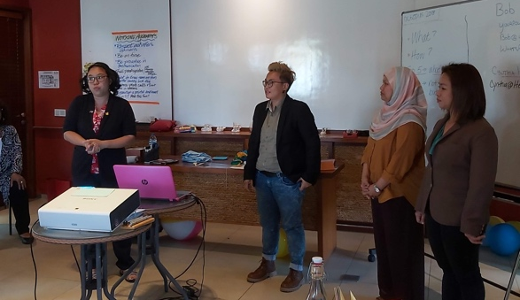
WLF Meeting (organized by CTC; funded by USRDMA and US DOI)
July 22-23, 2019 |Bali, Indonesia
RS participated in this activity thru Dr. Nora Ibrahim
Identified two activities for implementation this September 2019. First, a training that targets women leaders (supervisors, managers, and academics) in marine and coastal conservation areas in the CT6 member countries.
The second activity ws a two-day workshop and a 1-day write shop to generate inputs and insights from CTI-CFF stakeholders on how to integrate CTI-CFF’s cross cutting initiatives into the RPOA 2.0
Workshop on Aligning Cross-Cutting Initiatives (CCI) to the CTI-CFF Regional Plan of Action 2.0 & The CTI-CFF Women Leaders’ Forum Developing a Competency, Model to Elevate Women Leadership in Marine and Coastal Management (organized by CTC; funded by USRDMA and US DOI)
September 24 – 26, 2019 |Coral Triangle Center, Bali, Indonesia
RS participated in the workshop on Aligning CCI
brought together senior officials from NCCs and key leaders of WLF, LGN and Regional Business Forum.
In parallel with the workshop was the CTI-CFF Women Leaders’ Forum Developing a Competency Model to Elevate Women Leadership in Marine and Coastal Management

Slide 20
4
CAPACITY BUILDING PROGRAM FOR REGIONAL CORAL TRIANGLE NETWORK OFFICERS (RCTNO)

Slide 21
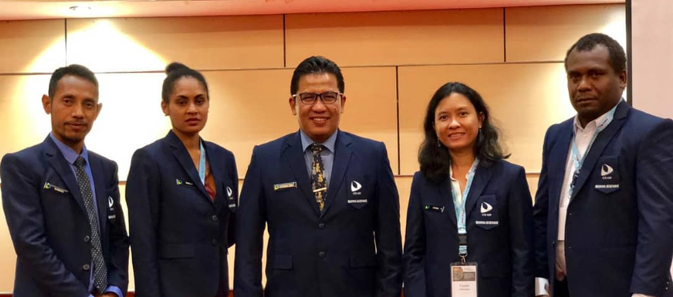
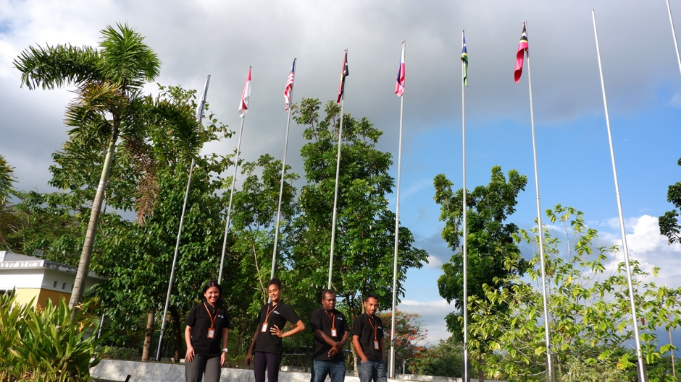
The 5-month program intends to provide learning experience on improving the implementation of the current Regional Plan of Action (RPOA); to be involved and contribute in the renewal of RPOA process; to improve understanding of RS functions; to provide opportunity on improving and strengthening the linkages of NPOAs to the RPOA; and act as focal points between RS and their respective NCCs for communication assistance.
The RCTNOs from Indonesia, Papua New Guinea, Solomon Islands and Timor-Leste have the opportunity to learn more the work of CTI-CFF Regional Secretariat through various exposure activities such as attendance in workshops, meetings and the like. Photo credit: CTI-CFF RS/R. Wasturini

Slide 22
5
PARTNERSHIPS

Slide 23
Activities implemented in collaboration with development partners:
USAID Strengthening Organizational and Administrative Capacity for Improved Fisheries Management (SOACAP)
US Department of Interior continued its support to the CTI-CFF by funding the following;
3rd Regional Priority Workshop for RPOA 2.0 in Manado, Indonesia last May 1, 2019
Workshop on CDT System Design and Development based on EAFM in Dili, Timor Leste last June 25-26, 2019
Workshop on Institutional Change for effective of CTI-CFF in Bali, Indonesia last August 13-14, 2019
B. Australian Government Support
The Australian Government supported the Strategic Communication Expert Workshop last May 22-23, 2019 in Manila, Philippines.

Slide 24
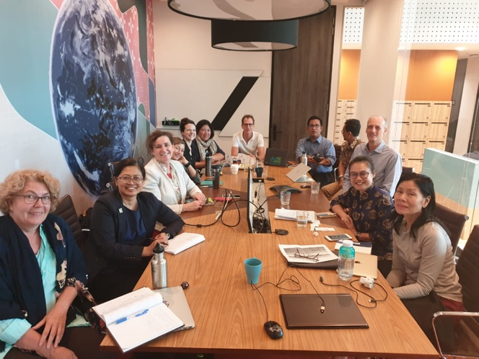
Development Partners Meeting
August 3, 2019 2019 | Singapore
The CTI-CFF Development Partners discussed plans as a partner role in addressing gaps or required action in the CTI-CFF RPOA 2.0.
Senior officials from Government of Australia, Coral Triangle Center, The Nature Conservancy, Wildlife Conservation Society, World Wildlife Fund and USAID Regional Development Mission for Asia also discussed the outcomes from the CTI-CFF Finance Resource Strategy Expert Workshop and analyze how this fits in the RPOA 2.0.
The need to socialize the RPOA 2.0 between the writeshop and SOM-15 along with an Impact Assessment Report is seen as an important activity. It was also noted that the incoming Executive Director is important with the RPOA 2.0 coming to the fore.

Slide 25
C. Exploring Cooperation Activities
Courtesy visits to embassies
- Ambassador Solomon Islands
- Ambassador Timor Leste
- Ambassador Australia
- Ambassador Norway
- Ambassador German
- Secretary General ASEAN Secretariat
- Ambassador European Union
CTI-CFF and ASEAN
The ASEAN Secretariat committed to inform relevant ASEAN WGs about CTI-CFF and potential for CTI-CFF to participate as stakeholder in the relevant ASEAN WGs
CTI-CFF and EU
The group met to EU team discuss potential synergy regarding strengthening ocean governance through European Union assistance.

Slide 26
Strategic Partner | Date | Met with | Highlight
ASEAN | 18 February 2019 | Secretary General and Director in charge of conservation, environmental, and human resources. | To cooperate in the fields of marine and fisheries in order to bring welfare for the coastal communities and nature conservation of the marine, coral reefs, fisheries and food security
European Union | 21 November 2019 | Meeting with Ambassador and staff in charge of regional cooperation and development assistance from European Union to region of Asia and Pacific. | Discussing possibilities of cooperation in the management of sea and fisheries cooperation in the Coral Triangle region, as well cooperation in the conservation of marine resources.
Australia | 13 May 2019 | Meeting with Ambassador and staff in charge of regional cooperation and development assistance from Australia to region of Asia and Pacific. | Discussing possibilities of cooperation in managing the resources of sea and fisheries cooperation in the Coral Triangle region, as well cooperation in the conservation of marine resources.
Germany | 21 November 2018 | Meeting with Ambassador and staff in charge of regional cooperation and development assistance from Germany to region of Asia and Pacific. | Discussing possibilities of cooperation in managing the resources of sea and fisheries cooperation in the Coral Triangle region, as well cooperation in the conservation of marine resources.

Slide 27
Strategic Partner | Date | Met with | Highlight
Solomon Island | 19 November 2018 | Meeting with Ambassador of Solomon Island. | Discussing possibilities of cooperation with Solomon Island in managing the resources of sea and fisheries cooperation in the Coral Triangle region, as well cooperation in the conservation of marine resources.
Timor Leste | 21 March 2019 | Meeting with Ambassador of Timor Leste. | Discussing possibilities of cooperation with Timor Leste in managing the resources of sea and fisheries cooperation in the Coral Triangle region, as well cooperation in the conservation of marine resources.
Norway | 22 March 2019 | Meeting with Ambassador of Norway. | Discussing possibilities of cooperation with Norway in managing the resources of sea and fisheries cooperation in the Coral Triangle region, as well cooperation in the conservation of marine resources.
ASEAN Foundation | 6 March 2019 | Meeting with Executive Director of the ASEAN Foundation advising on development cooperation in the Coral Triangle region evolving multiple stakeholders in marines and fisheries. | Discussing on development cooperation in the Coral Triangle region evolving multiple stakeholders in marines and fisheries.

Slide 28
6
PARTICIPATION IN
INTERNATIONAL ACTIVITIES

Slide 29
C. Participation in International Activities
International Conference on Regional Cooperation for the Protection of the Marine Environment (Singapore, January, 15-16, 2019)
51st Meeting of the SEAFDEC Council (Shangri-La Hotel, Surabaya Indonesia, March 18-22, 2019)
Boao Forum for Asia (BFA) Annual Conference: Maritime Security in the Asia Pacific Cooperation , Order and Rules (Boao, China, March 31, 2019)
The Intergovernmental Session of IOC WESTPAC (Manila, Philippines, April 2-5, 2019)
Women Maritime Asia Regional Conference (Kuala Lumpur, Malaysia, April 9-11, 2019)
Meeting of the Coordinating Body on the Seas of East Asia (COBSEA) Technical Working Group on Marine Litter, and at the COBSEA Intergovernmental Meeting (Bali, Indonesia, June 19-20, 2019)

Slide 30
Workshop on Incorporating Blue Carbon into Nationally Determined Contributions (NCDs): Integrating Science with Policy Discourse to Address Climate Change and Achieve in Sustainable Development in Asia Pacific Region (Hanoi, Vietnam, July 8-12, 2019)
PEMSEA 11th Partnership Council Meeting (Surabaya, Indonesia, July 2019)
13th Meeting of the Ocean and Fisheries Working Group - APEC (Puerto Varas, Chile, August 20-21, 2019)
NOAA Coral Reef Conservation Program Learning Network Exchange – Creating a Community of Practice workshop (Washington D.C., USA, August 20-27, 2019)
Sustainable Development of Marine Tourism and Conservation Management
(Hotel Sheraton Bandara, Banteng, Indonesia, September 30, 2019)
6th ASEAN Heritage Parks Conference
(Pakse, Lao, PDR, October 21-24, 2019)
Archipelagic and Island States (AIS) Forum 2019
(Manado, Indonesia, October 29, 2019)

Slide 31
7
CORPORATE AND FINANCIAL MANAGEMENT ACTIVITIES

Slide 32
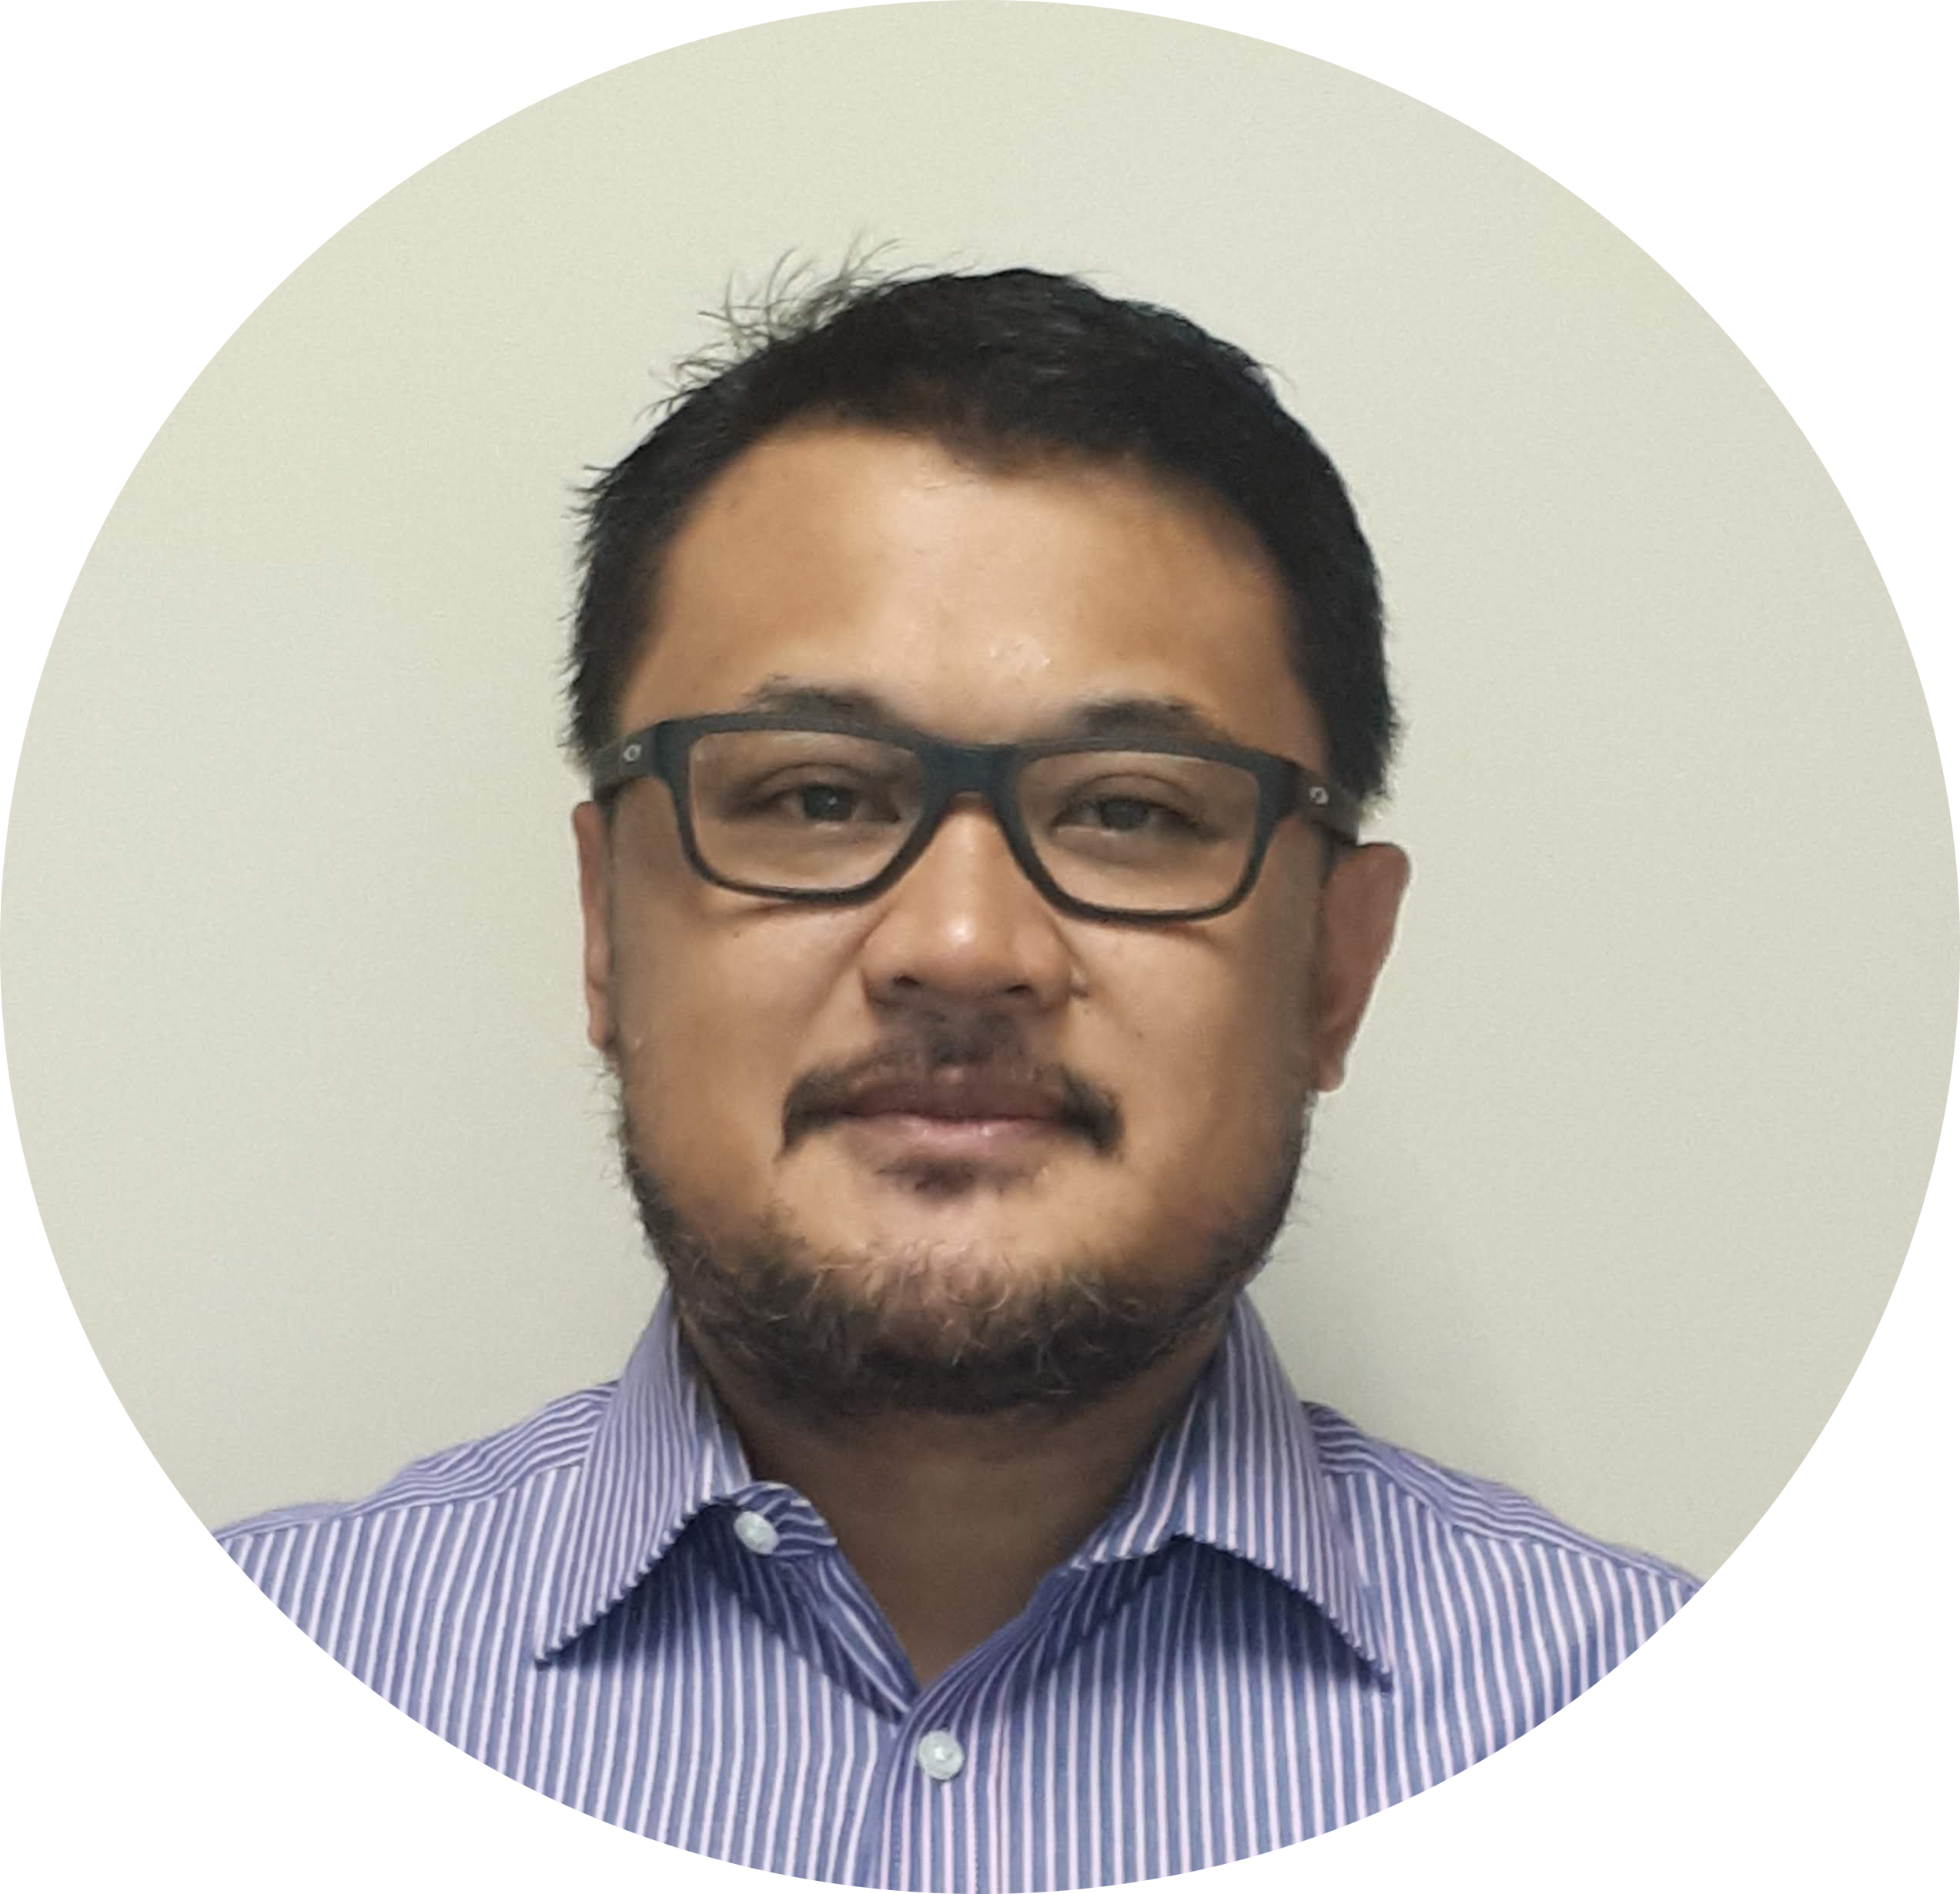
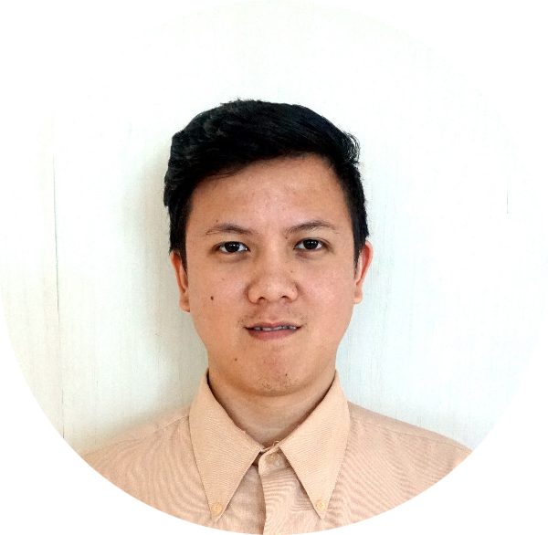
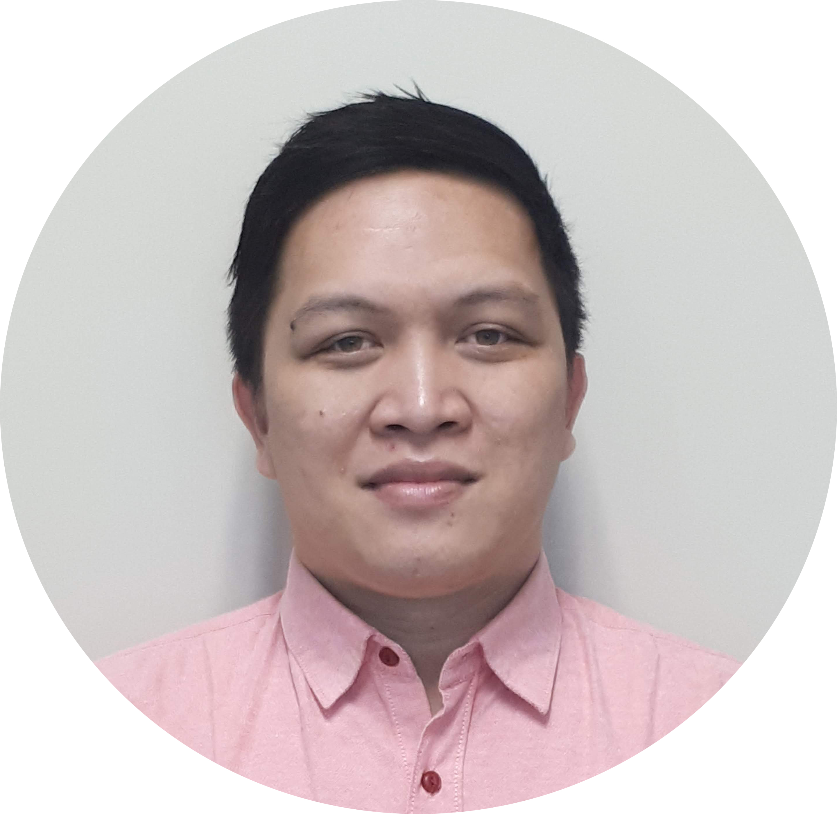
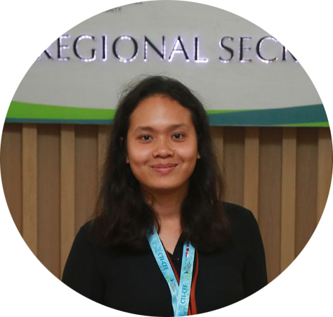
A. Hiring of new staff
Mr. Ivan Kiagoes
Finance and Operations Manager
Mr. William Tumimomor
Operations Assistant
Ms. Rumanti Wasturini
Assistant Manager for Publication
Mr. Solomon Sundah
IT Officer

Slide 33
B. Securing Financial Performance
Moved from cash basis to accrual basis accounting for more useful business analysis, easy planning and to make periodic financial statements
Implements new accounting software, XERO, Provide the current and real-time CTI-CFF financial positions to all stakeholders: Expenditures/Budget Utilization, Balance Sheet, Profit and Loss

Slide 34
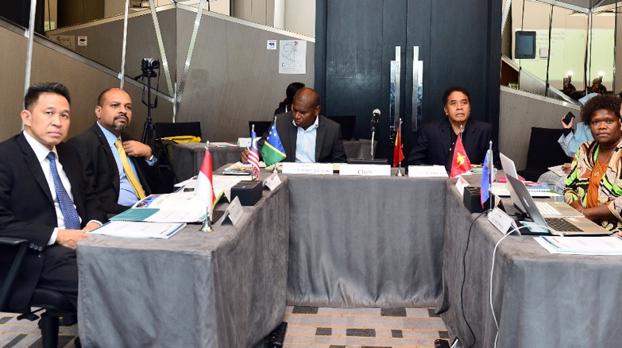
C. Selection of Executive Director (ED) and Deputy Executive Director for Corporate Services (DED CS) for CTI-CFF Regional Secretariat
The Regional Secretariat facilitated and coordinated the selection and recruitment of the new ED and DED CS
The members of the Appointment Committee are Mr. Aryo Hanggono (Indonesia), Dr. K. Nagulendran (Malaysia), Mr. Patesson Lusi (Solomon Islands) as Chair; Mr. Acacio Guterres (Timor Leste) and Ms. Yvonne Tio (Papua New Guinea). Ms. Armida Andres and Ms. Nilda Baling as alternate (Philippines) joined the meeting via Skype

Slide 35
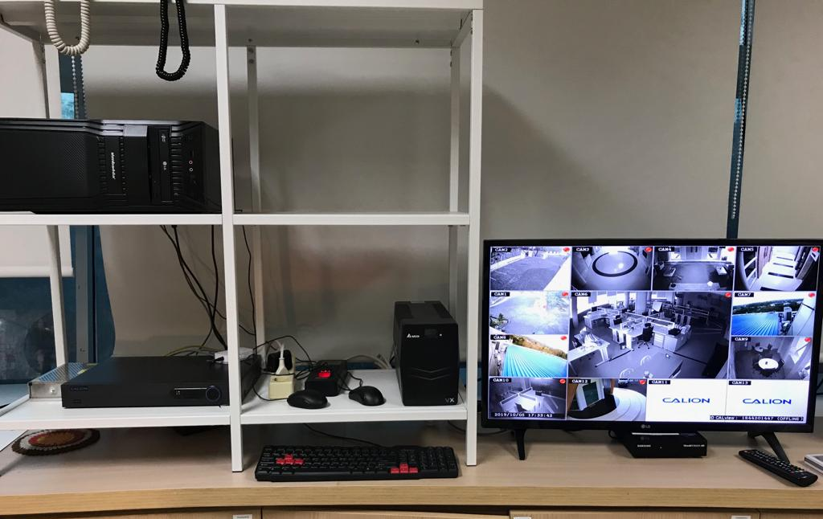
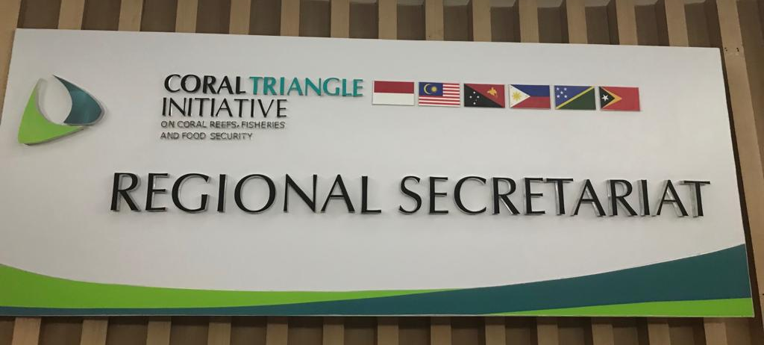
C. Improving Security and Visibility
Improved the infrastructure by securing CCTV on the grounds and premises of the Regional Secretariat.
Also, to enhance visibility, signages were placed outside the building as well as official vehicle of the Secretariat.

Slide 36
D. Expanding partners
13 March 2019
Signed a Cooperation a Cooperation Agreement with PT Garuda Indonesia Manado on rendering flexibility services to CTI-CFF –arranged flight in all Garuda flight routes and other corporate privileges served by Garuda and its group as well as Sky Team

Slide 37
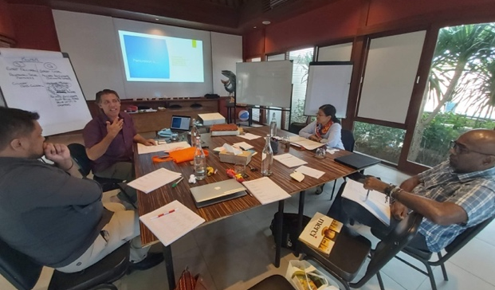
D. Capability Building
September 27, 2019
Key personnel of the CTI-CFF Regional Secretariat namely, Dr. Sharifah Nora Ibrahim, Deputy Executive Director for Program Services; Dr. Gregory Bennett, Senior Technical Program Manager; Mr. Ivan Kiagoes, Finance and Operations Manager; and Ms. Janet Rosalie Anne Polita underwent leadership training.
The training was made possible through the USAID RDMA, US DOI with CTC’s support.
E. Promoting Work-Life Balance
Zumba, a dance exercise is being conducted once a month at the lobby of the Regional Secretariat to promote healthy lifestyle and camaraderie among staff as well as employees working at the CTI Center in Manado, Indonesia.

Slide 38
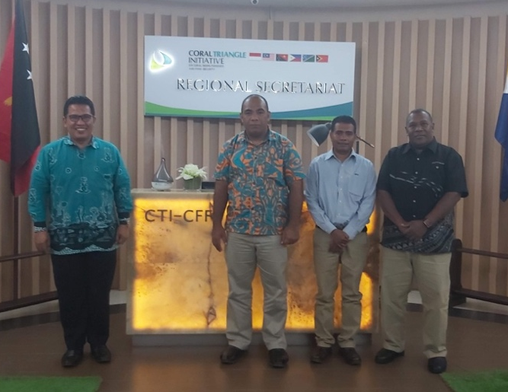
F. Visit of CSO Chair
October 7-9, 2019
The Chair of CTI-CFF CSO Dr. Melchior Mataki from Solomon Islands, the Vice-Chair of CSO represented by Mr. Horacio Guterres from Timor-Leste and IRC Chair Mr. Alick Misibini from Solomon Islands visited the CTI-CFF Regional Secretariat.
The visit was an opportunity to update the Excellencies about the current activities and discuss openly the concerns in the internal operations of the Regional Secretariat.

Slide 39
8
COMMUNICATION AND OUTREACH ACTIVITIES

Slide 40
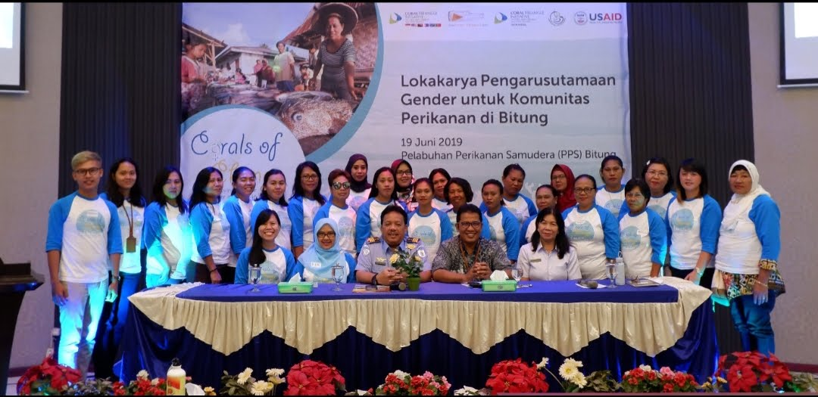
Coral Triangle Day Celebration
RS conducted an orientation-workshop for 20 women from the fishing community villages in Bitung City, North Sulawesi.
The activity raised awareness on gender equality as a step towards making them informed and involved in contributing to the livelihood of their family, community and economic development of Bitung.
The CTI-CFF Regional Secretariat in partnership with USAID Oceans, Oceanic Fishing Port Bitung and the Office of Bitung Marine and Fisheries Service

Slide 41
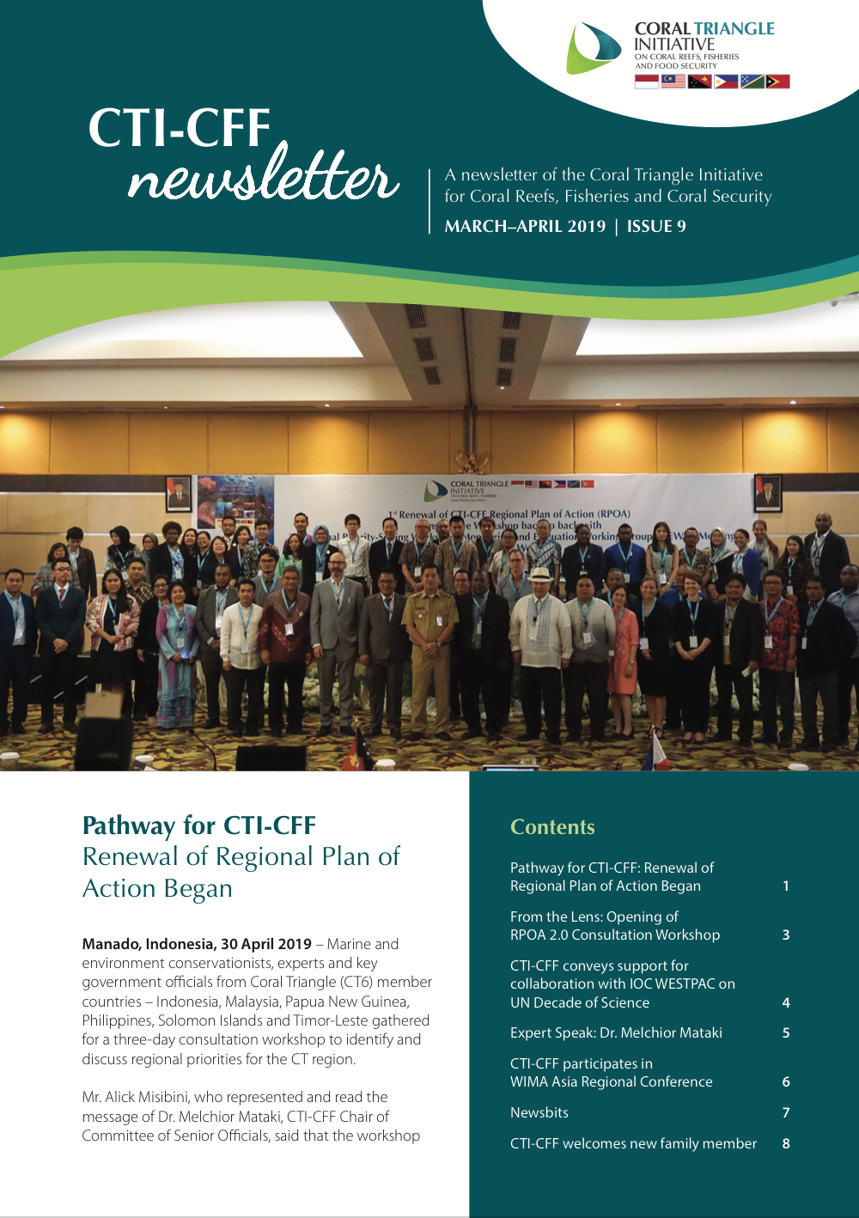
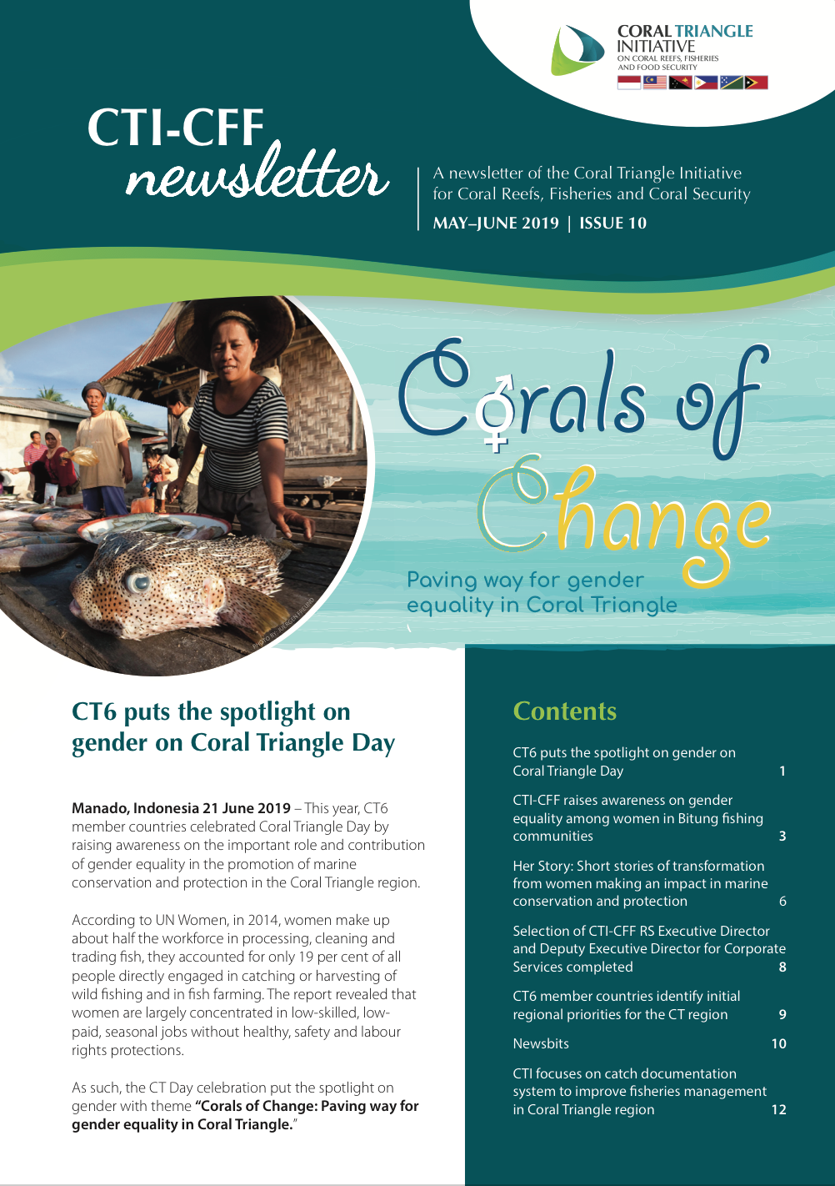
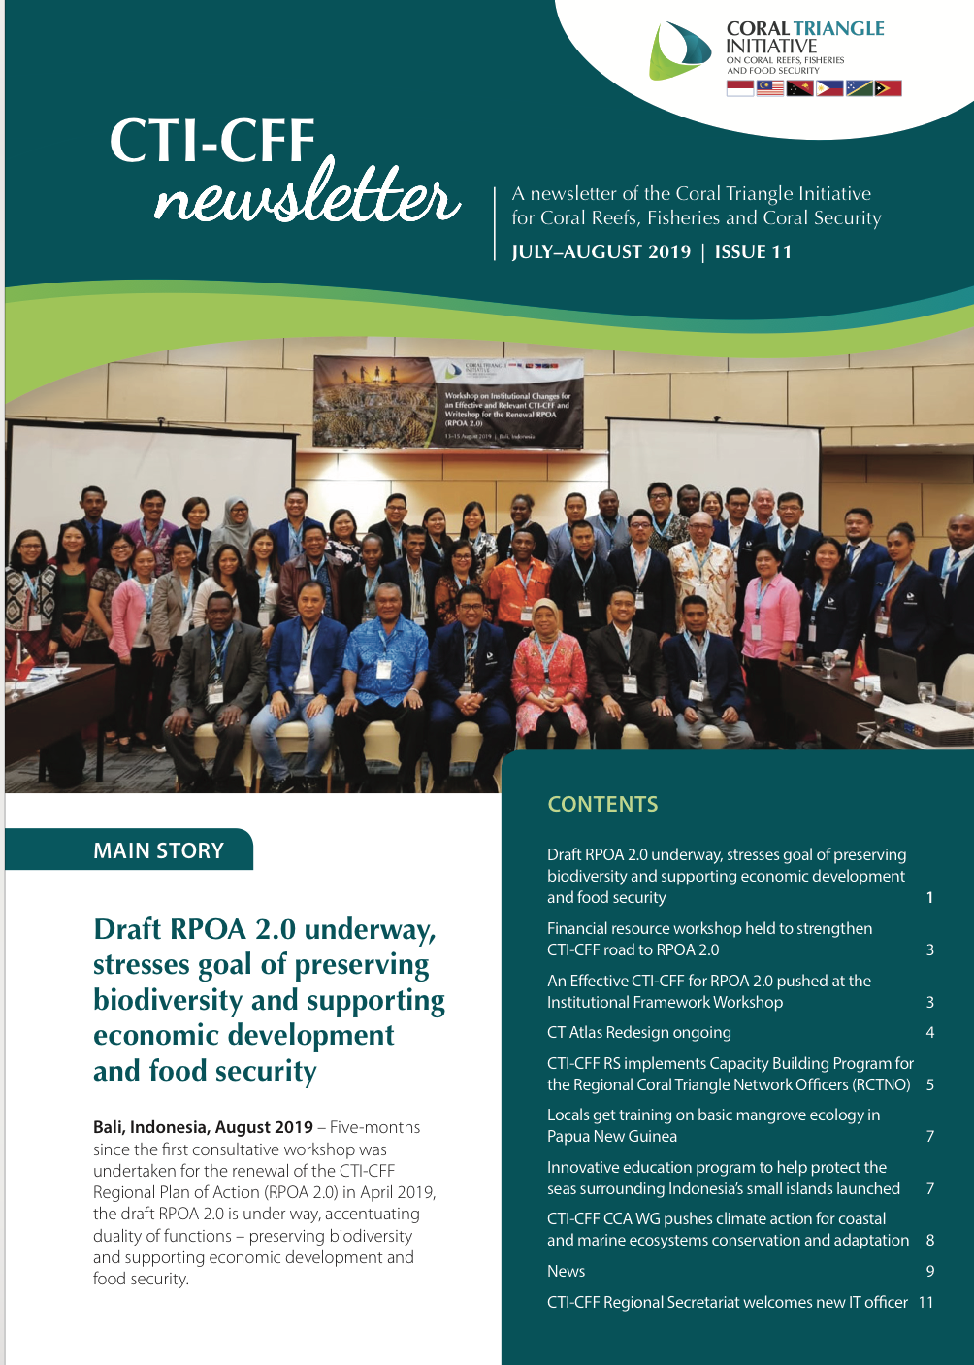
B. Bimonthly Production of CTI-CFF Newsletter

Slide 42
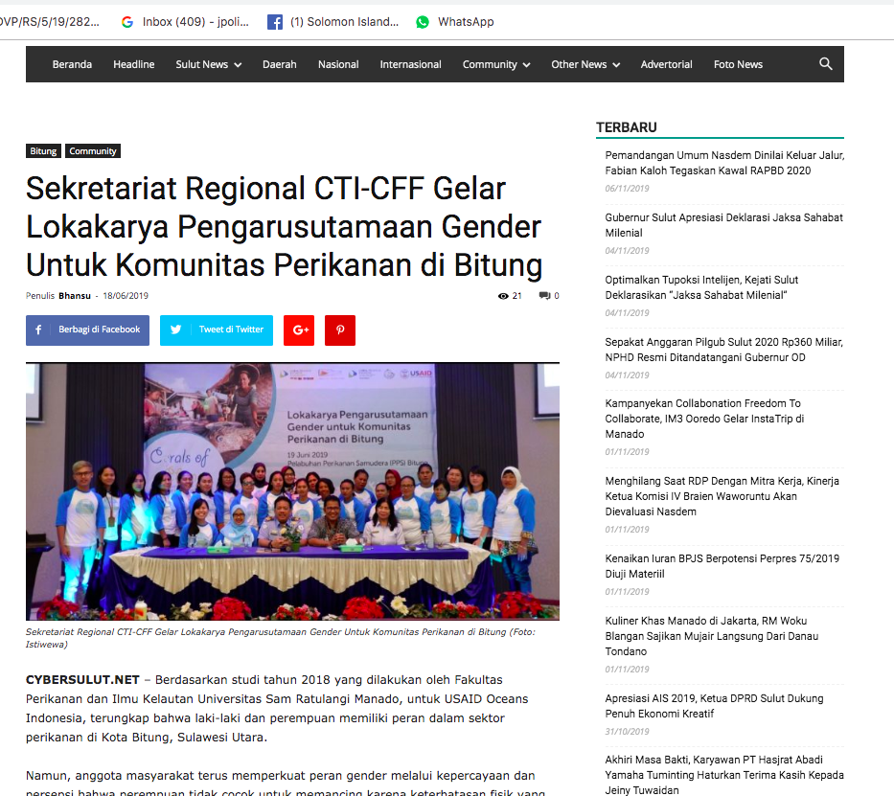
C. Preparation and dissemination of Press releases

Slide 43
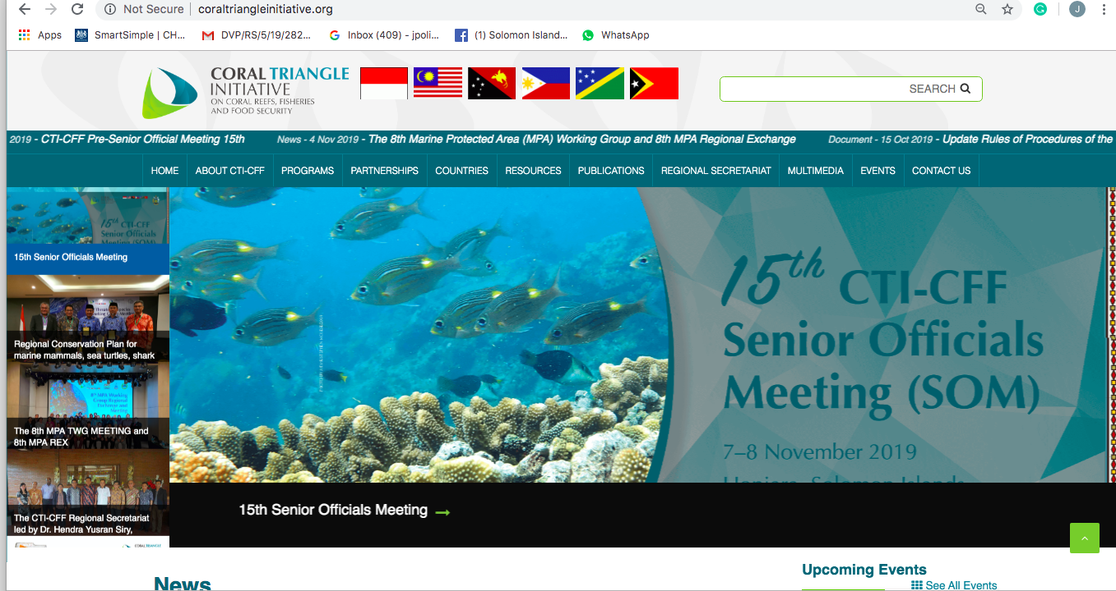
D. Maintenance of CTI Website and Social Media Platforms

Slide 44
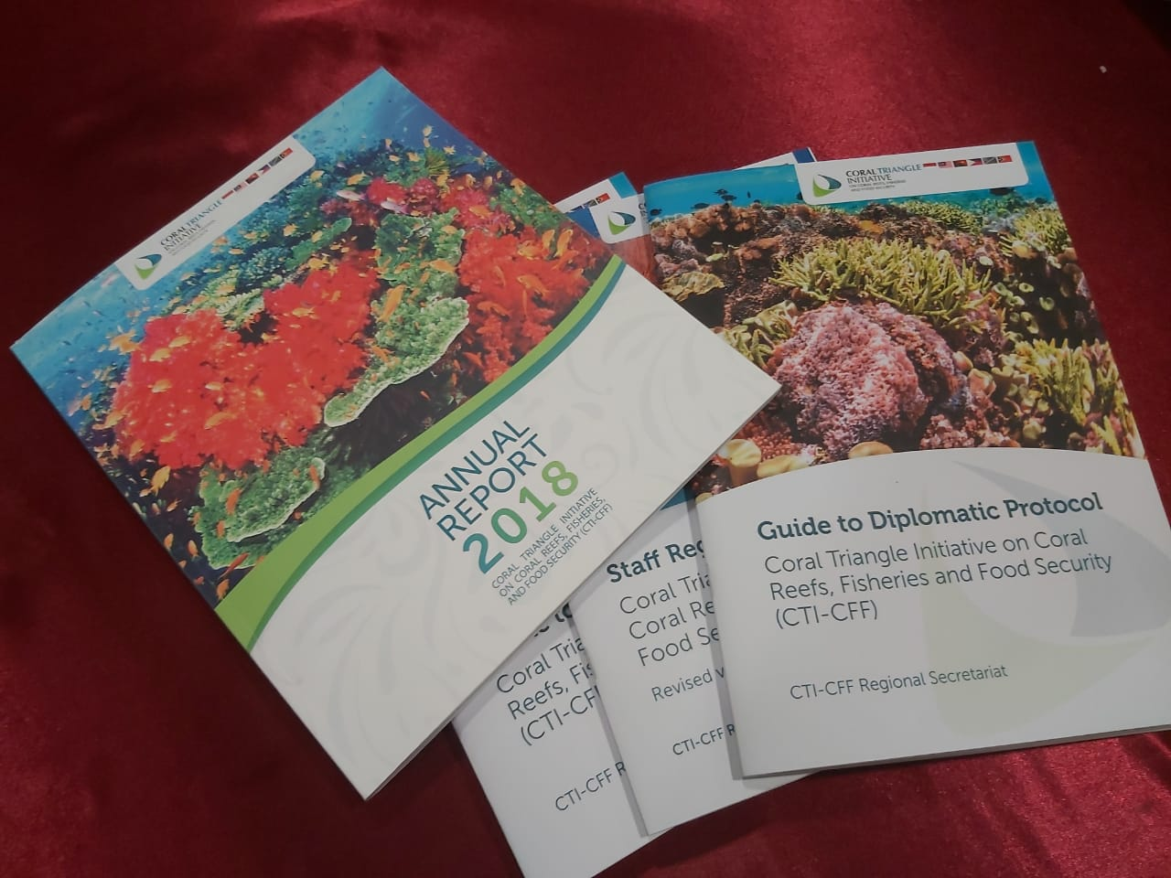
E. Production of IEC/Promotional Materials and Development of Infographics
Infographics: CTICFF Milestones

Slide 45
Infographics: Story of CTICFF

Slide 46
F. Participation in Exhibit
The CTI-CFF Regional Secretariat participated through and exhibition which featured information about CTI-CFF and its goals. The exhibition was also an opportunity to answer queries from the students on how they can do their part in raising awareness about marine and coastal conservation.
G. Communication Outreach
visited Sekolah Dian Harapan in Manado North Sulawesi, Indonesia and talked with and encouraged Grade 10 students to take part in the celebration of Coral Triangle Day on June 9 as well as marine protection advocacies such as beating plastic pollution.
Coordinated the participation of eight (8) British students age to be volunteers of the marine conservation activities in Manado, North Sulawesi, Indonesia.

Slide 47
9
UPCOMING ACTIVITIES November to December 2019

Slide 48
A. Regional Workshop on Data and Information Management (DIM)
December 3-5, 2019 | Bali, Indonesia,
Organizers: GEF IV- LEARN and PEMSEA
Objective: to foster inter-agency collaboration in sharing data and information and best practices on DIM especially in helping collecting data, provide good repository of knowledge as well as present state of the art tools that can guide and support data and information sharing on Large Marine Ecosystems (LME) as well as associated integrated coastal management (ICM) projects
Training on CT Atlas for CTI-CFF Regional Secretariat Key Personnel
December 2019 | WorldFish, Penang, Malaysia
The training is intended to further train the key staff of CTI-CFF Regional Secretariat handling the CT Atlas mainly, the IT Officer and Communication and Information Manager on the management of the CT Atlas.

Slide 49
10
SOM RECOMMENDATIONS

