Slide 2
Chair’s Report CY 2017 and 2018
Notes:
Good morning everyone, it is my honor to present to you the Chairmanship Report of the Philippines for calendar year 2017 and 2018.

Slide 3
Outline
Task from the 12th SOM and 6th MM
Actions taken
Activities hosted and/or supported
Support to Regional Secretariat
Coordination with CTI-Partners
Review of RPOA
Issues and Challenges
Recommendations and Opportunities
Notes:
The outline of the presentation is as follow:
Task from the 12th SOM and 6th MM
Actions taken
Activities hosted and/or supported
Support to Regional Secretariat
Coordination with CTI-Partners
Review of RPOA
Issues and Challenges
Recommendations and Opportunities

Slide 4
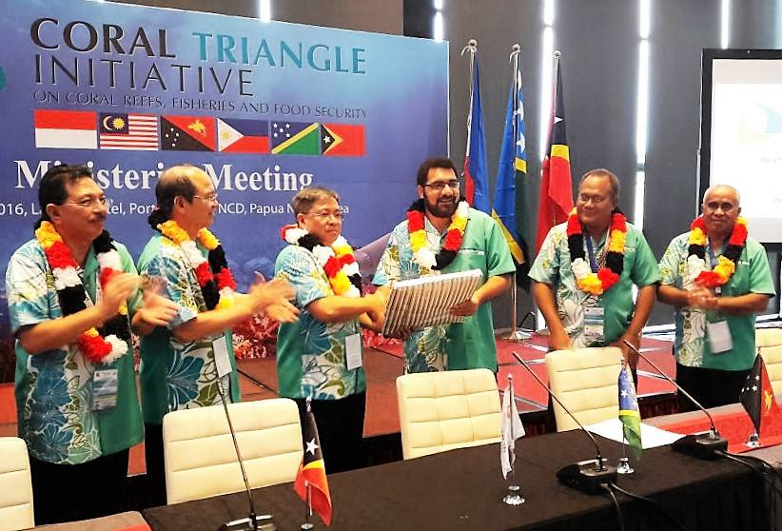
Handover of Chairship
November 2016
Port Moresby, Papua New Guinea
Notes:
During the 12th SOM and 6th Minister’s Meeting last November 2016 in Port Moresby, Papua New Guinea, the Chairmanship of the Council of Minister and Committee of Senior Officials of the CTI-CFF was transferred to the Philippines. It was Assistant Secretary Marcial Amaro Jr who received the Chairmanship, as representative of former Secretary Regina Lopez.

Slide 5
Task from the 12th SOM and 6th MM
Decision 7.3
“Regional Secretariat to work closely with Philippines… to formulate the 2017 budget taking into consideration the prioritization of activities /programs, including SOM-12 decisions that have financial implications to be included in the 2017 budget for CTI-COM endorsement; “
Decision 7.5
“Tasked the Regional Secretariat to work closely with Philippines … to review and revise criteria on the quantum from the respective CT6 Member Countries with regards to the country contribution. “
Notes:
During the 12th SOM and 6th MM, the Philippines as the incoming Chair of the Committee of Senior Officials an Council of Minister was tasked to formulate the 2017 budget taking into consideration the prioritization of activities /programs, including SOM-12 decisions that have financial implications to be included in the 2017 budget for CTI-COM endorsement.
Further, the Regional Secretariat was also tasked to work closely with Philippines as the next Chair of CTI-CSO and CTI-COM to review and revise criteria on the quantum from the respective CT6 Member Countries with regards to the country contribution.
Relative to those tasked, the Philippines immediately reviewed the financial documents

Slide 6
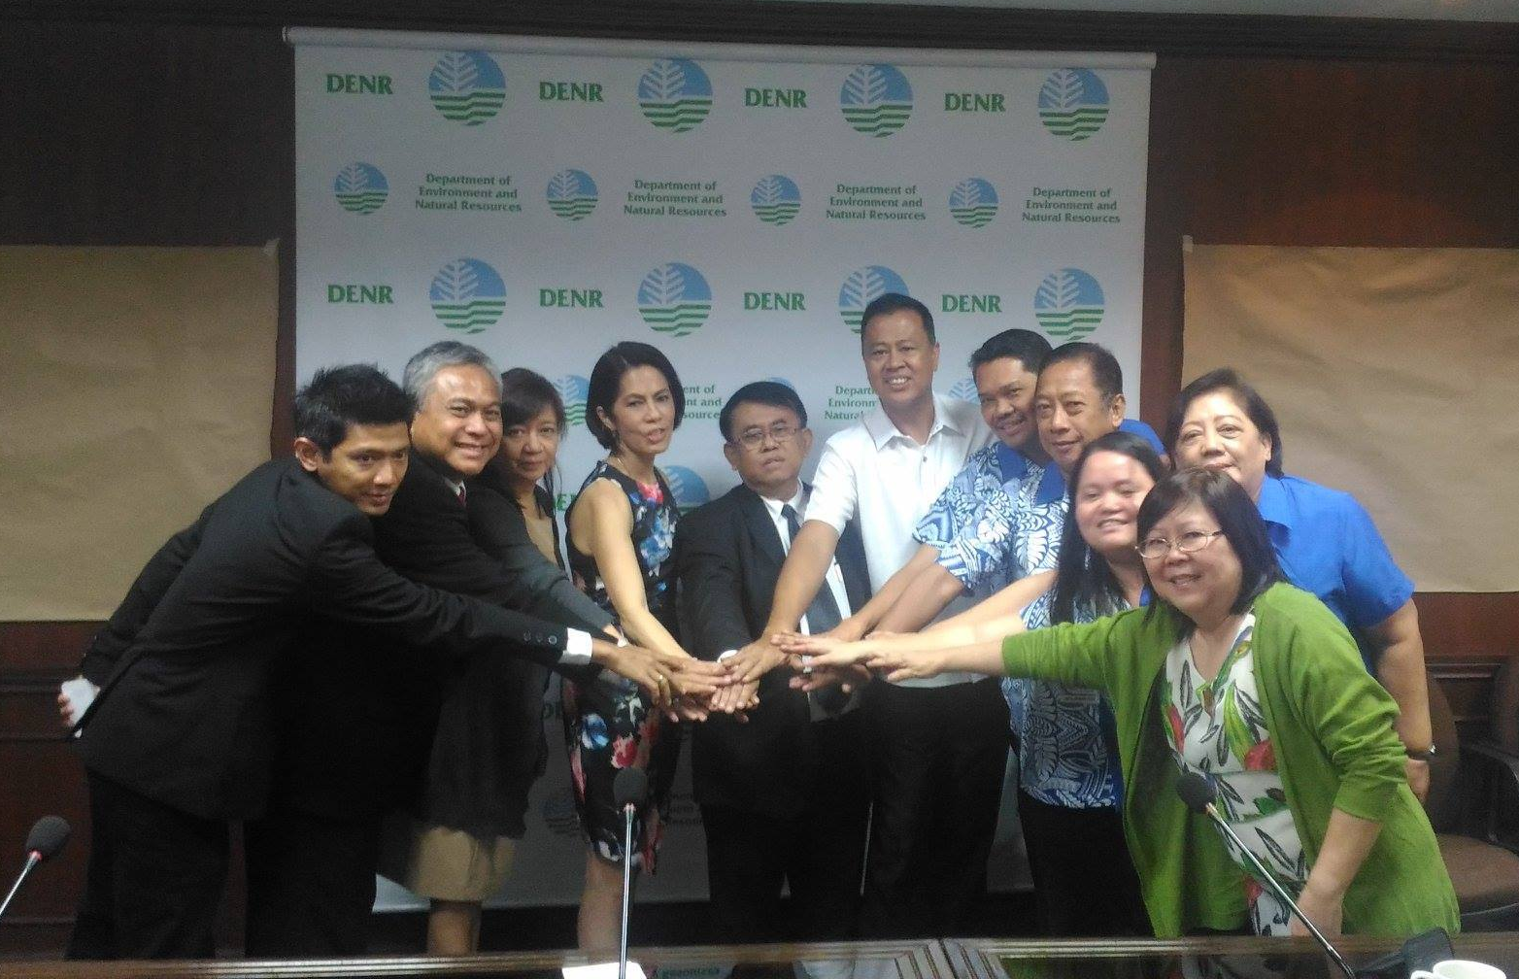
Actions taken
Several NCCC Meetings were conducted to review the financial documents and the proposed budget
Results
Matrix Summarizing the Major Audit Findings corresponding with the comments form the PH-NCCC
Deferment of the Proposed Budget for 2017
2. Courtesy Call of Regional Secretariat to DENR Secretary
Notes:
Relative to those tasked, the Philippines, through guidance of the CSO Chair and diligent effort of Director Angelito Fontanilla and the Philippine NCCC, immediately reviewed the financial documents and other documents related to the operations of the regional secretariat such as the Audit Report and Financial Statements.
Regional Secretariat conducted a courtesy call to the Chair of Council of Minister, Former Secretary Regina Lopez wherein the overview and background of CTI-CFF and the role of the CTI-COM Chairmanship were discussed as well as the updates from the Regional Secretariat and challenges in moving forward.
On January 5, 2017, the PH NCCC conducted a meeting wherein the 2015 Audit Report of the CTI-CFF Regional Secretariat and the Proposed Budget for 2017 were discussed. As a result, a matrix summarizing the major audit findings with the corresponding comments of the PH NCCC was made. Such matrix were sent to the Regional Secretariat in order for them to answer and justify the findings.
In addition to the matrix, the PH NCCC recommended to the CSO Chair to defer the Budget for 2017 of the Regional Secretariat.

Slide 7
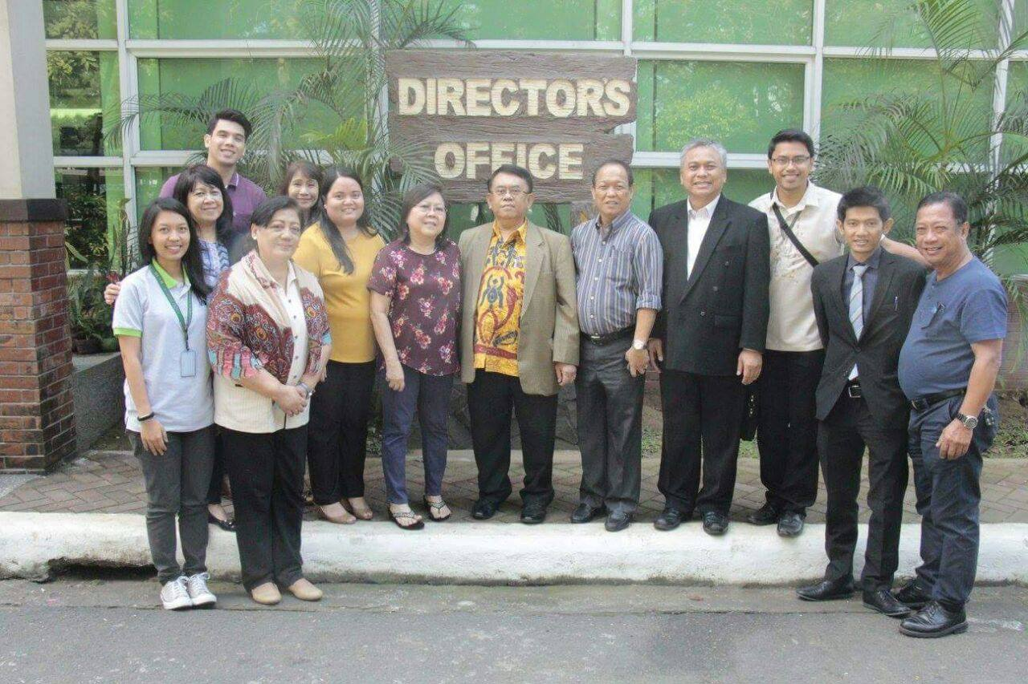
Actions taken
3. Regional Secretariat Meeting with the PH-NCCC
4. Regional Secretariat Meeting with DENR-BMB and Director Fontanilla
Notes:
Further, the Regional Secretariat to the Philippines, former Executive Director Pratikto and his staff attended the PH-NCCC Meeting. Another meeting was conducted to discuss the 2015 Audit Report was discussed. Among the results were the Regional Secretariat providing explanations, justifications and supporting documents to the comments on the audit and accepted the result of the evaluation and observations of the Philippines

Slide 8
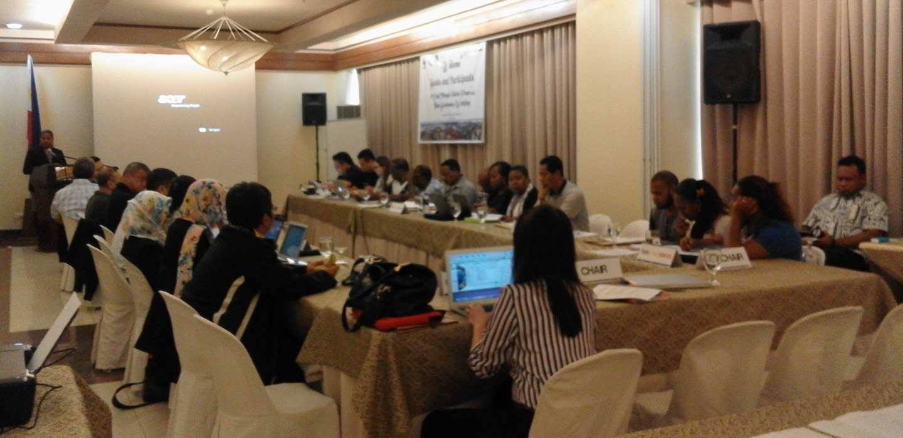
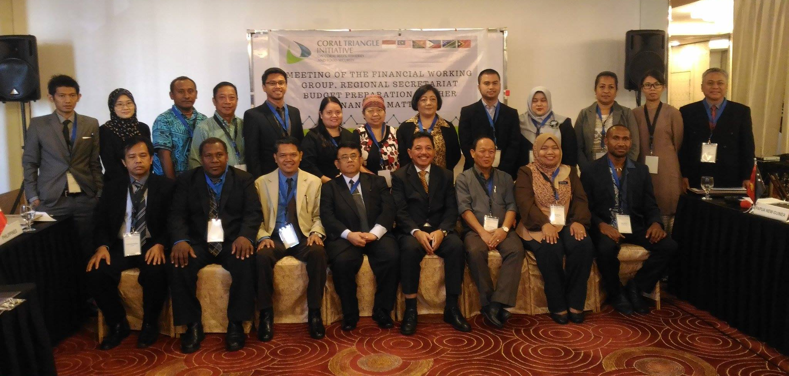
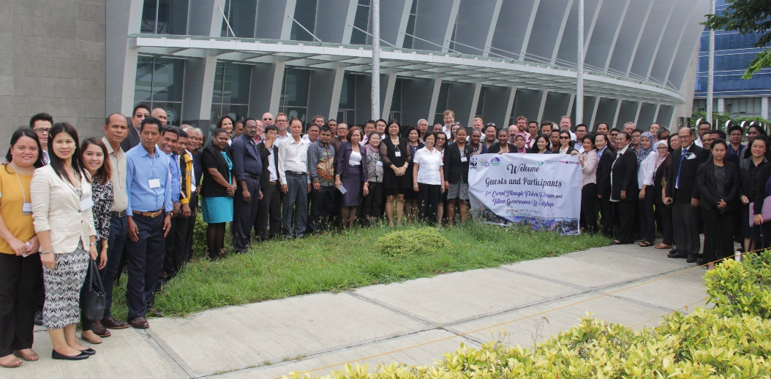
Meeting/Workshops Hosted and/or Supported
Tuna Governance Workshop
FRWG, Proposed Budget for 2017 and Other Financial Matters Meeting
3rd Fisher’s Forum
Notes:
Meetings and Workshops were also hosted by the Philippines under the leadership of the Chair.
On March 29-31, 2017, the Philippines supported the conduct of the FRWG, Proposed Budget for 2017 and Other Financial Matters Meeting in order to assist and guide the Regional Secretariat in improving their Financial Management System and come up with a Budget of CTI-CFF RS for 2017.
On July 4-7, 2017, the Philippines hosted the Fisher’s Forum back to back with Tuna Governance Workshop in Iloilo City. These are activities under the Ecosystems Approach to Fisheries Management (EAFM) Working Group

Slide 9
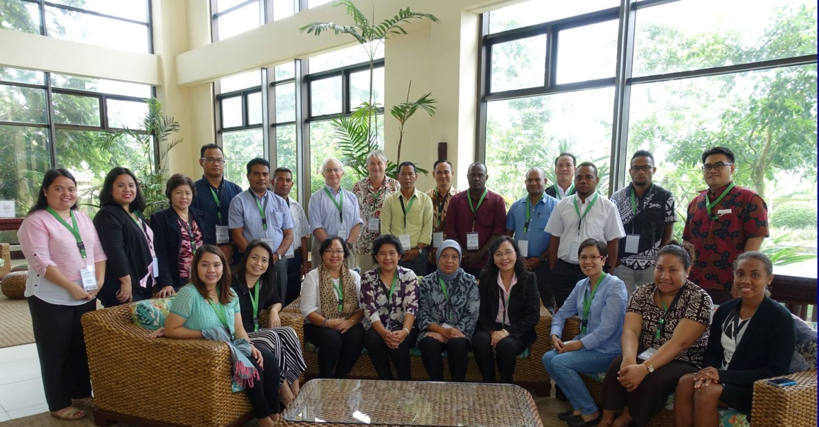
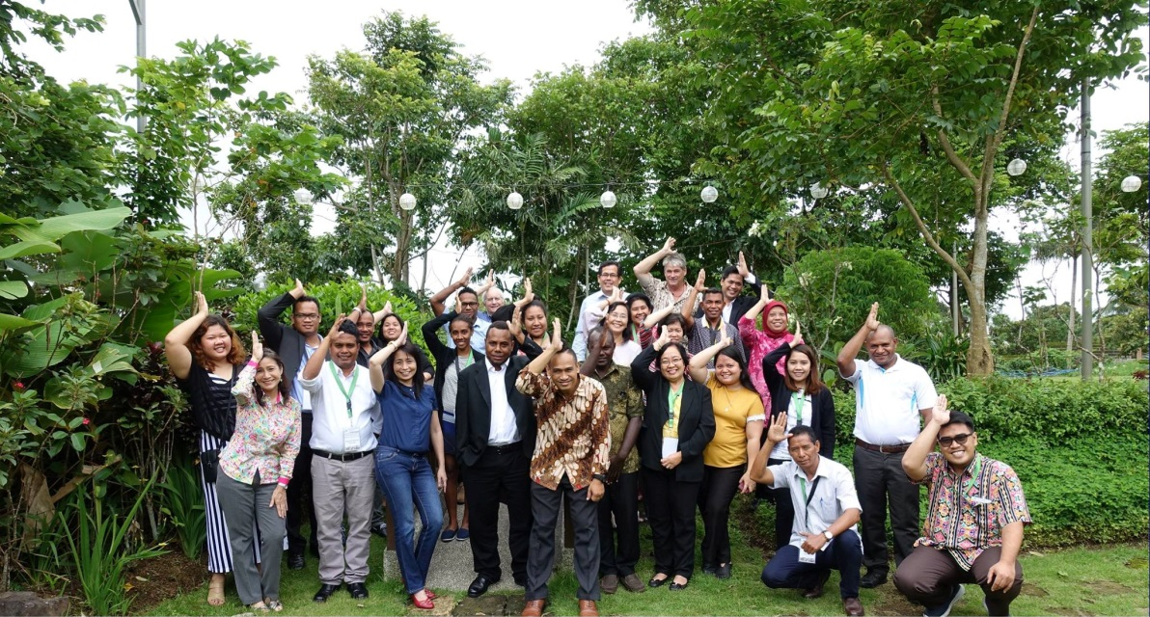
Activities Hosted and/or Supported
COASTFISH Workshop
6th EAFM Working Group Meeting
Notes:
On August 1-2, 2017, the Philippines hosted the COASTFISH Workshop and 6th EAFM Working Group Meeting in Tagaytay City under the activity of the EAFM Working Group as targeted in the Regional Plan of Action.

Slide 10
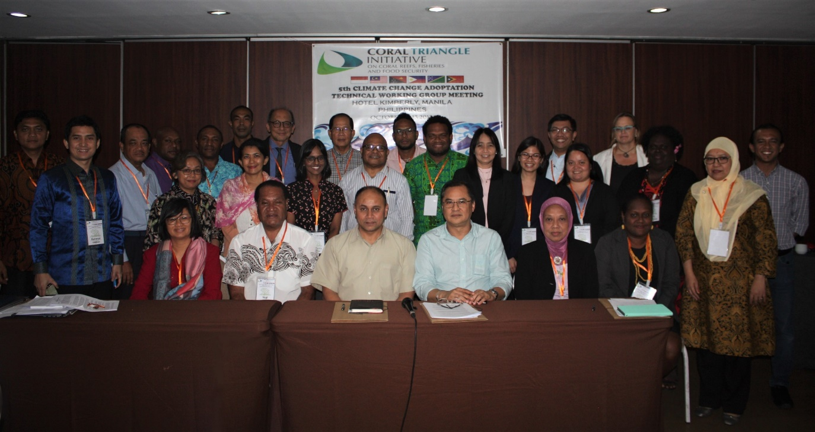
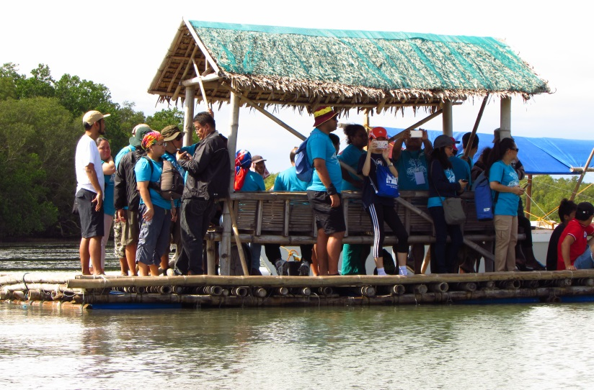
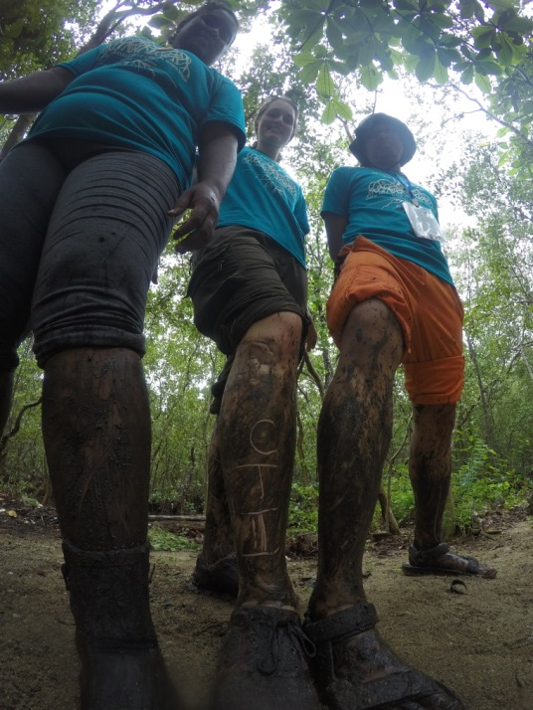
Activities Hosted and/or Supported
5th Climate Change Adaptation TWG Meeting
Blue Carbon Workshop
Notes:
On August 2017, the Philippines hosted the Coral Triangle Blue Carbon Workshop in Tagaytay City and Calatagan Batangas.
This workshop served as capacity building on the CT6 Countries when it comes to Blue Carbon. The participants visited Calatagan Batangas to showcase the said blue carbon ecosystems and the consultants demonstrated the how to measure blue carbon in mangrove ecosystem.
On October 12-13, 2017, the Philippines hosted the conduct of 5th Climate Change Adaptation TWG Meeting.
These activities are under the Climate Change Adaptation Technical Working Group.

Slide 11
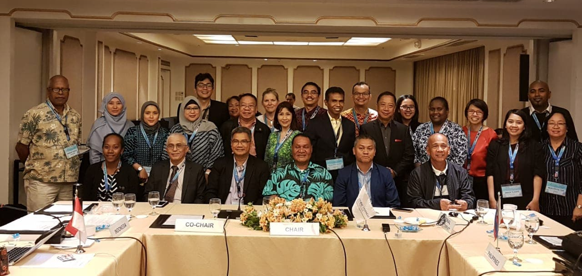
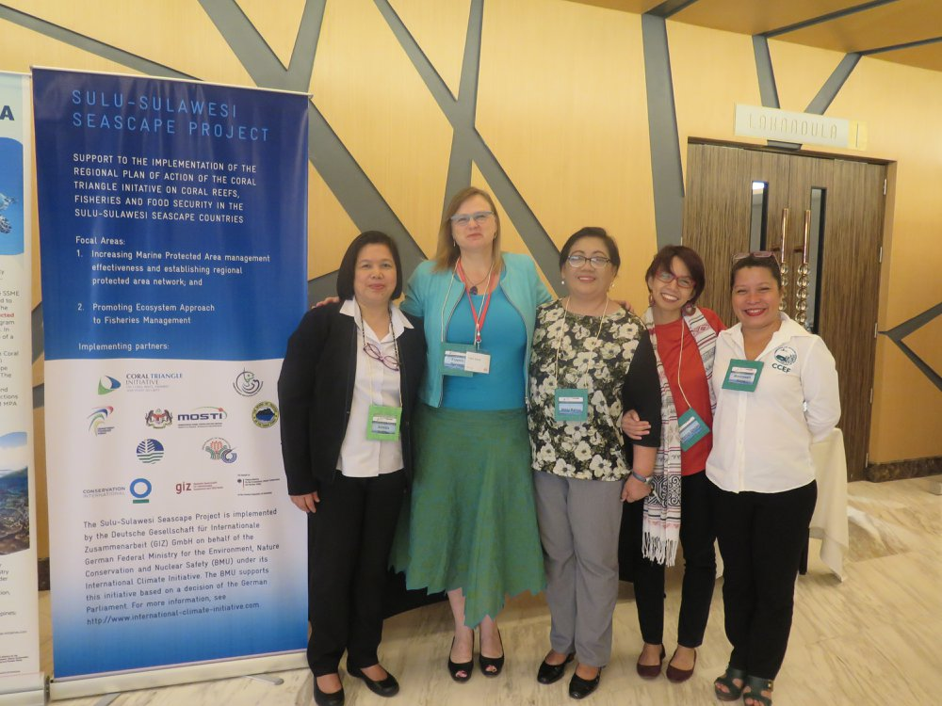
Activities Hosted and/or Supported
Hosted the 1st Threatened Species Working Group (TSWG) Regional Exchange and Meeting and TSWG Meeting on April 24-26, 2018 in Quezon City
Regional Sulu Sulawesi Convergence Meeting and Sulu Sulawesi Seascape (SSS) Ecosystems Approach to Fisheries Management (EAFM) Plan Review
Notes:
The 1st Threatened Species Working Group Regional Exchange and 2nd TSWG Meeting on April was also conducted on 24-26 April 2018.
Further, a Regional Sulu Sulawesi Convergence Meeting and Sulu Sulawesi Seascape (SSS) Ecosystems Approach to Fisheries Management (EAFM) Plan Review was also conducted on July 2 to 6, 2018 in Cebu City

Slide 12
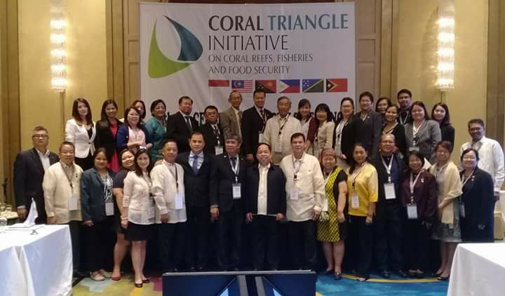
Activities Hosted and/or Supported
13th Senior Officials Meeting
2018 Special Senior Officials Meeting
Notes:
The Philippines hosted the 13th SOM. During this meeting, there were extensive discussions on the different Technical Working Groups, Governance Working Groups, Cross Cutting Themes and Financial Concerns of the CTI-CFF Regional Secretariat. Also, during this meeting, the Deputy Executive Director for Program Services was officially introduced to the CT6 Countries and partners.
Further, as the Chair of the Committee of Senior Officials, necessary steps was conducted in order to maintain accountability and transparency with the Regional Secretariat, CT6 Countries, and Development Partners specially on the financial management system.
A Special SOM was also convened last July 2018 in order to address the concerns of the Regional Secretariat and to facilitate the approval of the budget for 2018.

Slide 13
Support to the CTI-CFF Regional Secretariat
1. Constant communication with the RS through Skype, emails, messenger, WhatsApp and in person during meeting;
2. Continued guidance on several decision-making processes;
3. Conducted oversight function and provided guidance and directions during the transition;
4. Appointed the Deputy Executive Director for Program Services as the Acting ED;
5. Facilitated the process of hiring External Auditor to conduct the regular audit for 2017 and special audit; and
6. Addressed the concerns of the RS’ staff regarding their Holiday Pay and other benefits
7. Appointed Dr. Hendra Yusran Siry as the Interim Executive Director.
Notes:
The Chair also supported the operations of the CTI-CFF Regional Secretariat in which the following were provided:

Slide 14
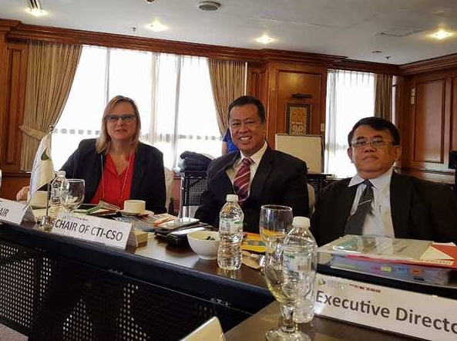
Coordination with CTI Partners
Partner’s Meeting (May 2017)
2. Dialogue with Partners during the 13th SOM
3. Skype calls with the representative of CTI-CFF Development Partners
4. Participation of Partners during discussions
in every meetings
Notes:
Coordination with the CTI Development Partners was also provided by the Chair including:
1. Partner’s Meeting held last May 22-23, 2017 in Pasig City;
2. A Dialogue with Partners during the 13th SOM;
3. Skype calls with the representative of CTI-CFF Development Partners; and
4. Encouraged the Participation of Partners during discussions in every meetings

Slide 15
Review of the Regional Plan of Action
Philippines is the Monitoring and Evaluation Group Chair
The review was funded by the Development Partners
The TOR for the RPOA 2.0 was drafted
Notes:
As the current Chair of the Monitoring and Evaluation Working Group (MEWG), the review of the current Regional Plan of Action was also initiated with the support of Development Partners. From the drafting of the Terms of Reference of the Consultant up to the finalizing the report regarding the review, the Philippines as the Chair of MEWG provided guidance with the help of Deputy Executive Director Nora Ibrahim and the development partners. A team of Consultant lead by Dr. Lida Pet-Soede conducted the review.

Slide 16
Issues and Challenges
Participation during the call meetings of all member countries
Inadequate/insufficient financial support for regional activities
Sudden reorganization of the Regional Secretariat

Slide 17
Recommendations and Opportunities
CT6 to prioritize attendance and participation to call meeting to facilitate coordination
CT6 and Regional Secretariat to urge the partners to support the regional activities and other activities/targets of the RPOA
Regional Secretariat to look for additional partners
Regional Secretariat to hire competent and efficient staff that can multi-task
NCC’s and RS to support Solomon Islands as the incoming Chair of CSO and COM

Slide 18
Thank you!
Notes:
The Philippines would like to thank all of the Coral Triangle Countries, Development Partners and the Regional Secretariat for all the support and trust that you gave to the Philippines as the Chair of CTI CSO. We cannot do these accomplishments alone. All of these are the fruit of cooperation and hardwork of everybody. The Philippines is now looking forward for continued partnerships and cooperation towards achieving our Regional Plan of Action (RPOA) and the new RPOA version 2.0

