Slide 1
Chair Report CY 2017 and 2018
Notes:
Good morning everyone, it is my honor to present to you the Chairmanship Report of the Philippines for calendar year 2017 and 2018.

Slide 2
Outline
Task from the 12th SOM and 6th MM
Actions taken
Activities hosted and supported
Support to Regional Secretariat
Coordination with CTI-Partners
Review of RPOA
Country LevelInitiative
Notes:
The outline of the presentation is as follow:
Task from the 12th SOM and 6th MM
Actions taken
Activities hosted and supported
Support to Regional Secretariat
Coordination with CTI-Partners
Review of RPOA
CTI-CFF Roll Out
PH-NCCC Meetings

Slide 3
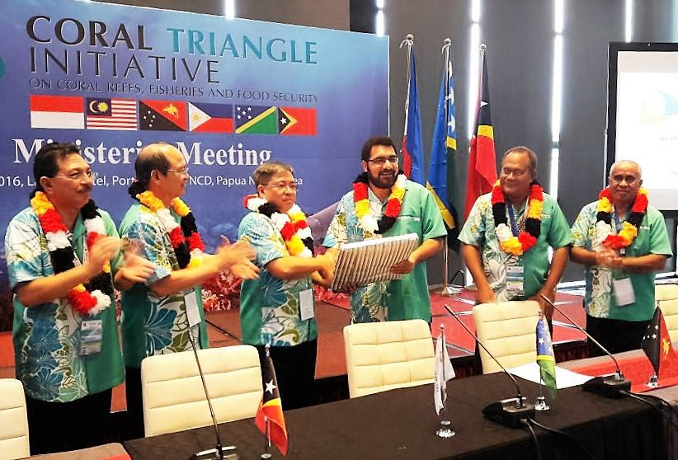
Handover of Chairship
November 2016
Port Moresby, Papua New Guinea
Notes:
During the 12th SOM and 6th Minister’s Meeting last November 2016 in Port Moresby, Papua New Guinea, the Chairmanship of the Council of Minister and Committee of Senior Officials of the CTI-CFF was transferred to the Philippines. It was Assistant Secretary Marcial Amaro Jr who received the Chairmanship, as representative of former Secretary Regina Lopez.

Slide 4
Task from the 12th SOM and 6th MM
Decision 7.3
“Tasked the Regional Secretariat to work closely with Philippines as the next Chair of CTI-CSO and CTI-COM to formulate the 2017 budget taking into consideration the prioritization of activities /programs, including SOM-12 decisions that have financial implications to be included in the 2017 budget for CTI-COM endorsement; “
Notes:
During the 12th SOM and 6th MM, the Philippines as the incoming Chair of the Committee of Senior Officials an Council of Minister was tasked to formulate the 2017 budget taking into consideration the prioritization of activities /programs, including SOM-12 decisions that have financial implications to be included in the 2017 budget for CTI-COM endorsement

Slide 5
Task from the 12th SOM and 6th MM
Decision 7.5
“Tasked the Regional Secretariat to work closely with Philippines as the next Chair of CTI-CSO and CTI-COM to review and revise criteria on the quantum from the respective CT6 Member Countries with regards to the country contribution. “
Notes:
Further, the Regional Secretariat was also tasked to work closely with Philippines as the next Chair of CTI-CSO and CTI-COM to review and revise criteria on the quantum from the respective CT6 Member Countries with regards to the country contribution.
Relative to those tasked, the Philippines through the leadership of Director Angelito Fontanilla and the Philippine NCCC immediately reviewed the financial documents

Slide 6
Actions taken
1. NCCC Meeting on January 5, 2017
Agenda
2015 Audit Report of CTI-CFF Regional Secretariat
Proposed Budget for 2017
Results
Matrix Summarizing the Major Audit Findings corresponding with the comments form the PH-NCCC
Deferment of the Proposed Budget for 2017
Notes:
Relative to those tasked, the Philippines, through the diligent effort of Director Angelito Fontanilla and the Philippine NCCC, immediately reviewed the financial documents and other documents related to the operations of the regional secretariat such as the Audit Report and Financial Statements.
On January 5, 2017, the PH NCCC conducted a meeting wherein the 2015 Audit Report of the CTI-CFF Regional Secretariat and the Proposed Budget for 2017 were discussed. As a result, a matrix summarizing the major audit findings with the corresponding comments of the PH NCCC was made. Such matrix were sent to the Regional Secretariat in order for them to answer and justify the findings.
In addition to the matrix, the PH NCCC recommended to the CSO Chair to defer the Budget for 2017 of the Regional Secretariat.

Slide 7
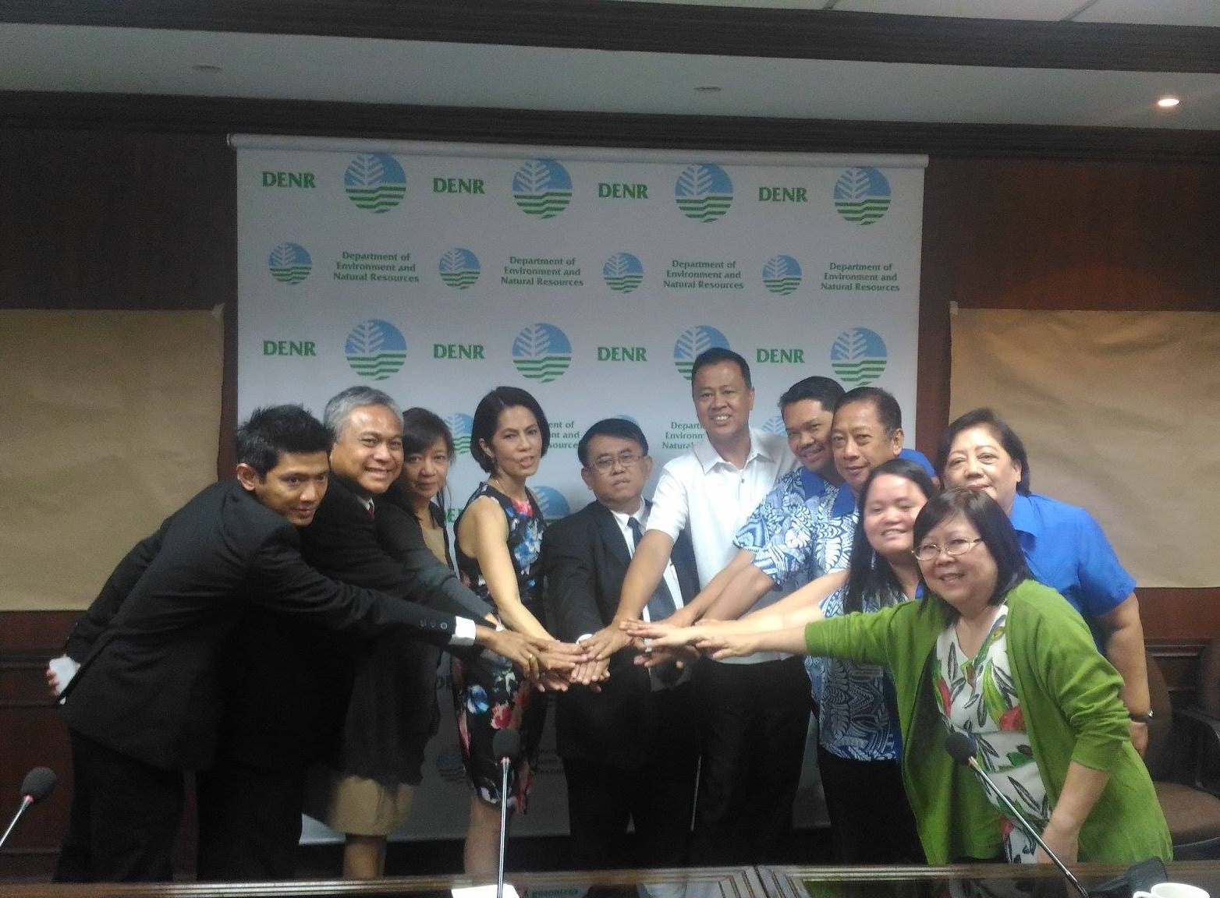
Actions taken
Courtesy Call of Regional Secretariat to DENR
Secretary on January 17, 2017
Agenda
The CTI-CFF At Glance
Role of CTI-COM Chairship
Update from the Regional Secretariat
Challenges Ahead
Notes:
On January 17, 2017, the Regional Secretariat conducted a courtesy call to the Chair of Council of Minister, Former Secretary Regina Lopez wherein the overview and background of CTI-CFF and the role of the CTI-COM Chairmanship were discussed as well as the updates from the Regional Secretariat and challenges in moving forward.

Slide 8
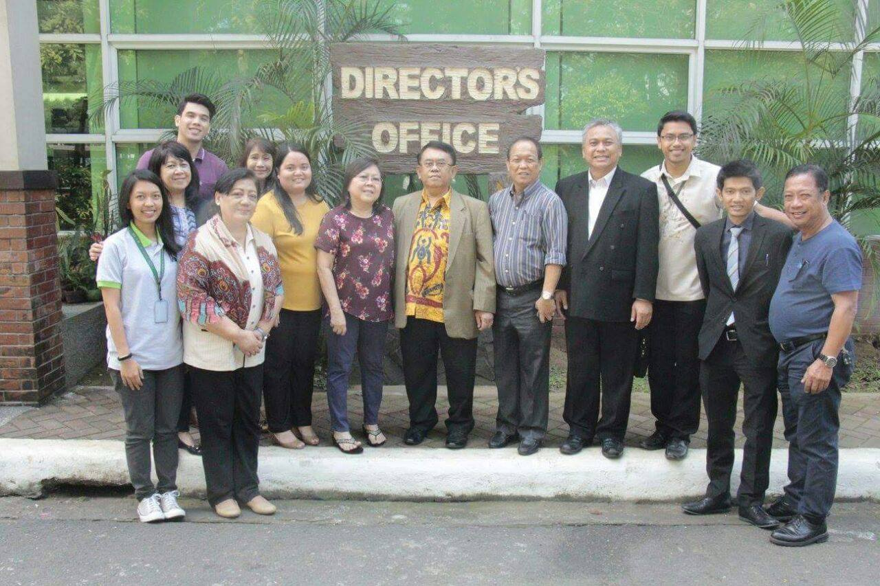
Actions taken
3. Regional Secretariat Meeting with the PH-NCCC
Agenda
Strengthening CTI-CFF Regional Secretariat
Strengthening National Coordination Committee (NCC) of CTI-CFF Member States
Engagement of Program Activities
Empowering TWG, GWG and Cross Cutting Themes
Supports of Development Partners
Need Supports from CSO and COM
Challenges
Notes:
In order to maximize the visit of the Regional Secretariat to the Philippines, former Executive Director Pratikto and his staff attended the PH-NCCC Meeting to strengthen the partnerships, the NCCC, the Technical Working Groups, the Governance Working Groups, the Cross Cutting Themes and solicit support from the Development Partners.

Slide 9
Actions taken
4. Regional Secretariat Meeting with DENR-BMB and Director Fontanilla (as the 12th SOM HOD) on January 19, 2017
Agenda:
2015 Audit Report of CTI-CFF Regional Secretariat
Result:
Regional Secretariat provided explanations, justifications and supporting documents to the comments on the audit
Regional Secretariat accepted the result of the audit
Notes:
On January 19, 2017, the Regional Secretariat team and the DENR-BMB as the Secretariat of the Philippine NCCC together with Director Fontanilla, as the HOD of the Philippines on the 12th SOM and 6th MM, conducted a meeting in compliance with the SOM and MM instructions.
In this meeting, the 2015 Audit Report was discussed. Among the results were the Regional Secretariat providing explanations, justifications and supporting documents to the comments on the audit and admitted the lapses and irregularities on the audit.

Slide 10
Actions taken
4. Regional Secretariat Meeting with DENR-BMB and Director Fontanilla (as the 12th SOM HOD) on January 19, 2017
Agreements
Regional Secretariat to find another external auditor
Regional Secretariat should coordinate closely with the CT6 in the process of selection for the new external auditor to conduct the audit for CY 2016
FRWG to convene a meeting immediately and discuss the result of the series of meetings regarding the audit findings and budget proposal for 2017 for CTI-CFF Regional Secretariat
Notes:
Further, it was agreed that Regional Secretariat shall find another external auditor, to coordinate closely with the CT6 in the process of selection for the new external auditor to conduct the audit for CY 2016 and for the FRWG to convene a meeting immediately and discuss the result of the series of meetings regarding the audit findings and budget proposal for 2017 for CTI-CFF Regional Secretariat

Slide 11
Meetings/Workshops
Hosted and Supported
Notes:
Meetings and Workshops were also hosted by the Philippines under the leadership of the Chair.

Slide 12
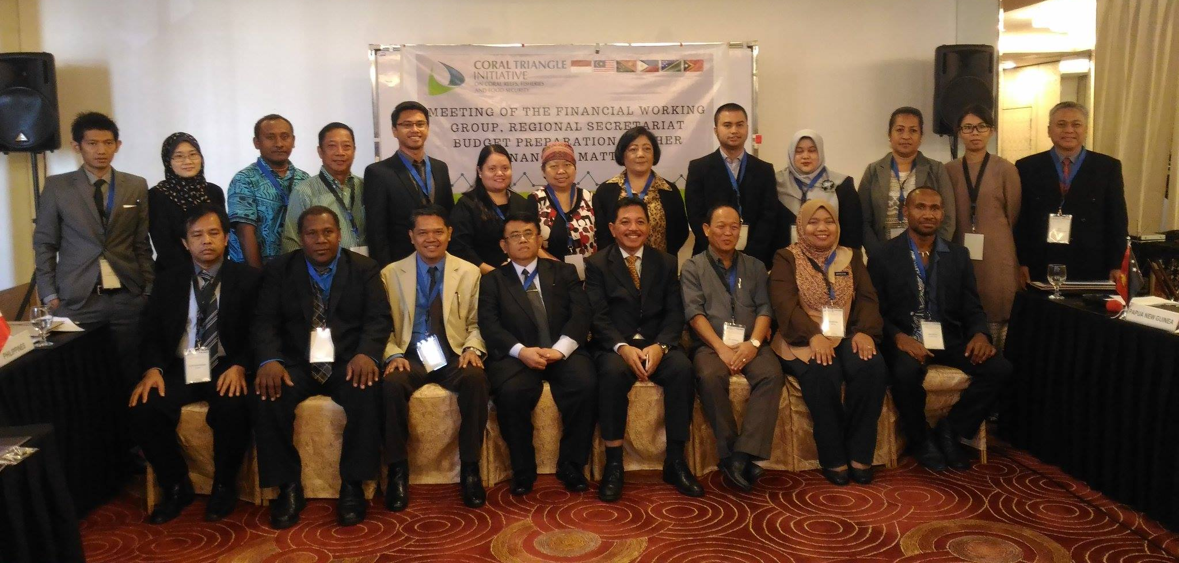
FRWG, Proposed Budget for 2017 and Other Financial Matters Meeting
Date: March 29-31, 2017
Venue: Pasig City
Notes:
On March 29-31, 2017, the Philippines supported the conduct of the FRWG, Proposed Budget for 2017 and Other Financial Matters Meeting. It was participated by the representatives of the CT6 and the Regional Secretariat. Prior to this meeting, it was emphasized that the representative of the CT6 should be knowledgeable on financial management in order to assist and guide the Regional Secretariat in improving their Financial Management System and come up with a Budget of CTI-CFF RS for 2017.
This meeting resulted to a blanket approval on the budget of the Regional Secretariat and agreed to review the existing policies of the Regional Secretariat such as the Financial Regulations and Staff Regulations.

Slide 13
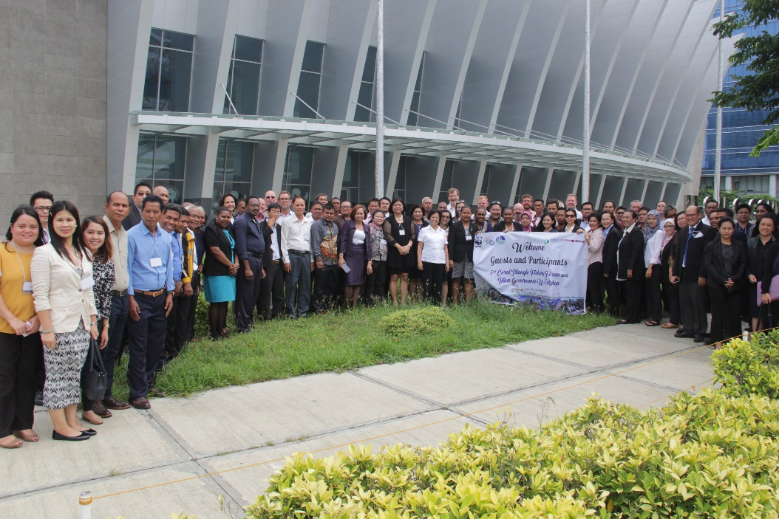
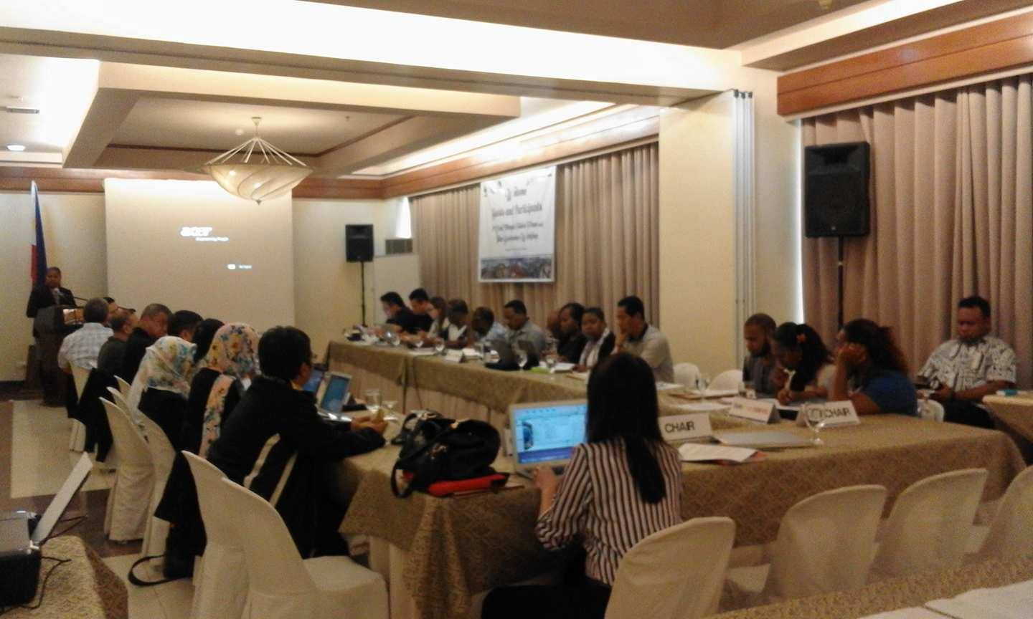
Fisher’s Forum back to back with Tuna Governance Workshop
Date: July 4-7, 2017
Venue: Iloilo City
Notes:
On July 4-7, 2017, the Philippines hosted the Fisher’s Forum back to back with Tuna Governance Workshop in Iloilo City. This activity was sponsored by the World Wildlife Fund for Nature (WWF) and was also supported by the Department of Agriculture-Bureau of Fisheries and Aquatic Resources (DA-BFAR), DENR-Biodiversity Management Bureau an DA-BFAR Region 6.

Slide 14
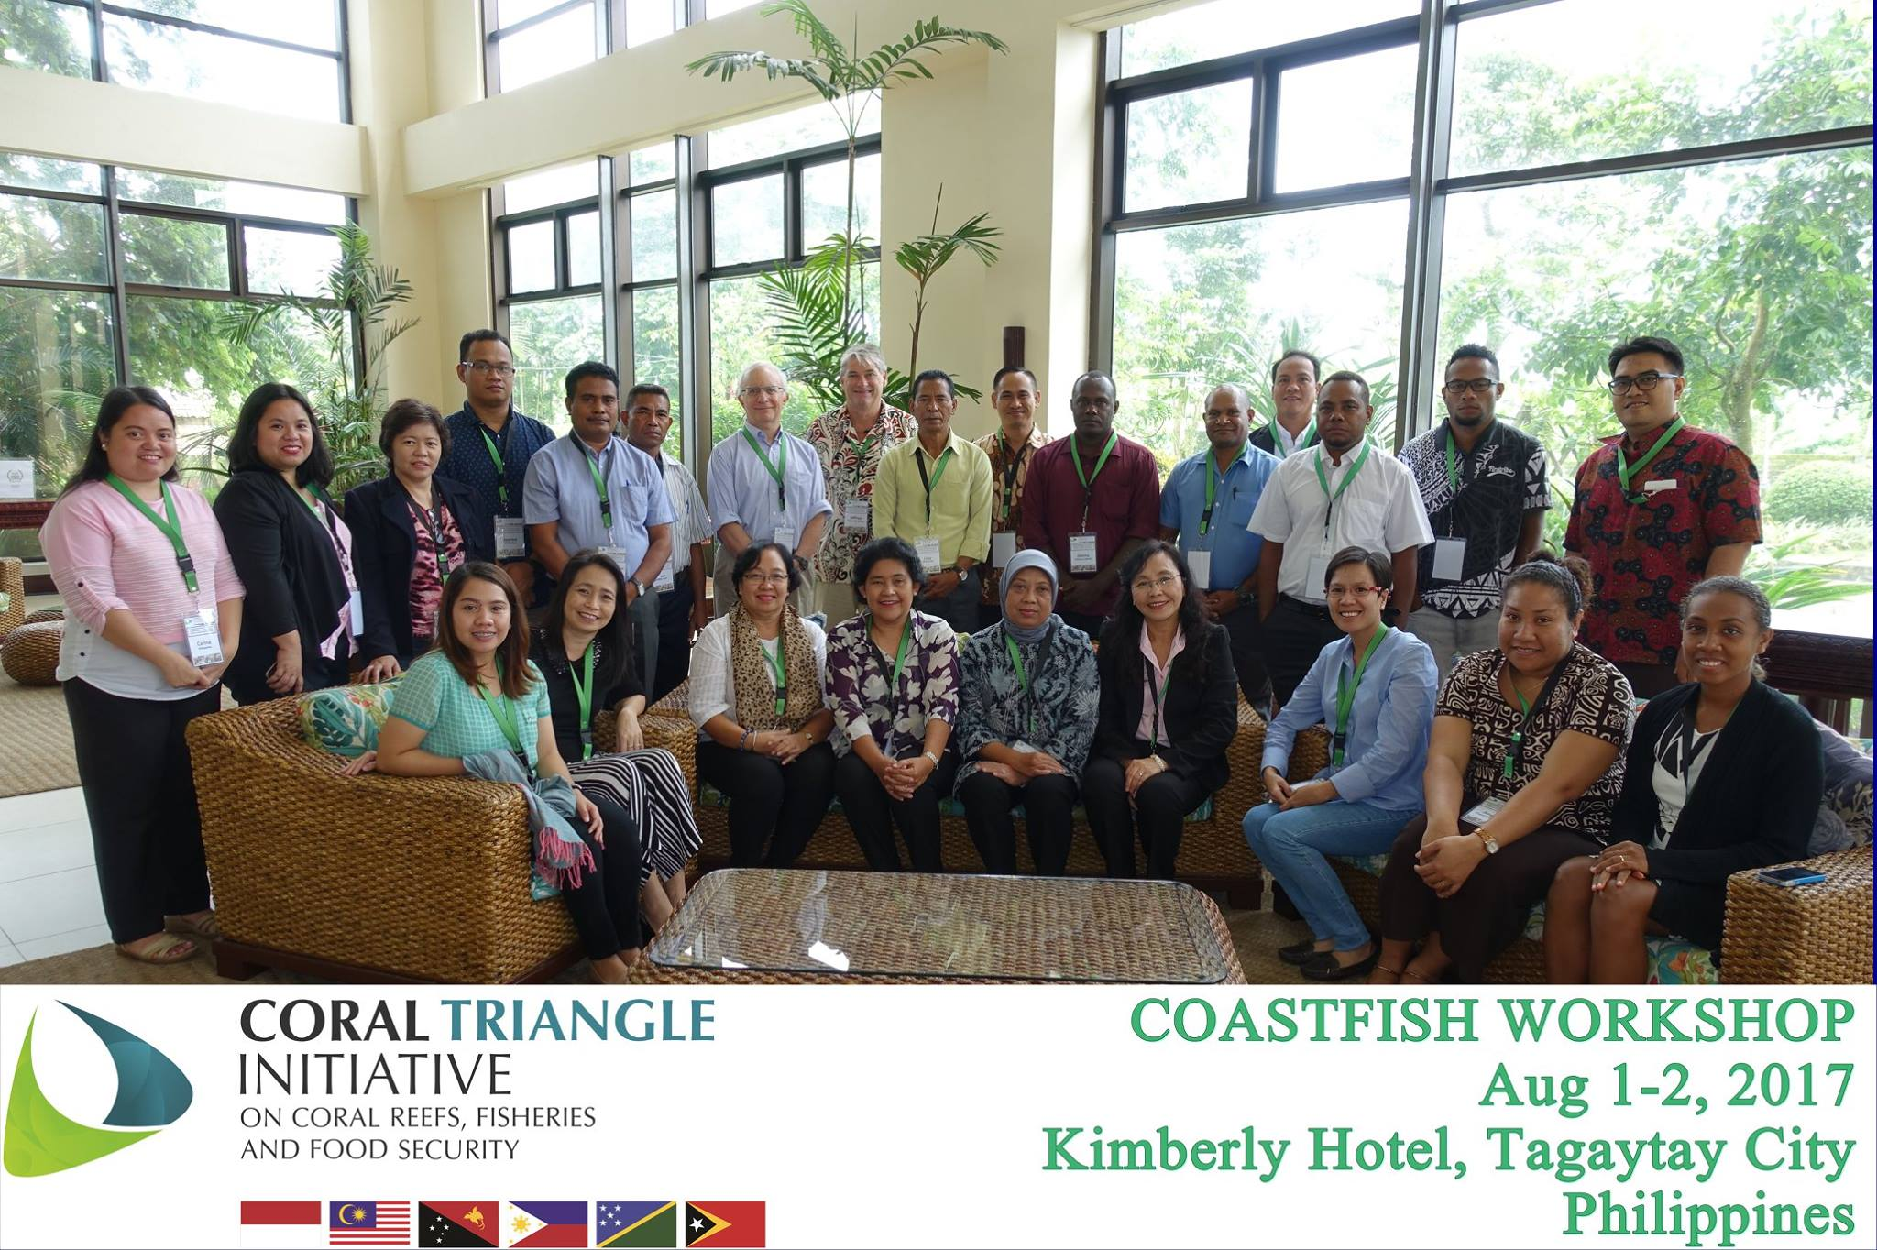
Notes:
On August 1-2, 2017, the Philippines hosted the COASTFISH Workshop in Tagaytay City. This workshop is an activity of the EAFM Working Group as targeted in the Regional Plan of Action

Slide 15
Notes:
In order to maximize the presence of the members of the EAFM Working Group Focal Persons and optimize the resources, the EAFM Working Group Meeting was conducted wherein the Roadmap for COASTFISH was developed by the working group

Slide 16
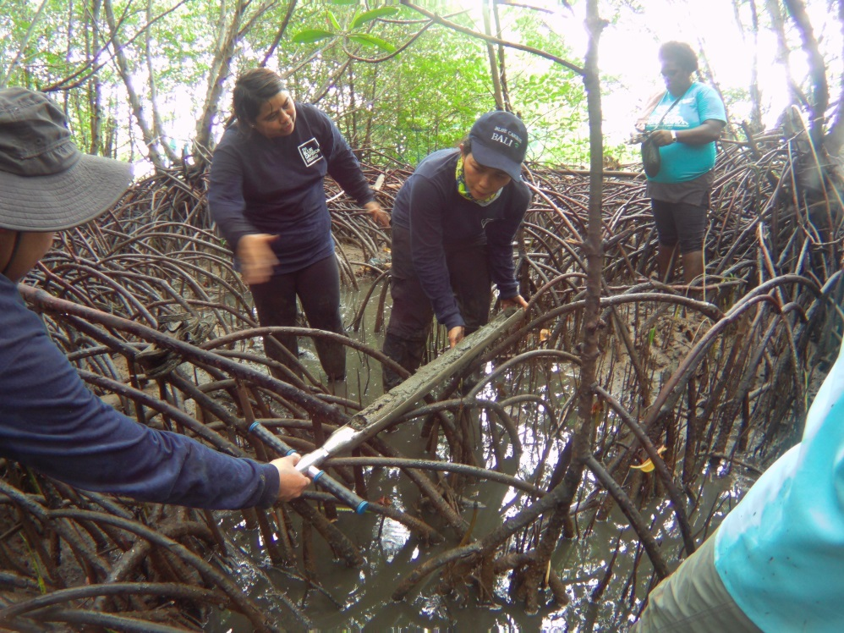
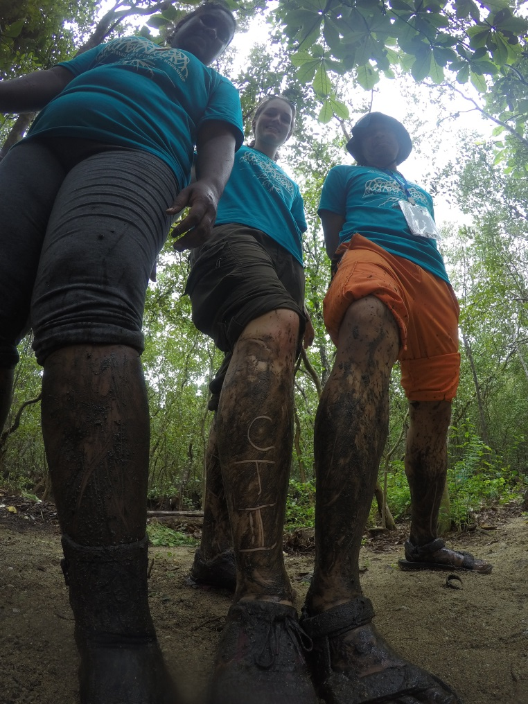
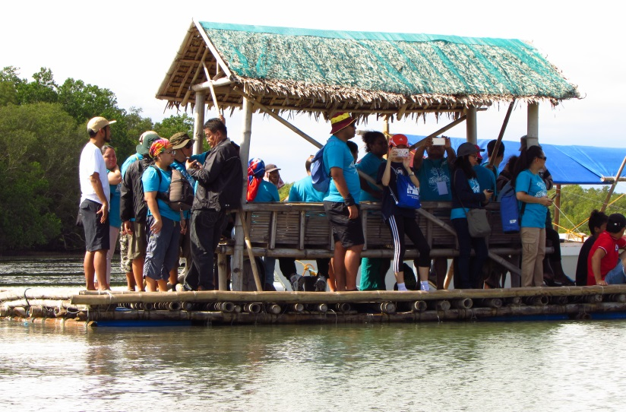
Blue Carbon Workshop
Date: August , 2017
Venue: Tagaytay City and Calatagan Batangas
Notes:
On August 2017, the Philippines hosted the Coral Triangle Blue Carbon Workshop in Tagaytay City and Calatagan Batangas. This workshop was sponsored by Australian Government in coordination with CI-Philippines. Further, the DENR-Biodiversity Management Bureau and Climate Change Commission co-sponsored the said activity.
This workshop served as capacity building on the CT6 Countries when it comes to Blue Carbon. Each CT6 Country conducted stock taking activity in order to assess the status of conservation of blue carbon ecosystems such as the mangrove ecosystem and sea grass beds. The participants visited Calatagan Batangas to showcase the said blue carbon ecosystems and the consultants demonstrated the how to measure blue carbon in mangrove ecosystem.

Slide 17
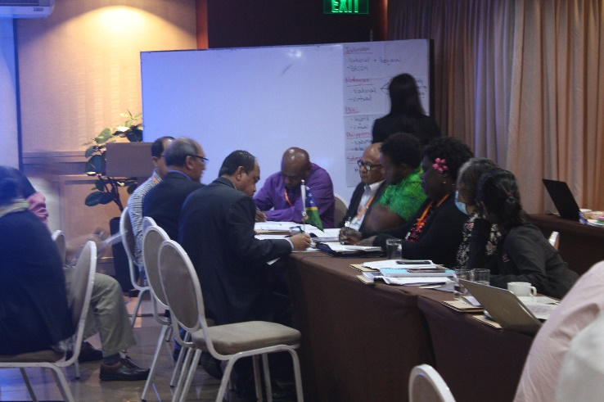
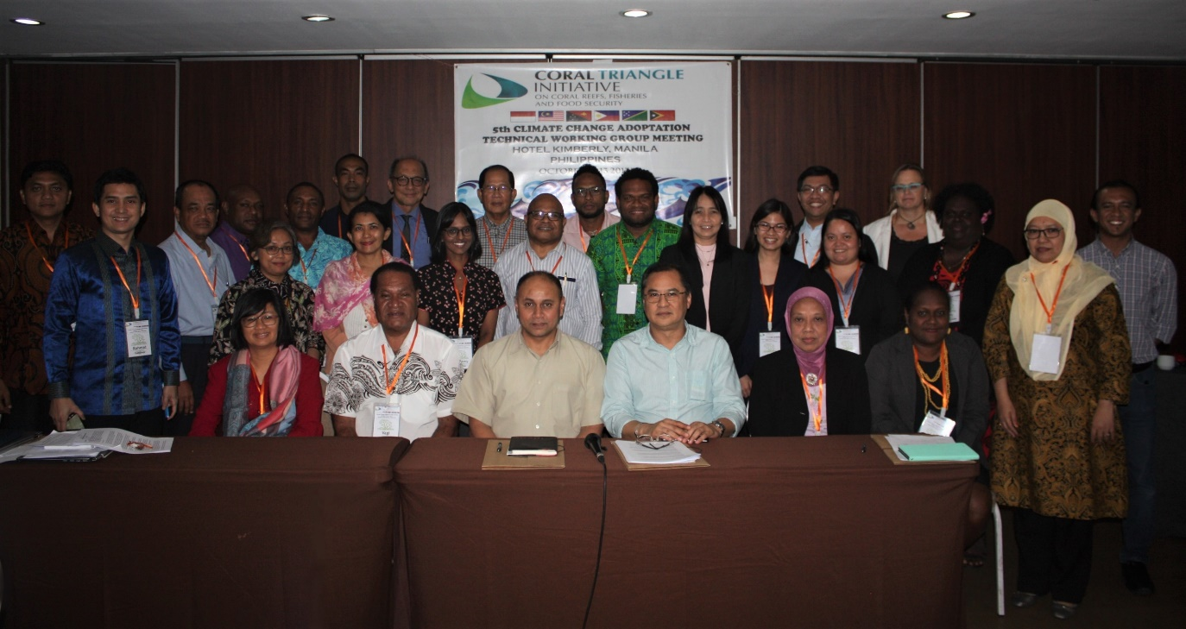
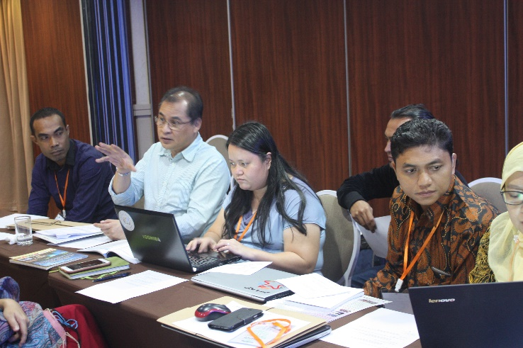
5th CCA-TWG Working Group Meeting
Date: October 12-13, 2017
Notes:
On October 12-13, 2017, the Philippines hosted the conduct of 5th Climate Change Adaptation TWG Meeting. During this meeting, the Blue Carbon Workplan for CTI CFF was finalized for endorsement on 13th SOM and the Terms of reference for the establishment of Centers of Excellence for CCA was drafted.

Slide 18
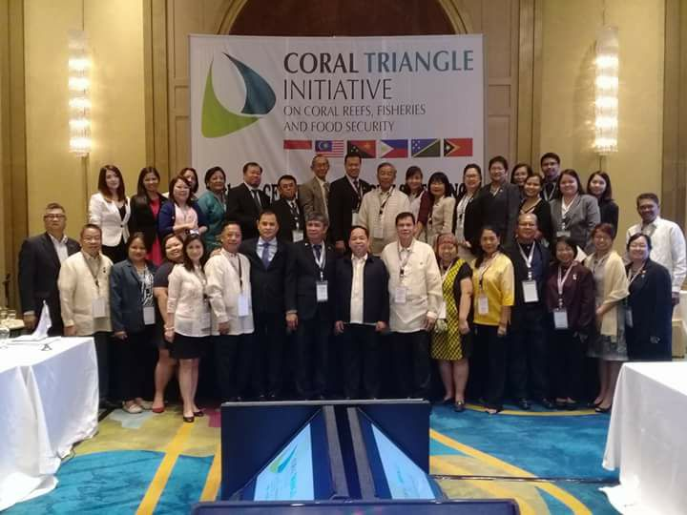
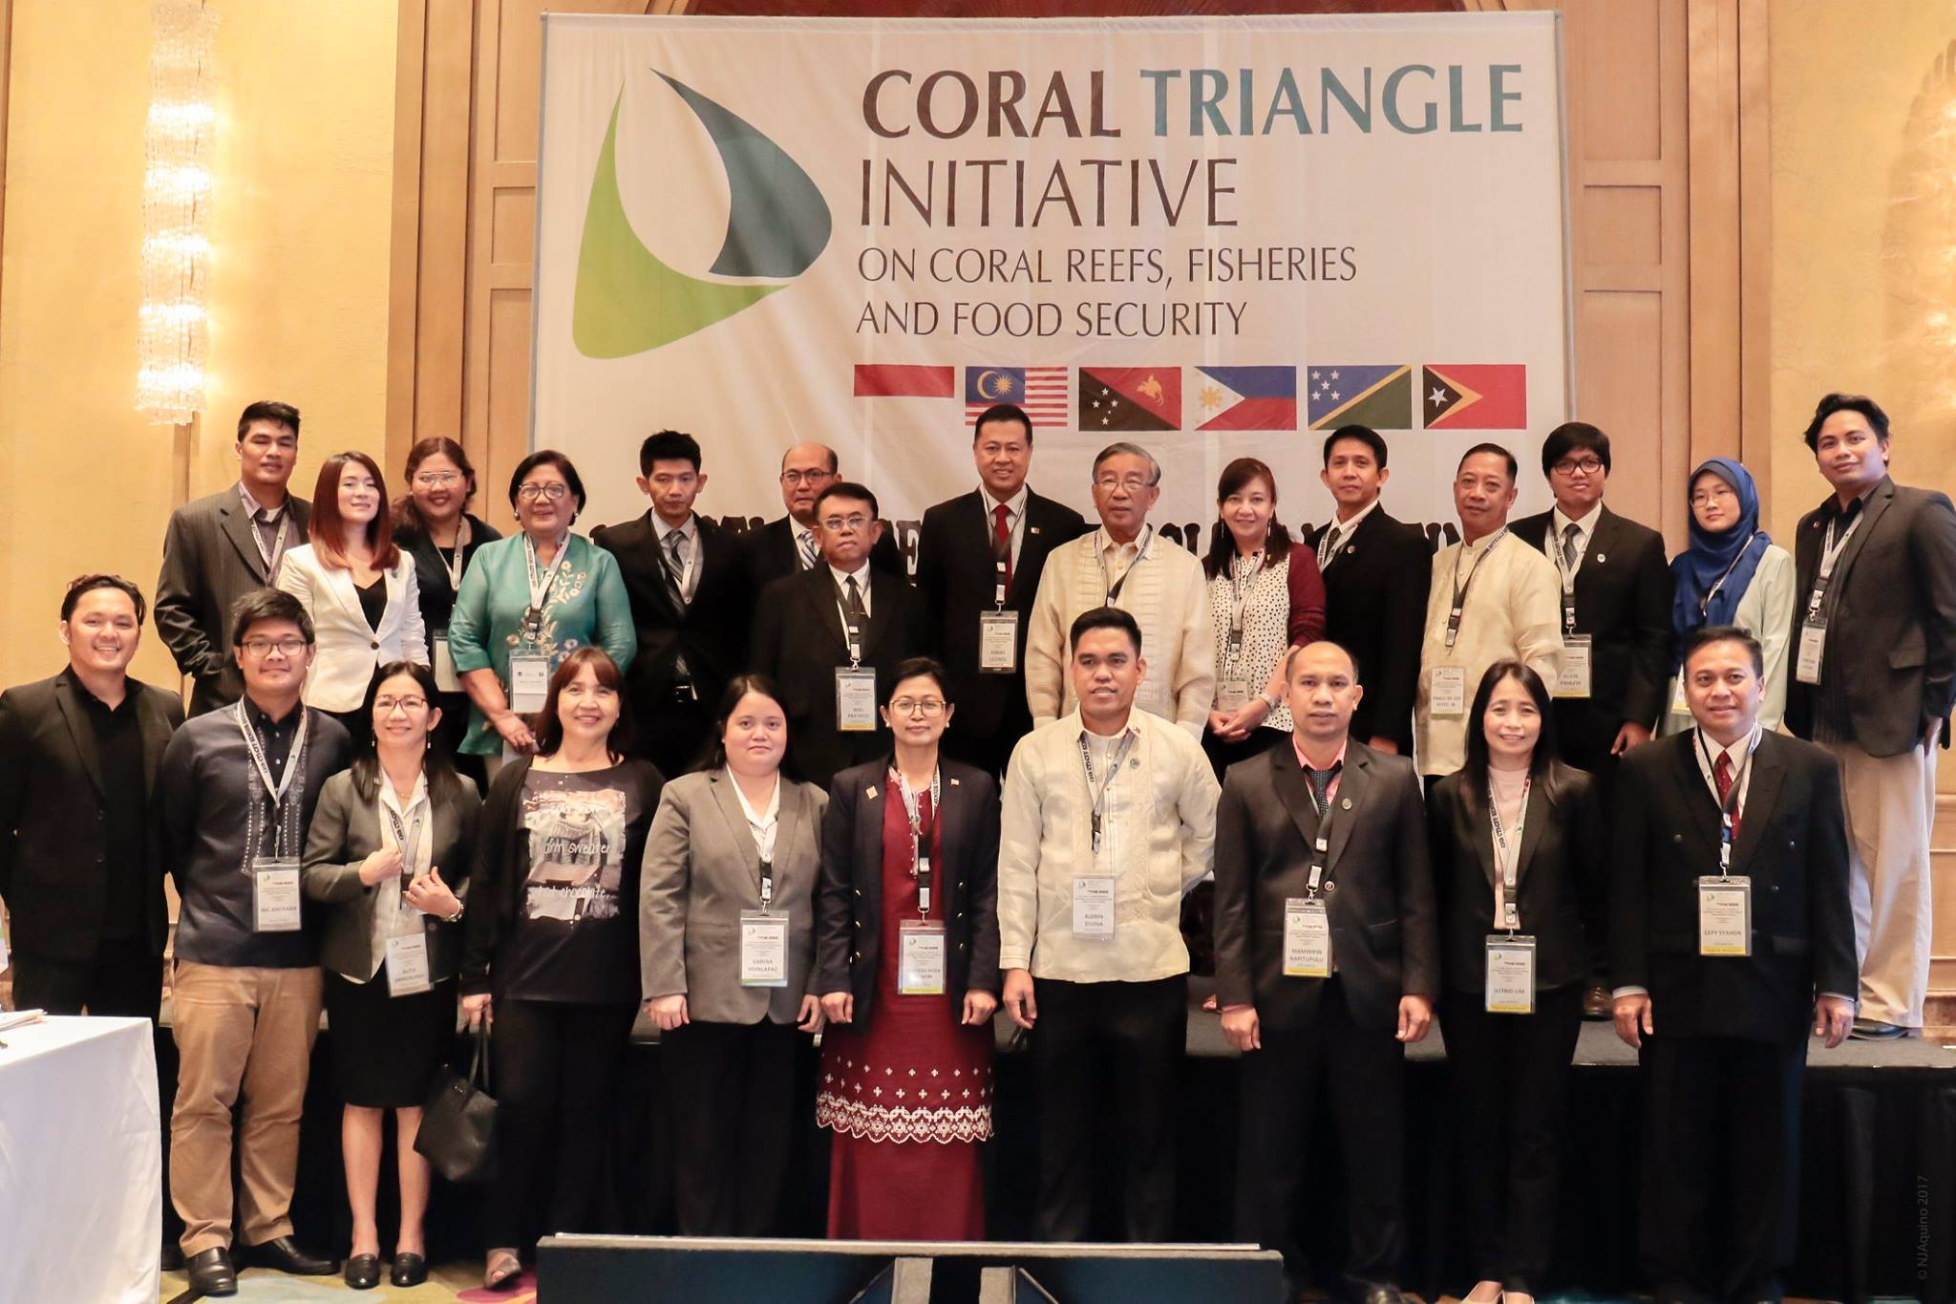
13th Senior Officials Meeting
Notes:
Note: The photos show the Philippine NCCC and the Secretariat team (both regional secretariat and Philippine NCCC Secretariat)
The Philippines hosted the 13th SOM. During this meeting, there were extensive discussions on the different Technical Working Groups, Governance Working Groups, Cross Cutting Themes and Financial Concerns of the CTI-CFF Regional Secretariat. Also, during this meeting, the Deputy Executive Director for Program Services was officially introduced to the CT6 Countries and partners.
Further, as the Chair of the Committee of Senior Officials, necessary steps was conducted in order to maintain accountability and transparency with the Regional Secretariat, CT6 Countries, and Development Partners specially on the financial management system.

Slide 19
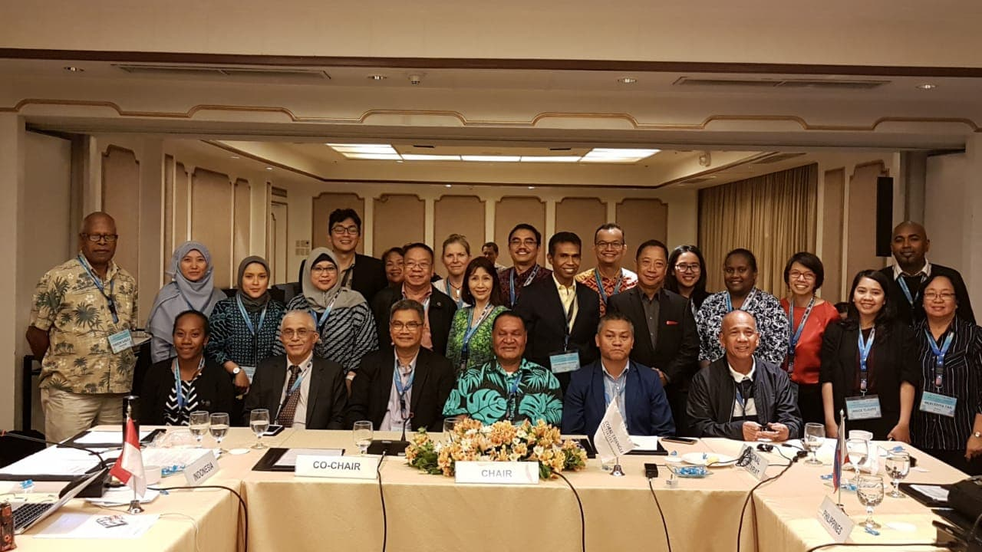
Hosted the 1st Threatened Species Working Group (TSWG) Regional Exchange and Meeting and TSWG Meeting on April 24-26, 2018 in Quezon City
The list of pool of experts was finalized
The Terms of Reference for experts was finalized
The indicators for the TSWG was drafted
Notes:
The 1st Threatened Species Working Group Regional Exchange and 2nd TSWG Meeting on April was also conducted on 24-26 April 2018.

Slide 20
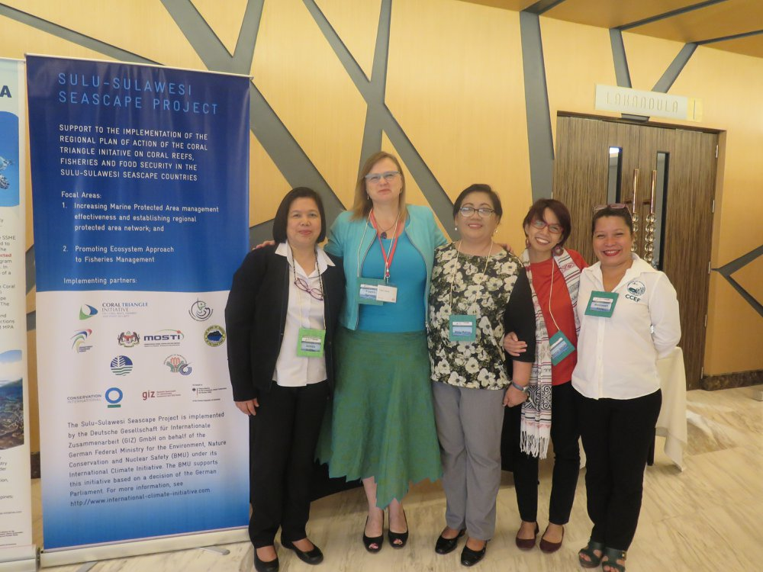
Regional Sulu Sulawesi Convergence Meeting and Sulu Sulawesi Seascape (SSS) Ecosystems Approach to Fisheries Management (EAFM) Plan Review on July 2 t0 6, 2018 in Cebu City
Notes:
Further, a Regional Sulu Sulawesi Convergence Meeting and Sulu Sulawesi Seascape (SSS) Ecosystems Approach to Fisheries Management (EAFM) Plan Review was also conducted on July 2 to 6, 2018 in Cebu City

Slide 21
2018 Special Senior Officials’ Meeting
Notes:
A Special SOM was also convened last July 2018 in order to address the concerns of the Regional Secretariat and to facilitate the approval of the budget for 2018.
In this meeting, the following are the agreements, the Budget of the RS for 2018 was approved, the CSO allowed the RS to hire consultants which were funded by the USAID-DOI, allowed the hiring of temporary finance officer, and allowed the Government of Indonesia to designate an Interim ED to resolve the concerns of the RS on the finance matters and human resources.

Slide 22
Support to the
CTI-CFF Regional Secretariat
Notes:
The Chair also supported the operations of the CTI-CFF Regional Secretariat in which the following were provided:

Slide 23
1. Constant communication with the RS through Skype, emails, messenger, WhatsApp and in person during meeting;
2. Continued guidance on several decision-making processes;
3. Conducted oversight function and provided guidance and directions during the transition;
4. Appointed the Deputy Executive Director for Program Services as the Acting ED;
5. Facilitated the process of hiring External Auditor to conduct the regular audit for 2017 and special audit; and
6. Addressed the concerns of the RS’ staff regarding their Holiday Pay and other benefits
7. Appointed Dr. Hendra Yusran Siry as the Interim Executive Director from the Government of Indonesia.
Notes:
1. Constant communication with the RS through Skype, emails, messenger, WhatsApp and in person during meeting;
2. Continued guidance on several decision-making processes;
3. Conducted oversight function and provided guidance and directions when the Executive Director resigned due to illness;
4. Appointed the Deputy Executive Director for Program Services as the Acting ED;
5. Facilitated the process of hiring External Auditor to conduct the regular audit for 2017 and special audit; and
6. Addressed the concerns of the RS’ staff regarding their Holiday Pay and other benefits; and
7. Appointed Dr. Hendra Yusran Siry as the Interim Executive Director from the Government of Indnesia.

Slide 24
Coordination with the
CTI Development Partners
Notes:
Coordination with the CTI Development Partners was also provided by the Chair including:

Slide 25
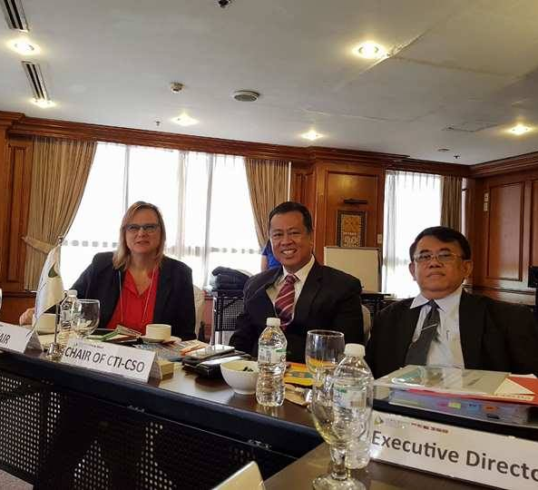
1. Partner’s Meeting
Date: May 22-23, 2017
Venue: Pasig City
2. Dialogue with Partners during the 13th SOM
3. Skype calls with the representative of CTI-CFF Development Partners
4. Participation of Partners during discussions
in every meetings
Notes:
1. Partner’s Meeting held last May 22-23, 2017 in Pasig City;
2. A Dialogue with Partners during the 13th SOM;
3. Skype calls with the representative of CTI-CFF Development Partners; and
4. Encouraged the Participation of Partners during discussions in every meetings

Slide 26
Philippines is the Monitoring and Evaluation Group Chair
The review was funded by the Development Partners
The TOR for the RPOA 2.0 was drafted
Notes:
As the current Chair of the Monitoring and Evaluation Working Group (MEWG), the review of the current Regional Plan of Action was also initiated with the support of Development Partners. From the drafting of the Terms of Reference of the Consultant up to the finalizing the report regarding the review, the Philippines as the Chair of MEWG provided guidance with the help of Deputy Executive Director Nora Ibrahim and the development partners. A team of Consultant lead by Dr. Lida Pet-Soede conducted the review.

Slide 27
Country Level Initiatives
Notes:
Within the National CTI Coordinating Committee, the Chair has also intervened to improve its initiatives and activities which contributes to the Regional goals and targets.

Slide 28
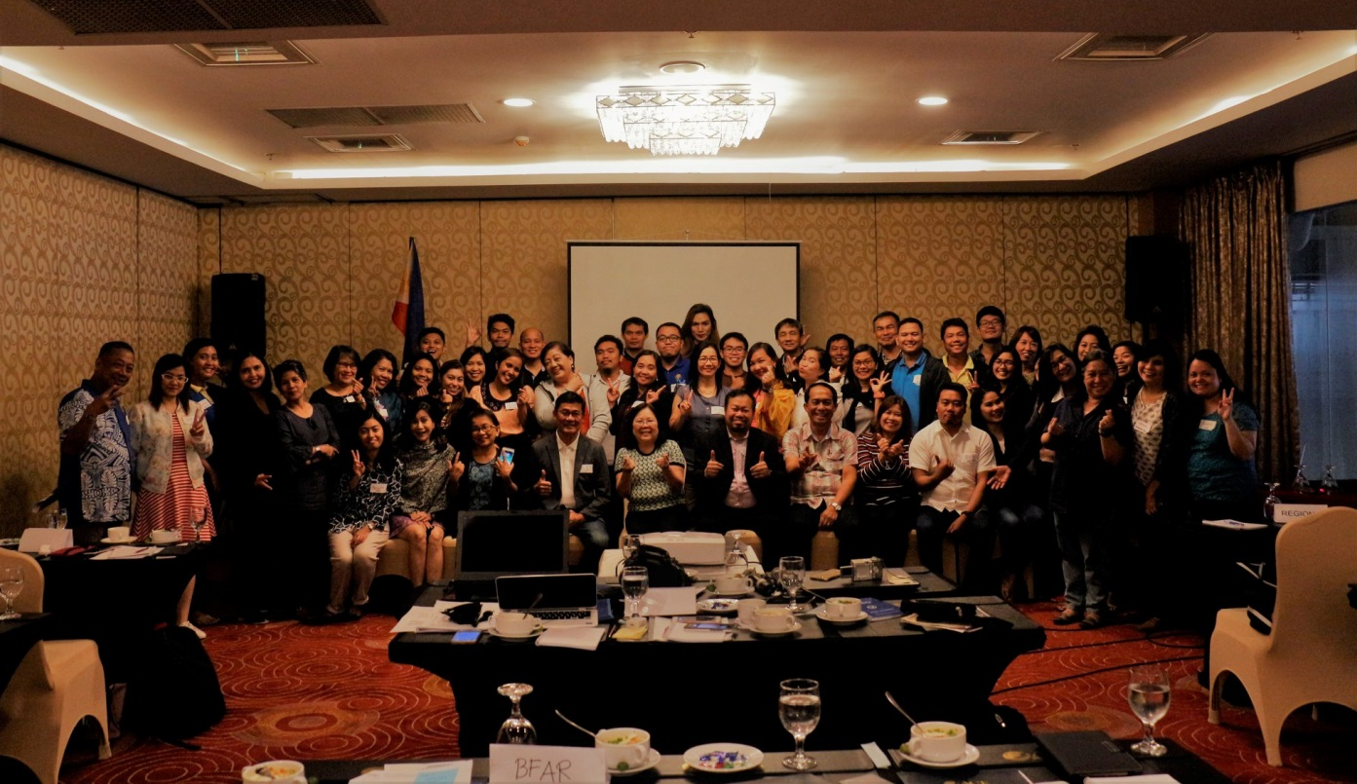
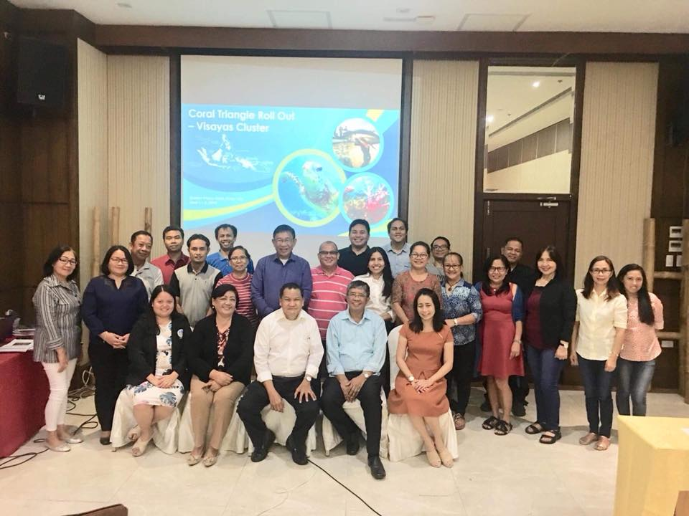
CTI-CFF Roll Out Events
Notes:
Lastly, the Philippines conducted three roll out events regarding CTI. The clusters are Luzon, Visayas and Mindanao. The participants of this activity were the field personnel. Its goal is to link all the efforts and accomplishments at the local level to the National Plan of Action so that the field personnel can appreciate the CTI and make them realize that what they are doing at the field level contributes to the international commitment of the country.

Slide 29
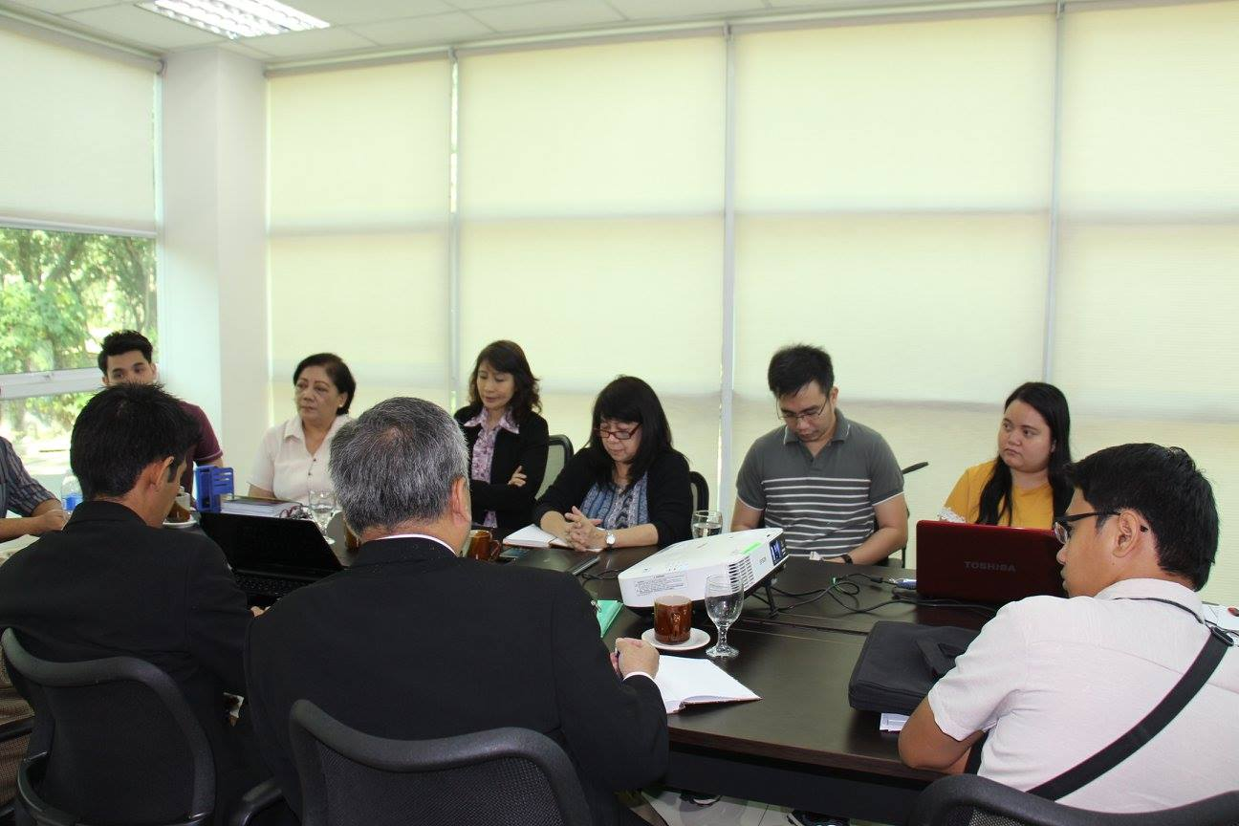
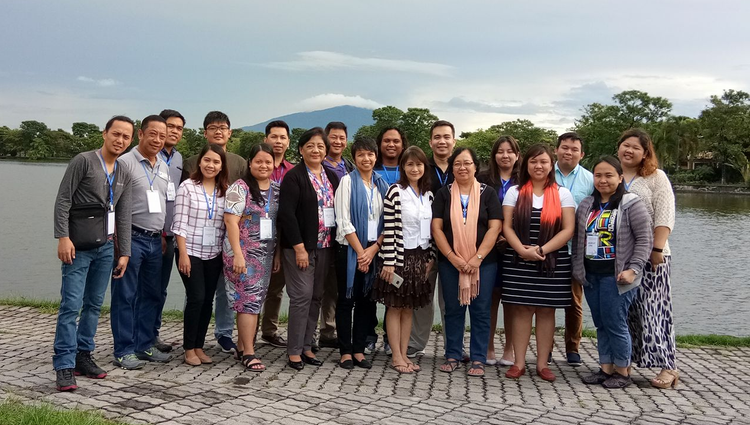
Philippine National CTI Coordinating Committee (PH-NCCC)
CY 2017 – 17 NCCC meetings were conducted
CY 2018 – 10 NCCC meetings were conducted
Notes:
The NCCC is also conducting regular meetings to address the concerns of the Philippines regarding CTI. Discussions regarding different activities and decision making are made here. It is composed of Department of Environment and Natural Resources, Department of Agriculture - Bureau of Fisheries and Aquatic Resources, Department of Foreign Affairs, Department of Interior and Local Government, the League of Municipalities, the Department of Finance, the University of the Philippines Marine Science Institute, Conservation International – Philippines, World Wildlife Fund for Nature - Philippines, Climate Change Commission and now we will include the Department of Tourism.
Currently, the Philippines is conducting NPOA Review as one of its agenda during the NCCC Meetings and Workshop.

Slide 30
Thank you!
Notes:
The Philippines would like to thank all of the Coral Triangle Countries, Development Partners and the Regional Secretariat for all the support and trust that you gave to the Philippines as the Chair of CTI CSO. We cannot do these accomplishments alone. All of these are the fruit of cooperation and hardwork of everybody. The Philippines is now looking forward for continued partnerships and cooperation towards achieving our Regional Plan of Action (RPOA) and the new RPOA version 2.0

