Slide 1
Partnering for Continued Learning
June 2019| The USAID Oceans and Fisheries Partnership

Slide 2
Regional eCDT Guidance Document
Purpose: To provide a clear and easily comprehensible guidance on how ASEAN and CTI member countries can develop and implement eCDT systems to meet their own fisheries traceability and sustainability needs and is:
dynamic and flexible through time;
allows for multiple types and scales of fishery supply chains, from small-scale to large commercial fishing operations; and
supports the broad range of regional disparity across ASEAN (national fisheries management capacity and private sector engagement).

Slide 3
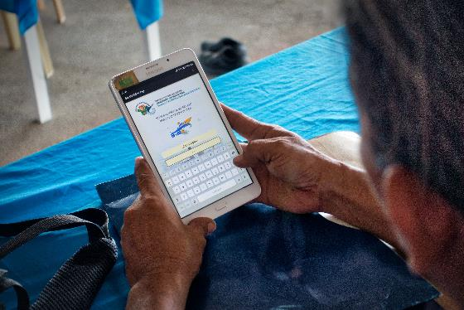
Regional eCDT Guidance Document
Designed to:
Guide transitions from paper-based catch documentation scheme to a transparent and financially sustainable electronic CDT system.
Support and complement the ACDS through guidance to establish and implement an electronic catch documentation scheme.

Slide 4
Regional eCDT Guidance
To provide:
Technical eCDT guidance that can be adapted to the different country capacities, circumstances and needs (and support regional harmonization);
General principles needed to establish and implement eCDT, including a set of minimum requirements and standards;
A process for eCDT design and implementation; and
Guidance for National eCDT Roadmaps.

Slide 5
Timeline for Regional Guidance Preparation, Adoption & Implementation
2017-2018
CDT 101 & 201
2019
Regional CDT Guidance Preparation (Jan – Apr)
2019 - 2020
Presentation at SEAFDEC Program Committee Meeting (Nov 2019)
SEAFDEC eACDS development and testing (BN)
USAID Oceans eCDT Learning Sites (ID, PH) & CDT Gaps Assessments (MY, TH, VN)
Socialization and review meetings (May – Aug)
Regional CDT Guidance Finalization (Sept – Nov)
Endorsement at SEAFDEC Council Meeting (Apr 2020)
Presentation at CTI CFF SOM 15 (Dec 2019)
Submission of review inputs (Sep)

Slide 6
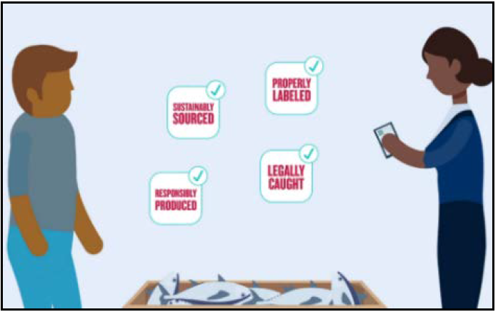
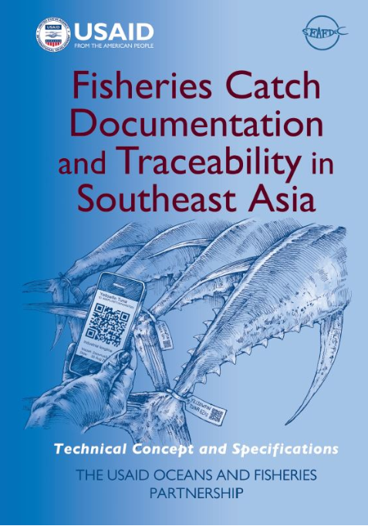
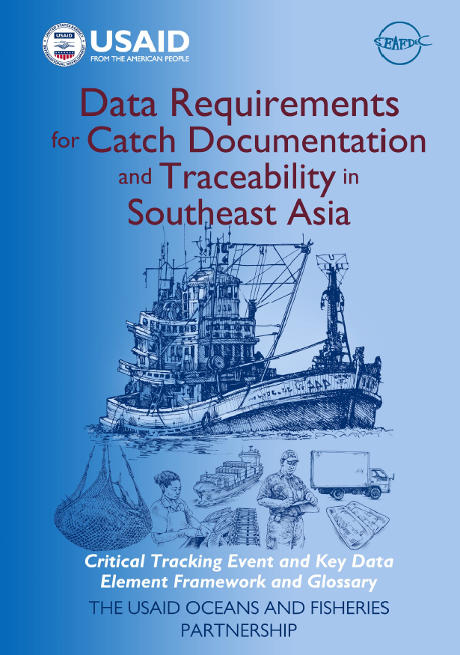
RESOURCES
eCDT Concepts, Guidelines, and Standards
“From Bait to Plate”
eCDT video
CDT “101”
CDT “201”
KDE Guide
www.seafdec-oceanspartnership.org

Slide 7
RESOURCES
Resource Guides
www.seafdec-oceanspartnership.org

Slide 8
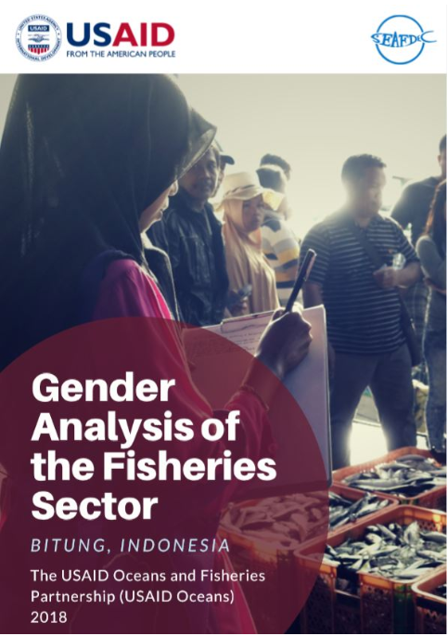
RESOURCES
Research and Studies
Gender Analyses
Labor Assessments
CDT Gaps Analyses
Partnership Appraisals
eCDT Impact Studies
www.seafdec-oceanspartnership.org

Slide 9
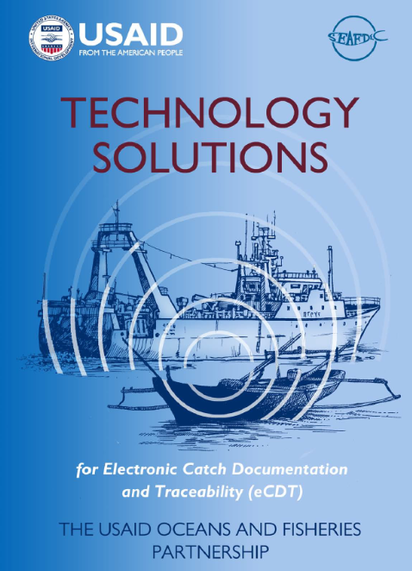
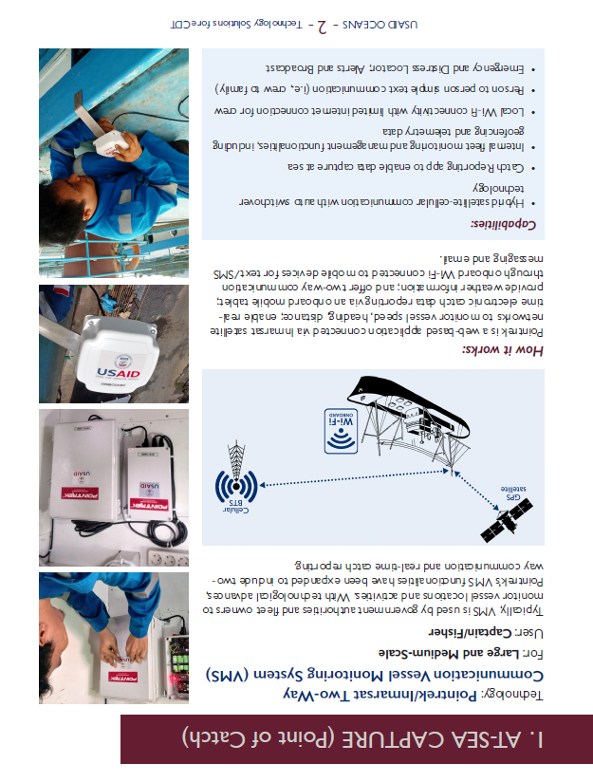
RESOURCES
Technology Resources
www.seafdec-oceanspartnership.org

Slide 10
UPCOMING
Partnership Capstone Guide
Use of eCDT for Fisheries Management Capstone
Gender in Fisheries Videos
www.seafdec-oceanspartnership.org

Slide 11
CO-BRANDING RESOURCES
AND PUBLICATIONS

