Slide 1
Indonesia Country Report
By Dr. Hendra Yusran Siry
Secretary Directorate General of Marine Spatial Management The Ministry of Marine Affairs and Fisheries of The Republic of Indonesia

Slide 2
Outline
Members (Agencies) of the National Coordination Committee
Progress/Accomplishments towards NPOA
Seascape, EAFM, MPA, CCA, Threatened Species, WLF and GESI Adoption
Challenges/Constraints Affecting Implementation
National Roadmap 2023
Seascape, EAFM, MPA, CCA, Threatened Species, WLF and GESI Adoption
Potential Regional Program and Support Required
Publications

Slide 3
Members (Agencies) of the NCC
Working Group | Focal Point
Seascapes | Mr. Suharyanto Director of Marine Spatial Planning, MMAF Alternate: M. Rasman Manafi , Asisstant Deputyr for Coastal and Marine Spatial Management, Coordinating Ministry for Maritime Affairs and Investment.
EAFM | Mr. Trian Yunanda Director of Fish Resources Management, MMAF Mr. Yaya Hudaya Sub-coordinator of Fish Resources Governance Group of Inland Sea, territorial and archipelagic waters, Directorate General of Fish Resources Management, Directorate General of capture fisheries
MPA | Mr. Muh.Firdaus Agung Kunto Kurniawan Director of Marine Conservation and Biodiversity, MMAF Mr. Amehr Hakim Coordinator Of Conservation Area Arrangement, Directorate Of Conservation And Marine Biodiversity, MMAF
TSWG | Mr. Muh.Firdaus Agung Kunto Kurniawan Director of Marine Conservation and Biodiversity, MMAF Mrs. Yudit Tia Lestari Marine and Coastal Ecosystem Manager, Directorate of Marine Conservation and Biodiversity, MMAF
CCA | Ms. Sri Tantri Arundhati Director of Climate Change Adaptation, MOEF Supported by Ms. Nuraeni Head of Sud Directorate for policy instrument development on CCA 2. Muh. Yusuf Director of Utilization of the Coast and Small Islands, MMAF
FRWG | Mr. TB. Witjaksono Adji Director of Intra Regional Cooperation on Asian, Pacific and Africa, MoFA
MEWG | Mr. Arie Prabowo Director for Public Relation and International Cooperation, MMAF

Slide 5
Progress – Seascape CTI-CFF National Programs
The 7th CTI-CFF Seascapes Working Group Meeting (defer 2023)
2. Coordinate and discuss with other TWGs, Partners, and University Partnership program in the management of priority seascapes
3. Mapping on Submarine cables and pipelines, and Artificial Island

Slide 6
Progress – Seascape Activities Related to CTI-CFF Goals with Different Budget
Enactment Local Government Regulation of Provincial Marine Spatial Plans for South Sulawesi and West Papua
Integration Process for 12 Provincial Marine Spatial Plans with Provincial (Land) Spatial Plans for Papua, North Maluku, Maluku, East Nusa Tenggara, West Nusa Tenggara, Bali, South Kalimantan, East Kalimantan, North Kalimantan, North Sulawesi, Central Sulawesi, South East Sulawesi
Enactment Presidential Regulation No 3 on Java Sea Inter-Regional Marine Spatial Plan
Enactment Presidential Regulation No 4 on Sulawesi Inter-Regional Marine Spatial Plan
Enactment Presidential Regulation No 5 on Tomini Bay Inter-Regional Marine Spatial Plan
Enactment Presidential Regulation No 6 on Bone Bay Inter-Regional Marine Spatial Plans
Enactment Presidential Regulation No 40 on Maluku Sea Inter-Regional Marine Spatial Plan
Enactment Presidential Regulation No 64 on The National Strategic Areat he Capital City Of Nusantara Spatial Plan
Legislation Process of Presidential Regulation on Flores Sea Inter-Regional Marine Spatial Plan
Development 7 Inter-Regional Marine Spatial Plans (Banda Sea, Bali Sea, Aru Sea, Seram Sea, Halmahera Sea, Cendrawasih Bay and Sawu Sea)

Slide 7
Progress – EAFM CTI-CFF National Program
2021/2022
Adoption EAFM prinsip in conduct fisheries Mgt plan (Minister regulation No. 22 Tahun 2021: Fisheries Mgt plan and Fisheries Mgt council in each Fisheries Mgt area).
Develop a standard of specific competency on EAFM (SKKK) for EAFM planner, and evaluator in Indonesia → Ministrial Decree no. 9/PERMEN-KP/2015
Develop a modul of training for EAFM planner and evaluator in Indonesia
Training for EAFM planner (20 participants, 5 days, hybrid, 2021)
Training for EAFM evaluator (35 participants, eastern Indonesia, Bali, 5 days, university/government)

Slide 8
Progress – EAFM Activities Related to CTI-CFF Goals with Different Budget
CTI-CFF National Programs
Ministerial Regulation No. 22/2021 on Fisheries Management planning and Authority in Indonesia Fisheries Management Area (WPPNRI)
Training for EAFM evaluator
Translate essential EAFM to Indonesian language by CTC (NGO), 2022
Training essential EAFM in Bali, 2022 by UNDP
Modul Training for EAFM evaluator

Slide 9
Progress – #1 MPA Extention
Marine Protected Areas Reserved
Marine Protected Areas Established by MMAF
Marine Protected Areas Managed by MoEF
TARGET SDGs, National: 10% of marine area allocation as MPA
Indonesia Marine Areas | Indonesia Target 2030 / 10% of Marine Area | Achievement MPA in 2022 | GAP
325 Million ha | 32,5 Million ha | 28,4 Million ha | 4,1 Million ha

Slide 10
Progress – #2 Regulation & Guidelines
Ministry of Marine Affairs and Fisheries Decree No. 31/2020 concerning Marine Protected Area Management → General MPA Management
MPA Vision: Guidance document for the development of MPA until 2030
Director General of Marine Spatial Management Decree No. 7/2022 Concerning Technical Guideline on Local MPA organizational units development.
Director General of Marine Spatial Management Decree No. 28/2020 Concerning Technical Guideline on MPA Management Effectiveness Evaluation Using Tools Called EVIKA.
In 2022, we evaluated 79 MPAs using EVIKA tools, the result shows:
1
Sustainable (Gold) 85,01% – 100%
Management functions have been running optimally and the objective of management achieved
32
Optimum (Silver) 50,01% – 85%
Management functions have been running adaptively and several management objectives have been achieved
79
MPAs
46
Minimum (Bronze) <50%
the management process has been implemented but efforts are still required to achieve the management objectives.

Slide 11
Progress #3 MPA Management System
A. INDONESIA MARINE PROTECTED AREAS DATABASE SYSTEM (SIDAKO)
Indonesia is currently developing MPA database system called SIDAKO containing data and information regarding the status and recent progress of Marine Protected Areas management in Indonesia.
http://sidakokkhl.kkp.go.id
B. SEAPARK SYSTEM
Indonesia has develop SEAPARK System (Integrated Electronic Service/Permit Administration Electronic Services for National MPA). This system facilitates permits issuance for everyone to enter and do various activities inside MPA (recreation, research and educational activities) particularly in National MPA.
https://seapark.kkp.go.id/

Slide 12
PROGRES/Accomplishment
CTI-CFF National Programs | Activities Related to CTI-CFF Goals with Different Budget
 | Training Mainstreaming EbA into CCA policy and Program (3-7 October 2022) in Bali hosted by MoEF supported by Global Project on EbA –GIZ with case study mangrove in Tahura Bali
 | Indonesia has developed climate villages which located in coastal areas in East Kalimantan, South Kalimantan, Central Sulawesi, West Sulawesi, South Sulawesi, Maluku, East Nusa Tenggara, and Papua in 2022.
 | Acknowledgment for community in coastal areas about disaster mitigation and climate change adaptation.
 | Indonesia develop Coastal Indonesia School to increase awareness for student in junior and senior school.
 | Empowerment of coastal communities through Tangguh Coastal Area Development Activities (PKPT)
 | Indonesia is rehabilitating coastal mangroves, reducing plastic waste and preventing marine and coastal pollution
 | Technical Guidance for Preparation of Climate Change Adaptation Plans for Local Governments in South Kalimantan and West Papua Provinces.
 | Socialization of Vulnerability of Mangrove Ecosystem to Climate Change Risk to governance.

Slide 13
Progress – Threatened Species
Sea Turtle:
Developing ID-US cooperation on Hawksbill Conservation in West Papua
Developing 2nd NPOA for sea turtle (period 2022-2024): legislation process
Drafting of Technical guidance for sea turtle handling by-catch
Drafting of Technical guidance for sea turtle landing monitoring
Drafting of Technical guidance for Information Geospatial Thematic (IGT) for fully protected marine species (ex. Sea turtle)
Evaluating management effectiveness of threatened species using tools called EPANJI:
Sea turtle: 78,39% (sustainable)

Slide 14
Progress – Threatened Species
Sharks and rays:
Whale sharks NPOA (2021-2025): Minister of MAF Decree No 16/2021
Drafting of 3rd NPOA for sharks (appendix and non-appendix CITES)
Drafting of 1st NPOA for fully protected rays
Developing Technical Guidance for Whale Sharks (Rhincodon typus) Tourism (Already been decreed under Directorate General Decree number 41 Year 2022)
Underway to protect our endemic species: the walking sharks of Halmahera (Hemiscullium Halmahera ) as a fully protected species through Minister of marine affairs and fisheries decree
Drafting Technical guidance for Information Geospatial Thematic (IGT) for fully protected marine species (ex. Manta rays and whale sharks)
Evaluating management effectiveness of threatened species using tools called EPANJI:
Whale sharks: 78,05 (sustainable)
Sharks (Appendix CITES): 68,70% - 70,18% (optimum - sustainable)
Rays (Mobula spp.): 48,85% (optimum)
Rays (Rhyncobatus spp.): 46,43% (optimum)
- Conducting International seminar as side event Road to Ocean-20 : “How Effective Marine Protected Area Management is Beneficial for Conservation and Manta Rays Tourism”, Jakarta on 11 October 2022

Slide 15
Progress – Threatened Species
Marine mammals:
NPOA for marine mammals (period 2018-2022): Minister of Marine Affairs and Fisheries Decree number 79 year 2018
Drafting Technical guidance for handling marine mammals by-catch
Drafting Technical guidance for handling marine mammals stranded
Drafting Technical guidance for Information Geospatial Thematic (IGT) for fully protected marine species (ex. cetaceans and dugong)
Evaluating management effectiveness of threatened species using tools called EPANJI:
Cetacea: 80,35% (sustainable)
Dugong: 74,10% (sustainable)
- Training for handling marine mammals stranded on 23 March 2022 in Kulonprogo, Yogyakarta

Slide 17
Challenges Seascape
Now, Indonesia has the number of regulations on the provincial coastal and small islands zoning plans and developing planning documents for several national-level/interregion marine spatial plans.
In 2020, Indonesia government enacted Law No. 11 on Job Creation which subsequently revision on some regulations including Law No 32/2014, Law No 1/2014, and Law No 26/2014 on Spatial Planning; Law No. 11/2020 gives mandate to governments to establish integration of several terrestrial and marine spatial planning and enact it in one regulation, which objectives to realize good governance of marine and coastal.
Effective communication and high engagement
Identifying funding resources to support the SWG to strengthen and/or initiate seascapes related activities, particularly those related to Priority Seascapes

Slide 18
Challenges EAFM
Training EAFM for leader and politician.
Subsidy for fisher “change behavior”
Fishing vessel data collection
Blue economy concept in correlation with EAFM
Develop EAFM indicator
Develop EAFM website

Slide 19
Challenges / Constraints
Lack of budget from State Budget Allocation (APBN) due to covid 19 recovery Program
Institutional arrangement is still changing in some institution related to CCA
There is no program dedicated for NPOA since there is no NPoA right now . The latest NPoA lasted in 2019

Slide 20
Challenges
MPA
Covid-19 Pandemics : limited activity and mobility
Still need improvement on :
Data and research
Monitoring and surveillance
Law enforcement
Human resources capacity and competence
Alternative livelihood development
Public awareness
Partners engagement in MPA management

Slide 21
Challenges CCA
Lack of data and information on marine resources sector.
Methodology of blue carbon measurement.
Policy.
Human Resources and expertise.

Slide 22
Challenges
Threatened Species
Covid-19 Pandemics : limited activity and mobility
Still need improvement on :
Data and research.
Surveillance and law enforcement due to vastness and remote ocean areas.
Alternative livelihood development.
Public awareness
Marine mammals stranding events are beyond our estimates (when, where, how etc).

Slide 23
Challenges: WLF and GESI Adoption
The gap of understanding amongst stakeholders related gender mainstreaming still wide
The budget supporting gender mainstreaming needs to increase

Slide 25
Roadmap – Seascape
CTI-CFF National Programs | Activities Related to CTI-CFF Goals with Different Budget
1. The 7th CTI-CFF Seascapes Working Group Meeting | Legislation Process of Local Government for 12 Provincial Marine Spatial Plans with Provincial (Land) Spatial Plans for Papua, North Maluku, Maluku, East Nusa Tenggara, West Nusa Tenggara, Bali, South Kalimantan, East Kalimantan, North Kalimantan, North Sulawesi, Central Sulawesi, South East Sulawesi
2. Coordinate and discuss with other TWGs, Partners, and University Partnership program in the management of priority seascapes | 2. Development 4 Inter-Regional Marine Spatial Plans (Seram Sea, Halmahera Sea, North Papua Sea, South Java Sea)
3. Design to Develop Seascape Diagnostic Analysis and it's strategic Action Plan (LSS and BSSE) | 3. Legislation Process for Presidential Regulation on Banda, Bali Sea, Aru Sea and Sawu Sea Inter-Regional Marine Spatial Plans
4. Funding Resources Workshop

Slide 26
EAFM development roadmap (2020 – 2024)
2020
Develop modul EAFM for training
2021
Develop modul EAFM for planner and evaluator
2022
Training EAFM for evaluator and planner
2023
Training EAFM for leader and senator
2024
EAFM assessment
Develop website EAFM
Training EAFM for leader and senator
EAFM assessment
Sensus/collecting fishing vessel data
Notes:
SK3 = Standar Kompetensi Kerja Khusus = Special Worker Competency Standard

Slide 27
Roadmap – CCA
CTI-CFF National Programs | Activities Related to CTI-CFF Goals with Different Budget
1. Indonesia submits Enhanced NDC to the UNFCCC Secretariat | Roadmap for marine sector climate change mitigation action;
2. Enactment Presidential Regulation No.98/2021 on Carbon Economic Value | Development of working group on marine sector climate change mitigation; Establishment of action plan and matching fund scheme; Mainstreaming marine sector climate change mitigation action in national development planning

Slide 28
Roadmap – Threatened Species
Sharks and Rays | Sea Turtles | Marine Mammals – Dugongs and Cetaceans
To develop traceability mechanism in trade monitoring To Improve law enforcement on catch/trade To foster shark and ray research and data To protect critical shark and ray habitat To develop shark and ray bycatch mitigation To improve public awareness through communication and campaigns To develop alternative livelihoods and access to capital/livelihood diversification | To improve sea turtle study and research data To protect Nesting Habitat/Turtle Migration Corridor To improve community Participation in Turtle Conservation To increase survival rate of sick/ stranded/ entangled turtles | To integrate and to update marine mammals database/ information To protect marine mammals critical habitat To foster marine mammals tourism To improve public awareness To strengthen regulation and law enforcement To reduce cetacean mortality/accidents caused by fishing activities To develop better guidance, human resources and networks for handling stranded marine mammals

Slide 29
Roadmap –WLF and GESI Adoption
GESI adopted and aligned with Medium Term Strategic Plan 2024-2029 and MMAF Strategic Plan Document 2024-2029
To strengthen the gender mainstreaming implementation at national level as well as regional level (provincial and regency)
Replication of successful implementation of gender mainstreaming in one area towards other potential areas

Slide 31
Seascape Potential Regional Program and Support Required
Training Marine Spatial Planning for CT6 members ( lesson learn from Indonesia MSP)

Slide 32
Potential Regional Program and Support Required
Threatened Species:
To publish regular publication (each country progress/activity) on CTI CFF website
Development of annual report on threatened species status in CT region
Development of threatened species regional handbook/guideline on marine mammals stranding
Training on sea turtle/marine mammals/sharks and rays stranding/by-catch
Training on law enforcement to support the prevention and management of the use of endangered and protected marine species on transboundary in CT6

Slide 33
Potential Regional Program and Support Required
CCA
Capacity Building on Training on Marine Sector Climate Change Mitigation Action, including Blue Carbon Measurement;
Gender Equity and Social Inclusion for Climate Change Adaptation;
Funding scheme for Marine Sector Climate Change Mitigation Action Program.
Sharing experience in conducting Mangrove Vulnerability Assessment particularly on identifying indicators throughout workshop
Training on Mainstreaming EbA for coastal development with potential fund from GIZ Global or TS SUPIA

Slide 35
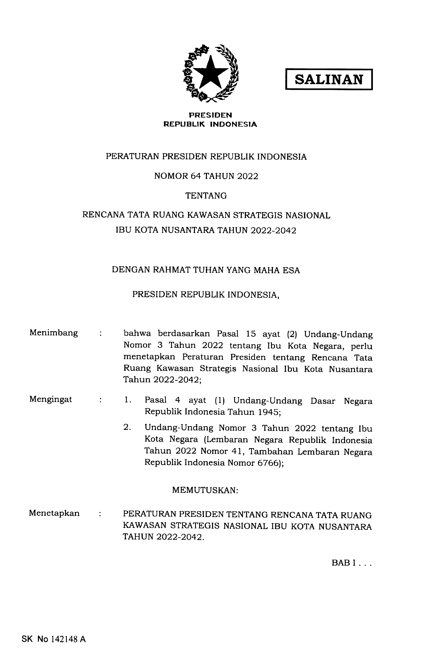
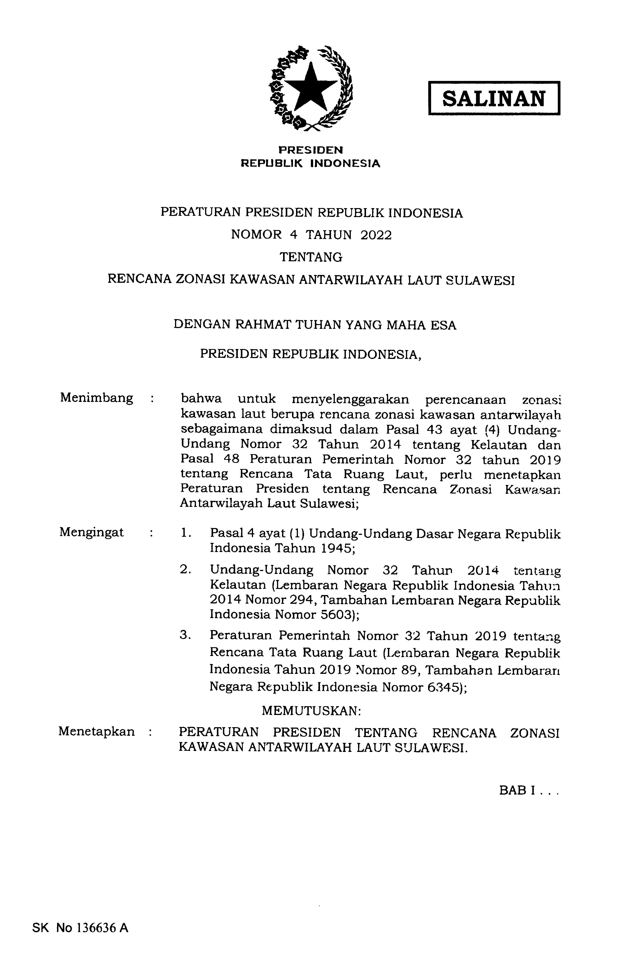
Publications: Seascape:
Local Government Regulation of Provincial Marine Spatial Plans for South Sulawesi and West Papua
Presidential Regulation No 3 on Java Sea Inter-Regional Marine Spatial Plan
Presidential Regulation No 4 on Sulawesi Inter-Regional Marine Spatial Plan
Presidential Regulation No 5 on Tomini Bay Inter-Regional Marine Spatial Plan
Presidential Regulation No 6 on Bone Bay Inter-Regional Marine Spatial Plan
Presidential Regulation No 40 on Maluku Sea Inter-Regional Marine Spatial Plan
Presidential Regulation No 64 on The National Strategic Area the Capital City Of Nusantara Spatial Plan

Slide 36
Publications: MPA:
MPA Vision 2030
Communication Strategy on MPA Management in Indonesia
GAP Analysis on Developing Capacity of Human Resources
New Normal Protocol in MPA

Slide 37
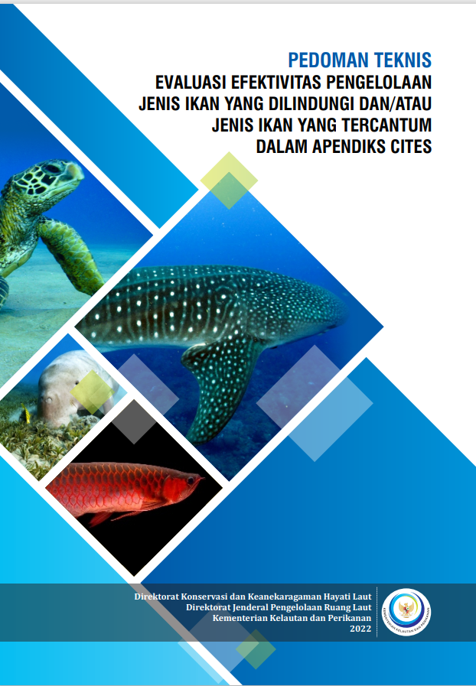
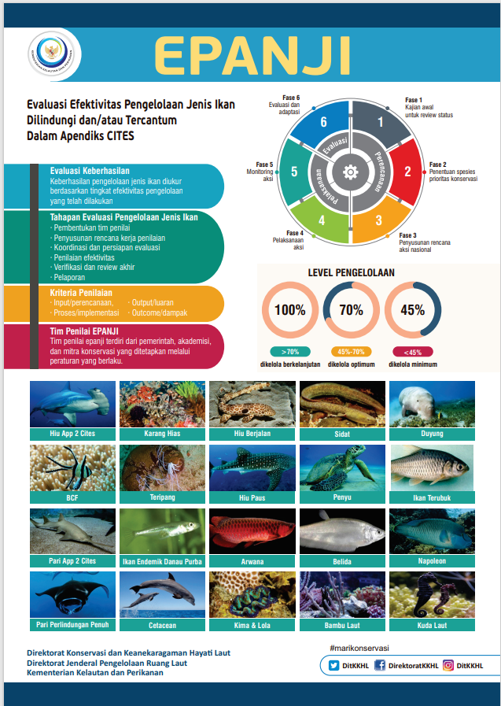
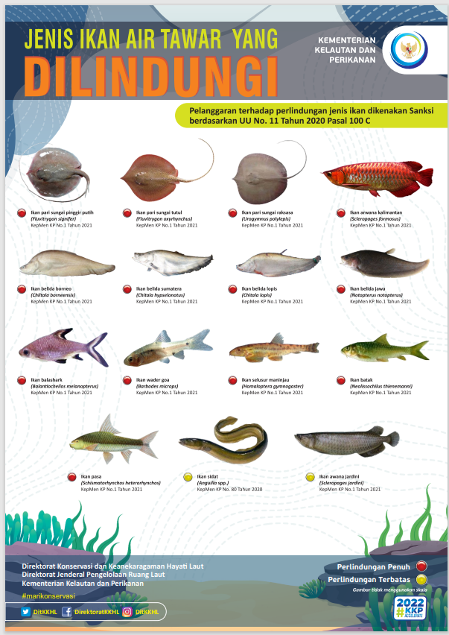
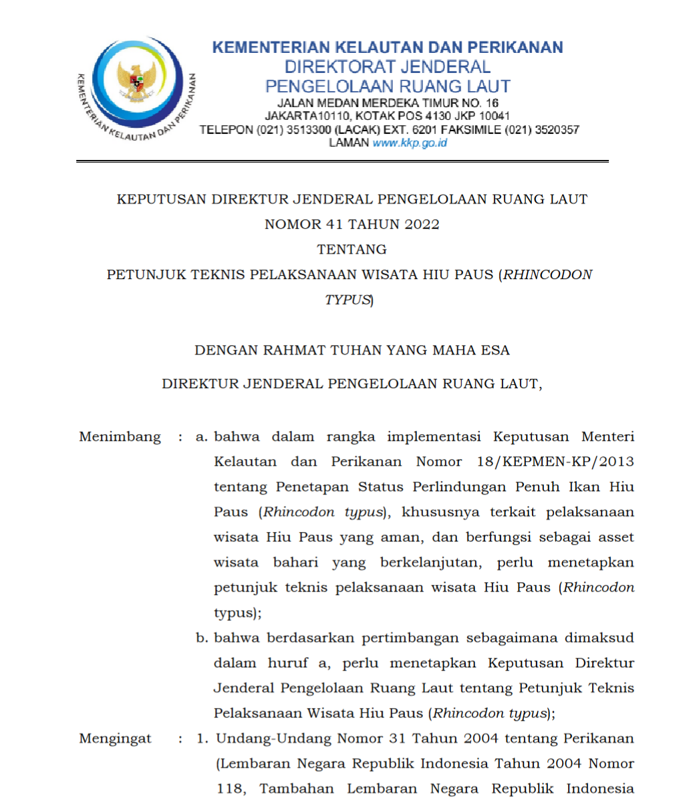
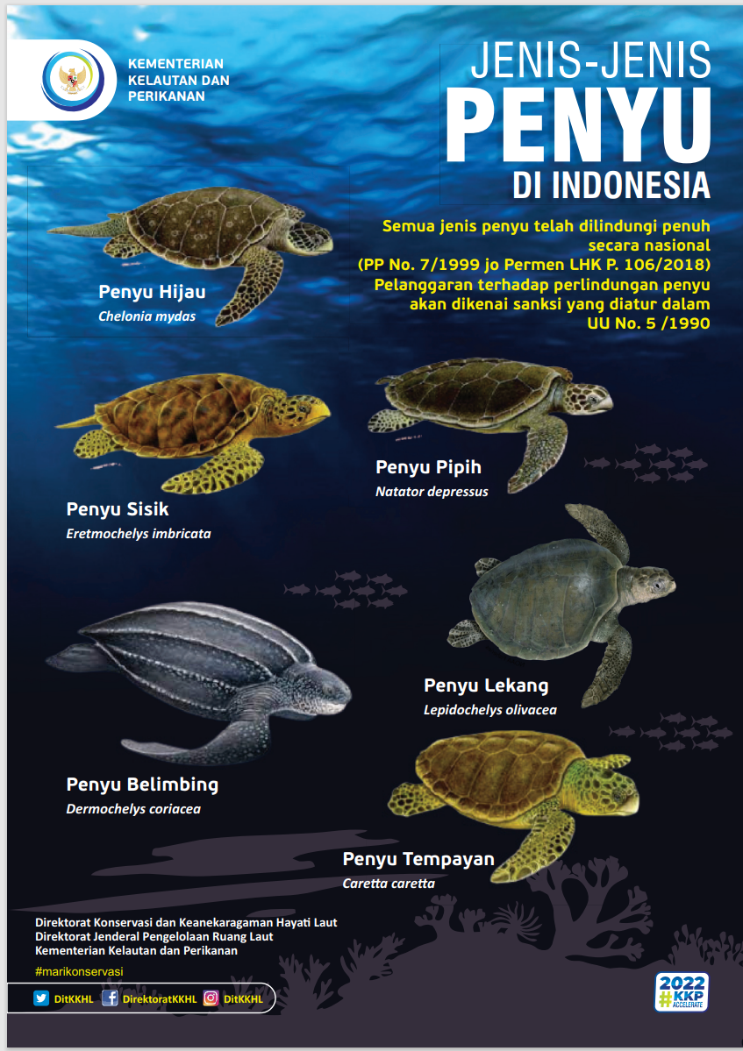
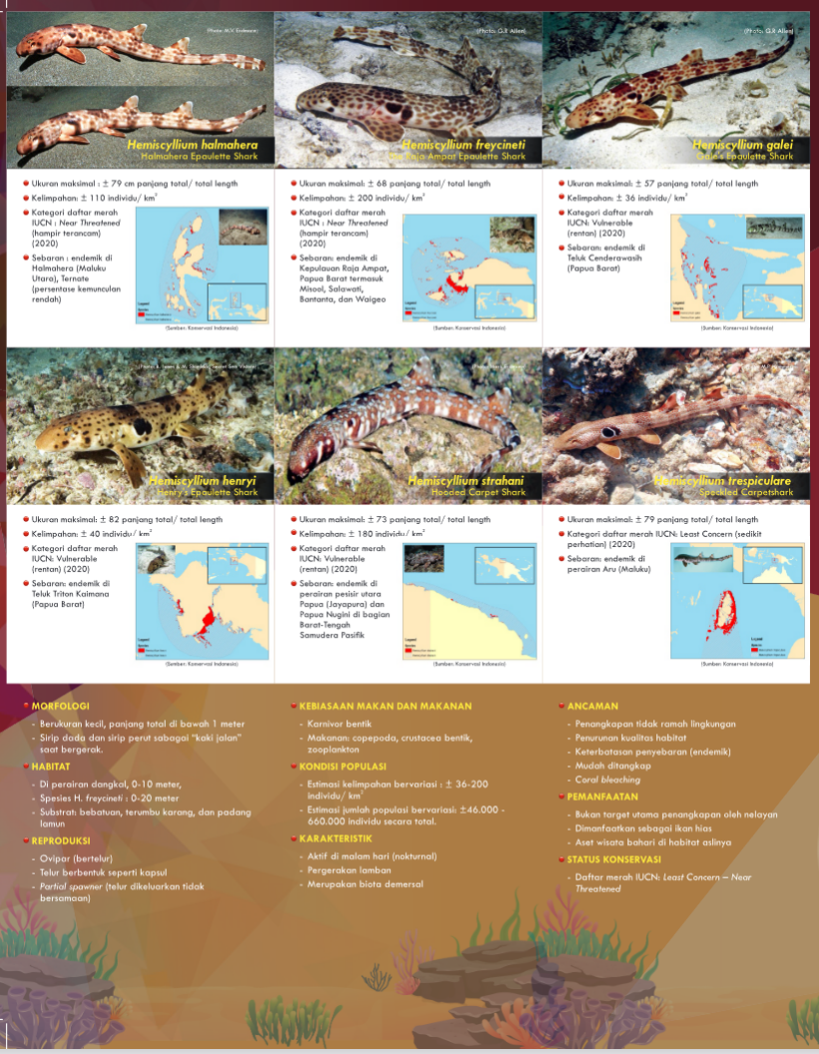
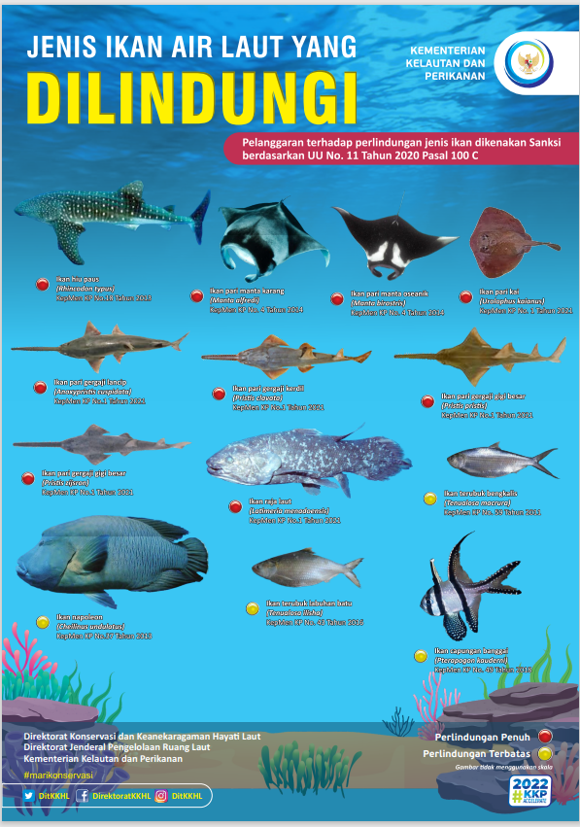
Publications: Threatened Species:
POSTERS: Six Species Sea Turtles in Indonesia Waters
LEAFLET: Walking sharks (Hemiscyllium spp.) in Indonesia
POSTERS: Protected Marine Fish Species in Indonesia
POSTERS: EPANJI Technical Guidance on Evaluating management effectiveness of threatened species
EPANJI: Technical Guidance on Evaluating management effectiveness of threatened species
POSTERS: Protected Freshwaters Fish Species in Indonesia
Directorate General Decree number 41 Year 2022 on Technical Guidance for Whale Sharks (Rhincodon typus) Tourism

Slide 38
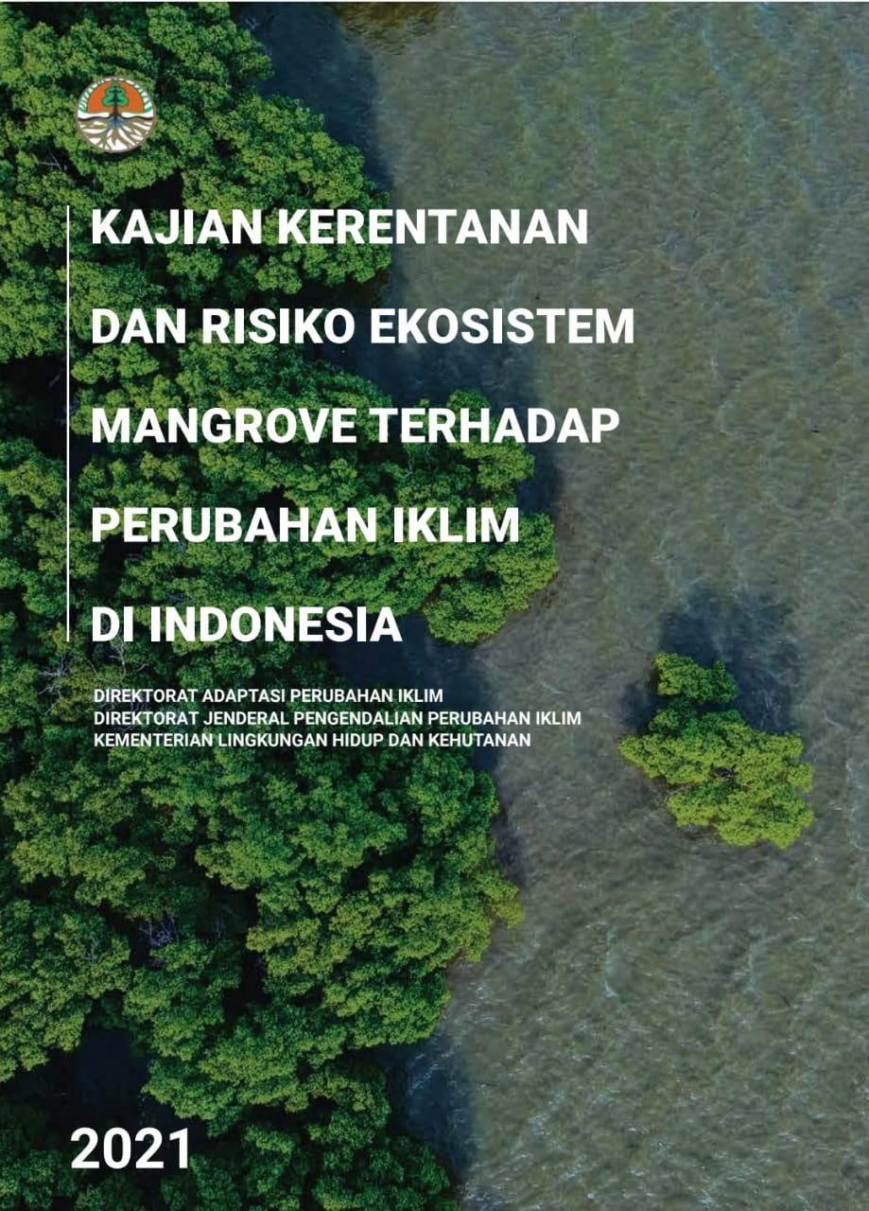
Publications: CCA

