Slide 1
TIMOR-LESTE FINAL REPORT WOMEN’S INTERGENARATIONAL LEADERSHIP LEARNING FORUM Conservation Challenge Small Grants Program Households plastics and fabrics Waste Management, in Atauro Villa and Beloi Village Support by CTC and implementing by Women Leader Forum Alda Sousa Lemos da Rosa, (Mentor) Esmeralda dos Santos , ( Mentee) Bali, 22-26 October 2018

Slide 2
MAP Atauro Island

Slide 3
Project Overview
Atauro Island, lies north of Timor Leste, is one Municipal in District of Dili. It has five Villages: Vila-Maumeta, Beloi, Maquili, Macadede, and Bequeli. There area 9,274 people live in Atauro Island comprises of 4,669 men and 4,605 women. Vila-Maumeta village where the conservation challenge was run, populated by 1,826 people comprise of 957 men 869 women. They almost equal on numbers of men and women on both Atauro Island and Vila-Maumeta village indicates that women in Vila-Maumeta should have important role for Atauro development.
The activities carry out in Vila and Beloi are, Approximation, socialization, Provide trash cans, collecting waste from households, training to recycle plastic and fabric clothes to produce bags, distribution and socialization.

Slide 4
Result
Expected
around 657 households received and use plastic and cloth bags for shopping
Success
725 bags distribution to households
Produce around US $ 200 income from bags donations
The visibility of sea water getting better around 60 cm in July 2018.
Vila and Beloi are cleaned

Slide 5
Challenges
In the beginning of project implementation, some challenges that women group faced were:
1. least participation from households to collect their waste.
2. Women out of the group, thought they will get paid for their participation.
3. There was an opinion that the activities will only wasting their time and can not give them income.
Even though facing the challenges, the women group were kept enthusiast in collecting waste.

Slide 6
Vision
Recommendation
Need trainings with good tools/facilities for other
villages where coral reef conservation are available.
Need site visit for the women group to learn waste management from other area.
Need a mechanism for the women group to facilitate their daily activities.

Slide 7
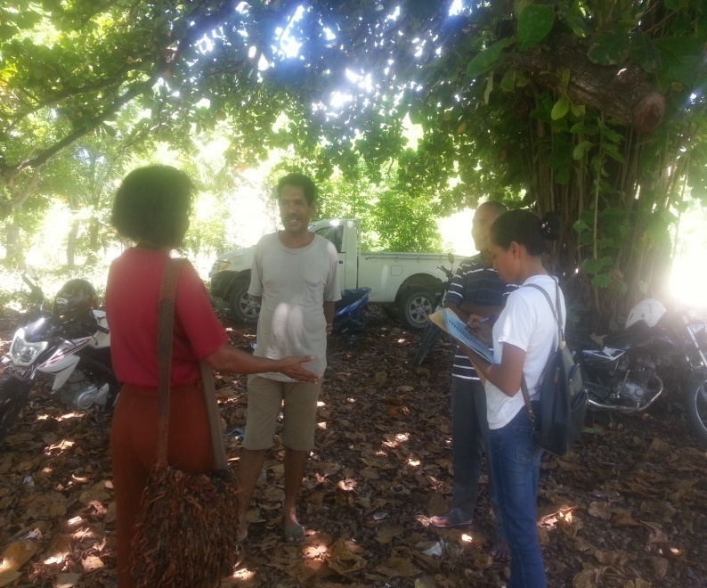
Final Report
Local Leader Approximation

Slide 8
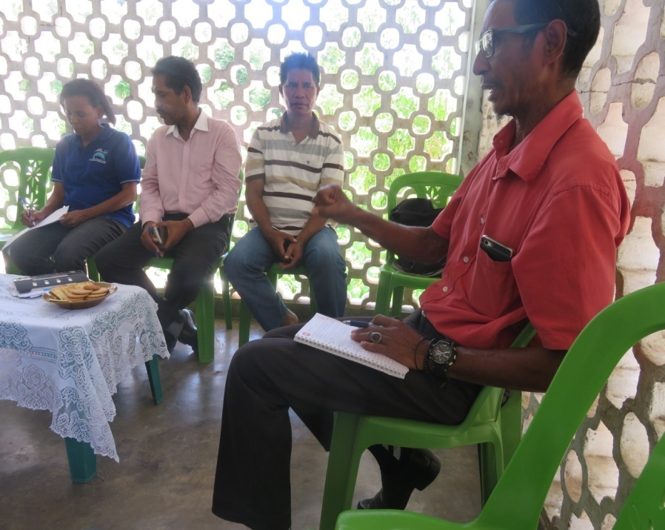
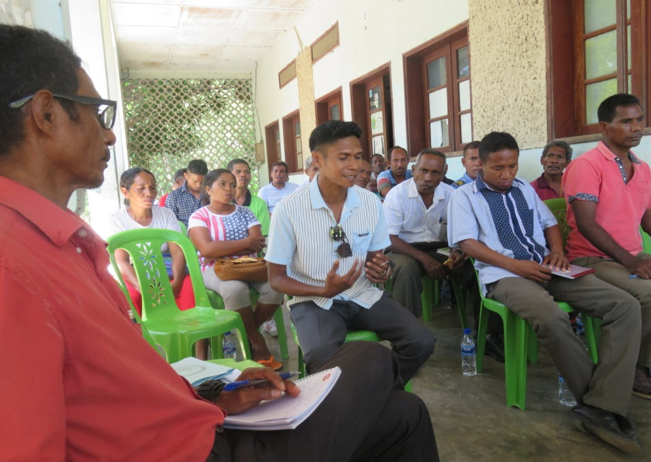
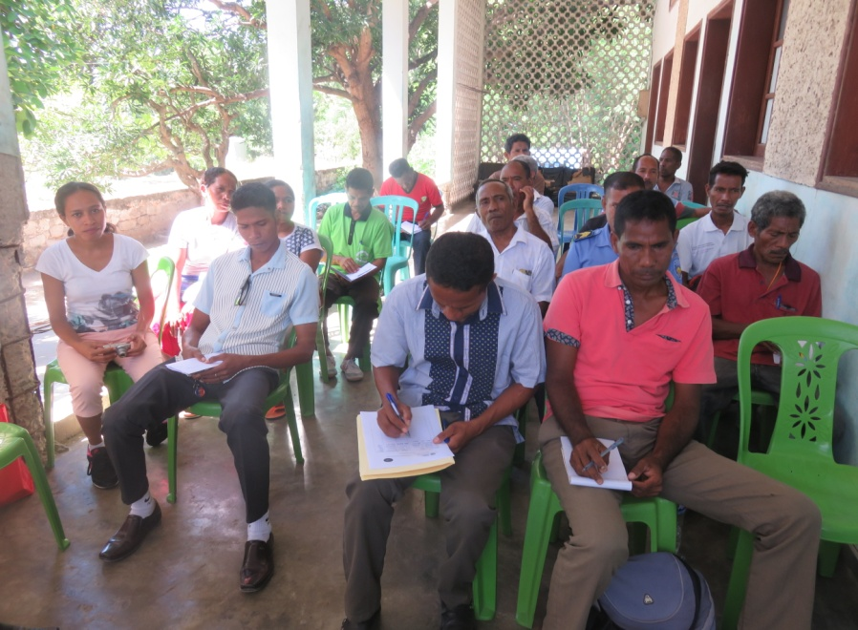
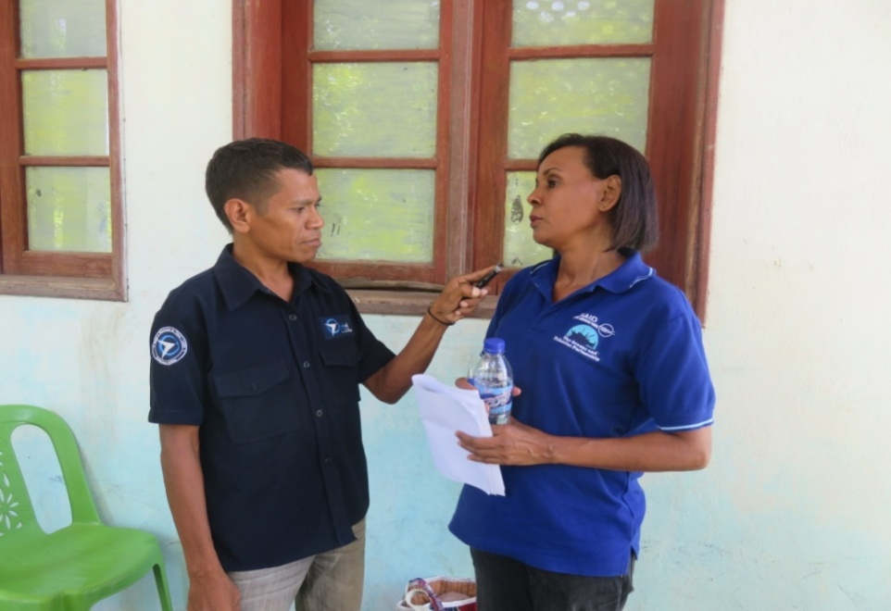
Socialization on Plastic & Fabric waste Collection with local leaders, veteran, religious in Villa & Beloi Villages
Interview with Radio Community of Atauro

Slide 9
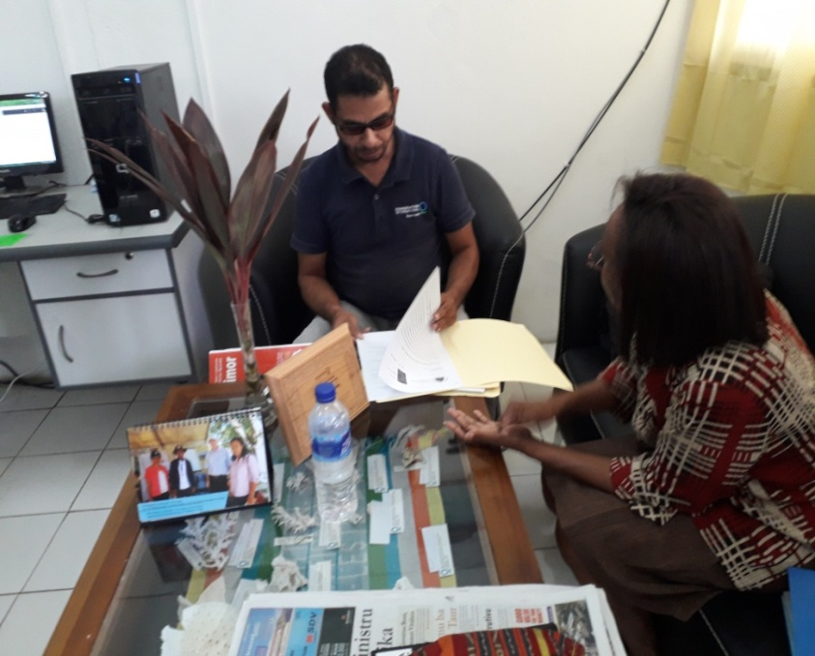
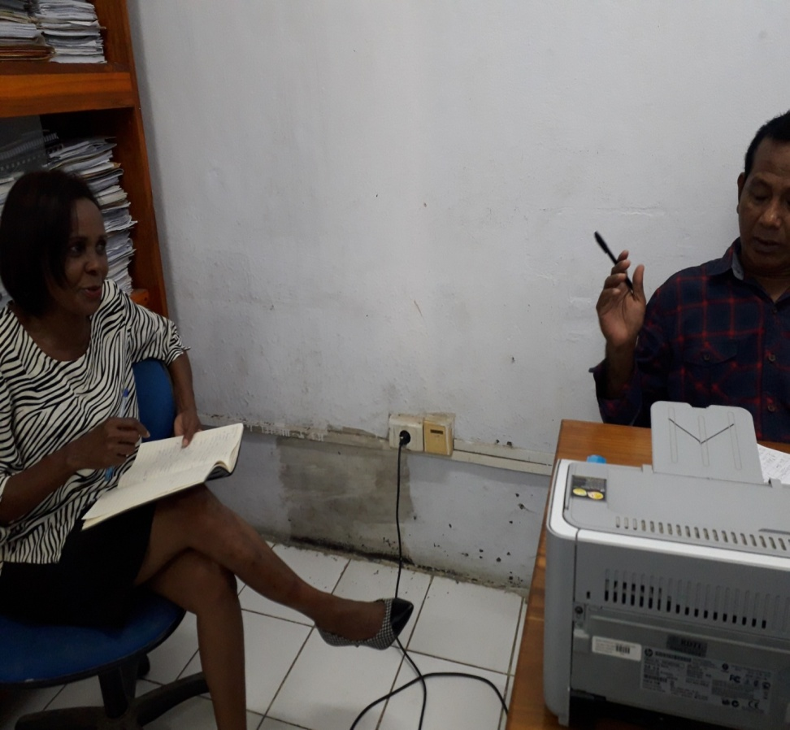
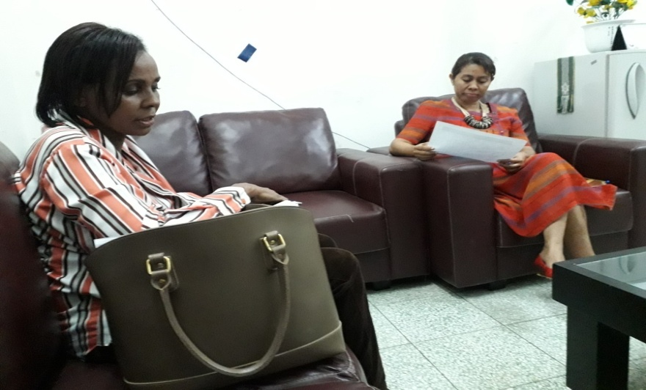
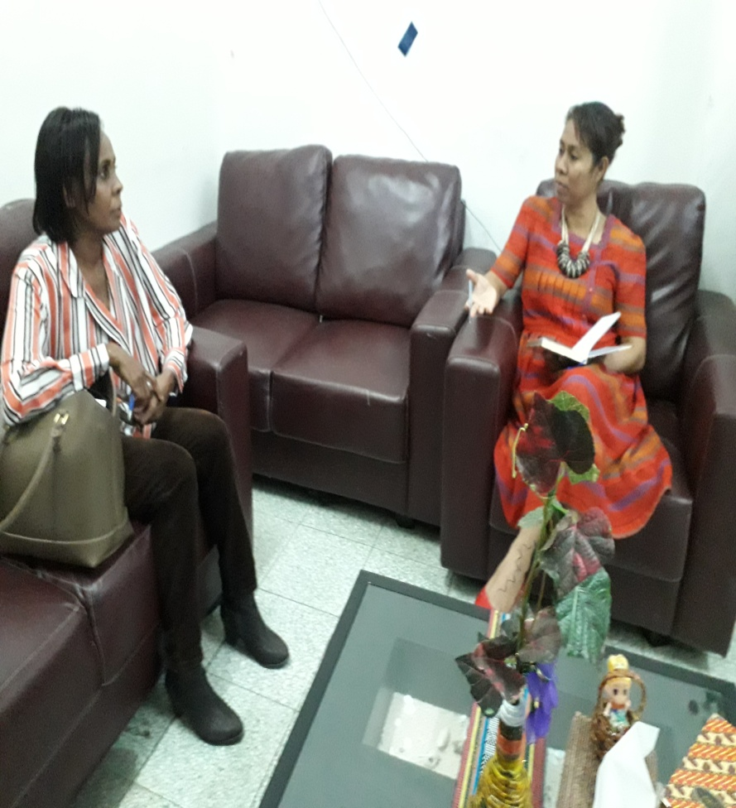
Update information about implementing activity & Coordination with CTC Coordinator & CI about progress work
Consultation with director of National Directorate of Pollution, from secretariat state of environment about waste management

Slide 10
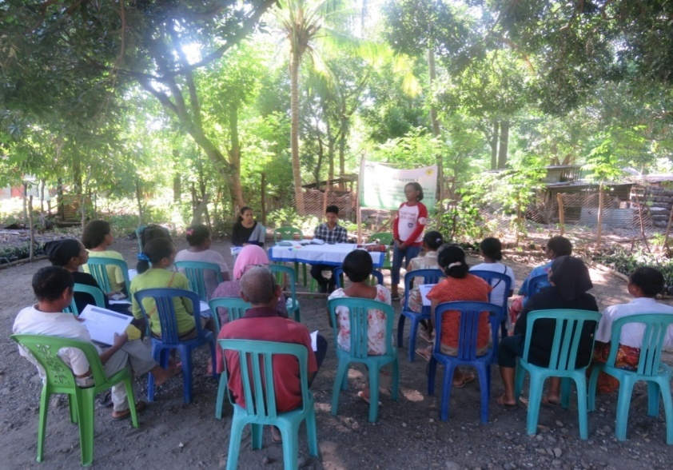
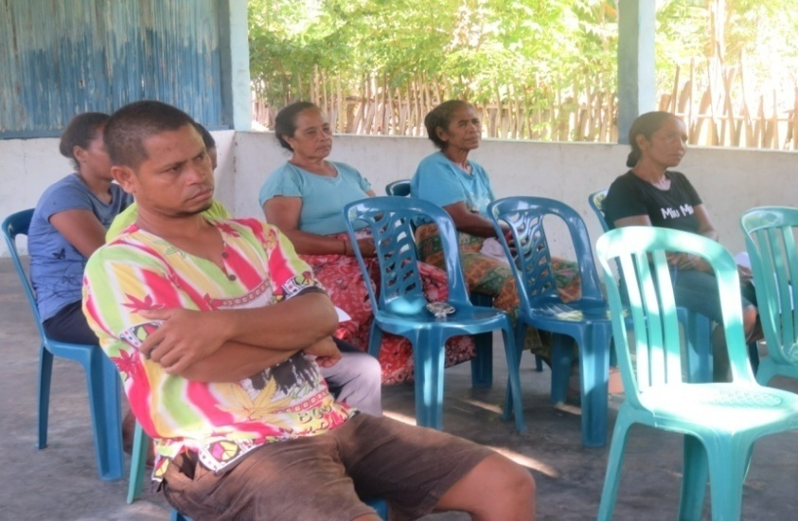
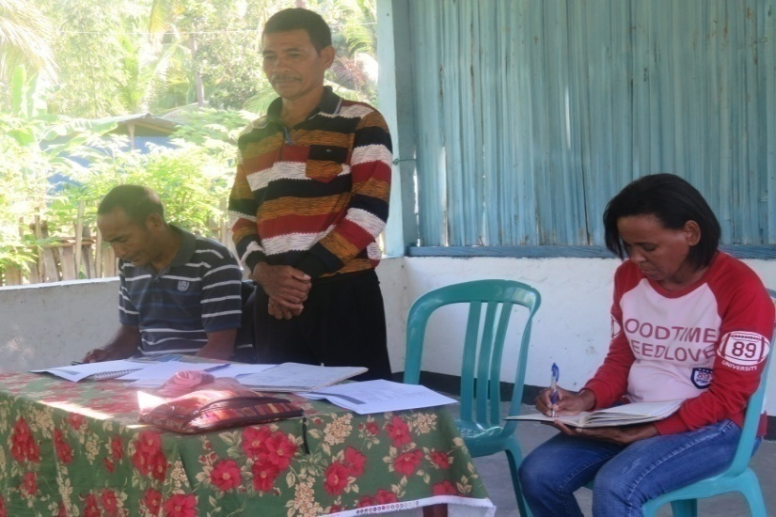
Identify Women Group for Households Plastic & Fabric Waste Management Vila Village Atauro Island TL
Identify Women Group for Households Plastic & Fabric Waste
Management Beloi Village Atauro Island TL

Slide 11
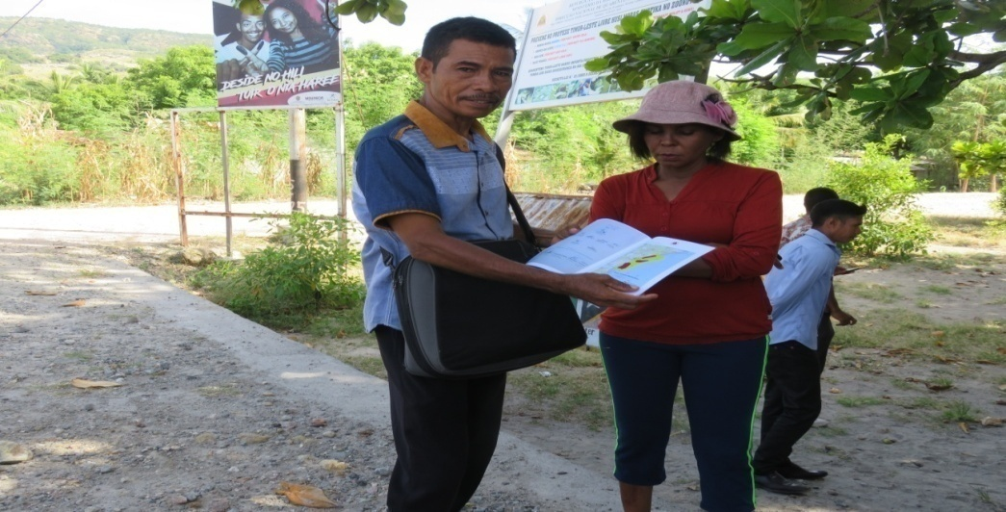
Hand over Villages Regulation area of conservation from Head of Village to Mentor & Mentee

Slide 12
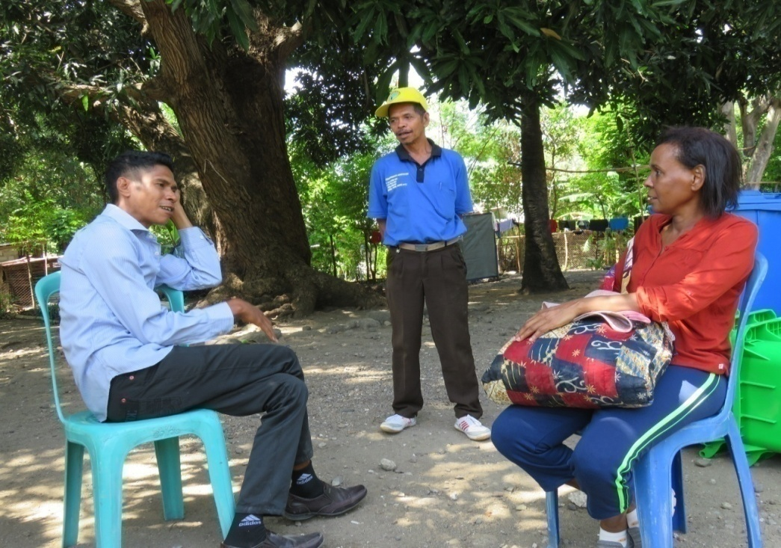
Delivered trash cans to Vila & Beloi, Atauro Island

Slide 13
Socialized use Diary to Collect Waste for Group Identification

Slide 14
DIARIO COLECÇÃO DE LIXO WLF
DIARIO WASTE COLLECTION WLF
TABEL UNIT OF RUBBISHBEENG
NAME OF RESPONSIBLE GRUPO : ...........................................................................................................
DISTRICT : ................................ SUB DISTRICT : ................................... VILLAGE : ……………………
GROUP : .........................................................................................................
DATE : ............./..................../...............
No | Name | Data | Trip/OTL | Varios waste quantity |  | OBS
 |  |  |  | Plastic | Cloth

Slide 15
Distribution trash cans for group identification

Slide 16
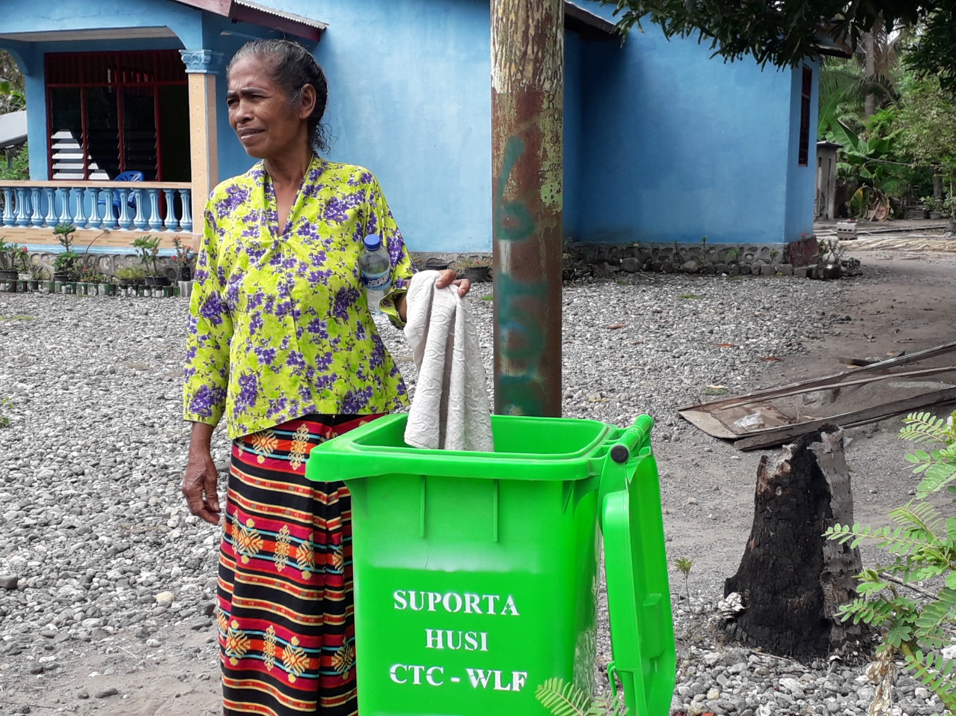
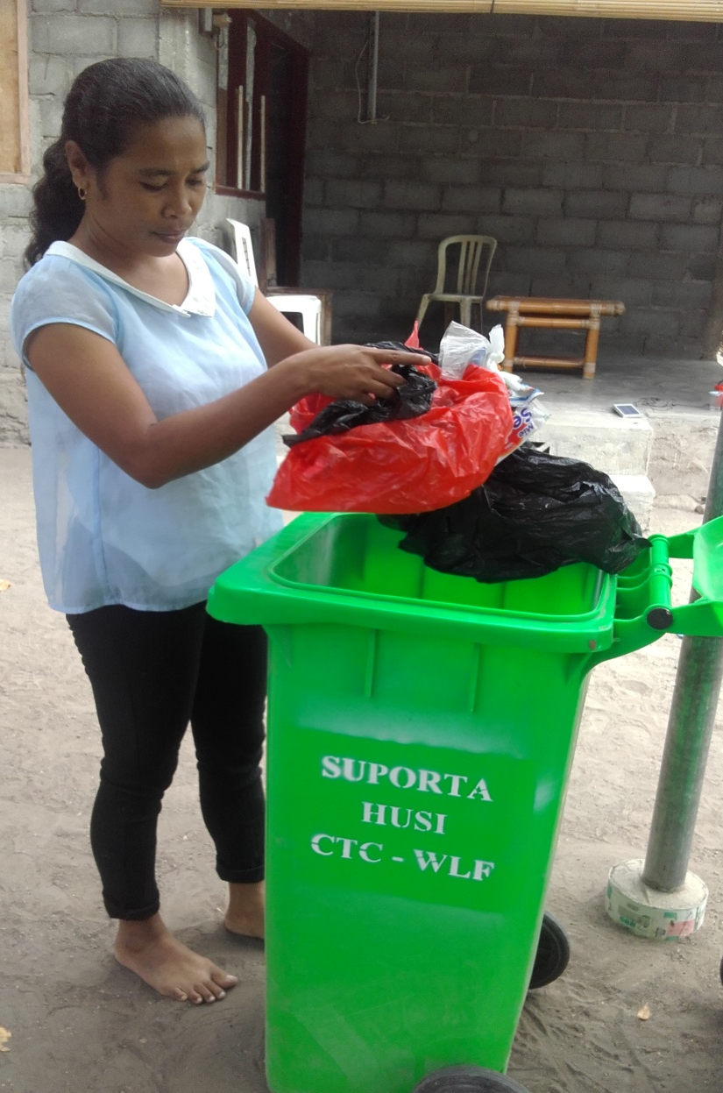
Group identification starting waste collection

Slide 17
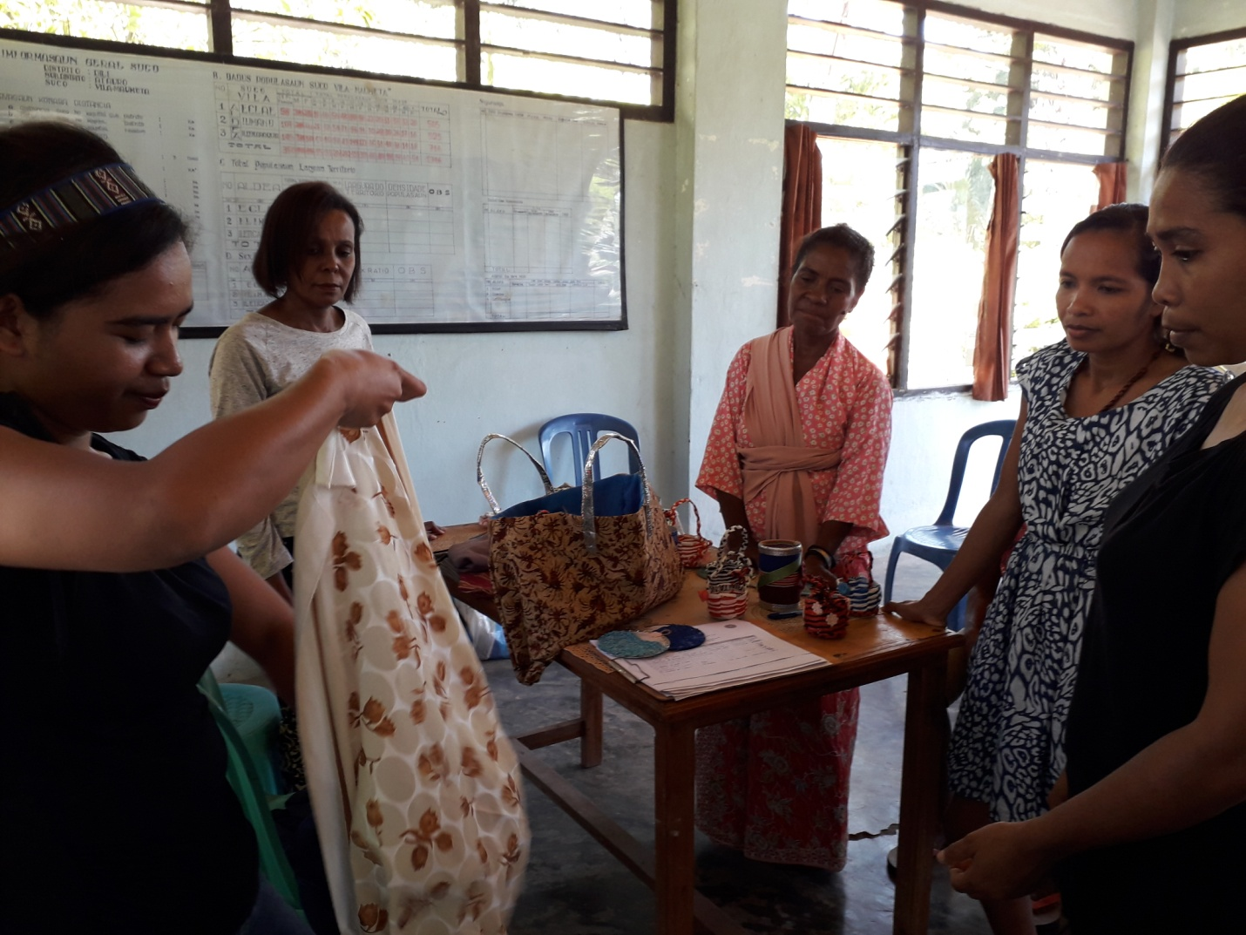
Socialized the function of its recycle plastic & fabric bags

Slide 18
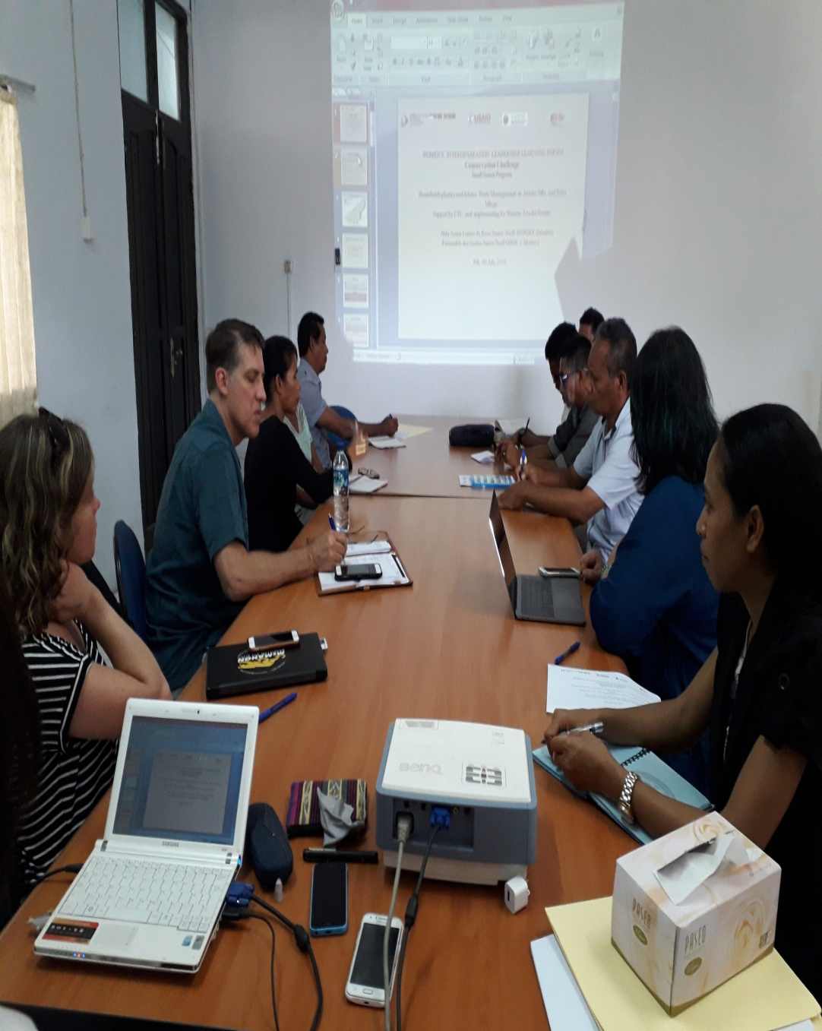
Update Progress work to Donors of USAID, CTC Bali, National Director & Chief of Dept. (July 09, 2018)

Slide 19
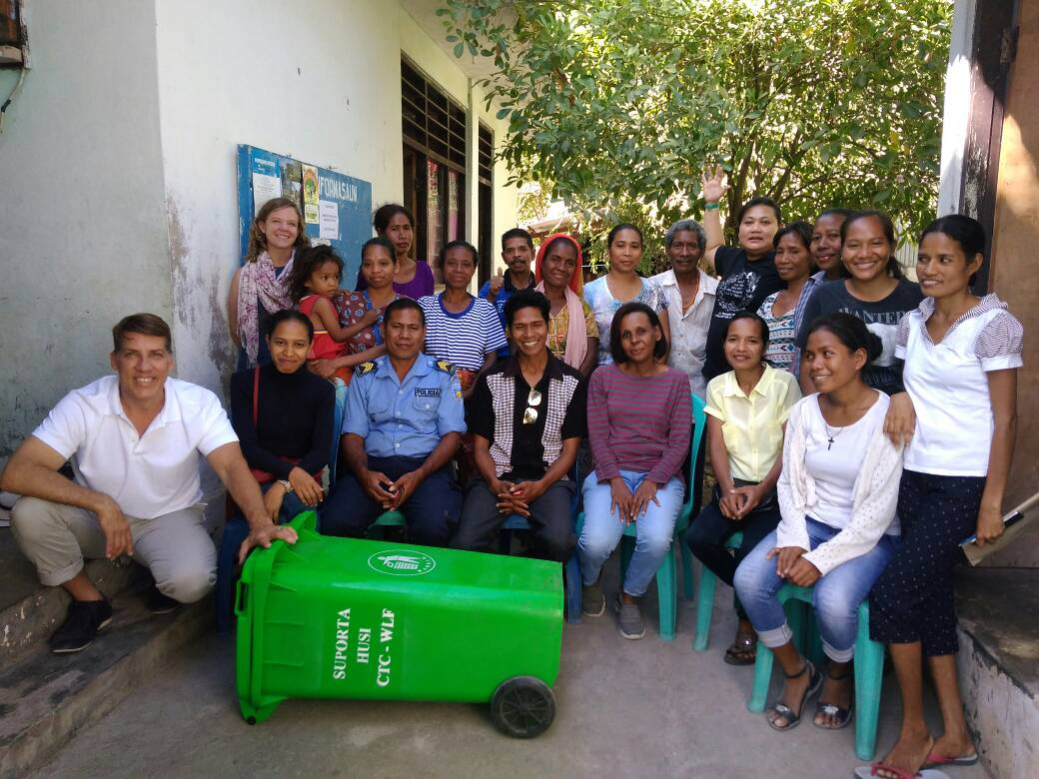
Site Visit to Atauro Island, discuss with women target group identification (July 10, 2018)

Slide 20
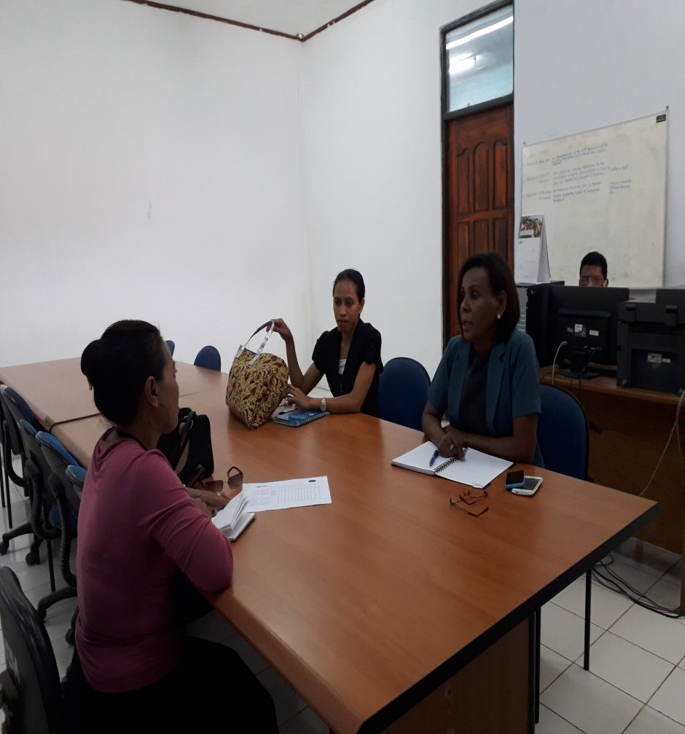
Consultation with Trainer from National Directorate of Pollution for preparation training on production plastic & cloth bags etc….

Slide 21
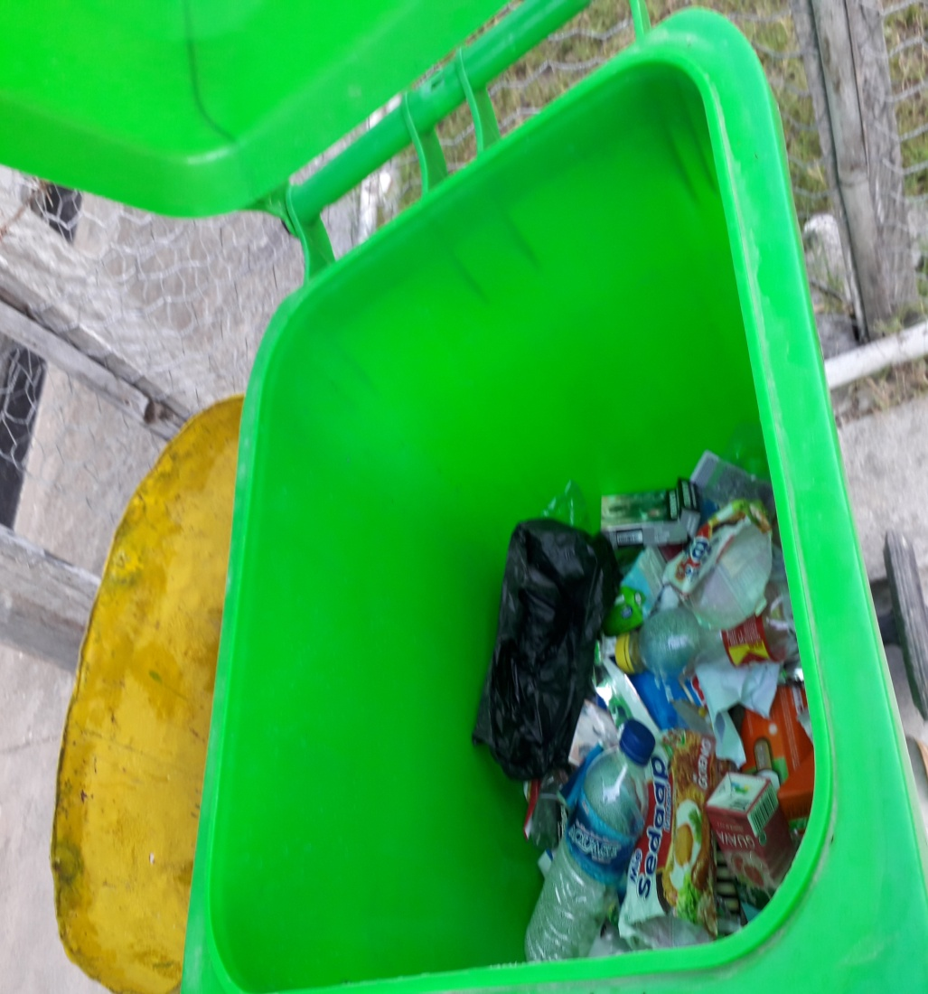
Door to door to women target group for waste collection

Slide 22
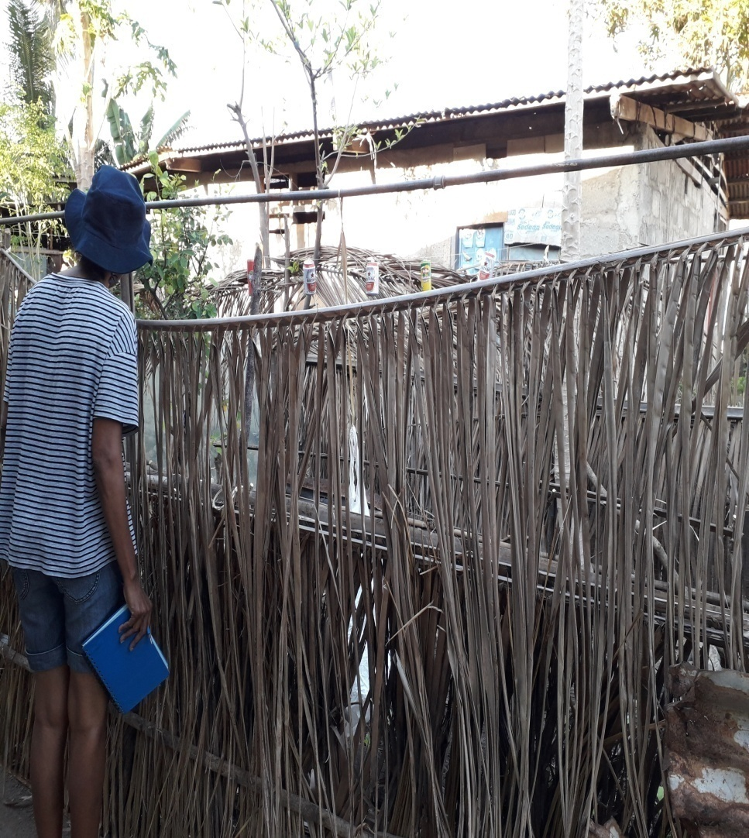
Door to door to Community House & Observe direct to how the community Creative to reduce Cans & Plastic from rubbish

Slide 23
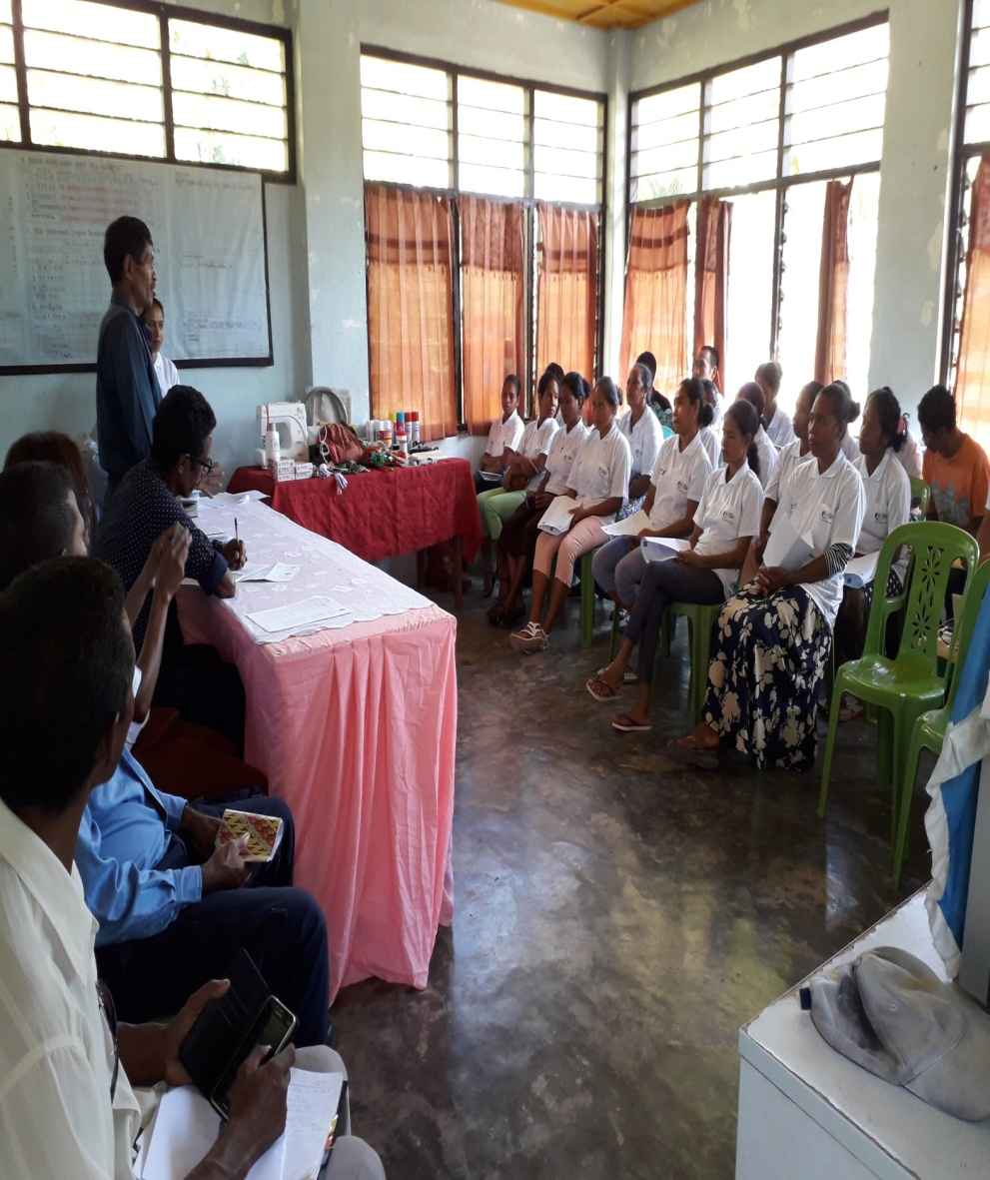
Opening Ceremony of households target woment group (Atauro Vila, August 13-24, 2018)

Slide 24
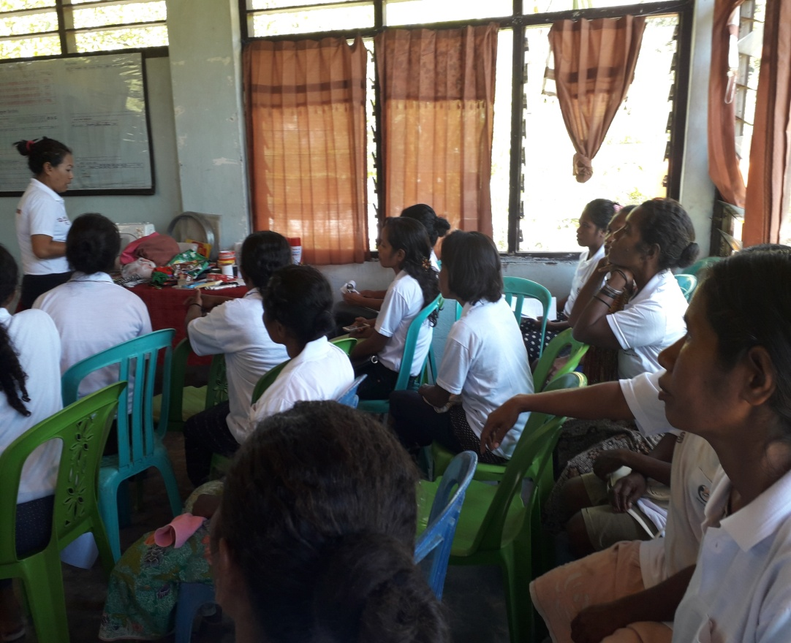
Women target group starting to collect the rubbish for production bags
The trainer starting to explain about how the function of plastic & cloth

Slide 25
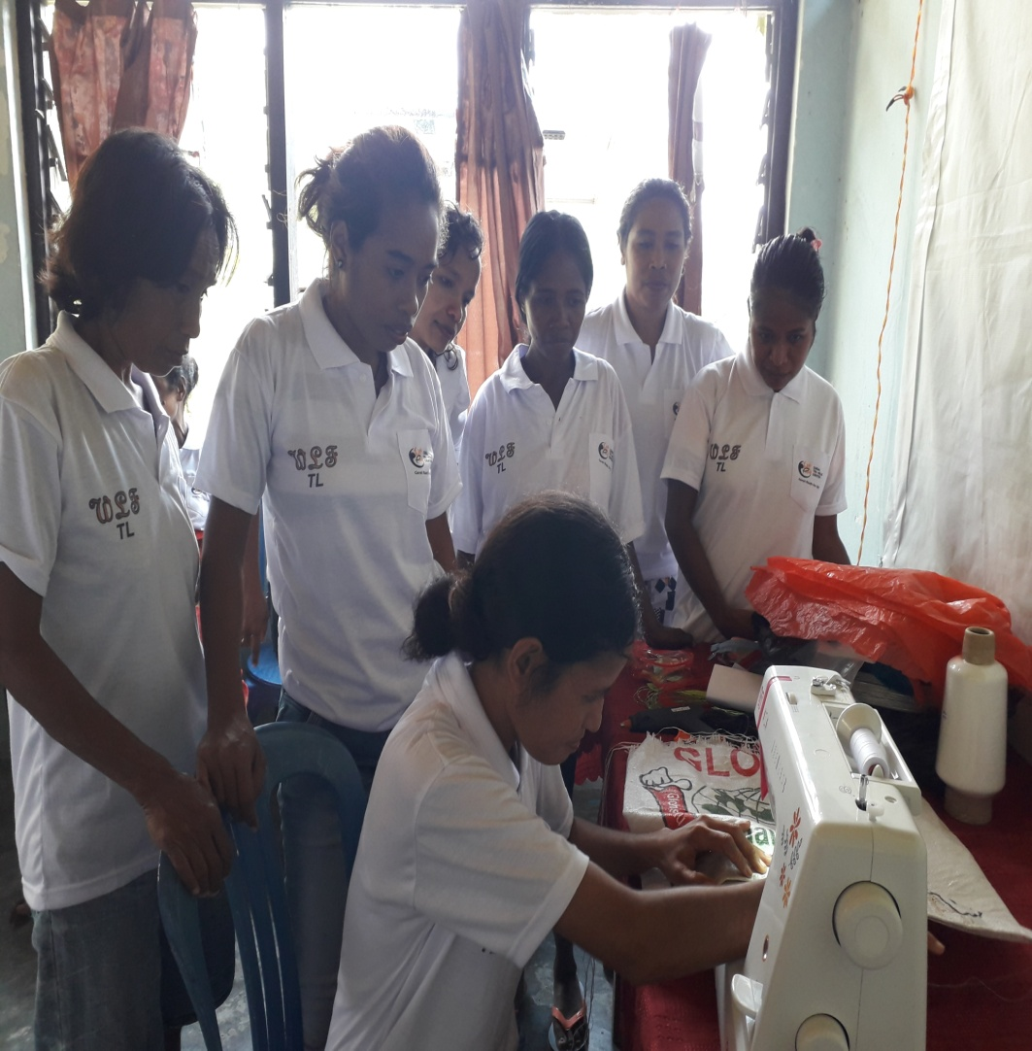
They are starting to produce the bags from plastic
They are sewing the plastic bags by using machine

Slide 26
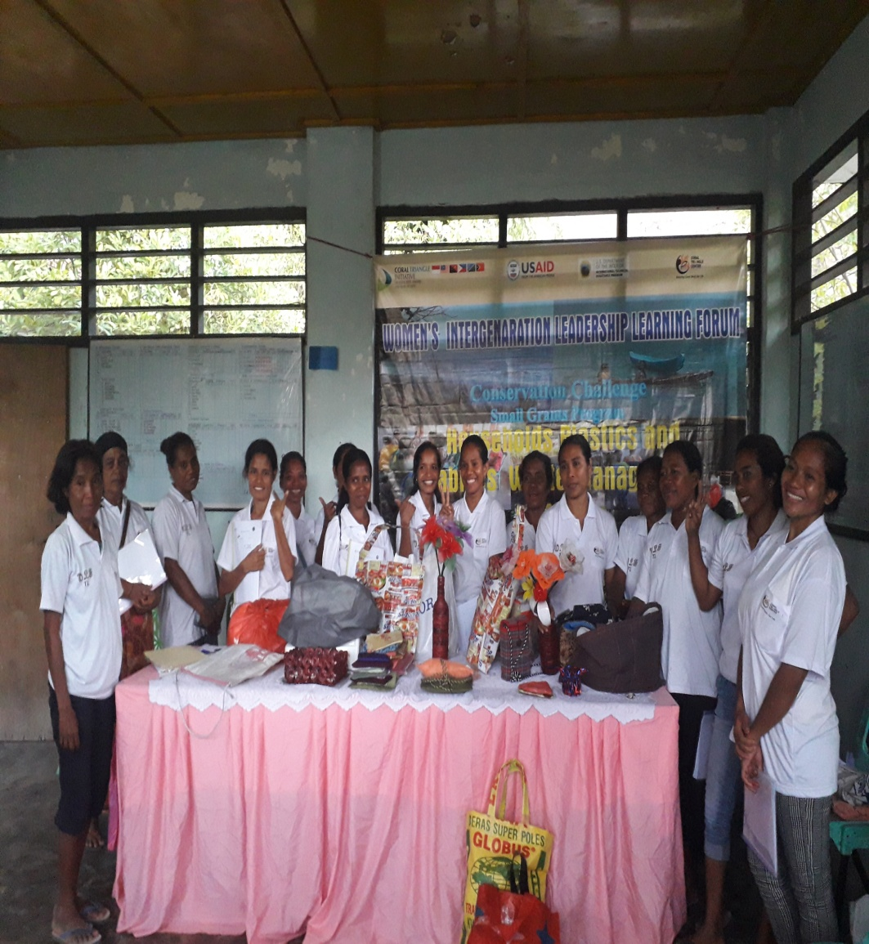
Visitant from NewZeland ambassador to women groups
15 women target group Vila & Beloi

Slide 27
Last day training organize Women target group to collect the rubbish around conservation area

Slide 28
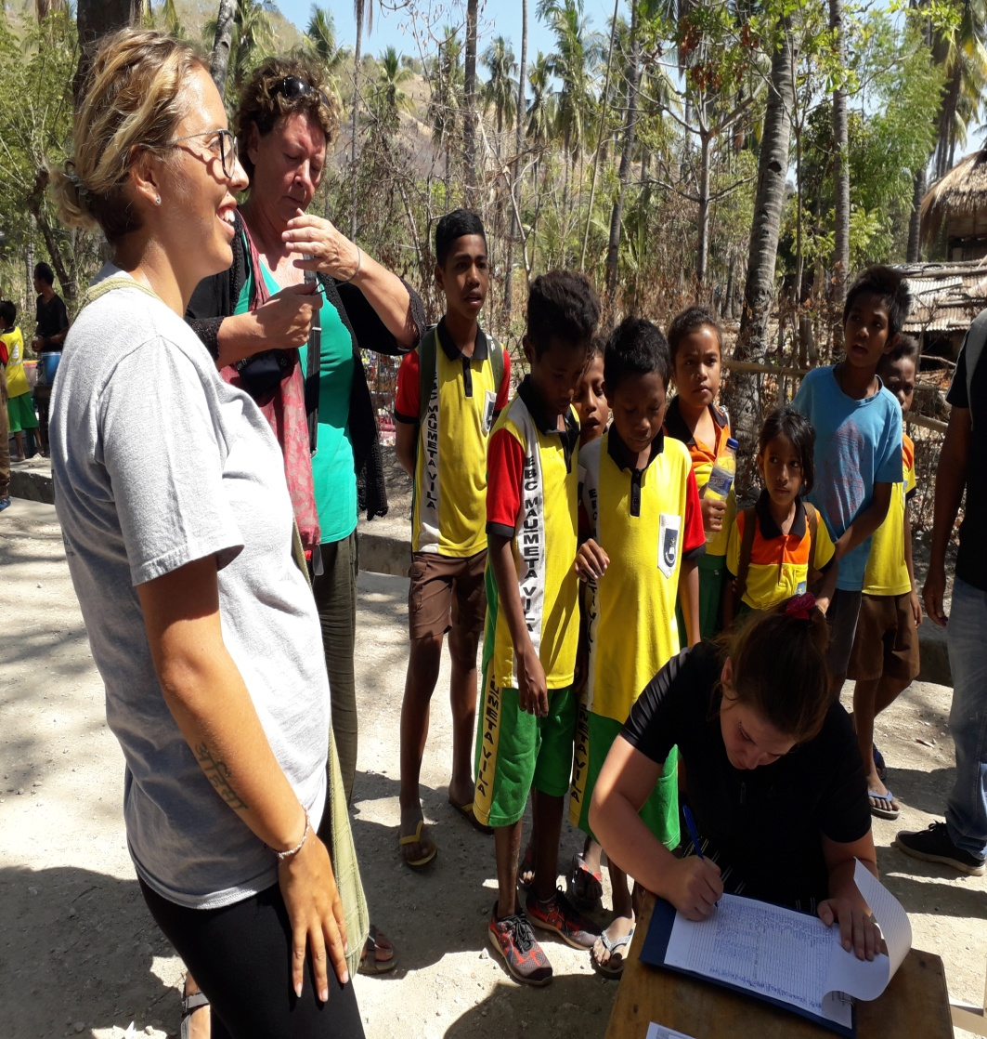
Welcome to our Guest with Traditional Dancing of Timor leste
Registration form of Socialization on plastic &cloth bags etc…!

Slide 29
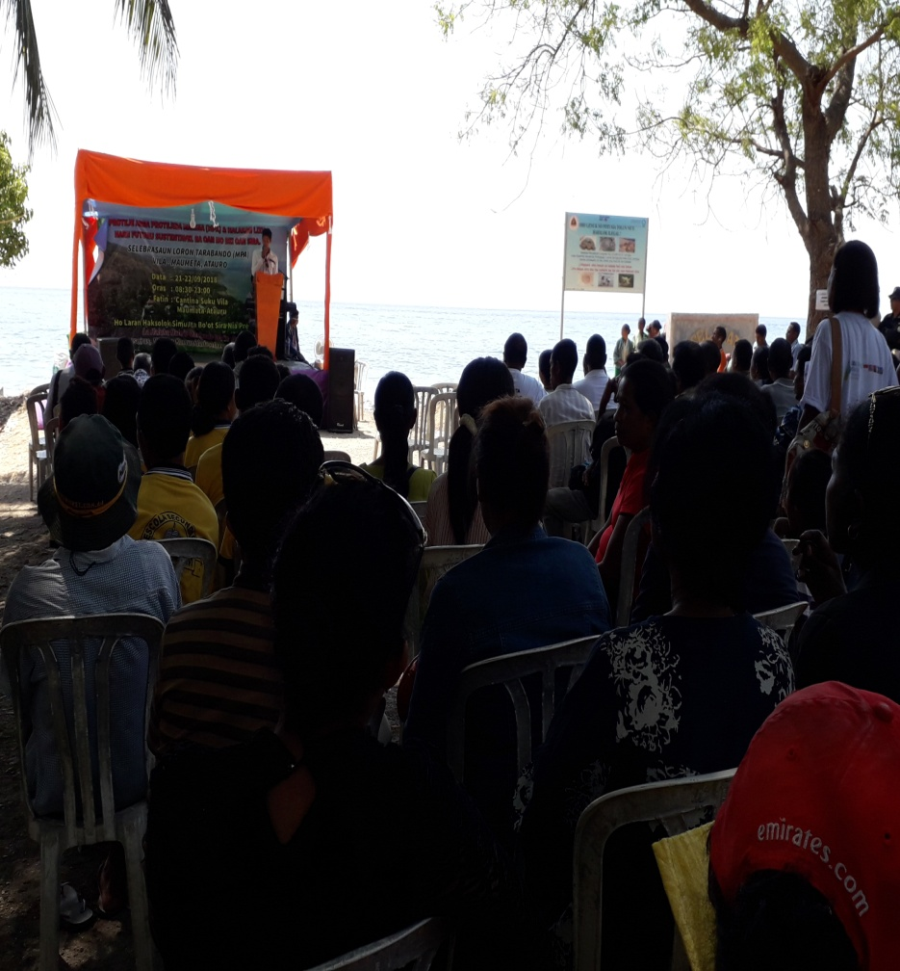
Opening Ceremony, speech from local leader, 21 Sept 2018 Vila Atauro Island
Speech from Chief of Village Atauro Vila

Slide 30
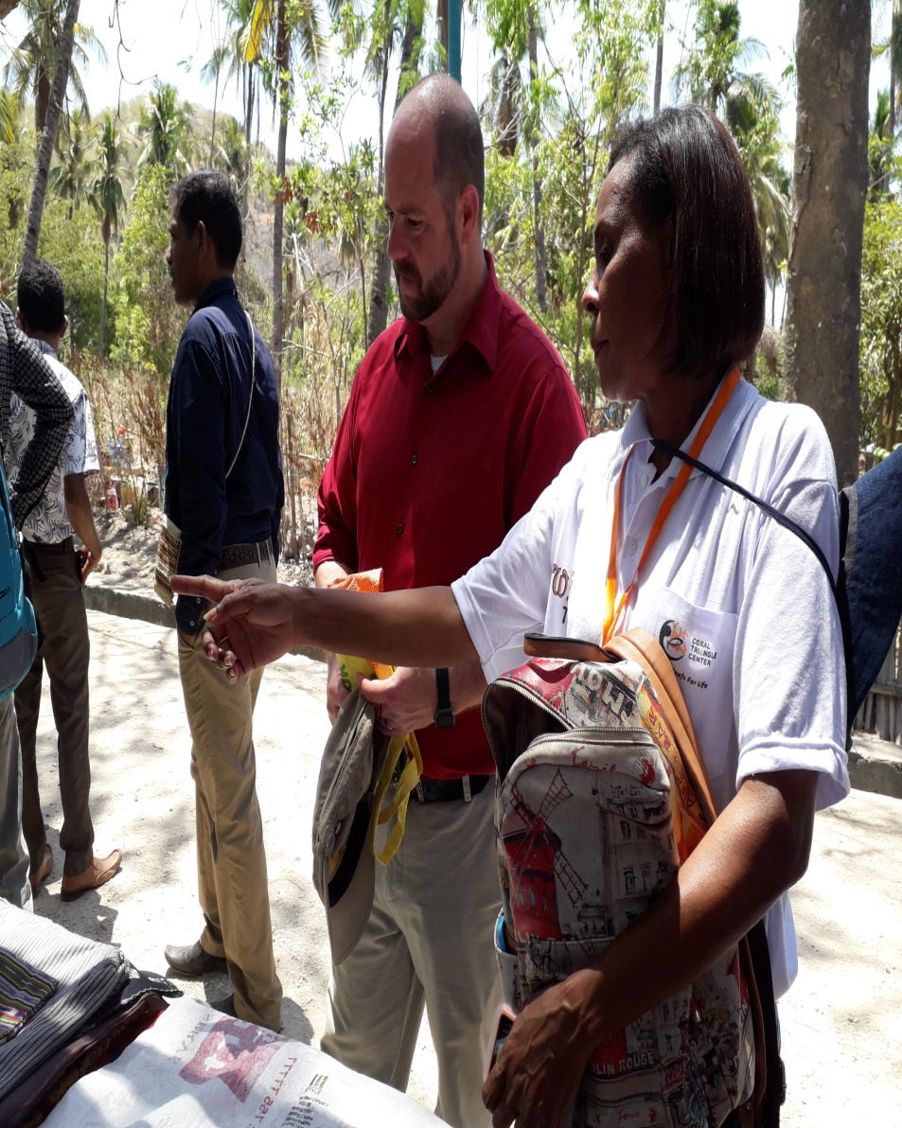
Guest visit our expo for socialization in 22 Sept 2018, Atauro Island Timor-leste

Slide 31
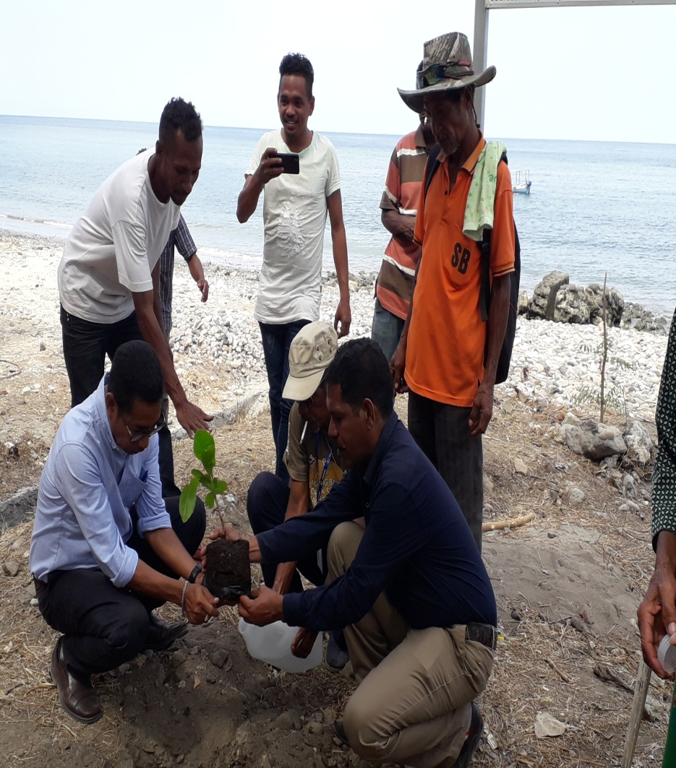
Visitant buy the product from households plastic and clothes bags
National Director of Fisheries with Sub District Administrator starting to plant Mangrove in Conservation area. Sept 22, 2018. Vila Atauro TL

Slide 32
Progress Activity implementation & timeline
 | Activity | Nov | Jan | Feb | Mar | Apr | May | Jun | Jul | Aug | Sep | Oct | Nov | Dec
1 | Inform the program to General Director of Fisheries
2 | 1.Inform the program to National Direction of Fisheries and Resources Management 2. interview Local Community & Fishermen
3 | 1.Coordination with TL CTC Coordinator & CI. 2. Local Leader Approximation
4 | 1.Local Leader Socialization on Plastic & Fabric Waste Management 2. Identify Women Group for House Holds Plastic & Fabric Waste management 3.Delivered trash cans to Villa Village
5 | 1.Socialize use diary to collect waste for Group Identification 2. Distribution trash cans for group identification
6 | 1.Mid activity report 2.Training on production the recycle plastic & fabric bags
7 | Monitoring and Collecting data
7 | Socialize on the function of its recycle plastic & fabric bags.
8 | Final Report
Note:
Activity not realize
Activity realized
Continue to monitoring activity

Slide 33
Thank you
Obrigado

