Slide 1
SOM14
14th Senior Officials’ Meeting
12 - 13 December 2018
Manila, Philippines
SESSION 4: AMENDMENTS TO CTI-CFF REGULATIONS AND RULES AND PROCEDURES
Co-Chair: Indonesia

Slide 2
Background: Revision of the Staff and Financial Regulations
The Revised Staff and Financial Regulations (with its accompanying Policies and Procedures Manual) was developed with the support of the U.S. Government through a consultancy.
CTI Member Parties’ recommendations / feedback were taken into account during the revision process.

Slide 3
Staff Regulations
& Staff Policies and Procedures

Slide 4
Staff Regulations (draft)
Regulation 1: Scope
Regulation 2: Applicability
Regulation 3: Definitions
Regulation 4: Executive Director
Regulation 5: Deputy Executive Directors
Regulation 6: Professional and Support Staff
Regulation 7: Recruitment Policy for the Executive Director and Deputy Executive Directors
Regulation 9: Health Certificates
Regulation 10: General Responsibilities of Staff
Regulation 11: Hours of Work
Regulation 12: Overtime
Regulation 13: Termination of the Contract of Employment
Regulation 14: Entitlements for First Reporting of Duty, Relocation and Termination
Regulation 15: Death of Staff
Regulation 17: Special Leave
Regulation 19: Determination and Currency of Payment
Regulation 20: Salaries
Regulation 21: Higher and Extra Duties Allowances
Regulation 22: Representational Allowance
Regulation 23: Professional Staff and Expatriate Allowances
Regulation 24: Offences
Regulation 25: Staff Committee
Regulation 26: Dispute Settlement and Appeal Procedures
Refer to Annex 5
Notes:
Refer to Annex 5

Slide 5
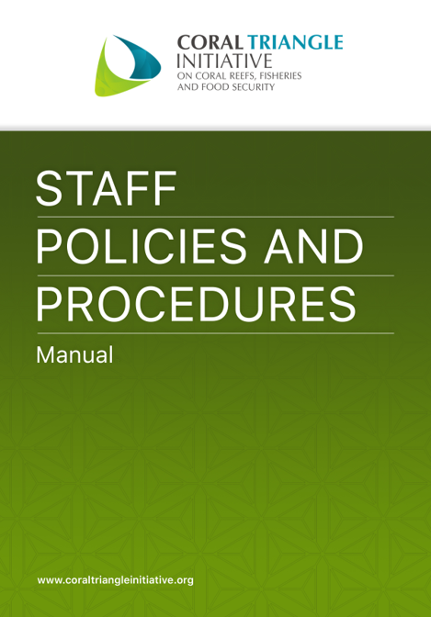
Staff Policies and Procedures (Manual) (draft)
Chapter 1: General Provisions
Chapter 2: Rights and Obligations
Chapter 3: Work Relations
Chapter 4: Working Hours
Chapter 5: Leave, rest, permission
Chapter 6: Protection
Chapter 7: Salary Payment
Chapter 8: Staff Benefits and Welfare
Chapter 9: Work Code of Conduct
Chapter 10: End of Work Relationship
Chapter 11: Complaints and Grievances
Chapter 12: Closing
Notes:
Refer to Annex 6

Slide 6
The Staff Policies and Procedures Manual is prepared in line with CTI-CFF Staff Regulations and following a cycle in staff recruitment cycle with following chapters:
Staff
Policies and
Procedures

Slide 7
Financial Regulations
& Financial Policies and Procedures

Slide 8
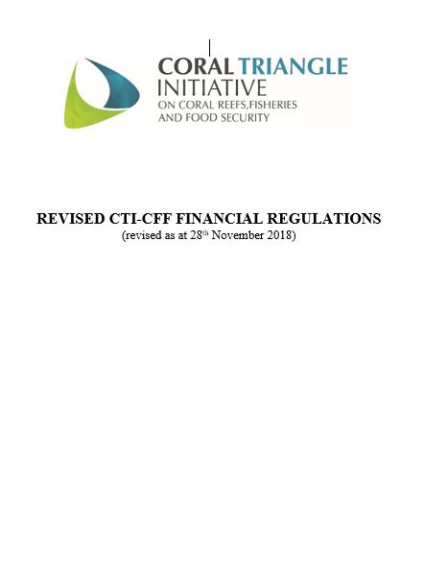
Draft Financial Regulations
Regulation 1: Applicability
Regulation 2: Financial Year
Regulation 3: Definition
Regulation 4: Contributions and Other Income
Regulation 5: Provision of Funds
Regulation 6: Establishment of Funds
Regulation 7: Custody of Funds
Regulation 8: Budget
Regulation 9: Appropriation
Regulation 10: Procurement of Goods and Services
Regulation 11: Accounting
Regulation 12: Reporting to CTI Parties and CTI Partners
Regulation 13: Internal Control
Regulation 14: External Audit
Regulation 15: Acceptance of Financial Statements
Regulation 16: Insurance
Regulation 17: Penalties
Regulation 18: Repealing Clause
Schedule 1: Assessed Contribution Formulae

Slide 9
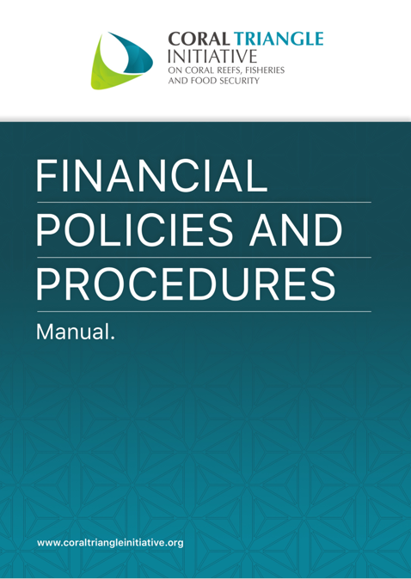
Draft Financial Policies and Procedures
Section 1: Introduction
Section 2: Internal Control
Section 3: Delegation of Financial and Signing Authority
Section 4: Accounting General Guiding Principles
Section 5: General Ledger
Section 6: Budgeting
Section 7: Country Contributions
Section 8: Accounting for Receipts of Funds
Section 9: Fund Accounting
Section 10: Expenditures
Section 11: Travel Management
Section 12: Procurement Management
Section 13: Fixed Assets
Section 14: Banking and Cash Management
Section 15: Appropriations
Section 16: Financial Reporting
Section 17: External Audit

Slide 10
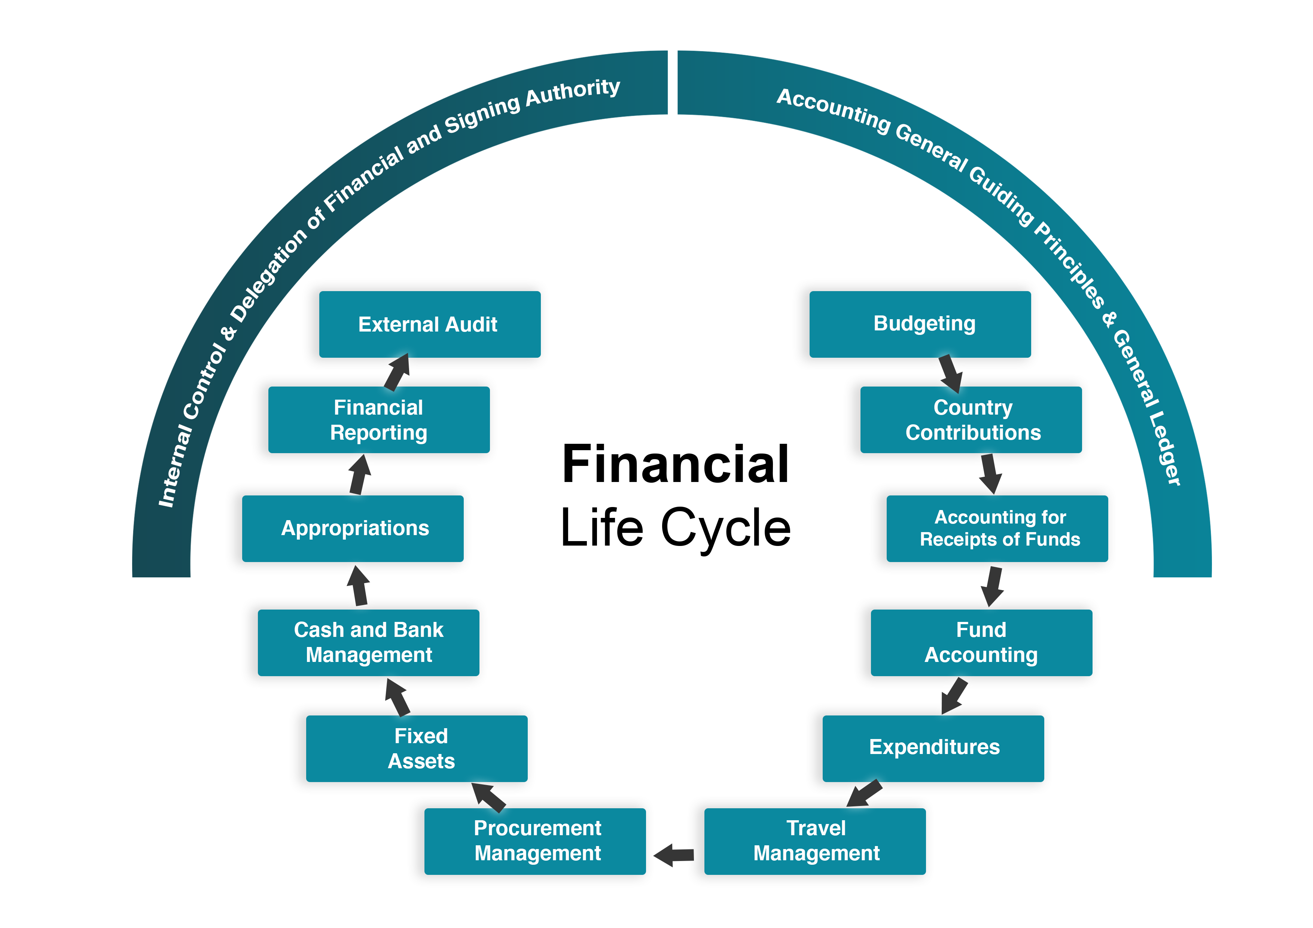
Financial
Life Cycle

Slide 11
SOM-14 Recommendations
Agree on the following:
To recall SOM-13 Decision, agree for the appointment of Executive Director, to observe the principle of rotational basis in alphabetical order among the CTI-CFF member parties;
To recall decision 5.5.1 of SOM-13 Chairman Summary:
to retain the need for the Executive Director to be appointed on rotational basis in alphabetical order among the CTI-CFF member parties;
to revoke the requirement for the Deputy Executive Directors – “will not be of the same nationality as Executive Director at any point of time”.
To propose amendments to Staff Regulations 7.3 with additional sentence that reads “The appointment mechanism for the Executive Director shall be made to observe the principle of rotation in alphabetical order among CTI-CFF Member Parties”.
To consider the principle of rotational basis effective from the appointment of the first Executive Director from Indonesia on April 15, 2015;
To finalize the draft Staff Regulations and Rules & Procedures by February 28, 2019;

Slide 12
SOM-14 Recommendations
Take note the draft of Financial Regulations, and circulate the revised version by 31st December 2018 and CT6 agree to provide comments no later by 31st January 2019. In the event of non-response by the deadline, it shall be deemed as final; and
Take note the draft of Financial Policies and Procedures Manual and circulate the revised version by 31st December 2018 and CT6 agree to provide comments no later by 31st January 2019. In the event of non-response by the deadline, it shall be deemed as final; and
To recommend to COM to delegate powers and responsibilities to the CSO to endorse recommendations 5 and 6 when it is finalized

Slide 13
Terima Kasih - Maraming Salamat Tank Iu- Obrigado Tagio Tumas
Photo credits: Pixabay & IYOR Bank/JayneJenkins/FabriceDudenhofer/Yen-YiLee

Slide 14
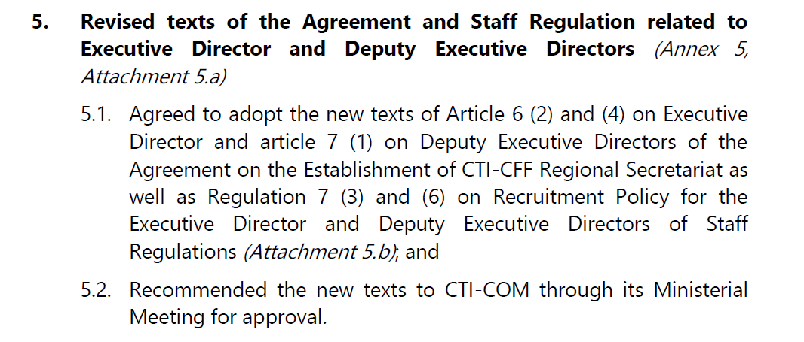
SOM-13 Decisions

Slide 15
