Slide 1
SOM14
14th Senior Officials’ Meeting
12 - 13 December 2018
Manila, Philippines
SESSION 2: PROGRESS REPORT
Co-Chair: Solomon Islands
Presented by Dr. Hendra Yusran Siry , CTI-CFF Regional Secretariat Interim Executive Director

Slide 2
Interim Executive Director’s Remarks
Appreciate the continued commitment from the CT6 Member Parties towards achieving the Regional Plan of Action (RPOA) goals and objectives;
Extend appreciation to the Development Partners - U.S. Government, Australian Government, the Asian Development Bank, World Wide Fund for Nature (WWF), The Nature Conservancy (TNC) and Wildlife Conservation Society (WCS) for the support provided for the Review and to contract consultants to undertake the Review of the Regional Plan of Action (RPOA);
Convey appreciation to the Australian Government for the support provided to develop the draft Terms of Reference (TOR) for the development of the Regional Plan of Action 2.0;
Express gratitude to CTI-CFF Development Partners and collaborators for the continued assistance towards meeting the RPOA goals and objectives;
Assure all stakeholders, that the Regional Secretariat is moving towards more transparency and agility.

Slide 3
Outline
Technical Working Groups
Governance Working Groups
Cross-cutting Theme Working Group
Partnerships and Potential Regional Programs
Participation in International/Regional Events
Corporate and Financial Management Activities
Communication and Outreach Activities
Planned November and December 2018 Activities

Slide 4
Summary of activities
7 activities
5 activities
2 activities
Technical Working Groups
Governance Working Groups
Cross Cutting Theme Working Groups
9 activities
7 events
7 communication platforms used
Partnerships and Potential Regional Programs
Corporate and Financial Management Activities
Participation in International events
Communication and Outreach Activities

Slide 5
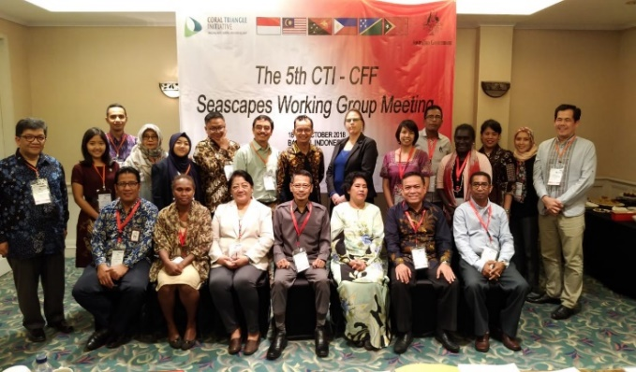
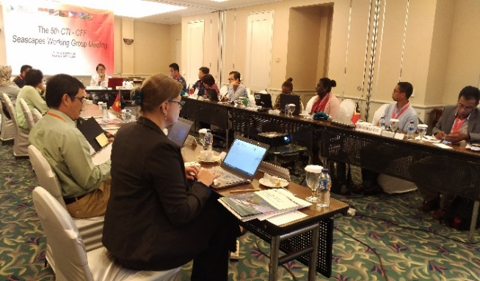
I.TECHNICAL WORKING GROUPS
Seascape Working Group
Multilateral Meeting on the Nomination of Lesser Sunda and Bismarck Solomon Seas Ecoregion as Priority Seascapes
Jakarta, Indonesia / 20 April 2018
2. Regional Sulu-Sulawesi Seascape Convergence Meeting and the Review of the Sulu-Sulawesi Seas EAFM Plan
Cebu, Philippines / 3-6 July 2018
3. 5th CTI-CFF Seascapes Working Group Meeting
Banten, Indonesia / 18-19 October 2018
5th CTI-CFF Seascapes Working Group Meeting
©MMAF/Dinah Yunitawa/2018
Regional Sulu-Sulawesi Seascape Convergence Meeting ©GIZ/Marion Daclan/2018

Slide 6
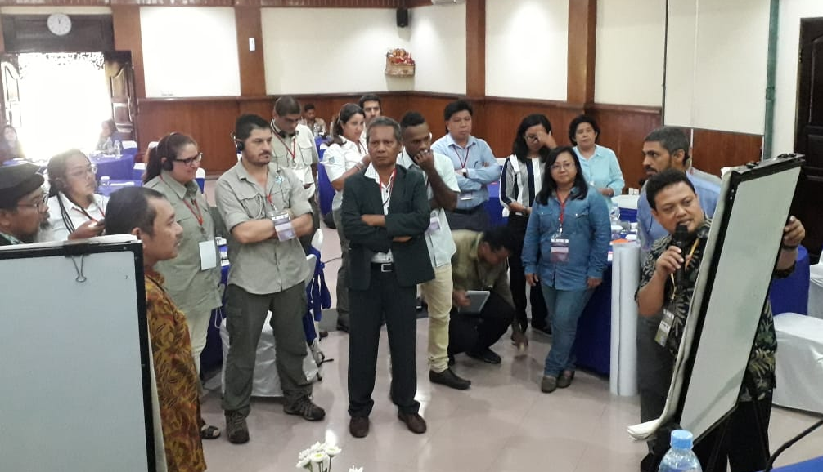
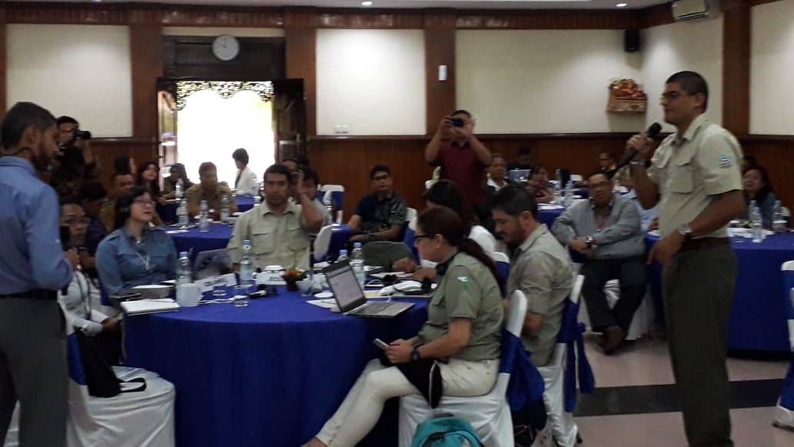
B. Ecosystem Approach to Fisheries Management Working Group
Regional Training Workshop on EAFM with CMAR
Bali, Indonesia / 7-10 August 2018
Gathered officials from conservation, environment, fisheries and maritime agencies of Costa Rica, Colombia, Ecuador, Panama, Indonesia, Malaysia, Solomon Islands and Timor-Leste.
Participants were provided with concepts, principles of EAFM and its application; development, implementation and monitoring of EAFM Plan.
Through the workshop, CT6 and South American countries hope to continue to coordinate, especially in terms of sharing experiences in the implementation of EAFM in their countries.
© CTI-CFF Regional Secretariat/Dr. Sharifah Nora Ibrahim/2018

Slide 7
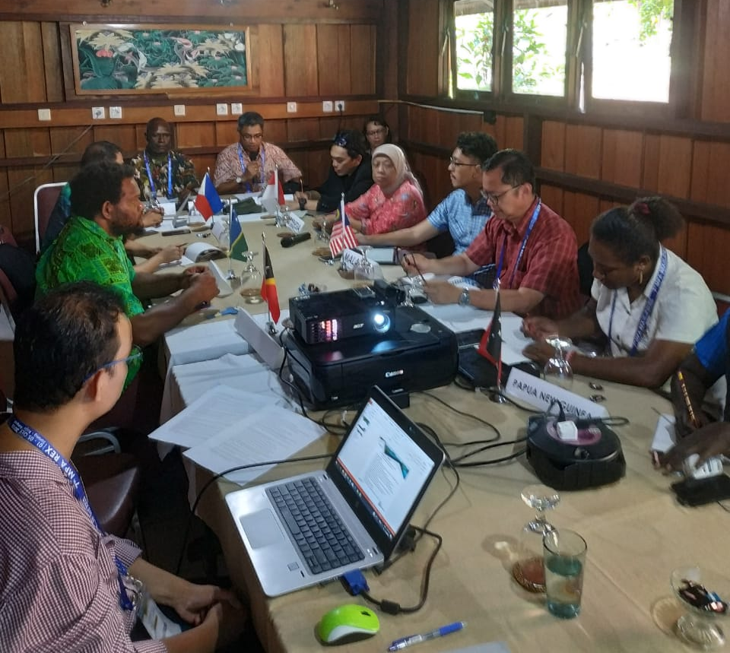
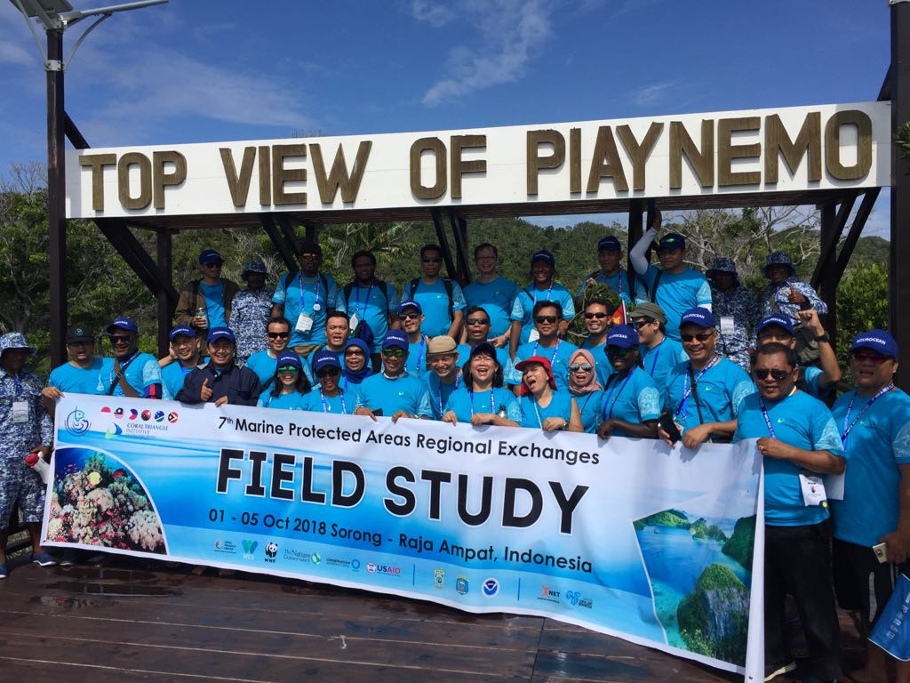
C. Marine Protected Areas
MPA Regional Exchange
Sorong and Raja Ampat, Indonesia / 30 Sept – 5 Oct 2018
Some decisions that came out from the meeting:
Regional Secretariat to facilitate capacity building for the CT Atlas Focal Points and resolve issues in accessing CT Atlas;
Extended the implementation of the roadmap for the third round of CTMPAS nomination until 2019 and to start the creation of the External Advisory Committee in November 2018;
Recognized and endorsed the program for the Recognition of Effectively Managed MPAs; and
Recommended that the Sustainable Marine Tourism Task Force begin their duties by reviewing the Global Sustainable Marine Tourism Council’s guidelines and criteria.
©CTI-CFF Regional Secretariat/2018

Slide 8
D. Climate Change Adaptation Working Group
1. The 5th CTI-CFF Climate Change Adaptation Working Group Regional Exchange and Grant Workshop
Sabah, Malaysia / 10-13 April 2018
Reviewed the priority actions outlined in the REAP –CCA, both at the country and regional levels;
Developed and ﬁnalized the draft Terms of Reference for the establishment of the Regional COE on CCA;
Developed the course outline for the Executive Course on CCA designed for local governments based on the LEAP Guide; and
Strengthened or enhanced the skills of the participants in terms of proposal-writing to increase chances of winning grants to support the national CCA programs and activities.

Slide 9
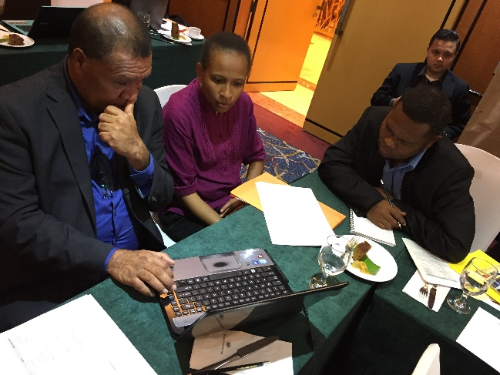
D. Threatened Species Working Group
The 1st Threatened Species (TS) Working Group Regional Exchange
Quezon City, Philippines / 24-26 April 2018
Finalized the draft TOR for the creation of a pool of experts on threatened species and initiated the drafting of the TSWG M&E indicators; and
Discussed the targets of Goal 5 particularly on how to complete the region-wide conservation plans on TS and the region-wide TS status report.
©CTI-CFF Regional Secretariat/2018

Slide 10
II. GOVERNANCE WORKING GROUPS
Coordination Mechanism Working Group &
Financial Resources Seascape Working Group
Financial Resources and Coordination Mechanism Working Group Meeting
Jakarta, Indonesia / April 2018
Deliberated internal CTI-CFF matters such as: (i) Staff Regulations & Rules and Procedures; (ii) Financial Regulations & Rules and Procedures; (iii) Budget 2018 and 2019; and (iv) Audit matters.
Deliberated and assessed the possibility of establishing an independent committee to oversee internal financial matters such as preparation of budget and audit.

Slide 11
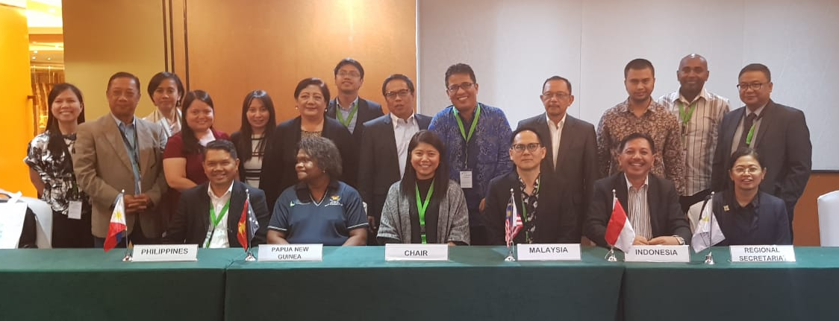
2. Special Senior Officials’ Meeting
Quezon City, Philippines / 25-26 July 2018
Deliberated and decided on the following;
Interim management measures to address operational challenges related to change in leadership of Regional Secretariat;
Proposed 2018 Budget of the CTI-CFF Regional Secretariat;
Proposed amendment of the Financial and Staff Regulations of the CTI-CFF Regional Secretariat;
Freeze hiring of new staff appointments;
Approval for audit process of 2017
as well as 2014-2016 financial
transactions; and
US government continued support for
several key consultants to address
financial issues.

Slide 12
Monitoring and Evaluation Working Group
1. RPOA Review and Presentation of its Results
May – October 2018
The Inception Report was submitted in June 2018; while the Final Report was submitted and presented to the RPOA Review Committee in October 2018 during the MEWG and FRWG Meetings in Jakarta, Indonesia.
Led by Dr. Lida Pet Soede from the Marine Unit of PT Hatfield Indonesia with Dr. Sharifah Nora Ibrahim as the RPOA Review Manager.
RPOA Review funded by the US Government together with the Australian Government ad Asian Development Bank, The Nature Conservancy, World Wildlife Fund, and Wildlife Conservation Society.

Slide 13
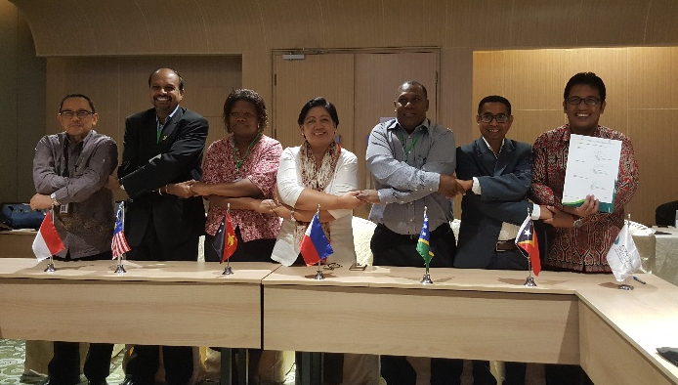
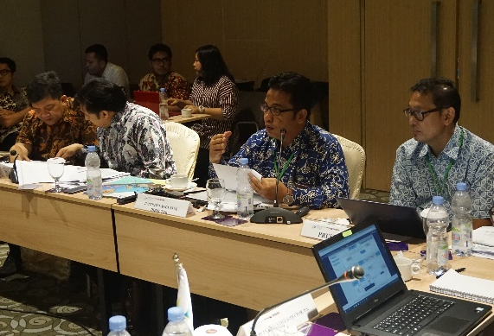
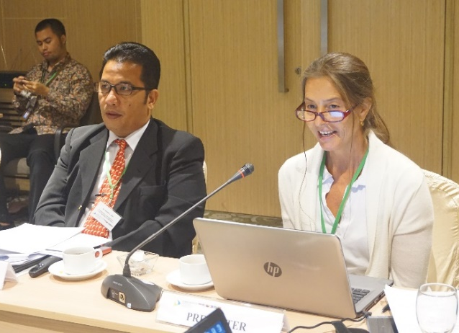
2. Preparatory SOM.MM Meeting (MEWG & FRWG Meetings)
Jakarta, Indonesia / 9-12 October 2018
Key decisions made in these meetings:
Acceptance of the RPOA Review findings and recommendations and agreed for this to put forward at the upcoming SOM-14 and MM-7 for acceptance;
Acknowledgement and appreciation of the Acting Executive Director, Dr. Sharifah Nora Ibrahim;
Acknowledgement of the Interim Executive Director, Dr. Hendra Yusran Siry;
Lifting of the staff hiring process;
Acceptance of 2018 budget and findings from the audit process;
Acceptance of the temporary proposed 2018 organization chart; and
Agreement of the revised 2019 organization chart for SOM-14 and MM-7 acceptance and endorsement.
©CTI-CFF Regional Secretariat/2018

Slide 14
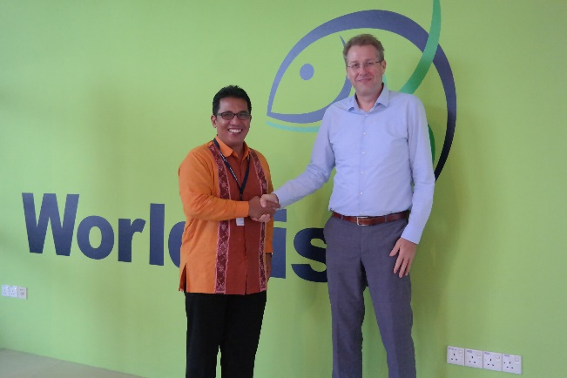
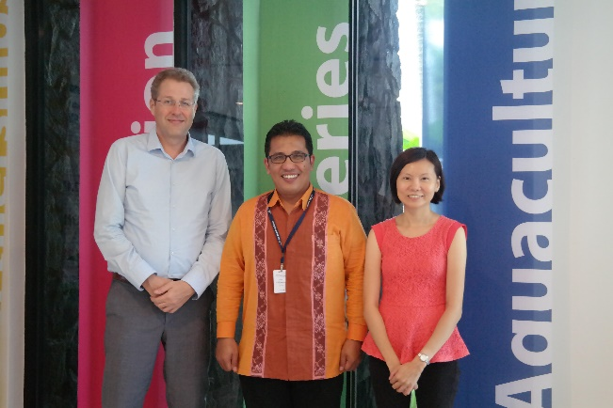
3. Meeting with Director General of WorldFish-CT Atlas
Penang, Malaysia / 8 November 2018
Results of the meeting:
Acknowledged that the CT Atlas is linked to the ReefBase database and WorldFish in principal;
Agreed that CT6 data in ReefBase can be migrated to CT Atlas when it is moved to Manado;
A Concept Note shall be prepared for MEWG consideration that would describe a two (2) years program of redesigning, training and migrating the CT Atlas to the RS’s headquarter; and
A Consultation or Planning Workshop and Business Plan with CT6 is being planned.
©CTI-CFF Regional Secretariat/2018

Slide 15
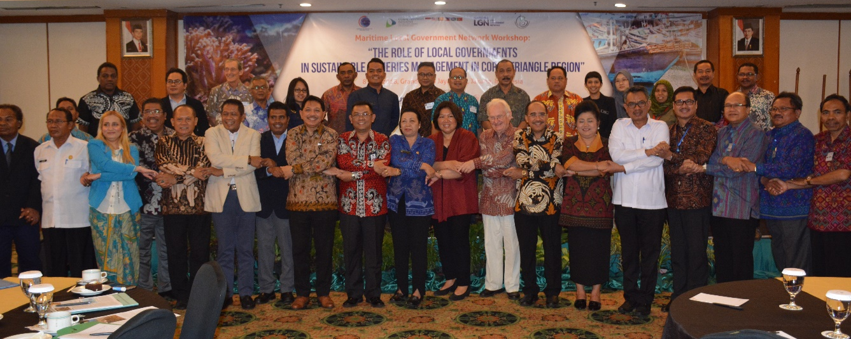
III. CROSS-CUTTING THEME WORKING GROUP
Local Government Network
1. LGN Workshop – The Role of Local Governments in Sustainable Fisheries
Jakarta, Indonesia / 9 May 2018
Conducted for the local governments of CT member countries to develop a local government plan of action that will ensure coastal and marine management and protection.
Envisaged to localize the EAFM and encourage other local governments to develop a plan that is aligned with the national and regional plans of action for the Coral Triangle.
Supported by the Coral Triangle Centre (CTC) through the USAID-DOI.
©LGN Coordinator/2018

Slide 16
Women Leaders Forum
WLF Call Meetings
A preliminary scoping report was prepared and found that indeed a CTI-CFF Gender Policy is critically needed to ensure mainstreaming of gender matters into program implementation and to drive the development and implementation of gender legislations.
Intergenerational Learning
This leadership program is implemented by the Coral Triangle Centre (CTC) through the support from the U.S. Government.
Concluded at the recent Our Ocean Conference (OOC) 2018 with a side event highlighting the work of the mentor-mentee pairs from the respective CT6 member countries.

Slide 17
IV. PARTNERSHIPS AND POTENTIAL REGIONAL PROGRAMS
USAID Strengthening Organizational and Administrative Capacity
for Improved Fisheries Management (SOACAP)
Activity 2.1: CTI-CFF Public Private Partnership Preparation: Expert Consultation Meeting on PPP Design and Arrangement
Jakarta, Indonesia / 4-5 April 2018
Aimed at:
(1) introducing and building better understanding concept of PPP in sustainable fisheries to CT member countries through National Coordination Committee of CTI-CFF;
(2) develop better and suitable PPP arrangement which allows member countries to actively participate in the development of PPP activities related to improve sustainable fisheries practices

Slide 18
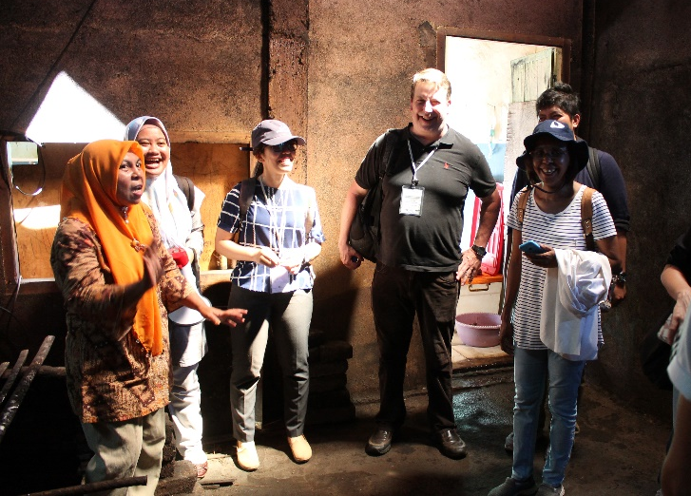
2. Activity 1.2: Learning Exchanges for CT6 Countries at
USAID Oceans Learning Site
Manado-Bitung, Indonesia / 25-28 June 2018
Focused on the application of catch documentation and traceability (CDT) system for fisheries and seafood products.
A partnership activity of the CTI Regional Secretariat and USAID Oceans.
©USAID Oceans/Melinda Donnelly/2018

Slide 19
B. Other Regional Cooperation Activities
1. Third Targeted Regional Workshop for GEF IW projects in East Europe and Asia-Pacific
Bangkok,Thailand / 30 April – 2 May 2018
Together with the International Commission for the Protection of the Danube River (ICPDR), the International Union for the Conservation of Nature (IUCN) and the United Nations Industrial Development Organization (UNIDO), as well as representatives from Partnerships in Environmental Management for the Seas of East Asia (PEMSEA) and the Capturing Coral Reef & Related Ecosystem Services (CCRES) project.
Focused on the following topics: Knowledge Platforms, Innovative Tools, Legal and Institutional Frameworks, Benefit Sharing, and Economic Valuation.

Slide 20
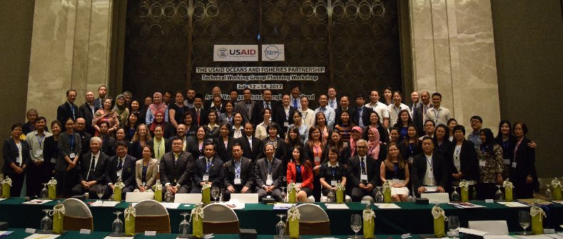
2. Ocean and Fisheries Partnership Technical Working Group Planning
Bangkok, Thailand / 16-18 July 2018
Participated in the USAID Oceans organized activity that convened its Regional Technical Working group members, partner organizations and US government representatives.
Gathered inputs for the development of a set of regional guidelines on the adoption and use of electronic catch documentation and traceability system (e-CDT).
© Oceans/Melinda Donnelly/2018

Slide 21
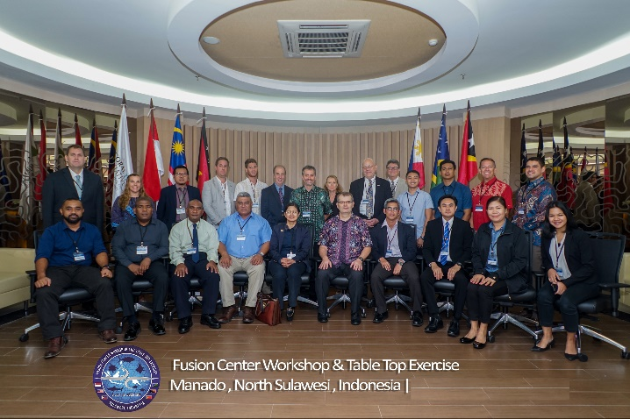
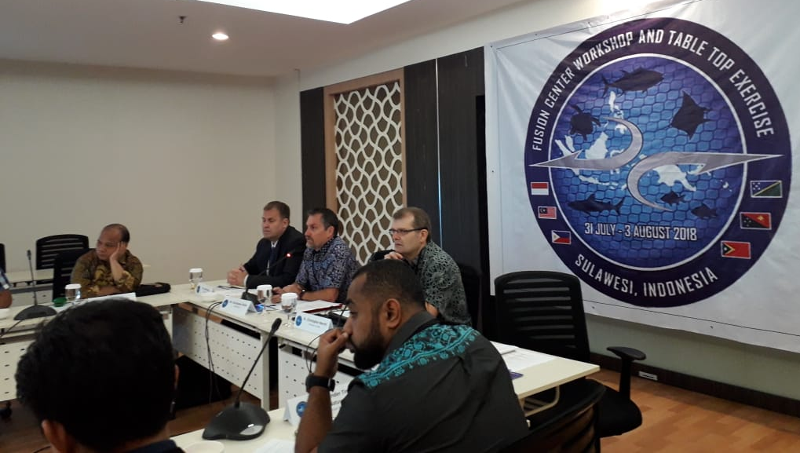
3. Maritime Environmental Security - US Pacific Command Maritime Fusion Cell Table Top
Manado, Indonesia / 31 July- 3 August 2018
Hosted by the US Indo-Pacific Command
Demonstrated the value of information sharing for countering Illegal, Unregulated and Unreported (IUU) Fishing, advanced maritime domain awareness and information sharing among Indo-Pacific partners through table-top exercise (TTX)
Emphasized the following:
a. The benefits of information-sharing
internationally through national Data Fusion
Centers, and
b. The link between IUU fishing and other
transnational crimes including wildlife trafficking, human trafficking, and drug smuggling.
c. The link between Environmental Security and
Maritime Domain Awareness (MDA).
©USINDOPACOM/2018

Slide 22
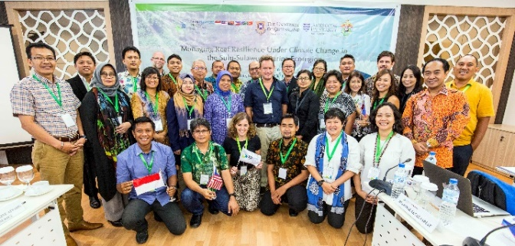
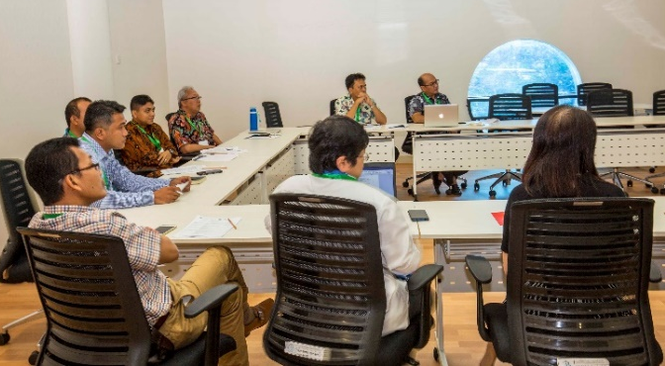
4. Managing Reef Resilience Under Climate Change in the Sulu-Sulawesi Marine Ecoregion (SSME)
Manado, Indonesia / 7-9 May 2018
Organized by the University of Queensland and Hasanuddin University in cooperation with CTI-CFF Regional Secretariat and other university partners - Deakin University, University of Borneo, University of Malaysia Sabah, University of the Philippines, and University of Sam Ratulangi.
A project proposal in light of this workshop was prepared by Prof. Peter Mumby of Queensland University and shall be further taken up by the Seascape TWG for further process through GEF-7 cycle
©CTI-CFF Regional Secretariat/2018

Slide 23
5. Managing Reef Resilience Under Climate Change in the Bismarck Solomon Marine Ecoregion (BSME)
Brisbane, Australia / 13-15 August 2018
The three-day workshop identified issues and challenges facing reefs and associated fisheries within the BSME region, both at regional and national level and how these can be translated into a proposal for implementation.
The activity was also an opportunity for CTI-CFF to raise appreciation and understanding on the value of a ‘seascape’ approach to marine resource management in the context of BSME.
©CTI-CFF Regional Secretariat/2018

Slide 24
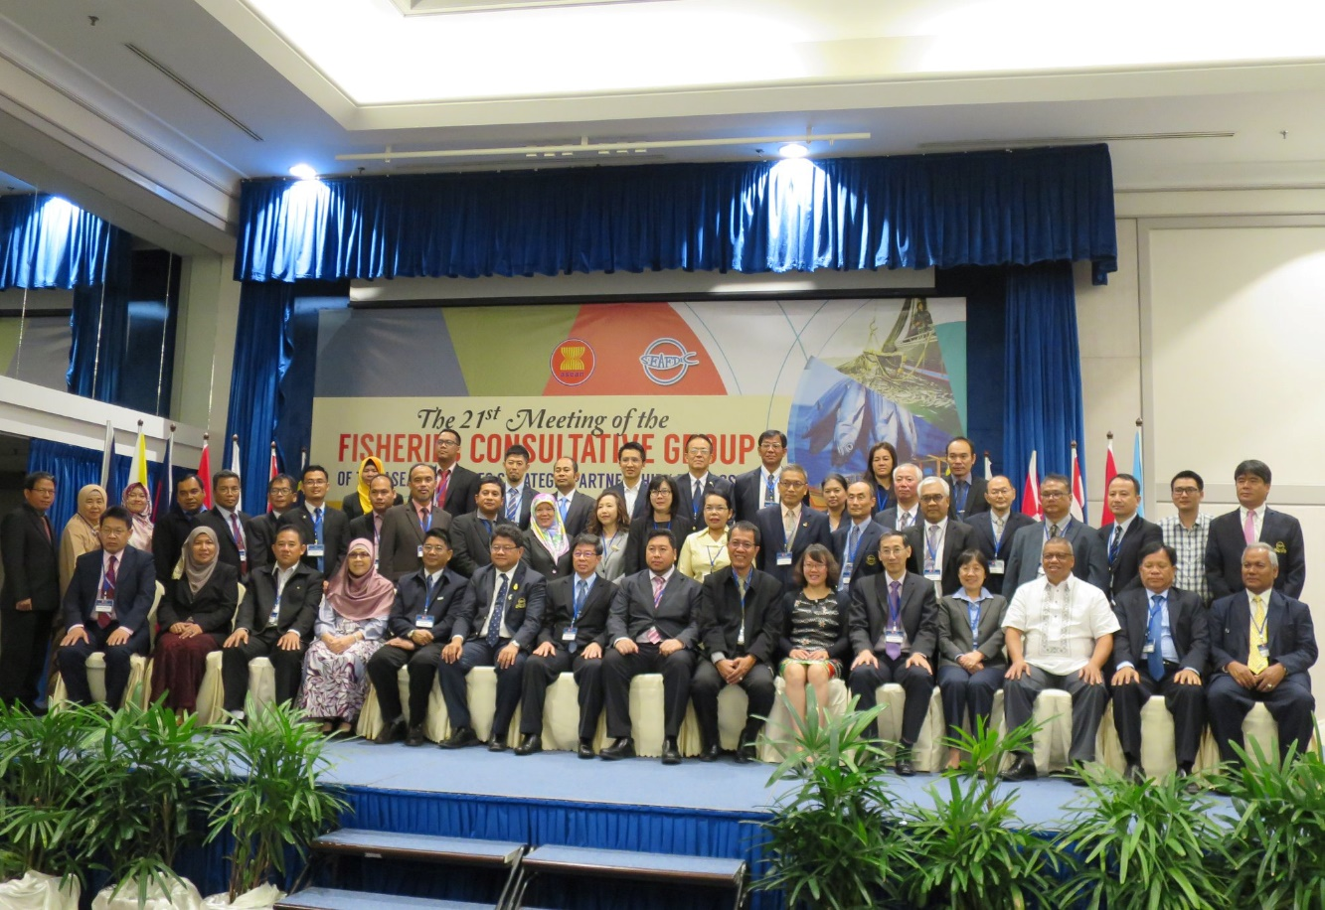
6. 41st Meeting of the SEAFDEC Program Committee (41PCM) and 21st Consultative Group of the ASEAN-SEAFDEC Strategic Partnership
Langkawi, Malaysia / 5-7 November 2018
Invited as a partner to SEAFDEC through the MOU) signed in 2015 for a 5-year period.
CTI Reg’l Secretariat IED Dr. Hendra Siry made an intervention to call for focus on the issue of illegal trade of Live Reef Fish for Trade (LRFFT); and to work closely with SEAFDEC on activities that would benefit the CT6 countries
©SEAFDEC/2018

Slide 25
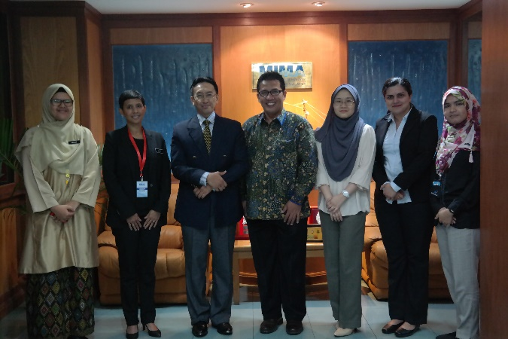
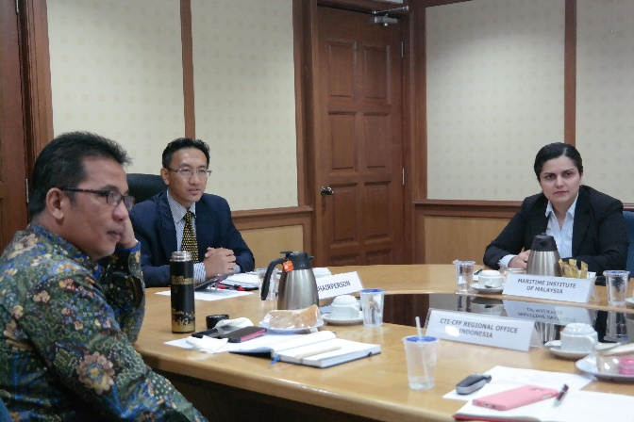
7. Courtesy Meeting to the Maritime Institute of Malaysia (MIMA)
Kuala Lumpur, Malaysia / 9 November 2018
Courtesy meeting to the Deputy Director General, Dr. Rizal Abdul Kadir at the Maritime Institute of Malaysia (MIMA) was also attended by NCC Malaysia representatives
Agreed that MIMA can be one of policy resource organizations both for Malaysia and to contribute to CT6 discussions
© Regional Secretariat/2018

Slide 26
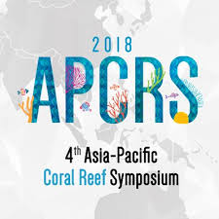
V. PARTICIPATION IN INTERNATIONAL/REGIONAL EVENTS
4TH Asia-Pacific Coral Reef Symposium 2018
Kuala Cebu City, Philippines / 4-8 June 2018
Organized by the Marine Protected Areas Network
2. Pacific SIDS Regional Preparatory Meeting
Nuku’alofa, Tonga / 19-21 June 2018
Provided an invaluable opportunity for SIDS in the Pacific to share their national experiences and best practices as well as identify opportunities to address major challenges at this important juncture in the implementation process.

Slide 27
3. Sustainable Ocean Initiative – Convention on Biological Diversity Workshop
Jakarta, Indonesia / 31 July – 3 August 2018
The CTI-CFF through its Regional Secretariat expressed commitment to contribute towards the achievements of Aichi Biodiversity Targets 10 and 11 and the Priority Actions during the Convention on Biological Diversity Sustainable Ocean Initiative (CBD-SOI) Sub Regional Capacity-Building Workshop Coral Triangle.
The CTI-CFF committed to provide the enabling environment for better articulation and coordination among marine environment-related national strategies and action plans of its member countries.
©CBD-SOI/2018

Slide 28
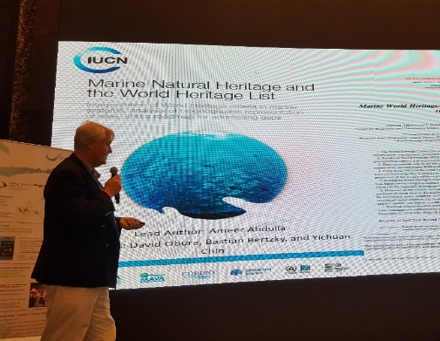
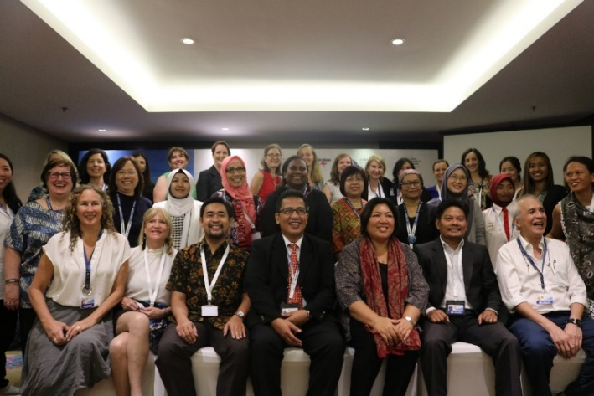
4. Our Ocean Conference
Bali, Indonesia / 29-30 October 2018
Hosting and organizing of the following two (2) Ocean Talks:
Ocean Talk “Strategic Direction for Coral Triangle: Update and Way Forward for Regional Plan of Action
b. Ocean Talk “Legacy for Coral Triangle – Towards International Recognition for Marine Megabiodiversity Area”
c. Side event: Women Leaders, Breaking Waves in Ocean Conservation
©Dr.Lida Pet-Soede/2018
©CTI-CFF Regional Secretariat/2018
©USAID Oceans/Melinda Donnelly/2018

Slide 29
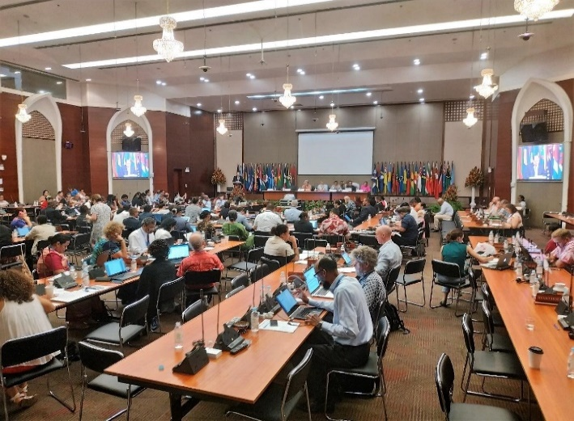
5. Inter-Regional Partnership Dialogue
Samoa / 29 October – 1 November 2018
Facilitated and supported by UN-DESA through the SIDS Unit, OHRLLS and by relevant agencies of the UN system including regional commissions.
The discussions were built on the outcomes of three regional partnership dialogues, with the overall objective to advance the SAMOA Pathway and the 2030 Agenda for Sustainable Development in SIDS.
©CTI-CFF Regional Secretariat/Dr. Gregory Bennett/2018

Slide 30
VI. CORPORATE AND FINANCIAL MANAGEMENT ACTIVITIES
Facilitated the appointment of an independent audit firm to conduct special audits for 2014 to 2016 and full audit for 2017 financial transactions of the CTI-CFF.
The final audit reports were sent to CT6 member countries in early November 2018.
USAID provided support to Regional Secretariat to engage a Strategic Financial and Administrative Consultant to assist and provide interim guidance as well as recommendations on corporate and financial management activities of the Regional Secretariat.

Slide 31
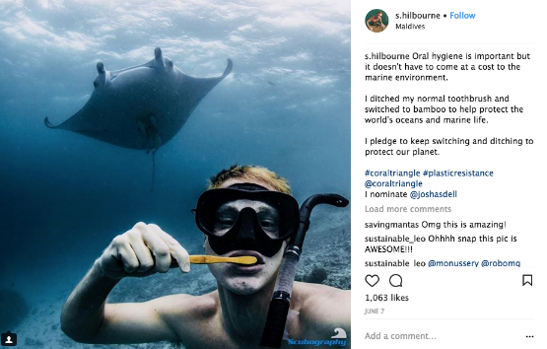
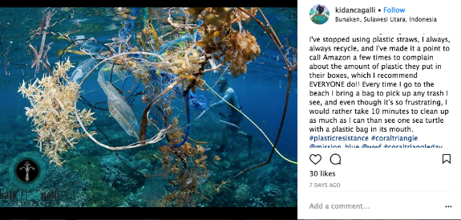
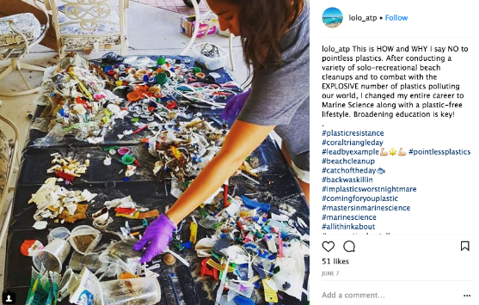
VII. COMMUNICATION AND OUTREACH ACTIVITIES
Coral Triangle Day Celebration
Focused on increasing awareness of the impacts of plastic of marine environment and the destructive use of plastics
In partnership with WWF, launched the Instagram Contest from May – 22 June 2018. The contest attracted a total of 447 entries.

Slide 32
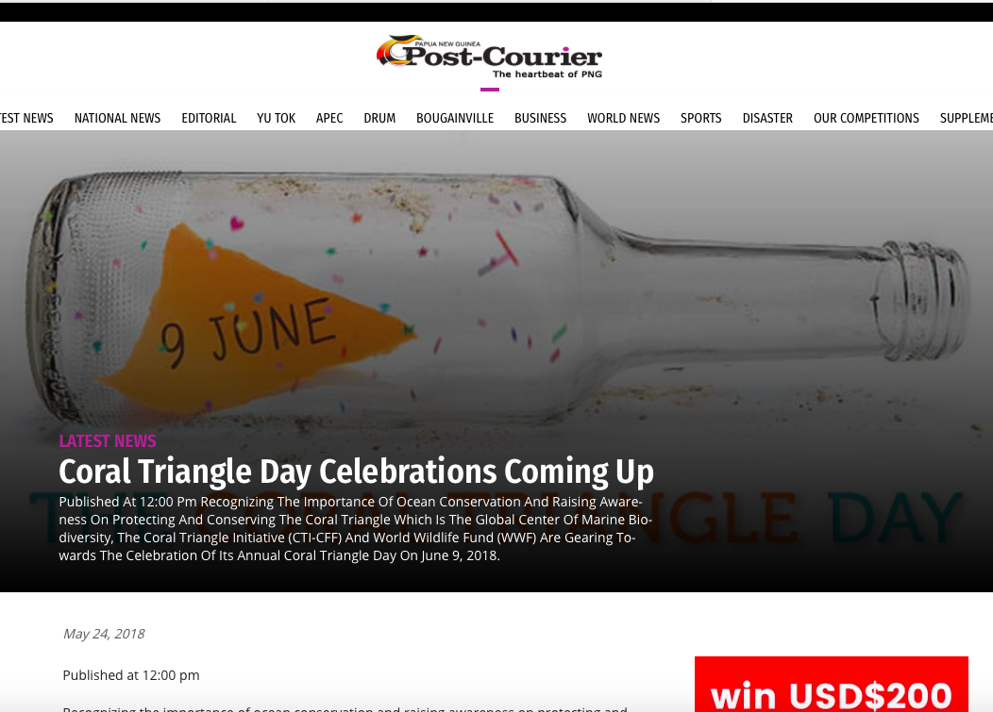
Bimonthly production of CTI-CFF Newsletter
Preparation and dissemination of Press Release

Slide 33
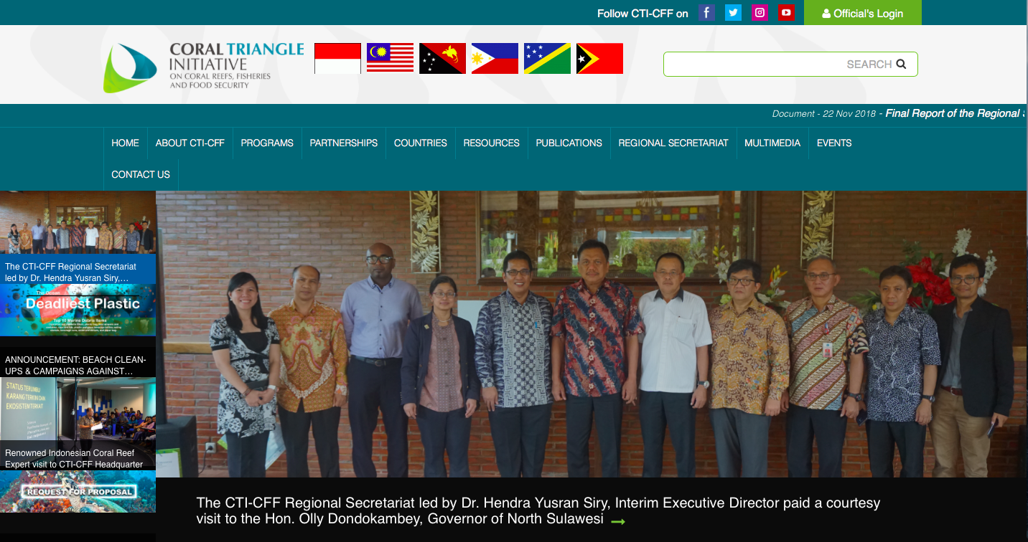
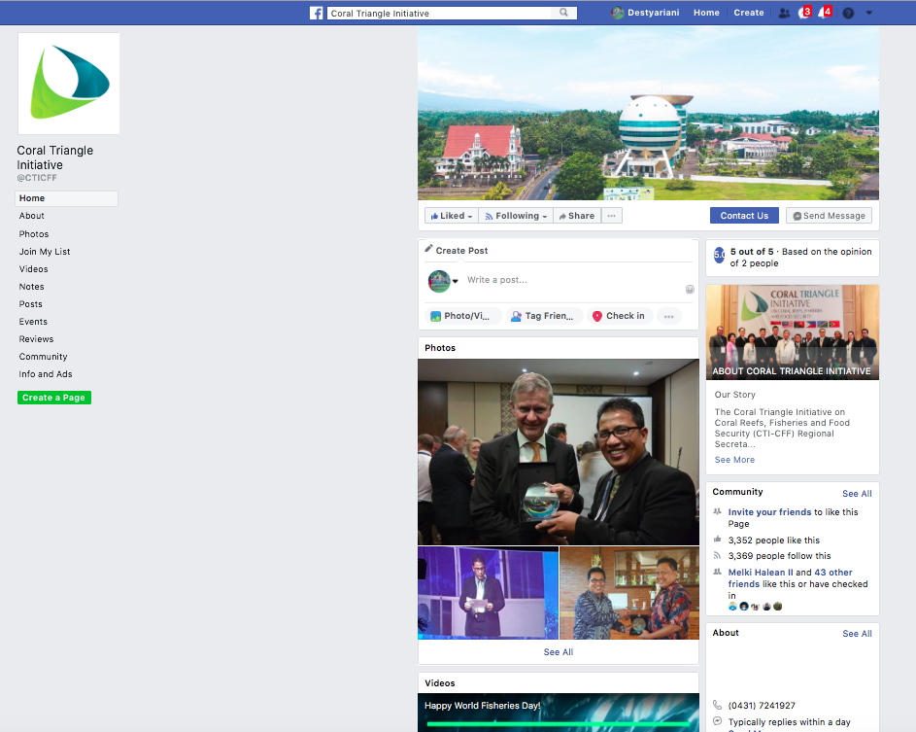
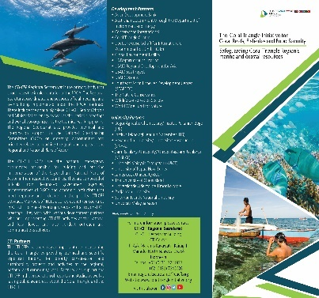
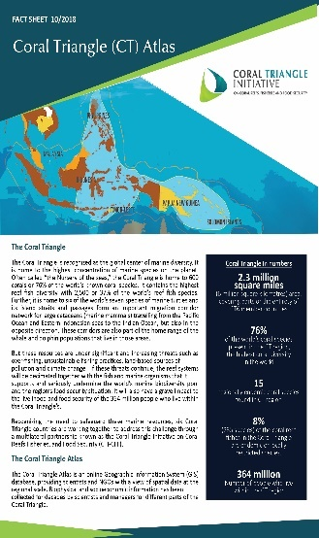
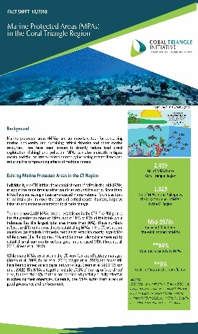
Regular updating/maintenance of CTI Website and Social Media Platforms
CTI Website – www.coraltriangleinitiative.org
CTI Twitter
CTI Instagram
CTI Facebook
Production of IEC/Promotional Materials (Brochure, Fact Sheets)

Slide 34
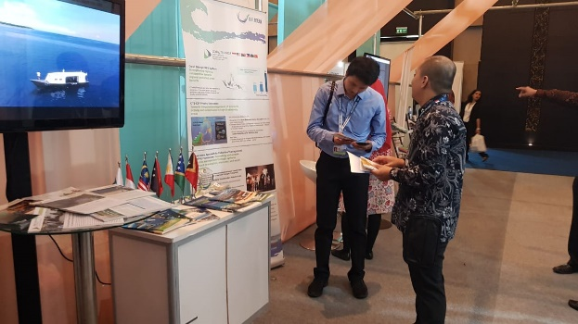
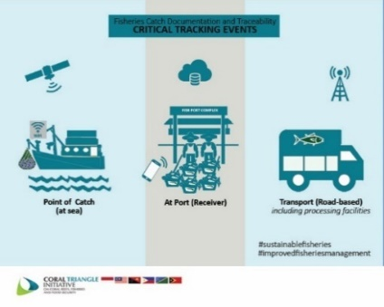
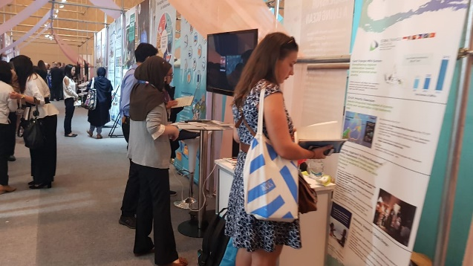
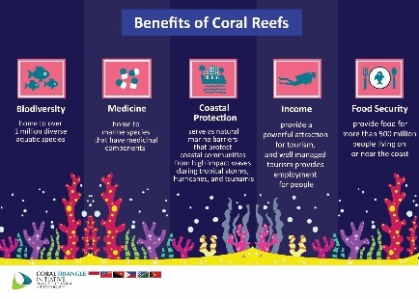
Development of infographics about e-CDT, CT Day MPAs, IYOR and Sulu-Sulawesi Seascapes.
Participation in International Exhibition
©CTI-CFF Regional Secretariat/Wiwin Joko Winarbo/2018

Slide 35
VIII. NOVEMBER & DECEMBER 2018 ACTIVITIES
1. Sustainable Blue Economy Conference
November 26-29, 2018
Kenyatta International Convention Centre
Nairobi, Kenya
The CTI-CFF shall be represented by the Interim Executive Director, Dr. Hendra Siry through the support from United Nations.
2. 33RD International Coral Reef Initiative (ICRI) General Meeting
December 5-7, 2018
Yacht Club de Monaco, Monaco
Participation Objective: The CTI-CFF presence and participation is mandatory as the CTI-CFF will be accepted as one of ICRI members.

Slide 36
SOM-14 RECOMMENDATIONS
Acknowledge and accept the Progress Report of CTI-CFF 2018; and
Agree to prepare an Annual Report based on the Progress Report including audited financial statements by May 2019.

Slide 37
Terima Kasih - Maraming Salamat Tank Iu- Obrigado Tagio Tumas
Photo credits: Pixabay & IYOR Bank/JayneJenkins/FabriceDudenhofer/Yen-YiLee

