Slide 1
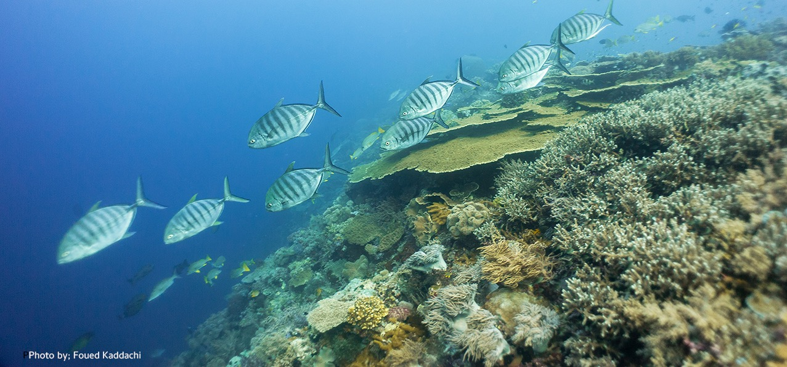
PARTNER UPDATE CORAL TRIANGLE CENTER DECEMBER 2021-OCTOBER 2022

Slide 2
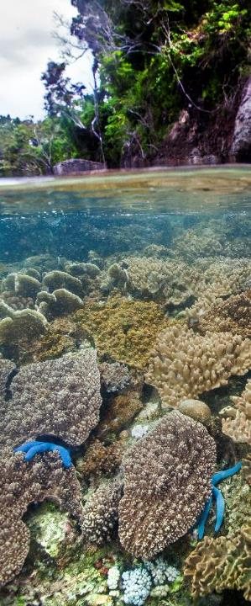
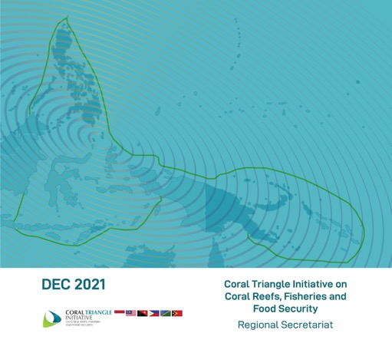
CTI-CFF CAPACITY BUILDING STOCK-TAKE
Produce an overview of the work being done by capacity providers throughout the CT to support marine managed areas [MMAs], including MPAs, LMMAs, OECMs and other marine and coastal priority conservation areas.
Produce an analytical report that can form the basis for the development of a 10-year road map to complement the RPoA in building the human capital required to meet 30x30 targets.

Slide 3
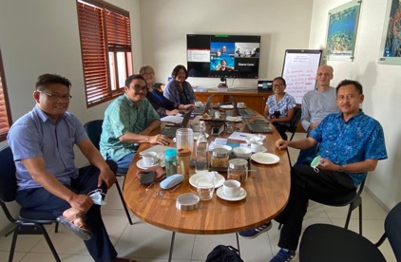
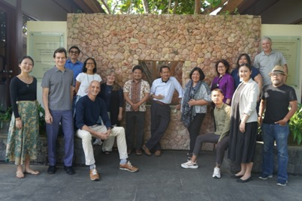
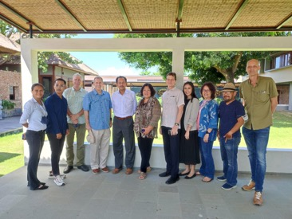
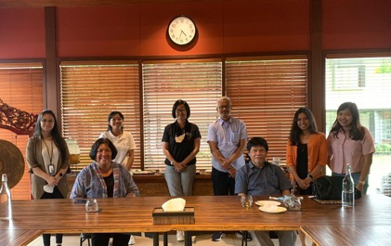
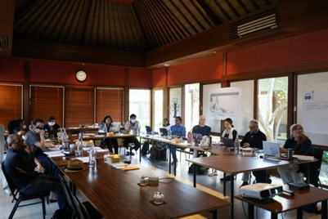
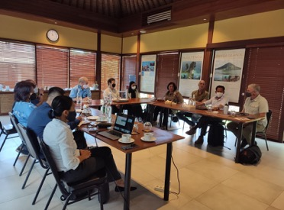
CTI-CFF CAPACITY BUILDING ROADMAP DEVELOPMENT
& PARTNER MEETINGS CTC CENTER FOR MARINE CONSERVATION, SANUR, BALI
DECEMBER 2021
MAY 2022

Slide 4
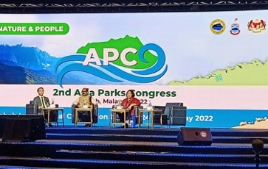
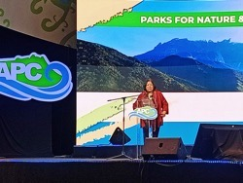
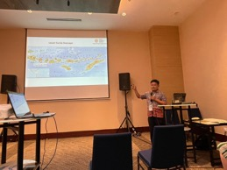
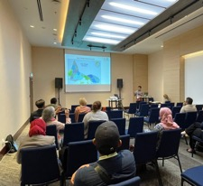
INTERNATIONAL ENGAGEMENT
Plenary Panel Discussion: Regional Transboundary Conservation
The Coral Triangle Initiative: Successes, Issues & Challenges by Rili Djohani, CTC Executive Director
Session Presentations
Capacity Building Assessment in the Coral Triangle: Results and Opportunities , by Rili Djohani, CTC Executive Director
Strengthening Management Effectiveness in Nusa Penida and Atauro Island MPAs in the Lesser Sunda Seascape by Marthen Welly, CTC Marine Conservation Adviser

Slide 5
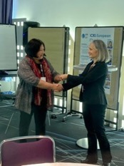
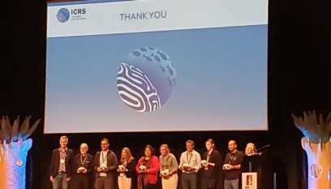
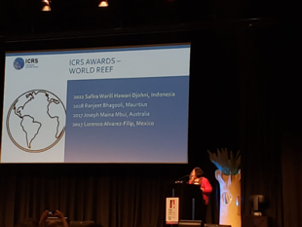
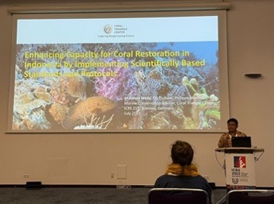
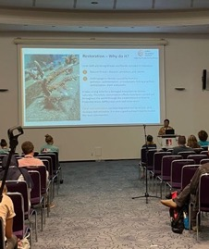
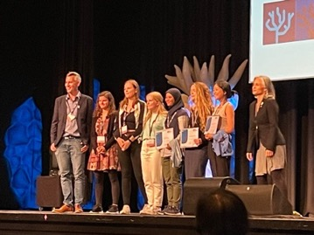
INTERNATIONAL ENGAGEMENT
Rili Djohani, ICRS World Reef Award 2022
Link: https://bit.ly/ICRSWorldReefAward
Presentations:
1. “Scaling Up Capacity and Collaboration Via Peer Learning Networks Lessons Learned From The Women Leaders Forum In The Coral Triangle Region,” by Rili Djohani, Hesti Widodo, Leilani Gallardo
2. “Enhancing Capacity for Coral Restoration in Indonesia by Implementing Scientifically Based Standards and Protocols.” by Marthen Welly, Rili Djohani, Philippa Mansell
3. Minimizing the Competency Gap for Effective Coral Reefs Management: Lessons Learned from the Sunda-Banda Seascapes, by Hesti Widodo, Nyoman Suardana, Kasman
15th ICRS, Bremen, Germany
Key facts and figures
791 in-person oral and poster presentations
193 virtual oral and poster presentations
80 countries

Slide 6
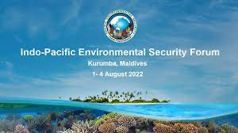
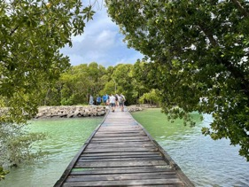
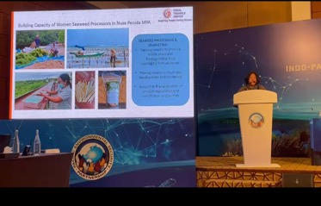
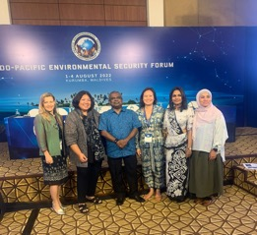
INTERNATIONAL ENGAGEMENT
Presentation: “Scaling up the Development of Human Capital in the Coral Triangle, The Role of Women in the Protection of Marine Bio-Diversity, Food Security, and Blue Economy” by Rili Djohani, CTC Executive Director

Slide 7
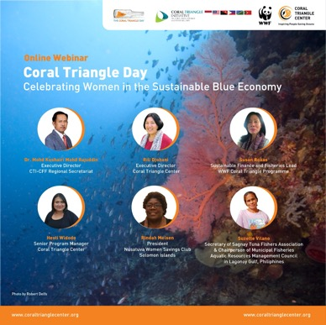
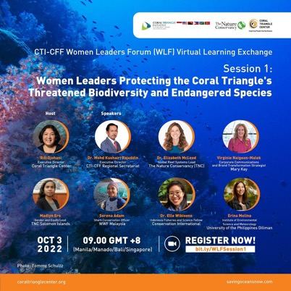
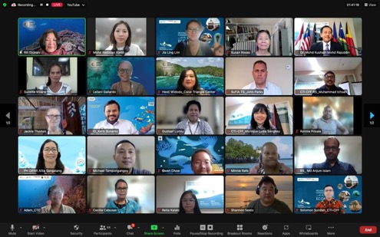
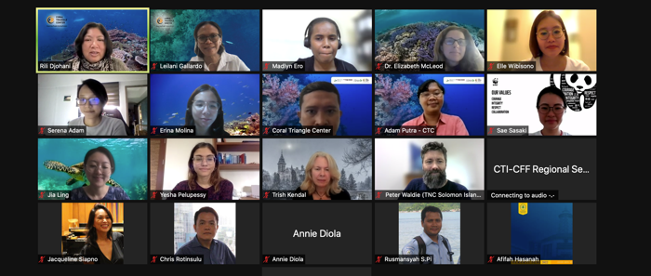
CORAL TRIANGLE DAY AND CTI-CFF WOMEN LEADERS FORUM VIRTUAL LEARNING EXCHANGE

Slide 8
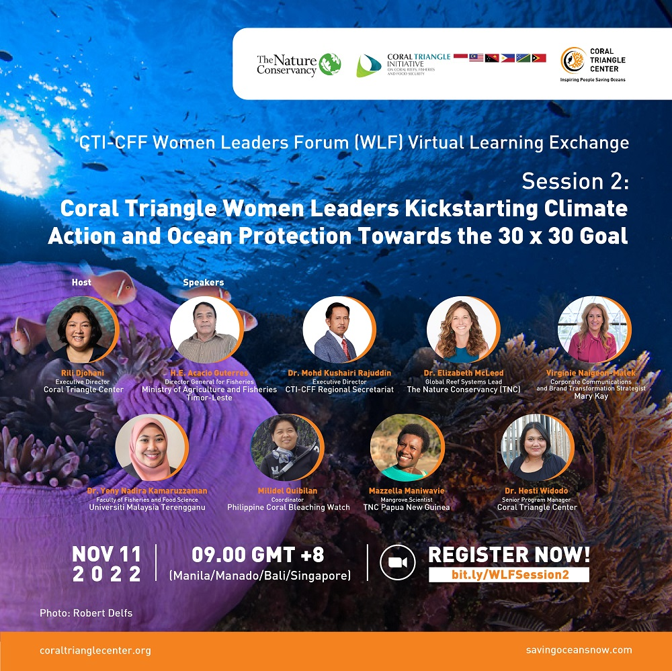
REGISTRATION LINK
bit.ly/WLFSession2

Slide 9
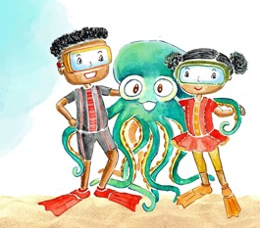
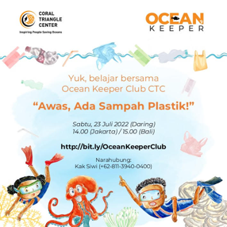
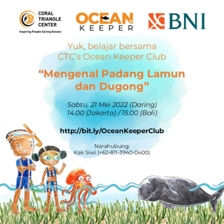
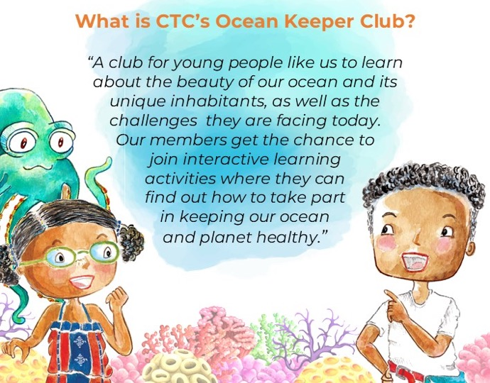
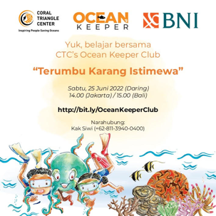

Slide 10
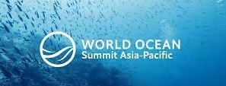
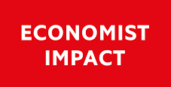
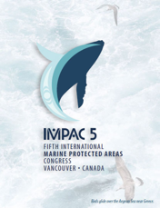
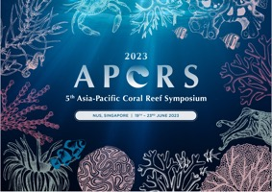
UPCOMING EVENTS
The Economist World Ocean Summit Asia Pacific, which will be held in Singapore at the end of November 2022
IMPAC 5 in Vancouver in February 2023 – IUCN and CTC will facilitate a session
5th Asia-Pacific Coral Reef Symposium 2023, 19–23 June 2023, Singapore – WWF and CTC will facilitate a session

Slide 11
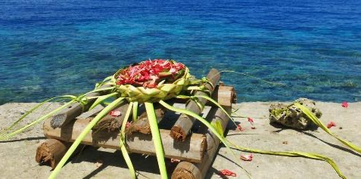
THANK YOU!
Coral Triangle Center
Jalang Betngandang II, 88-89, Sanur,Bali, 80228 Indonesia
coraltrianglecenter.org
savingoceansnow.com

