Slide 1
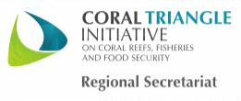
SOM14
14th Senior Officials’ Meeting
11-12 December 2018
Manila, Philippines
SESSION 10: COUNTRY REPORT
Philippines
Ms. Crisanta Marlene P. Rodriguez
DENR-Biodiversity Management Bureau
Notes:
Excellencies, Ladies and Gentlemen Good Morning! I am pleased to present to you, the country report of the Philippines regarding our implementation of the CTI-CFF National Plan of Action.

Slide 2
Topic Outline
Technical Working Group Members
Progress/Achievements Towards NPOA
Constraints/Issues and Challenges
National Roadmap
Potential Regional Program
Notes:
Our presentation follows this outline:
First we would like to show you our representatives to the different Thematic and Governance Working groups, to be followed by our progress towards the NPOA; constraints and challenges in the NPOA implementation, our national roadmap for 2019, and the potential regional programs of the NCCC.

Slide 3
I. Technical Working Group Members / Agencies
TWG | Focal Point
Seascapes | Dir. Crisanta Marlene P. Rodriguez DENR-Biodiversity Management Bureau Support: Ms. Nilda S. Baling
EAFM | Usec. Eduardo B. Gongona DA-Bureau of Fisheries and Aquatic Resources Support: Mr. Rafael V. Ramiscal
MPA | Dir. Crisanta Marlene P. Rodriguez DENR-Biodiversity Management Bureau Support: Mr. Pablo G. de los Reyes, Jr.
CCA | Comm. Noel Antonio V. Gaerlan Climate Change Commission Support: Mr. Alexis D. Lapiz
TSWG | Usec. Eduardo B. Gongona DA-Bureau of Fisheries and Aquatic Resources Support: Ms. Ludivina Labe Dir. Crisanta Marlene P. Rodriguez DENR-Biodiversity Management Bureau Support: Mr. Pablo G. de los Reyes, Jr.
Notes:
Here are our representatives for the different working groups. For Seascapes and MPA: Dir. Crisanta Marlene Rodriguez of the DENR-BMB, for EAFM: Undersecretary Eduardo Gongona of the DA-BFAR, and for the CCA: Commissioner Noel Antonio Gaeran of the Climate Change Commission.

Slide 4
I. Governance Working Group/ Cross Cutting Themes Members / Agencies
TWG | Focal Point
M&E WG | Dir. Crisanta Marlene P. Rodriguez DENR-Biodiversity Management Bureau Support: Ms. Luz Baskiñas
CMWG | Dir. Crisanta Marlene P. Rodriguez DENR-Biodiversity Management Bureau Support: Ms. Carina C. Manlapaz
FRWG | Dir. Wilfredo Obien DENR- Financial Management Service Support: Ms. Maybelle Mangubos
LGN | Dir. Anna Liza F. Bonagua DILG- Bureau of Local Government Development Support: Ms. Jenifer Galorport/ Ms. Kristine Carmen Diones
SAG/UP | Dr. Fernando Siringan UP – Marine Science Institute Support: Dr. Porfirio Aliño/ Mr. John Erick Avelino
Notes:
As for the Governance Working Group, representatives will be coming from the DENR-BMB, the DENR Finance Management Service, the Department of Interior and Local Government, and the University of the Philippines Marine Science Institute.

Slide 5
I. Governance Working Group/ Cross Cutting Themes Members / Agencies
TWG | Focal Point
RBF | Dir. Crisanta Marlene P. Rodriguez DENR-Biodiversity Management Bureau Support: Ms. Luz Baskiñas
WLF | Dir. Crisanta Marlene P. Rodriguez DENR-Biodiversity Management Bureau Support: Reg. Dir. Remia Aparri/ Ms. Salome Bonnit
Notes:
skip

Slide 6
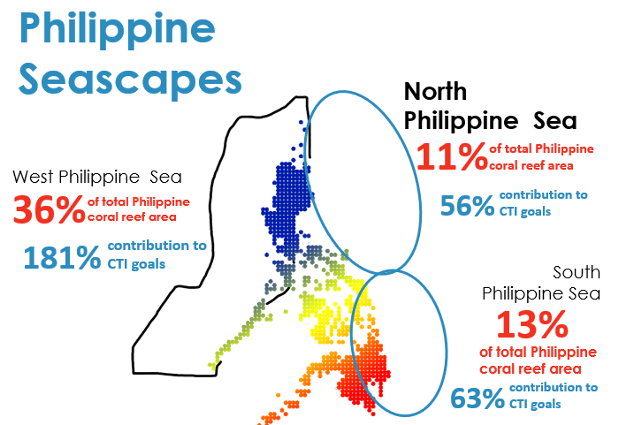
II. Progress/Achievements Towards NPOA
SEASCAPE
CTI-CFF NATIONAL PROGRAMS
Sulu Sulawesi Seascape Project Completed (MPA&EAFM)
Planning for Seascape Implementation: West Philippine Seascape and North Philippine Seascape
Total Action | Completed | On-Going | Not Started
9 | 3 | 4 | 2
Notes:
Moving on to the progress and achievements towards the NPOA implementation. For goal 1 which is on seascapes the Philippines has already completed the Sulu Sulawesi Seascape Project which also cuts across the targets of MPA & EAFM. Furthermore, initial planning for Seascape Implementation was also conducted for the development of West Philippine Seascape and North Philippine Seascape.

Slide 7
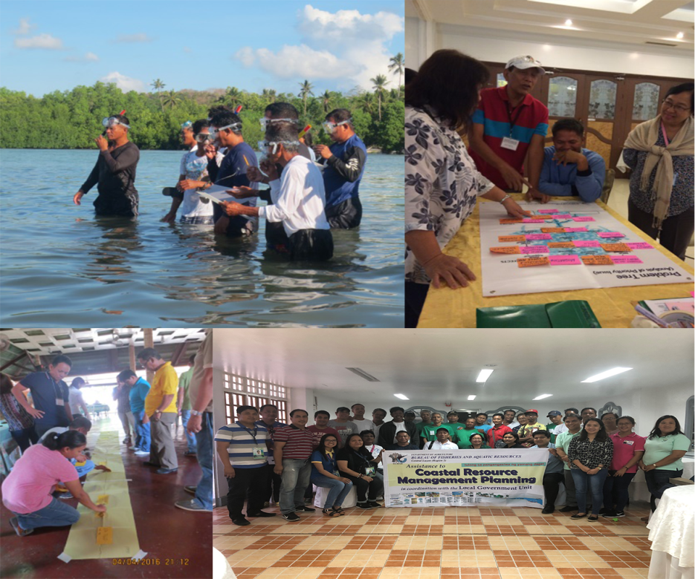
II. Progress/Achievements Towards NPOA
EAFM
CTI-CFF NATIONAL PROGRAMS
Continuous conduct of resource/habitat assessments, resource ecological assessments, fisheries profiling, and implementation of National Stock Assessment Program
Nationwide vulnerability and suitability assessment for capture and aquaculture fisheries
Creation of Philippine Committee on IUUF through Executive Order No. 154
Creation of National/Regional Law Enforcement Council (NALEC/RLEC)
Continuous conduct of IEC activities such as conduct of summits/ conferences focusing on highly valued commodities i.e., sardines, tuna, shrimp, milkfish, tilapia, etc.
Fishing gear regulation on municipal waters
Development of management plans, i.e. Tuna Management Plan, Sardine Management Plan
Total Action | Completed | On-Going | Not Started
24 | 6 | 18 | 0
Notes:
With regards to goal 2 which is on Ecosystems Approach to Fisheries management, the National Stock Assessment Program is continuously being implemented along with resource and habitat assessment and fisheries profiling. Moreover, a Nationwide vulnerability and suitability assessment for capture and aquaculture fisheries was conducted.
The Philippine Committee on Illegal, Unregulated, and Unreported Fishing was also created through Executive Order No. 154. The National/Regional Law Enforcement Council (NALEC/RLEC) was also created strengthening law enforcement on the coastal waters in the Philippines. Continuous conduct of IEC activities such as conduct of summits/ conferences focusing on highly valued commodities i.e., sardines, tuna, shrimp, milkfish, tilapia, etc. is also held in support of this goal.
Morevoer, fishing gear regulation on municipal waters is currently being implemented and management plans on tuna and sardines have already been developed.

Slide 8
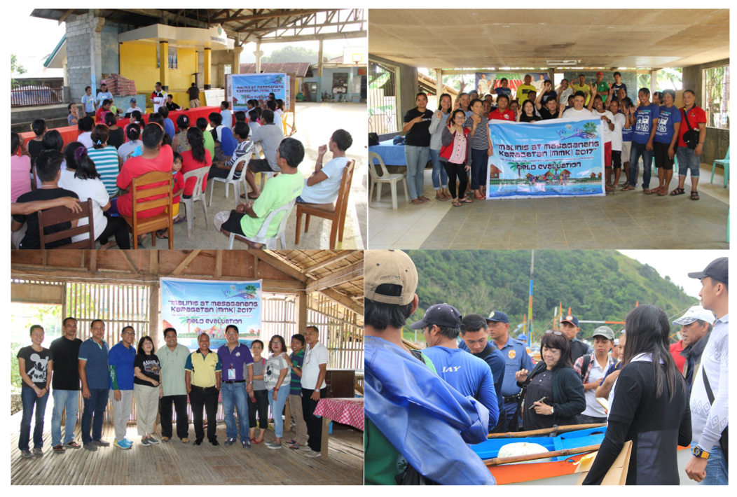
II. Progress/Achievements Towards NPOA
EAFM
CTI-CFF NATIONAL PROGRAMS
Tuna traceability system development (initial phase is the development of application/database)
Baseline Assessment of Napoleon Wrasse in TRNP and Napoleon Wrasse Non-Detrimental Findings study in Tawi-Tawi completed with management recommendations
Seasonal Fishing Closures in Northern Palawan, Davao Gulf, Visayan Sea, Zamboanga, and Balayan Bay
Development of Electronic Catch Documentation and Traceability and small scale catch documentation
Reconstitution of National Tuna Industry Council (NTIC), amending Special Order No. 659, series of 2000 through Special Order No. 1117 series of 2018
Conduct of value chain analyses on tuna, sardines and ornamental fishes
Conduct assessments on reef-based ornamentals
Total Action | Completed | On-Going | Not Started
24 | 6 | 18 | 0
Notes:
Still under EAFM, the Tuna traceability system is under development and is now in its initial phase of developing the application/database. Baseline Assessment of Napoleon Wrasse in TRNP and Napoleon Wrasse Non-Detrimental Findings study in Tawi-Tawi were also completed with management recommendations.
Seasonal Fishing Closures are also being done in Northern Palawan, Davao Gulf, Visayan Sea, Zamboanga, and Balayan Bay.
An Electronic Catch Documentation and Traceability and small scale catch documentation is also being developed.
In addition, the National Tuna Industry Council was also reconstructed, amending Special Order No. 659, series of 2000 through Special Order No. 1117 series of 2018.
Value chain analyses on tuna, sardines and ornamental fishes and assessments on reef-based ornamentals were also conducted by the NCCC.

Slide 9
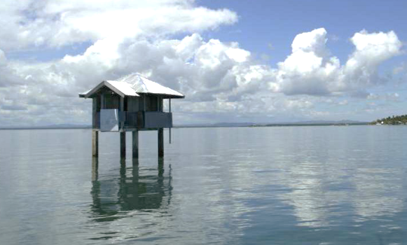
I. Progress/Achievements Towards NPOA
MPAS
CTI-CFF NATIONAL PROGRAMS
Legislation of additional 10 MPAs under RA 11038
National MPAs: 43
Locally Managed MPAs: 1816
1.4% protected of the total sea area (EEZ)
Proclamation of 1st offshore MPA: Philippine Rise through PP 489
Implementation of the Coastal and Marine Ecosystems Management Program from 2017 to 2018
25 MPA networks supported and about 200 biodiversity friendly enterprises assessed and provided with technical assistance
Conducted habitat assessments, as well as ocean acidification baseline study, coastal stability assessment, deep water survey, reef and reef fish monitoring on nationally-managed MPAs including Philippine Rise and West Philippine Sea
Total Action | Completed | On-Going | Not Started
8 | 4 | 4 | 0
Notes:
For Goal 3 which is on Marine Protected Areas. One of the milestones of the Philippines is the legislation of additional 10 MPAs under RA 11038. Currently, the Philippines has 43 nationally-managed MPAs and 1,816 locally managed MPAs covering 1.4% of the country’s total sea area. In addition, the Coastal and Marine Ecosystems Management Program is also fully implemented where among the activities include the following: habitat assessment for NIPAS MPA, MPA Networking Technical Assistance for LGUs, support to 25 Marine Protected Area networks and about 200 biodiversity friendly enterprises, and the inclusion of ocean acidification baseline study in selected NIPAS MPAs.
Coastal stability assessment, mapping, impact monitoring, resiliency studies and updating of coral reef baseline data in the West Philippine Sea and Philippine Rise were also conducted.

Slide 10
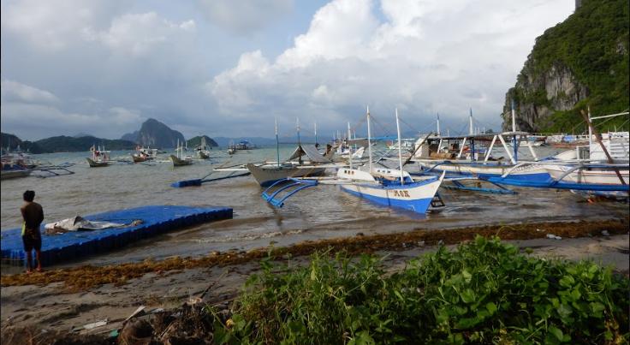
II. Progress/Achievements Towards NPOA
MPAS
CTI-CFF NATIONAL PROGRAMS
2M hectares of MPA in NE, Palawan established
MPAN management plan approved in Davao Gulf
Establishment of seven lines in Southern Palawan
Verde Island Passage (VIP) Management Board Established (CI-SmartSEAS)
1st Management Board meeting conducted
MPA and MPA network establishment in 5 provinces in VIP
Effective Management of MPA networks:
Oriental Mindoro – MSN Best MPA Network
Batangas MPAN – MSN Hall of Fame
Resumption of Joint Management Committee on TIHPA
Attendance to MPA REX and Meeting
Marine Enforcement Manual in Davao Gulf
MPA Capacity Building Training for Mentors – Modules Completed
Total Action | Completed | On-Going | Not Started
8 | 4 | 4 | 0
Notes:
Moreover, a 2 million hectare MPA in North East of Palawan was established , an MPA management plan was approved in Davao Gulf, and a seven line was established in Southern Palawan.
For the Verde Island Passage, a Management Board was already established with the conduct of its 1st Management Board meeting. Within the VIP, MPA and MPA network were also established in 5 provinces. 2 MPA networks were also recognized because of its effective management including: Oriental Mindoro as the MSN Best MPA Network and the Batangas MPA network as an MSN Hall of Famer.
Moreover, the joint management of the Turtle Islands Heritage Protected Area has also resumed, a Marine Enforcement Manual was developed in Davao Gulf, and modules were completed for the MPA Capacity Building Training for Mentors.

Slide 11
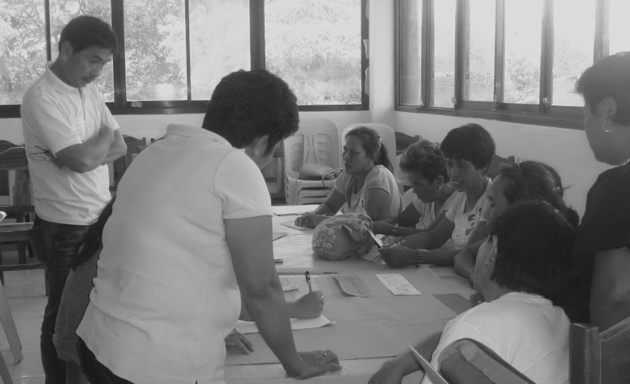
II. Progress/Achievements Towards NPOA
CLIMATE CHANGE ADAPTATION
CTI-CFF NATIONAL PROGRAMS
Commission Resolution on Climate Risk Management Framework with Academe, CSOs, LGUs and NGAs
Mainstreaming Climate Change Action in Ecosystem Based Adaptation Planning
2nd National Convention on Climate Change and Disaster Risk Reduction
Blue Carbon
National Blue Carbon TWG (NBCTWG) created to draft roadmap for management of blue carbon ecosystem
Total Action | Completed | On-Going | Not Started
11 | 4 | 7 | 0
Notes:
On the goal on Climate Change, the Commission Resolution on Climate Risk Management Framework with Academe, CSOs, LGUs and NGAs was developed. Climate Change Action in Ecosystem Based Adaptation Planning is also being mainstreamed. The 2nd National Convention on Climate Change and Disaster Risk Reduction was conducted and on Blue Carbon, a National Blue Carbon TWG (NBCTWG) was created to draft roadmap for management of blue carbon ecosystem.

Slide 12
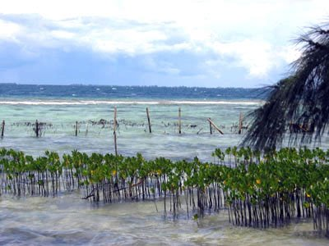
II. Progress/Achievements Towards NPOA
CLIMATE CHANGE ADAPTATION
CTI-CFF NATIONAL PROGRAMS
VIP Mangrove Rehabilitation
(CI-Turing Foundation Mangrove Green Wall of Mindoro Project)🡪 Research, mangrove MPA and nursery establishment; Policy and outreach; Sustainable Financing (livelihood and Ecotourism)
Carbon Stock Assessment conducted to identify blue carbon management sites (CI)
VA-CCA planning workshop in Davao Gulf
Building Coastal Resilience for DRR and CC (CI-FFEM) (Project Site is Conception Iloilo. And will explore feasibility of green-gray approach)
Drafting of BFAR Climate Change Strategic Framework for Disaster Risk Reduction and Management
Nationwide vulnerability and suitability assessment for capture and aquaculture fisheries
Total Action | Completed | On-Going | Not Started
11 | 4 | 7 | 0
Notes:
Still under the same goal, an on-going VIP Mangrove Rehabilitation is being conducted which includes activities focusing on research, a mangrove MPA and nursery establishment, Policy and outreach, and Sustainable Financing. Carbon Stock Assessment were also conducted to identify blue carbon management sites.
In addition, a VA-CCA planning workshop was also held in Davao Gulf, coastal Resilience for DRR and CC is also being built, a BFAR Climate Change Strategic Framework for Disaster Risk Reduction and Management is being drafted, and a nationwide vulnerability and suitability assessment for capture and aquaculture fisheries was conducted.

Slide 13
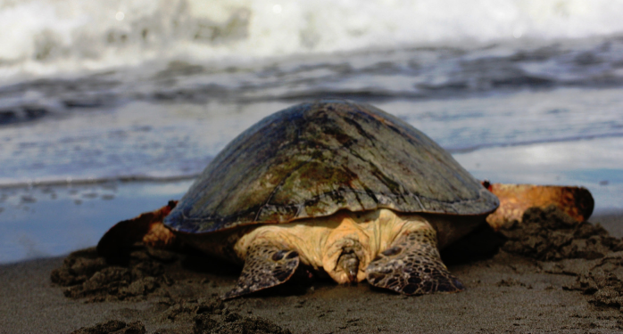
II. Progress/Achievements Towards NPOA
THREATENED SPECIES
CTI-CFF NATIONAL PROGRAMS
NPOA for Marine Turtles and Dugong
Updating of Marine Turtle tagging database
(Include Protect Wildlife Project)
CI-Protect Wildlife: Palawan
Local communities trained on behavioural change towards biodiversity
Universities trained in developing research and conservation curricula
Local government trained in combatting wildlife and environmental crime
Policy review/development to combat wildlife crimes
Cetacean Study in Davao Gulf
Draft Wildlife Communications and Coordination Protocols for the Marine Turtle Protected Area Network
Research on Napoleon Wrasse
Attendance to TSWG REX/Meeting
Total Action | Completed | On-Going | Not Started
8 | 4 | 4 | 0
Notes:
For goal 5 a NPOA for Marine Turtles and Dugong was developed and the Marine Turtle tagging database is continuously being updated.
A Protect Wildlife Project is also being conducted in Palawan where Local communities are trained on behavioural change towards biodiversity, Universities trained in developing research and conservation curricula, the Local government trained in combatting wildlife and environmental crime and a Policy is reviewed and developed to combat wildlife crimes.
A cetacean Study in Davao Gulf and a research on napoleon wrasse was also conducted and the Wildlife Communications and Coordination Protocols for the Marine Turtle Protected Area Network were developed.

Slide 14
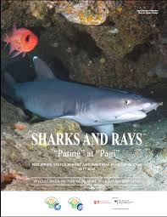
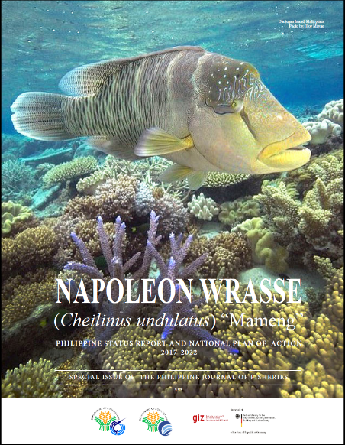
II. Progress/Achievements Towards NPOA
THREATENED SPECIES
CTI-CFF NATIONAL PROGRAMS
Publication and Dissemination of Sharks and Napoleon Wrasse Country Status Report with NPOA
Full implementation of Fisheries Administrative Order 233 (Aquatic Wildlife Conservation)
Operationalization of National/Regional Aquatic Wildlife Management Council (NAWMC/RAWMC)
Operationalization of Philippine Aquatic Red List Committee
Activation and Utilization of Aquatic Wildlife Management Fund
Ongoing Red Listing of Philippine Aquatic Species
Total Action | Completed | On-Going | Not Started
8 | 4 | 4 | 0
Notes:
Still under the goal on threatened species, the Sharks and Napoleon Wrasse Country Status Report with NPOA were also published and disseminated. Fisheries Administrative Order 233 or the Aquatic Wildlife Conservation is in full implementation and a red listing of Philippine Aquatic Species is on-going.

Slide 15
II. Progress/Achievements Towards NPOA
CROSS CUTTING THEMES
Research
Mapping and impact research on resilience of reefs
National ocean modeling for coral reef connectivity
Continuous Professional Masters-Tropical Marine Ecosystems Management
Enabling Policy
DENR Administrative Order 2016-26 on the Implementation of Coastal and Marine Ecosystems Management Program
Republic Act 11038 Amendment to National Integrated Protected Areas System Act
Fisheries Compliance Audit (Memorandum Circular)
BMB-BFAR Convergence Consultation
Capacity Building
Green fins (Assessor trainings etc)
BDFE (Business Model Workshop)
Coastal Assessment for Rehabilitation Enhancement – Capacity Development and Resiliency of Ecosystems (CARE-CADRES)
3rd Biodiversity Resource Information Network Group Training on Marine Biodiversity Management
Paralegal training for enforcement conducted
Capacity Building on Aquatic Wildlife Management
Notes:
Furthermore, cross cutting activities were also conducted.
On research Research:
Mapping and impact research on resilience of reefs
National ocean modeling for coral reef connectivity
On Enabling Policy:
DENR Administrative Order 2016-26 on the Implementation of Coastal and Marine Ecosystems Management Program
Republic Act 11038 Amendment to National Integrated Protected Areas System Act
Fisheries Compliance Audit (Memorandum Circular)
BMB-BFAR Convergence Consultation
And On Capacity Building:
Green fins Assessor trainings
Business model workshop on Biodiversity Friendly Enterprise (BDFE)
Coastal Assessment for Rehabilitation Enhancement – Capacity Development and Resiliency of Ecosystems (CARE-CADRES)
3rd Biodiversity Resource Information Network Group Training on Marine Biodiversity Management
Paralegal training for enforcement conducted
Capacity Building on Aquatic Wildlife Management

Slide 16
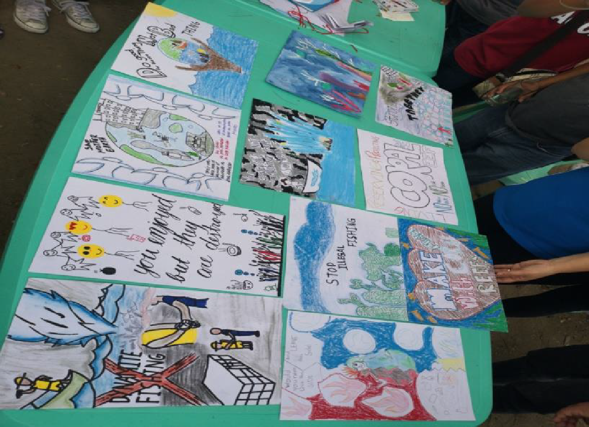
II. Progress/Achievements Towards NPOA
CROSS CUTTING THEMES
Enforcement
2nd Wildlife Law Enforcement Summit
Boracay Rehabilitation Project
Manila Bay Project
VIIRS night light boat detection Implementation in MPAs
Communication, Education, and Public Awareness (CEPA)
Celebration of Special Environment Events (Month of the Ocean, Coral Triangle Day, Environment Day, International Coastal Cleanup, International Year of the Reef)
Knowledge, Attitudes and Practices survey conducted and consequent development and implementation of Flagship Communication Campaigns on the 33 nationally-managed MPAs
Participation to knowledge exchange fora (Asia-Pacific Coral Reef Symposium, East Asian Seas Congress, Sustainable Blue Economy Conference)
CTI Roll-out (Country-wide)
Notes:
On Enforcement the following were conducted:
2nd Wildlife Law Enforcement Summit
Boracay Rehabilitation Project
Manila Bay Project
And on Communication, Education, and Public Awareness (CEPA):
Celebration of Special Environment Events (Month of the Ocean, Coral Triangle Day, Environment Day, International Coastal Cleanup, International Year of the Reef)
Knowledge, Attitudes and Practices survey conducted and consequent development and implementation of Flagship Communication Campaigns on the 33 nationally-managed MPAs
Participation to knowledge exchange fora (Asia-Pacific Coral Reef Symposium, East Asian Seas Congress, Sustainable Blue Economy Conference)
CTI Roll-out (Country-wide)

Slide 17
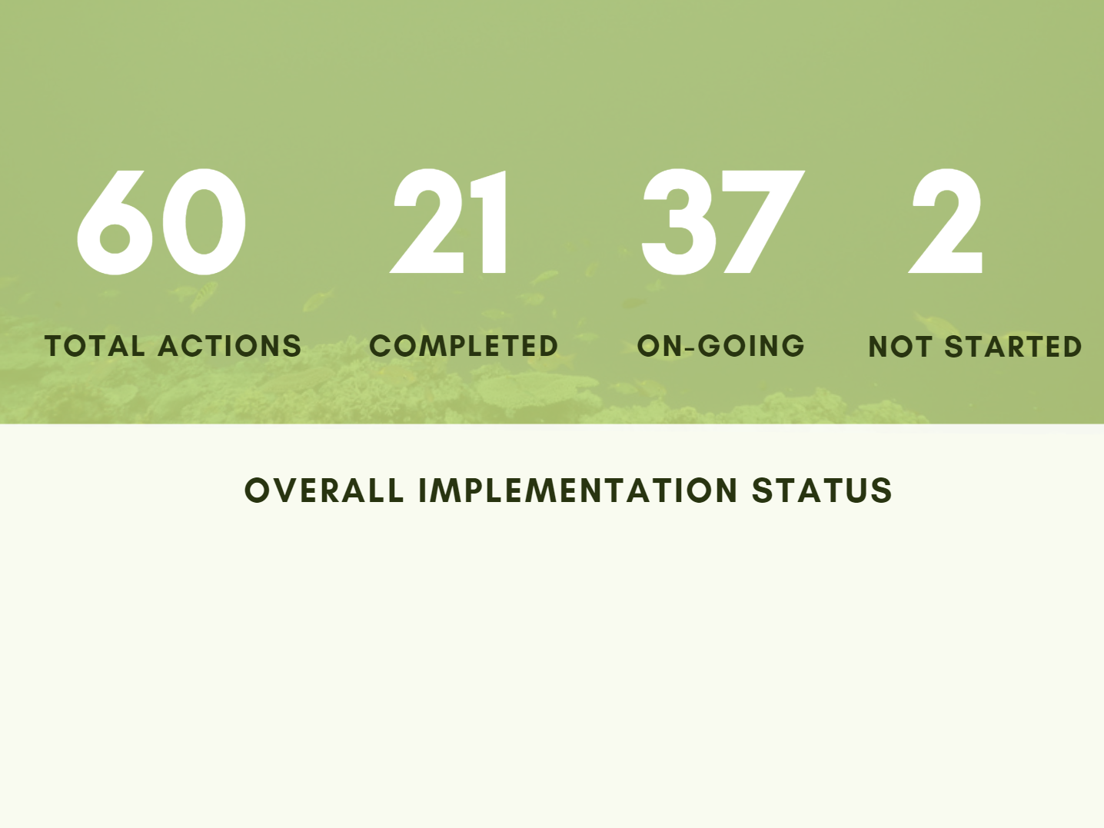
II. Progress/Achievements Towards NPOA
Notes:
Overall, among the 60 actions identified 21 has already been completed, 37 actions are on-going and 2 actions have not started.

Slide 18
III. Constraints/Issues/Challenges Affecting Implementation of Identified Activities
Need for strengthening the NCCC (i.e., inactivity of some member NCCC agencies, need to expand membership to cover activities)
Insufficient of manpower resources to fully meet implementation requirements
NPOA needing an implementation plan, and needs to be mainstreamed and relevant to Coastal and Marine Ecosystems National program, global targets.
M&E indicators need to be updated
On MPA Implementation
Insufficient data on metes & bounds of locally managed MPAs
Identification of Coral Triangle Atlas focal points
Identify Marine Tourism Task Force Focal Point
Notes:
Moving on, among the challenges encountered by the NCCC in implementing the NPOA are:
Need for strengthening the NCCC (i.e., inactivity of some member NCCC agencies, need to expand membership to cover activities)
Lack of manpower resources to fully meet implementation requirements
NPOA needing an implementation plan and needs to be mainstream and relevant to Coastal and Marine Ecosystems National Program and global targets.
M&E indicators need to be updated
Specifically on MPA Implementation
Insufficient data on metes & bounds of locally managed MPAs
Identification of Coral Triangle Atlas and Marine Tourism Task Force needed.

Slide 19
IV. National Roadmap 2019
On Seascapes Implementation
CTI-CFF Seascape Model and Regional Framework Roll-out
On EAFM Implementation
Continuous development of local EAFM plans and establishment of FMAs
Implementation of Fish RIGHT program in Calamianes, Visayan Sea, and Southern Negros
On MPA implementation
MPA Financing Strategies
MPA Capacity Building (per cluster training)
Management Effectiveness Assessments
Vulnerability Assessment in Marine Protected Areas
Nomination of Apo Island as Category 4 under CTMPAS etc.
Inclusion of CTI to the cluster Call of Nominations for the MPA Awards
Notes:
In 2019, On Seascapes Implementation the NCCC plans to roll-out the CTI-CFF Seascape Model and Regional Framework
On EAFM Implementation, a continuous development of local EAFM plans and establishment of FMAs, and implementation of Fish RIGHT program in Calamianes, Visayan Sea, and Southern Negros will be done
And On MPA implementation, activities such as MPA Financing Strategies, MPA Capacity Building, Management Effectiveness Assessments, Vulnerability Assessment in Marine Protected Areas, are among others that are planned to be conducted.

Slide 20
IV. National Roadmap 2019
Continuous review of the NPOA
Discussions on Marine Litter
Manila Bay (Nature-based Ecotourism)
CTI Congress
Implementation of ProCoast Project
Notes:
Moreover, the NCCC plans to conduct a continuous review of the NPOA, conduct discussions on Marine Litter, implement the Manila Bay project component on Nature-based Ecotourism, the conduct of a CTI Congress, and the implementation of ProCoast Project.

Slide 21
V. Potential Regional Program & Support Required
Take forward Sulu Sulawesi EAFM Framework Plan (USAID-Oceans Project) e.g. Project Development discuss between SWG and EAFM WG
Sulu-Sulawesi Regional Strategic Action Program for Sustainable Fisheries Management – for SWG and EAFM WG Discussion
Sulu-Sulawesi transboundary resilient reefs – discuss proposed project (SWG, EAFM, MPA WG) and University Partnership
Develop the draft Threatened Species Conservation Action Plan (Threatened Species Working group)
Marine Debris
Blue Carbon
Notes:
In terms of potential regional program and support required, there is a need to take forward theSulu Sulawesi EAFM Framework Plan (USAID-Oceans Project) through a Project Development discussion between the Seascapes Working Group and the EAFM Working Group.
The Sulu-Sulawesi Regional Strategic Action Program for Sustainable Fisheries Management needs to be discussed as well by the SWG and EAFM WG.
Moreover, the proposed Sulu-Sulawesi transboundary resilient reefs needs to be discussed by the SWG, EAFM, MPA WG and the University Partnership.
And there is also a potential to develop the draft Threatened Species Conservation Action Plan by Threatened Species Working group, and discuss timely topics such as growing issues on Marine Debris and Blue Carbon.

Slide 22
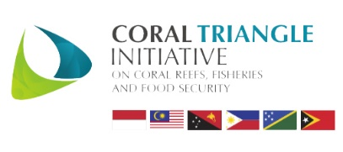
TERIMA KASIH - MARAMING SALAMAT TANK IU- OBRIGADO TAGIO TUMAS
Photo credits: IYORBank_Rebecca Weeks and Yen-Yi Lee
Notes:
Thank you very much for listening.

