Slide 1
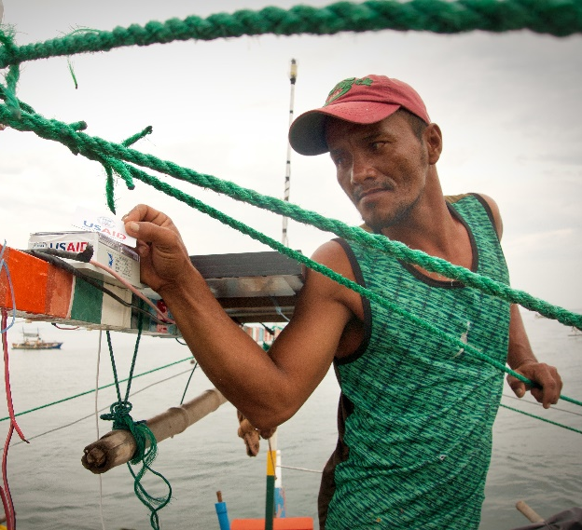
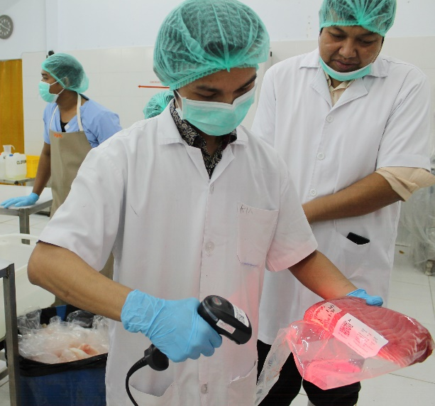
Workshop to Review eCDT Technology Solutions and
Advance Regional Guidance for Fisheries Traceability
Dili, Timor-Leste
June 24 and 27-28, 2019
THE OCEANS AND FISHERIES PARTNERSHIP
(USAID OCEANS)

