Slide 1
Uniform Guidance 2 CFR 200 Overview
Why is the 2 CFR (code of federal regulations) 200 for grants and agreements important to CTI/CFF
Why isn’t this presentation only for the finance staff?
Why do I need to be aware of the guidance?
How do our financial details and data relate back to our activity outcomes and performance?
How do we tell the CTI CFF story, how do we tell it through reporting, performance measures and outcomes?
Notes:
Concepts for current situation, and moving forward. How to use 2 CFR to benefit Organization.

Slide 2
What is 2 CFR 200?
PART 200—UNIFORM ADMINISTRATIVE REQUIREMENTS, COST PRINCIPLES, AND AUDIT REQUIREMENTS FOR FEDERAL AWARDS
The Office of Management and Budget's (OMB) Uniform Administrative Requirements, Cost Principles, and Audit Requirements for Federal Awards (commonly called "Uniform Guidance") was officially implemented in December 2014. The Uniform Guidance – a "government-wide framework for grants management" – is an authoritative set of rules and requirements for Federal awards. The reforms that comprise the Uniform Guidance aim to reduce the administrative burden on award recipients and, at the same time, guard against the risk of waste and misuse of Federal funds. 2 CFR 200 directs the focus of audits on areas that have standardize the processing of data; Clarifies and updates cost reporting guidelines for award recipients. been identified as at risk for waste, fraud and abuse; Lays the groundwork for Federal agencies to

Slide 3
Overview of Financial Program Management- Where to find the policies *Statutory and Policy Requirements 200.300 *Performance Measures 200.301 *Financial Management 200.302 *Internal Controls 200.303 *Cost Share/Matching (if applicable) 200.306 *Revision of Budget and Program Plans 200.308.
Notes:
5-1

Slide 4
Performance Measurement 2 CFR 200.301 Non Federal Entities must: *Relate Financial Data to Performance *Show Cost Effective Data *Measure Performance Federal Awarding Entities must: *Communicate Expectations *Provide Clear Goals *Analyze and Apply Data
Notes:
CFR Part 200 Grants and Agreements
200.301 Performance Measurement – 5-3 NFE and FE responsibilities (Uniform Administrative Requirements)
200.302 (4) 5-5 Financial Management- Accountability for funds, property and other assets – safeguard assets, used solely for purpose of authorized program purpose.
200.303- 5-5 Internal Controls – FE wants assurance that NFE is managing federal award in compliance with regulations
200.304- Bonds not applicable
200.305 5-9 Payment (7) (i)

Slide 5
Internal Controls 200.303 *Establish and maintain effective internal control over the Federal Award. *Reasonable assurance that the NFE is managing the award in compliance with 2 CFR 200, and the terms and conditions of the award. *Safeguard PII (Personally Identifiable Information)
Notes:
5-5 and 200.303

Slide 6
Financial Management Systems 2 CFR 200.302 *Identify Funding Sources- track the funding *Accurate and Current *Identify Expended Funds *Effective Internal Controls *Budget Comparisons to Inputs and Outcomes *Compliance with Payment Requirements *Determine Cost Allowability
Notes:
200.302 (4) 5-4, 5 Financial Management- Accountability for funds, property and other assets – safeguard assets, used solely for purpose of authorized program purpose.
200.303- 5-5 Internal Controls – FE wants assurance that NFE is managing federal award in compliance with regulations
200.304- Bonds not applicable
200.305 5-9 Payment (7) (i)

Slide 7
Revisions of Budget and Program Plans *Change in Scope *Change in Key Personnel *Project Disengagement *Costs that Require Pre-Approval *Contracting/Sub Awarding *Changes to Cost Share (if applicable)
Notes:
200.308 (5-17)
Pre-Approvals- (5-20)
200.201 , 200.308 Revision of budget and program plans.
200.309 Period of Performance (only incurred within the period of performance of the grant) or authorized pre-award costs.

Slide 8
Questions: 1. Identify the section of the uniform guidance that details the requirements of a recipient financial management system 2. Identify two responsibilities listed in the Uniform Guidance for both agencies and recipients for using performance measures.
Notes:
200.302 Financial Management
5-3 200.301 identifies responsibilities of both non-federal and federal entities for performance measures

Slide 9
Activity: Go to the ecfr website by searching for 2 CFR, Part 200 - https://www.ecfr.gov/cgi-bin/text-idx?tpl=/ecfrbrowse/Title02/2cfr200_main_02.tpl What section of the 2 CFR 200 can an CTI find “General Provisions for Selected Cost” Give 3 examples of allowable costs that are related to CTI expenditures.
Notes:
Google 2 CFR part 200 to find efr site (not gpo) and look at cost principles. Allowable cost examples. Disallowed costs that stand out?
Micro purchase? Quotes? What is CTI procurement policy when buying equipment, market value?

Slide 10
Resources. MCI manual lesson 5 (printed and electronic for participants) 2 CFR 200 (ecfr link) https://www.ecfr.gov/cgi-bin/text-idx?tpl=/ecfrbrowse/Title02/2cfr200_main_02.tpl

Slide 11
Break time!

Slide 12
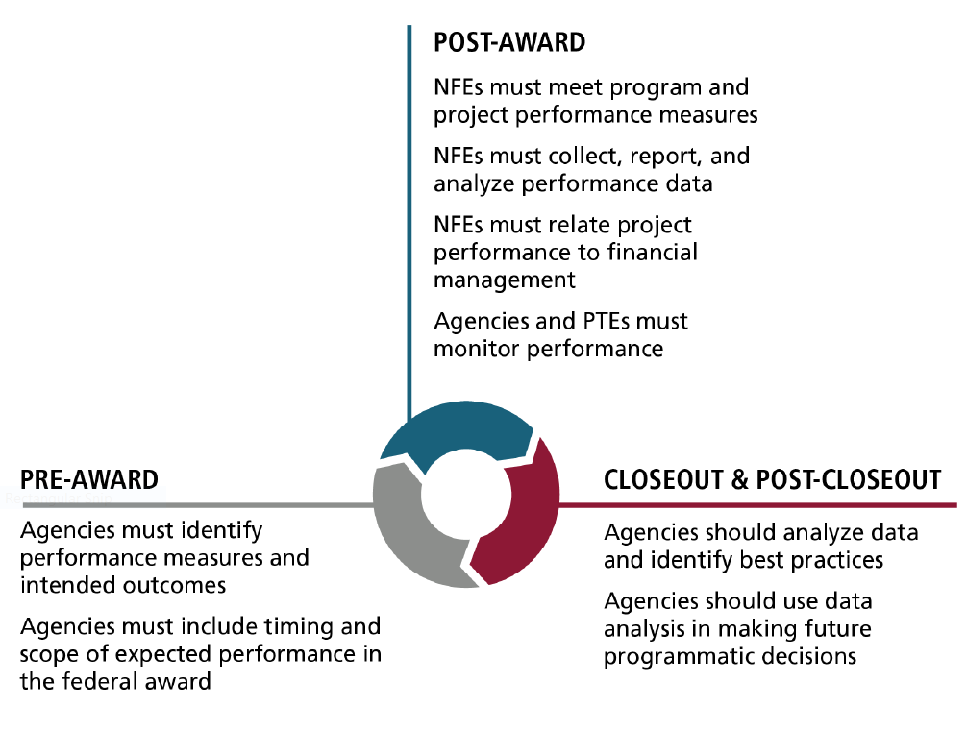
Defining Performance measures Performance measurement in the grants life cycle
Notes:
1-2/3 performance accountability for Federal Grants under 2 CFR 200

Slide 13
Example: Federal Awardee Performance and Integrity Information System (FAIPIS)
Applicable to all grant awards in 2016
Contains information relating to NFE past performance
Designed to strengthen accountability of NFE’s in administering federal grant awards
Let’s check CTI-CFF! https://www.fapiis.gov/fapiis/index.action
Notes:
1-9

Slide 14
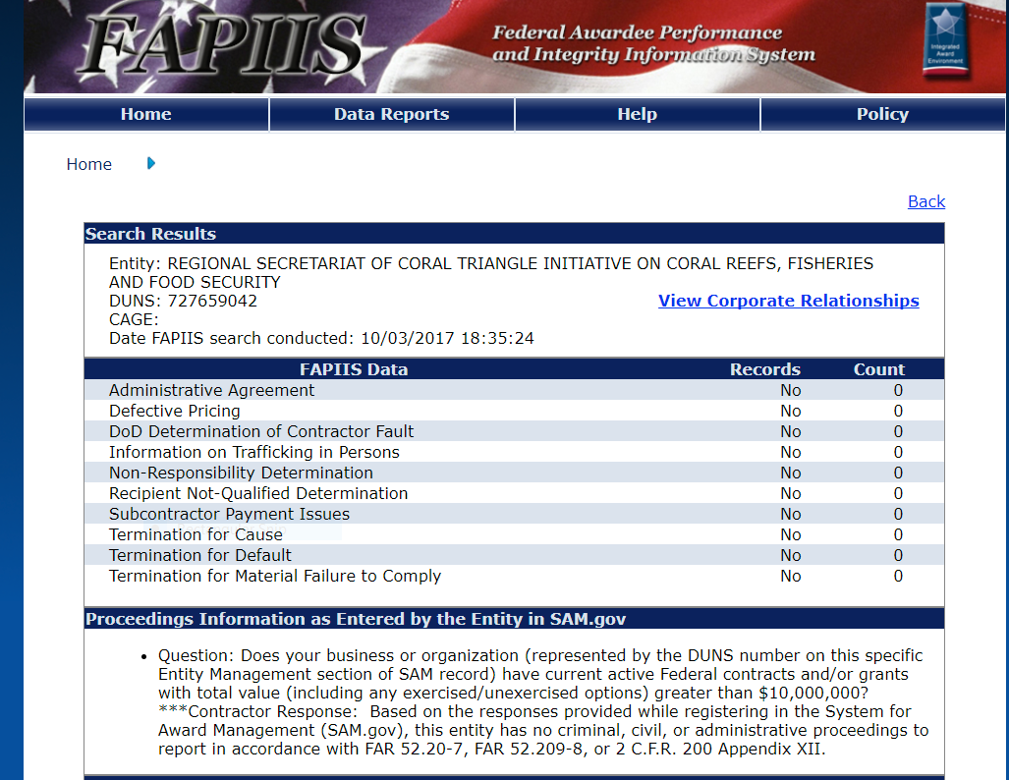
CTI CFF FAIPIS search ☺
Notes:
1-9 FAIPIS tracks performance of recipients, mostly indicates if an award was terminated for default, cause or compliance related issues. www.SAM.gov is a required system (System for Award Management) checks the excluded parties list (by name and entity) and provides routing for core data, key financial officials. The RS CTI-CFF has a current DUN’s# thanks to Cepy!

Slide 15
Basic Theory of Change (Problem to Results
Notes:
2-3 theory of change, can be beneficial in targeting resources to bring about intended change. Increasing number of federal agencies are requiring applicants to submit a “theory of change”
Problem (how was the problem identified?) problem identification process,
Frequency, Duration, Scope, Severity, Perception

Slide 16
Updated Theory of Change Diagram Interventions are the specific set of activities that the project will include to meet the established goals. This is a backwards-working design in which the outcome is established first and the process to achieve the outcome is then developed. Developing a project with the end in mind is beneficial in ensuring the goals will be met. What are some CTI CFf examples of Problem/Intervention and then intended result?
Notes:
2-4/5- research literature, case studies, relevant evidence and data pertaining to the problem. Interventions should have a prior evidence of success. Selected interventions should result in the entity achieving the intended outcome. Is there a relationship between the intervention and the intended outcome? Are resources adequate for implementation, is it worth the effort for the expected change or outcome.

Slide 17
Logic Model Example Template
Notes:
Logic model sample printed for participants, and in manual page 2-9

Slide 18
Let’s enter a quick logic model for a CTI/CFF problem/issue! 20 mins
Break into small groups, use the logic model example to review the Input, Output, Outcome –impact of a current “situation”
Questions to ponder – Be creative, its just practice!
*A logic model explains what is invested, what is done and the intended result. Any example can be used
*A logic model can be beneficial to the organization in developing a project design and evaluating performance (outcomes)
*Your group can use any example, this is a way of thinking planning, evaluation and implementation

Slide 19
Another example tempaate: Defining Measures with Logic Models –GAO Model
Notes:
2-10 defining performance measures with logic models

Slide 20
Mission Statements – Do your programs support your mission statement or vision for the organization?
What is CTI-CFF Mission statement? http://www.coraltriangleinitiative.org/history-cti-cff
Let’s see if the mission statement meets this criteria!
Use language that is easily conveys a purpose
Explain why the organization exists
Be concise
Be actionable
Be specific
Align with the organization priorities
Notes:
2-12 aligning goals with mission statements

Slide 21
Goals
Goals outline what the entity wants the project to accomplish. Goals are more detailed than mission statements. While missions describe the purpose of the organization, goals provide actionable items. Goals should be identified in the logic model to verify that the project's activities are aligned with the overall purpose of the organization.
Notes:
2-12 well written goals are consice, specify the expected result from the project, identify the target population to be affected.

Slide 22
Objectives
Objectives are measurable targets of a project's goals. Objectives describe the extent of a project's expected results in a given time period. Objectives are used to evaluate if a project has achieved its goals. Well written objectives follow the SMART method. The following figure details the SMART method of writing objectives.
Notes:
2-13 SMART method for objectives

Slide 23
SMART Objectives
Notes:
2-14-15

Slide 24
Inputs
Inputs Vary depending on the nature of the project/task. Some common inputs include:
*Funding amounts
-Identify existing resources that will be used for the project
-Identify additional resources resulting from project funding
*Time and level of effort
*Employees, and volunteers
*Materials, equipment, technology, space and supplies used
*Expertise, research, and increase of knowledge base
*Partners, consultants, and community relationships
Notes:
2-18 Human, financial, community and organizational resources that will be used to administer a project.

Slide 25
Activities can include:
*Developing products, such as brochures and training materials that ultimately benefit the public.
*Providing services such as training or counseling.
*Building infrastructure that benefits the public
*Engagement, such as community outreach projects or fostering relationships.
Notes:
2-18/19 Activities are the elements which result from the inputs and are conducted to implement the project (workshops, training, events)

Slide 26
Defining and understanding Outputs and Outcomes
OUTPUTS | OUTCOME
Number of training sessions conducted | Decreased use of tobacco by teenagers
Number of individuals receiving a vaccination | Reduced related absenteesism
pH Level of river after cleanup activities | Improved river ecosystem
Number of client referrals | Enhanced quality of life for clients
Number of police officers hired | Improved feeling of safety of residents in their community
Group: CTI-CFF Output | Group: CTI-CFF Outcome
Group: CTI-CFF Output | Group: CTI-CFF Outcome
Notes:
2-19

Slide 27
Performance measures
Are Results oriented
Relevant to program mission
Responsive
Valid
Reliable
Accessible (Can the organization deliver on their plans?)
Comparable
Clear

Slide 28
WHY? Performance Management in Non-profits translates a mission into reality and evaluates the results to all stakeholders
•Strategic Level
–Measure Progress on Issues
–Define & Validate Policy Strategies
–Enhance Stakeholder Satisfaction and Support
•Operational Level
–Drive Change to Implement Organizational Strategies
–Ensure Compliance
–Achieve Efficiencies
–Improve Cycle Time
–
•Individual Level
–Improved Morale/Retention
–Achieve Clarity of Responsibilities
Transparency of Performance to:
*Donors
*Elected Leaders
*Senior Management
*Oversight Entities
*Employees
*Customers
*Partners

Slide 29
Break time?

Slide 30
Post Award requirements for Non-Federal Entities
Relating Financial data to performance when required
Providing cost information, such as unit cost data when required
Complying with the terms and conditions of the award by meeting performance goals, indicators, and milestones
Complying with reporting requirements, and submitting reports in a timely manner
Take a quick look at: 200.328 Monitoring and reporting program performance. -Subpart D—Post Federal Award Requirements
Notes:
6-3 200.328

Slide 31
Performance Reporting Requirements 2 CFR 200.328
Frequency determined by federal awarding agency (CTI-CFF is quarterly)
Compare actual project performance to targeted performance
Detail why targets were not met
Explain cost overruns and high unit costs (this could include cost per trainee, or cost per workshop, or travel)
Notes:
6-3 6-4

Slide 32
Relating Financial Data to Performance Accomplishments
2 CFR 200 requires non-federal entities to:
*Relate financial data to performance accomplishments
*Provide cost information to demonstrate cost effective practices
Notes:
6-7

Slide 33
Internal Controls for Performance Measurement Systems 2 CFR 200.303
Effective and efficient operations
Reliable reporting
Compliance with applicable laws and regulations
Notes:
Handouts: 2-5 to 2-58

Slide 34
Establishing and Maintaining the Internal Control Environment
Organizational climate
Oversight (checks and balances, reassessing program results)
Commitment to competence
Accountability

Slide 35
Understanding Direct vs. Indirect costs
2 CFR 200 Subpart E (basic criteria for all costs)
Allowable costs must be:
Reasonable and necessary
Permissible under the project
Allocable to the project
Consistently treated as either direct or indirect
Not included as a cost or a cost match for another federal program
https://www.ecfr.gov/cgi-bin/text-idx?node=2:1.1.2.2.1.5&rgn=div6

Slide 36
Indirect costs (10% de minimus rate) Are those that are not easily assigned to a particular project but which are necessary to the operation of the grantee and the performance of the project. Typical indirect costs include, for example salaries or wages of administrative staff, building maintenance and utilities, and basic office supplies that can’t be counted toward a program (how many times did Joe use that pen toward the federal grant?! ☺)
Direct Costs:
Are those that can be readily designated as benefitting one particular federally funded project or activity. Examples include salaries and wages of staff working directly on a federally funded project and unique supplies or equipment purchased specifically for use on a particular grant project.

Slide 37
•A direct cost is any cost that can be specifically identified with a particular project, program, or activity or that can be directly assigned to such activities relatively easily and with a high degree of accuracy.
Direct costs include, but are not limited to, salaries, travel, equipment, and supplies directly benefiting the grant-supported project or activity.
•Most organizations also incur costs for common or joint objectives that cannot be readily identified with an individual project, program, or organizational activity.
Facilities operation and maintenance costs, depreciation, and administrative expenses are examples of costs that usually are treated as F&A costs.

Slide 38
10% De Minimis Rate
10% De Minimis Rate 2CFR 200.414 (f) In addition to the procedures outlined in the appendices in paragraph (e) of this section, any non-Federal entity that has never received a negotiated indirect cost rate, except for those non-Federal entities described in Appendix VII to Part 200—States and Local Government and Indian Tribe Indirect Cost Proposals, paragraph D.1.b, may elect to charge a de minimis rate of 10% of modified total direct costs (MTDC) which may be used indefinitely. As described in §200.403 Factors affecting allowability of costs, costs must be consistently charged as either indirect or direct costs, but may not be double charged or inconsistently charged as both. If chosen, this methodology once elected must be used consistently for all Federal awards until such time as a non-Federal entity chooses to negotiate for a rate, which the non-Federal entity may apply to do at any time.
* If a cost can be designated as benefitting one particular federally funded project, charge it as direct. The direct or indirect must be consistently charged and may not be double charged or inconsistently charged as both.

Slide 39
Business Management Systems
Personnel Systems and considerations
*Position descriptions: Individual personnel file for each employee
*Recruiting and hiring: Should be formalized and consistent
*Compensation: Salary schedule for all employees
*Fringe benefits: Benefits should be reasonable and consistently applied
*Consultants: Written policies regarding consultants, and distinguish between consultants and in-house employees
Notes:
3-15 Personnel Systems

Slide 40
Personnel systems continued
Fringe Benefits
Typical are paid holidays, paid vacation, unpaid leave insurance –should be equitable across organization.
Termination
Dismissal and termination processes
Notes:
3-16

Slide 41
Procurement systems 200.317 and 200.326
Standards for procurement are broad. Primary focus is to ensure that recipients have adequate internal controls over procurement. The federal standards for procurement are detailed in 2 CFR 200.317 through 2 CFR 200.326
Let’s look that up!
https://www.ecfr.gov/cgi-bin/text-idx?node=2:1.1.2.2.1.4.31&rgn=div7
Discuss!
Notes:
Handout ecfr procurement

Slide 42
Procurement con’t
Code of conduct- Written and implemented policies regarding acceptable practices, conflicts of interest, or standards of ethical or moral behavior for making procurement (buying)
Competition- Official written policy should promote and verify that procurements provide for full and open competition
Procurement Procedures- Work with trusted vendors (not suspended or debarred) buy local when possible
Cost and Price Analysis- Document market research (best value for the $!) Policies should identify how to document and who is responsible.
Notes:
3-19

Slide 43
Procurement continued…
Procurement Records- Written policy for documenting procurement actions and history. Under 2 CFR 200.333 Records retention is 3 years from date of final expenditure report.
Contract Administration- Ensure contractors meet the terms and conditions of the contract and evaluate contractor performance.
Notes:
3-20

Slide 44
Property Management Systems
Does CTI-CFF purchase property with federal funding? Will you in the future? Here is the guidance:
2 CFR 200.310 through 200.316
Equipment should be adequately safeguarded and maintained and disposition should comply with federal requirements.
Equipment
Records
Insurance
Inventory and control requirements
Maintenance records
Disposition procedures
Notes:
3-22 23

Slide 45
TRAVEL Procedures
Authorization and approval
Centralized reservations
Advances / reimbursements
Credit and debit cards
Documentation
Special circumstances
Notes:
3-27

Slide 46
Travel Cost principles
General travel costs - 2 CFR 200.274
Dependent care costs – 2 CFR 200.474 (c) Travel for dependents is unallowable
Airfare costs – 2 CFR 474 (d) Customary standard, coach, or equivalent, reasonable
Recruiting costs – 2 CFR 200.463
Notes:
3-27 3-29

