Slide 1
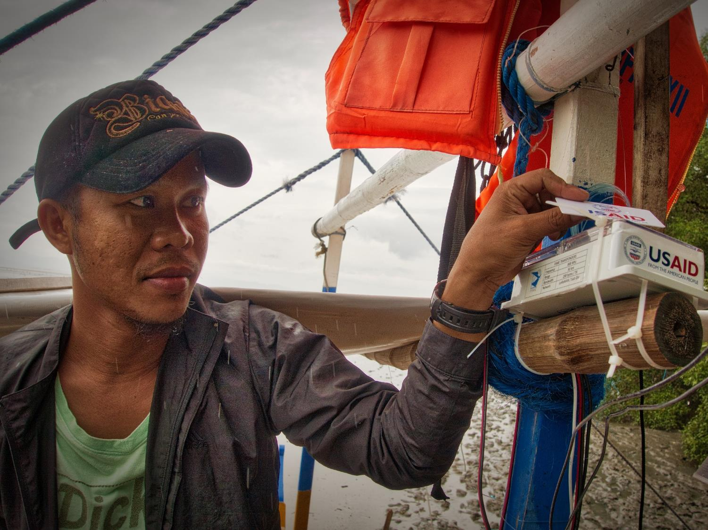
USAID Oceans and Fisheries Partnership
Program Overview
June 2019 | Farid Maruf, Regional CDT Specialist

Slide 2
PURPOSE
To combat illegal, unreported, and unregulated (IUU) fishing and seafood fraud, promote sustainable fisheries, and conserve marine biodiversity.

Slide 3
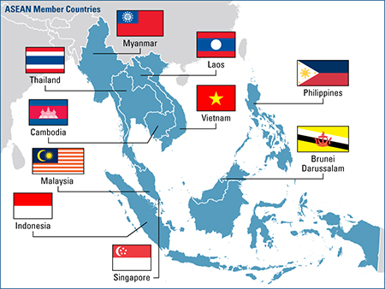
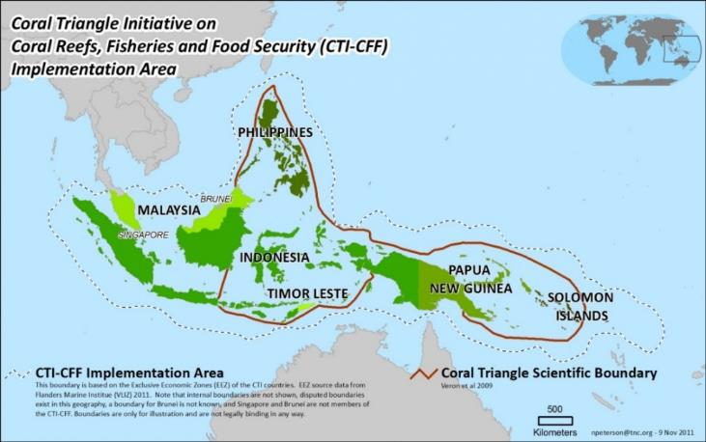
SCOPE
USAID Oceans is a 5-year (May 2015 – May 2020) regional project engaging with the 10 ASEAN and 6 Coral Triangle (CTI-CFF) Member Countries.

Slide 4
OVERVIEW
USAID Oceans Project focuses on 4 primary objectives:
Objective 1: Develop a financially sustainable regional electronic catch documentation and traceability (eCDT) system to combat IUU fishing and seafood fraud in areas where sustainable fisheries management planning is being conducted.
Objective 2: Expand the use of eCDT systems at priority marine biodiversity conservation areas within the ASEAN/CTI-CFF region.
Objective 3: Strengthen the human and institutional capacity of regional organizations to conserve marine biodiversity through eCDT and sustainable fisheries management to combat IUU fishing and seafood fraud.
Objective 4: Enhance public-private partnerships to conserve biodiversity, promote sustainable fisheries, and combat IUU fishing.

Slide 5
PRIMARY STRATEGIES
USAID Oceans aims to improve marine biodiversity conservation and increase the sustainability of Asia-Pacific’s international seafood trade through four strategies:

Slide 6
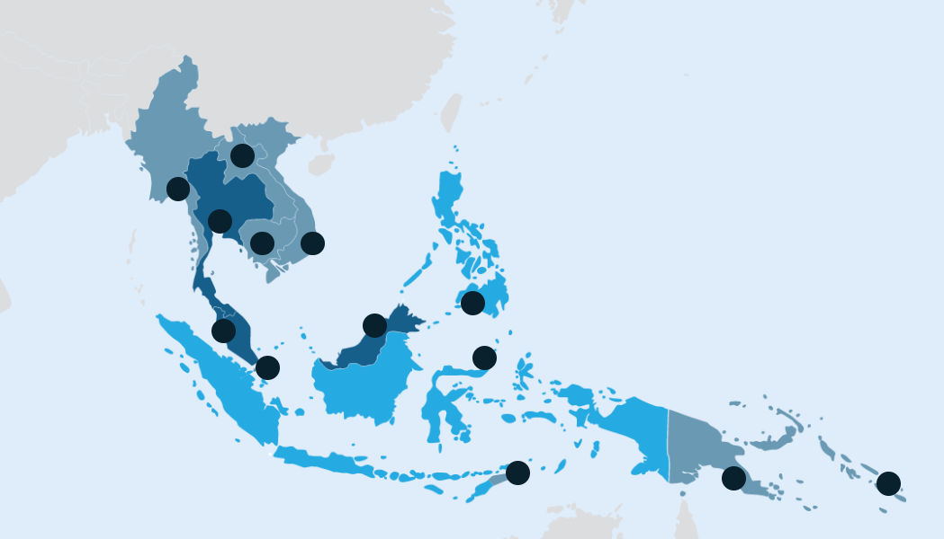
LEARNING & EXPANSION SITES
Learning Sites | Expansion Sites - 1 | Expansion Sites - 2
Bitung, Indonesia (FMA 716) General Santos, Philippines (Sarangani Bay Protected Seascape and surrounding EEZ waters) | Thailand (Songkhla) Malaysia (Kelantan; Sabah) Vietnam (Nha Trang) | Cambodia Myanmar Lao PDR Brunei Darussalam Singapore Papua New Guinea Solomon Islands Timor Leste

Slide 7
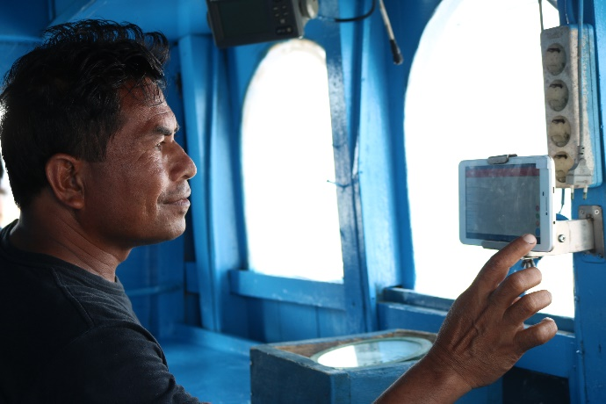
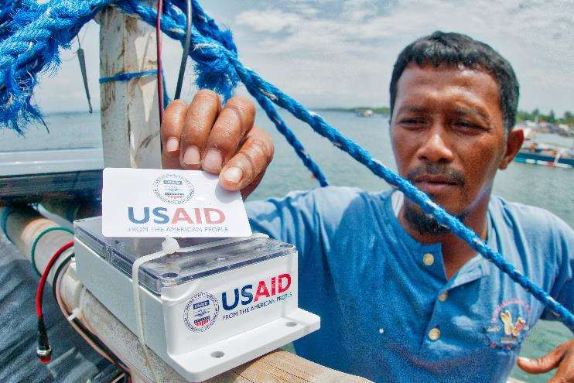
eCDT TECHNOLOGY
Pointrek/Inmarsat Two-Way Vessel Monitoring System
“FAME”
Small-Scale Vessel Transponders

Slide 8
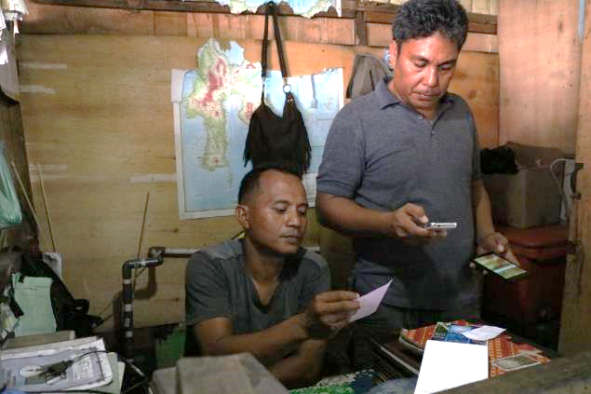
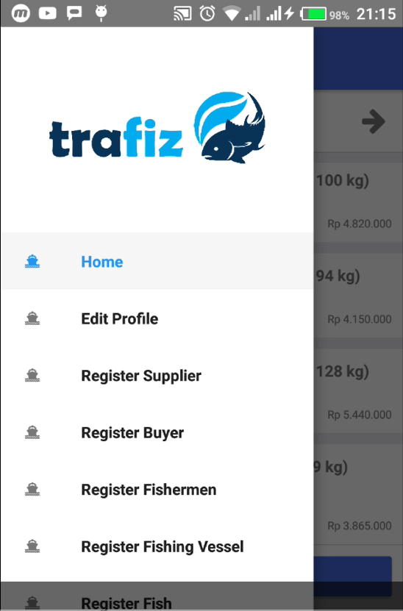
eCDT TECHNOLOGY
Trafiz Mobile Application

Slide 9
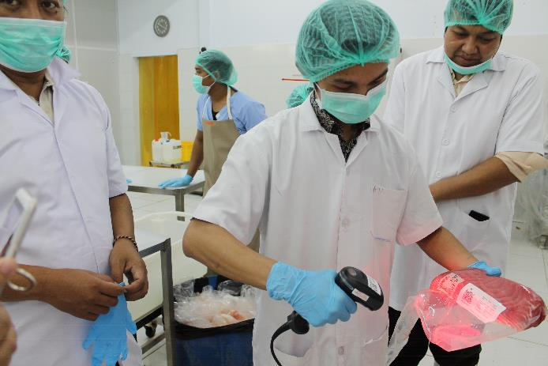
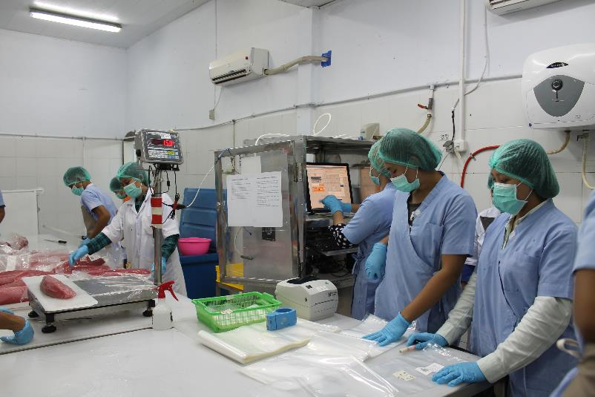
eCDT TECHNOLOGY
TraceTales Processor System

Slide 10
eCDT TECHNOLOGY
Establishing CDT Monitoring Center
Indonesia (3) :
E-logbook (Jakarta)
STELINA (Jakarta)
Port Authority (Bitung)
Philippines (2) :
BFAR FIMC Manila
BFAR 12 General Santos City

Slide 11
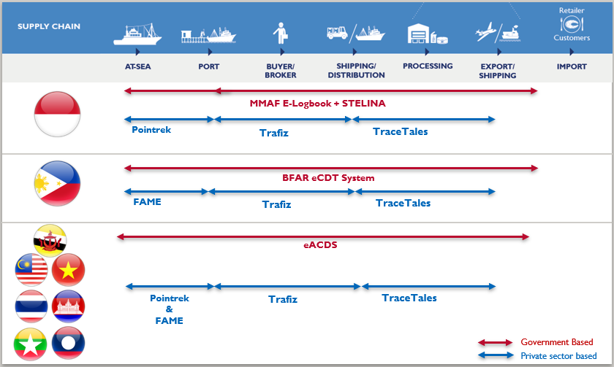
Our Joint Strategy
Underwriting the cost of innovation
Since 2015
Notes:
In this slide you can see how we strategize our interventions. From the beginning this is our PARADIGM in the provision of eCDT in ASEAN
In our expansion countries we strongly proposed to use eACDS as the building platform of eCDT. We are fully committed to deliver the success by SEAFDEC including building interoperability with existing system. There is nothing can prevent one to implement another independent system, but it will create redundant works with the risk of inconsistency data.
The arrow length represent the supply chain coverage. Both BFAR and MMAF with support from industry, has formally requested us build this “connection” amongst the systems
Our tested and supported tools and technologies can be a great supplement to eACDS. We will help to build the interopability.

Slide 12
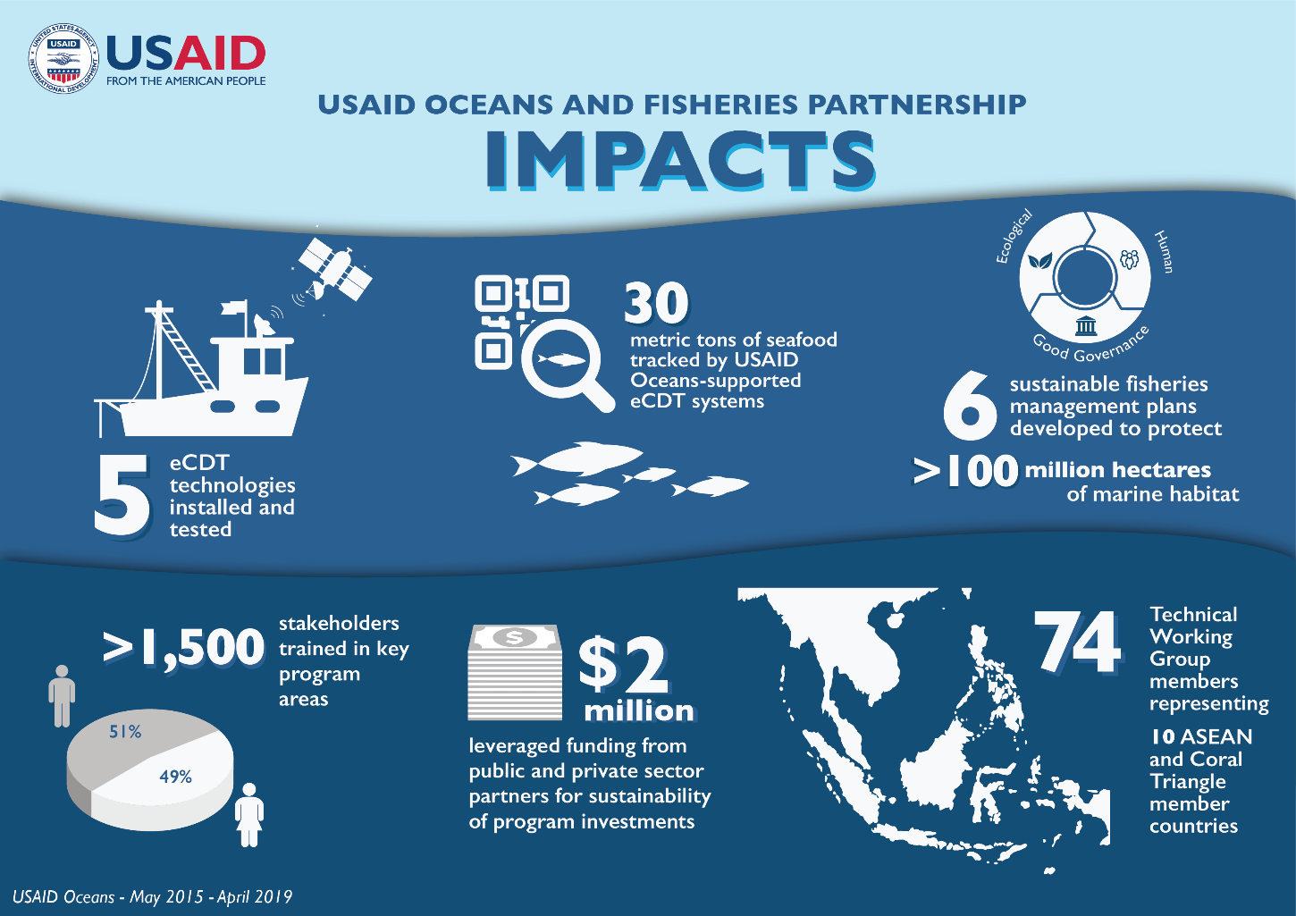
IMPACTS

Slide 13
LESSONS LEARNED
eCDT TECHNOLOGY –
“One size fits all” solutions can be challenging to implement and ineffective – systems must be interoperable and accessible.
eCDT systems should be built upon the strengths of existing CDT protocols.
Critical for support from strong enforcement (including validation and verification) among government agencies and a clear (private sector) business model.
FISHERIES MANAGEMENT –
Effective fisheries management plans should incorporate and be backed by eCDT systems, in concert with other management measures.
The use of eCDT data for informing fisheries management is relatively new, thus it requires the development of new tools, methodologies, and software.

Slide 14
LESSONS LEARNED
PARTNERSHIPS –
The most successful partnerships are formed between multiple parties (i.e. private sector, government, and local community groups).
Periodic partnership reviews and evaluation can optimize existing partnerships and identify new opportunities to support priorities.
HUMAN WELFARE –
Human welfare and gender have become key considerations for traceability, including the roles of women and men, their working conditions, policies, business environments, and markets.
eCDT systems can be a valuable human welfare tool.
If developed holistically, eCDT can enable valuable human welfare-related functions, including non-compliance and abuse alerts.

Slide 15
John Parks
USAID Oceans, Chief of Party
John.Parks@oceans-partnership.org
Cristina Vélez Srinivasan
USAID/Regional Development Mission for Asia
cvelez@usaid.gov

