Slide 1
The 12th Senior Officials’ Meeting (SOM-12)
1-2 November 2016
Port Moresby – Papua New Guinea
Session 6:
Status of the Ratification of the Agreement on
the Establishment of Regional Secretariat of CTI-CFF
Widi A. Pratikto Ph.D.
CTI-CFF Regional Secretariat
1 November 2016

Slide 2
BACKGROUND
The status of instrument ratification of CTI-CFF member countries on the Agreement on the Establishment along with its submission to the Depository was acknowledged in SOM-11 in Manado.
In SOM-11, CTI-CFF member countries encouraged PNG to expedite the ratification process of the Agreement on the Establishment of CTI-CFF Regional Secretariat.
The meeting subsequently tasked Regional Secretariat to facilitate PNG in its ratification of the said document.

Slide 3
FOLLOW UP & RESULT
To expedite PNG ratification process
To discuss on preparation of SOM-12 back to back with MM-6 in PNG
To discuss on preparation for handover of CTI COM Chair & Vice Chair as well as CTI CSO Chair & Vice Chair respectively
RS
WORK VISIT TO PORT MORESBY, PNG in July 2016

Slide 4
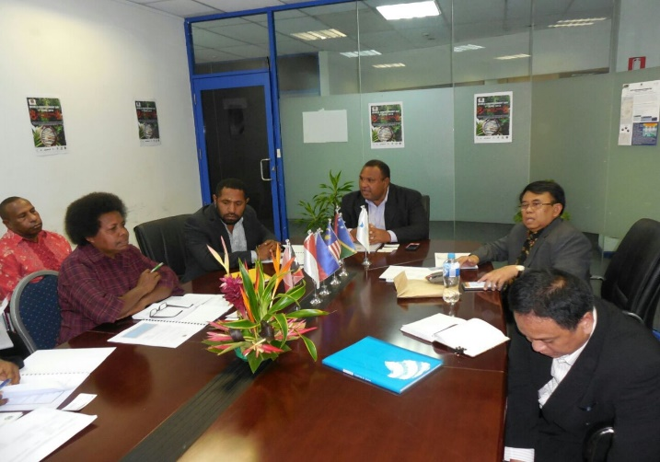
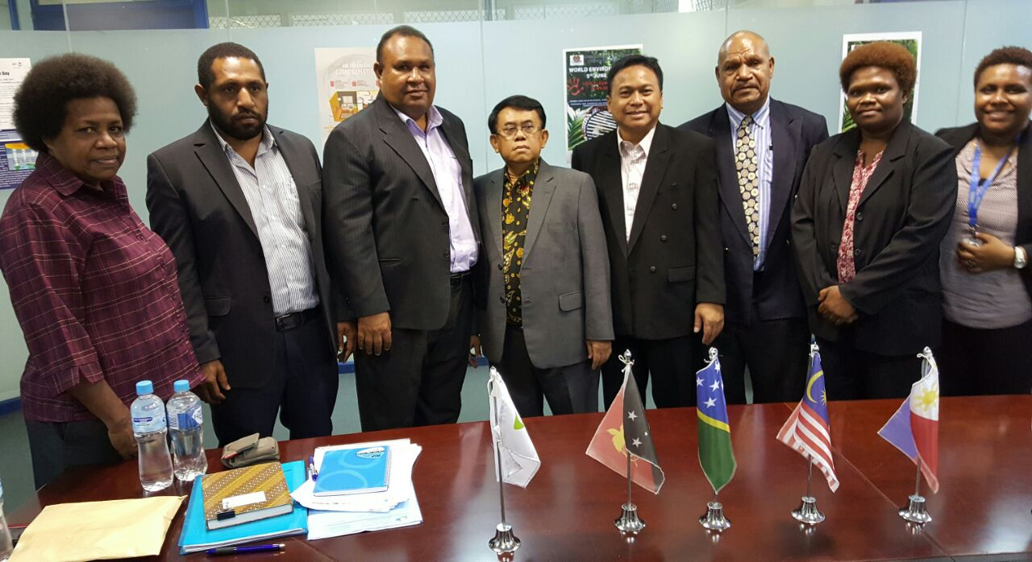
Meeting with CEPA PNG
(18-20 July 2016)
Ratification of PNG on the Agreement on the Establishment of Regional Secretariat of CTI-CFF signed by Hon. Rimbink Pato, OBE, LLB, MP as Minister for Foreign Affairs and Immigration on 31 August 2016.
Embassy of the Independent State of Papua New Guinea has submitted the instrument of ratification to the Depository (i.e. Ministry of Foreign Affairs of the Republic of Indonesia) through its Diplomatic Note as of 13 September 2016 (Ref. No. 112/2016).
RESULT

Slide 5
STATUS RATIFICATION OF THE AGREEMENT ON THE ESTABLISHMENT OF THE REGIONAL SECRETARIAT OF CTI-CFF
As of 30 September 2016
No | Country | Dates of Signing Instrument of Ratification | Dates of Acceptance of Instrument of Ratification
1 | Malaysia | 13 February 2013 | 15 April 2013
2 | Indonesia | 9 May 2014 | 9 May 2014
3 | Solomon Island | 2 September 2014 | 8 October 2014
4 | Timor-Leste | 13 October 2014 | 27 October 2014
5 | Philippines | 24 November 2014 | 8 January 2015
6 | Papua New Guinea | 31 August 2016 | 13 September 2016

Slide 6
RECOMMENDATION
To acknowledge and appreciate the ratification of the Papua New Guinea on the Agreement on the Establishment of the Regional Secretariat of CTI-CFF on 31 August 2016 and submission of the instrument of ratification on 13 September 2016.
To acknowledge and appreciate that all 6 (six) member countries of CTI-CFF had ratified the Agreement on the Establishment of the Regional Secretariat of CTI-CFF.

