Slide 1
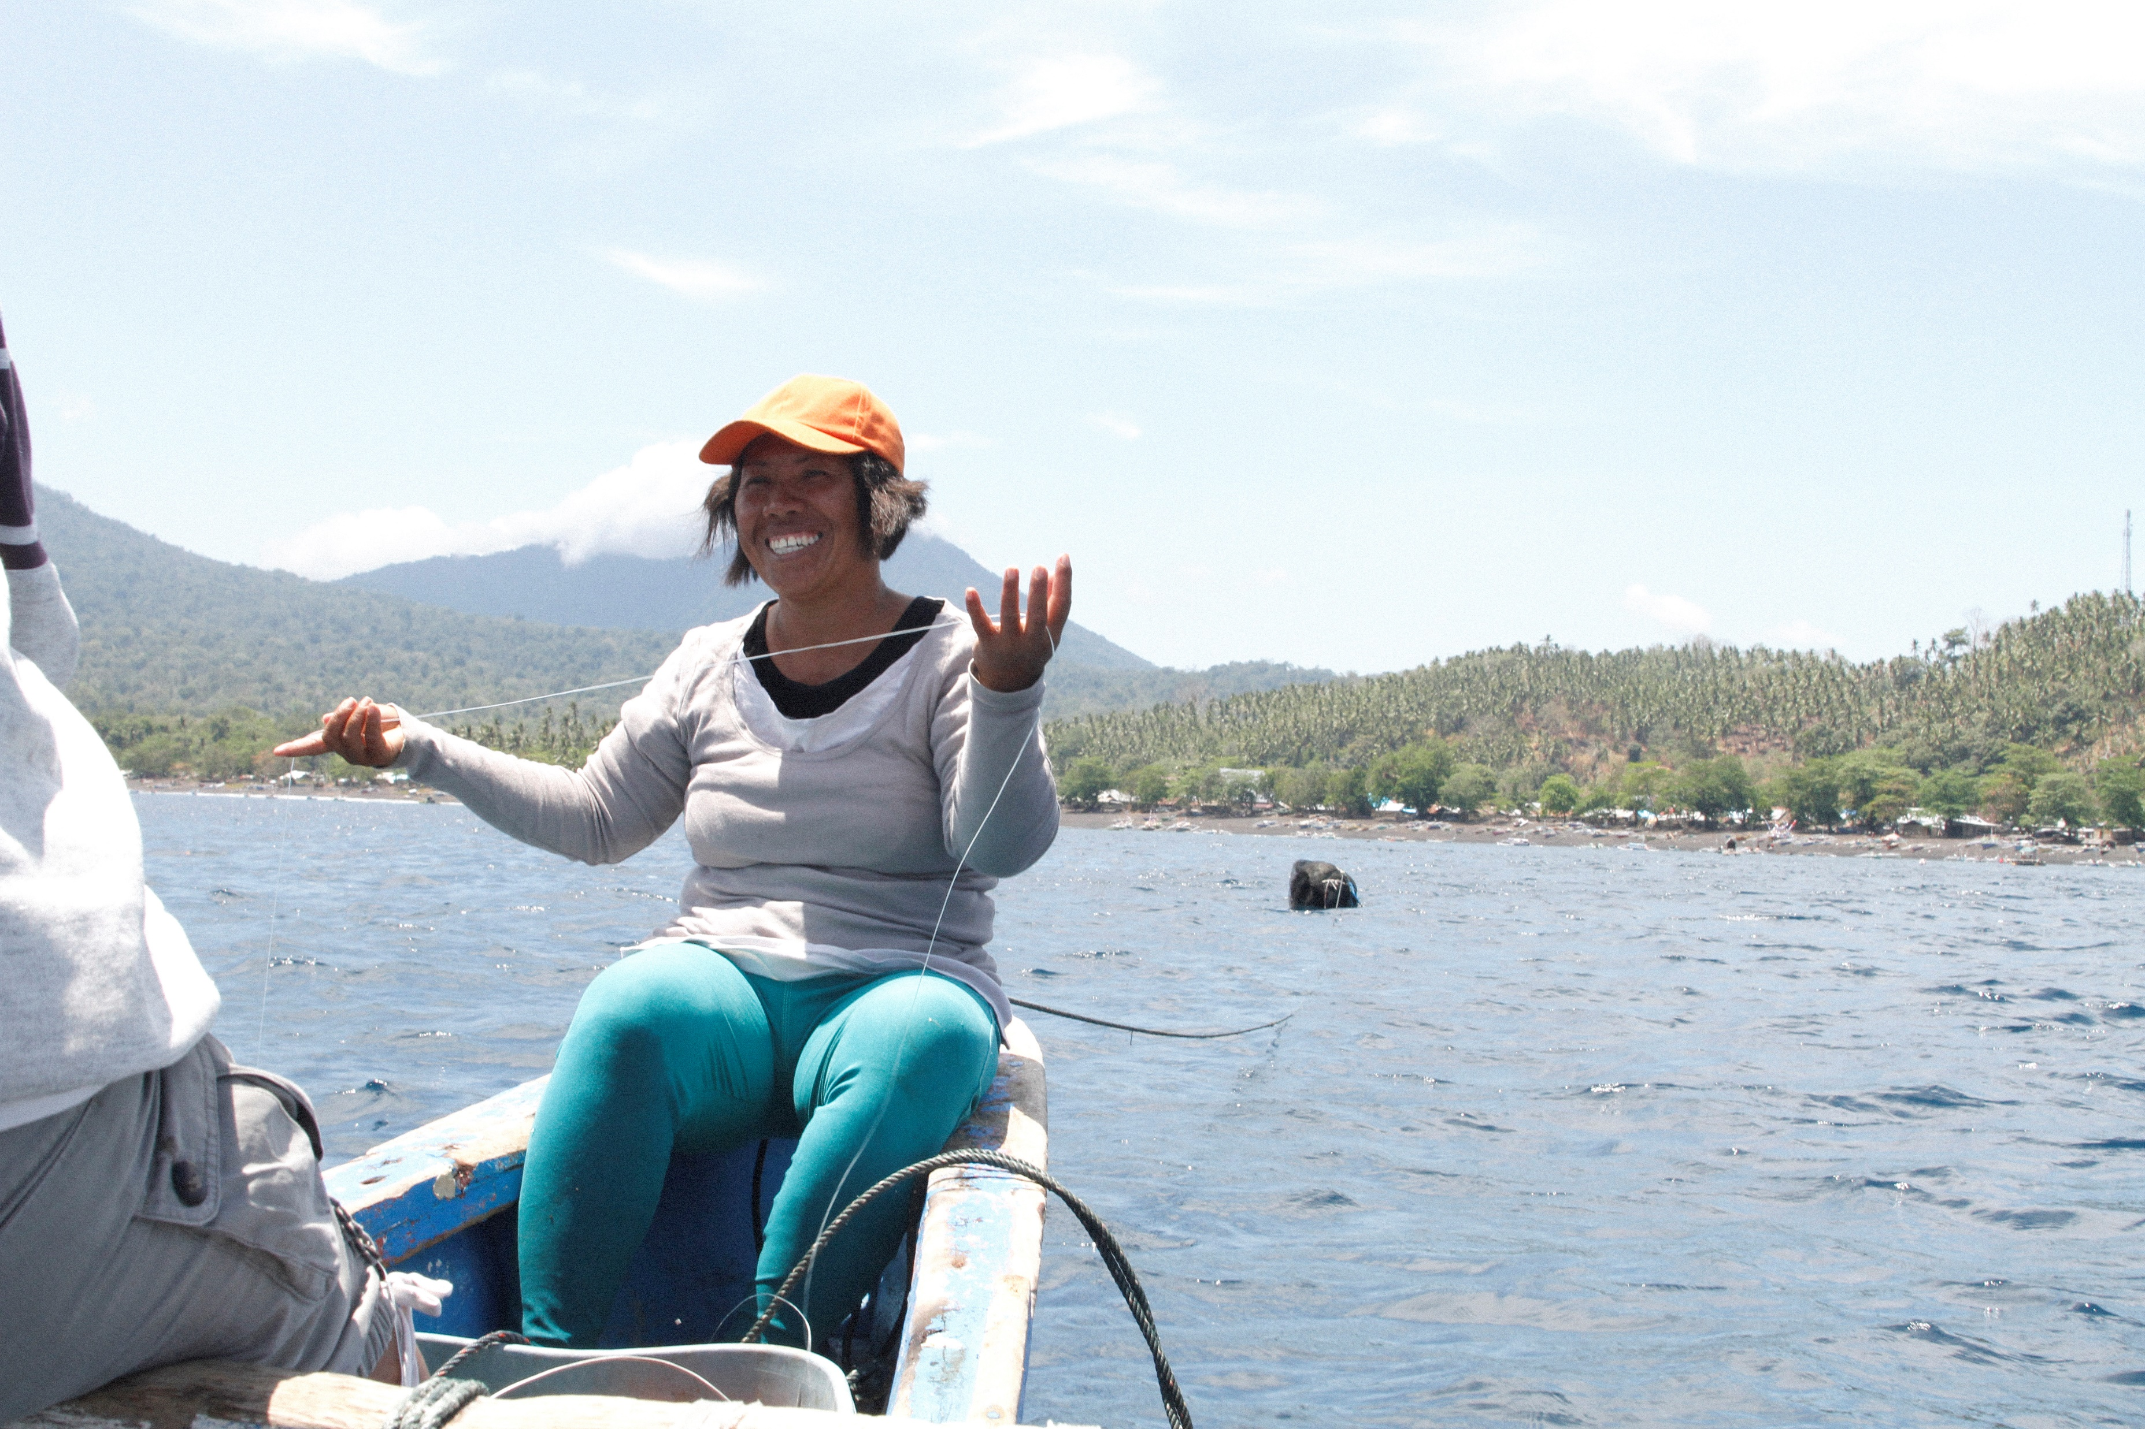
Women and Marine Conservation in Coral Triangle: Progress, Challenges and Future Directions
Arlene Nietes Satapornvanit
Gender in Aquaculture and Fisheries Section, Asian Fisheries Society

Slide 2
Aim: an integrated social, economic and environmental development, that safeguards the planet, well-being of people and an equitable distribution of development over time.
Human person – focus of sustainable development
Gender equality – heart of the 2030 Agenda for Sustainable Development

Slide 3
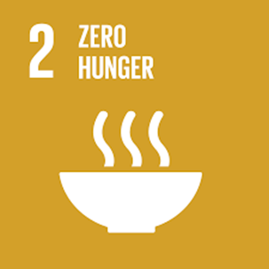
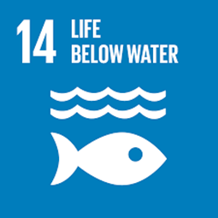
SDGs relevant to CTI-CFF

Slide 4
PROMOTING GENDER EQUALITY & WOMEN’s EMPOWERMENT
equitable rights, capabilities and access to resources & opportunities
strengthening women’s ability to make choices and decisions and act upon them
eliminating gender-based violence and discrimination
transforming power relations at all levels of society
OSAGI (Office of the Special Advisor on Gender Issues and Advancement of Women) 2001. “Gender Mainstreaming: Strategy for Promoting Gender Equality.” Factsheet. http://www.un.org/womenwatch/osagi/pdf/factsheet1.pdf

Slide 5
Why women? Rationale behind SDG5
half of the world’s population and half of its potential
underrepresented at all levels of political leadership
perform a disproportionate share of unpaid domestic work
inequalities can begin right at birth and follow them all their lives

Slide 6
Progress of SDG5 in Asia-Pacific
poverty, quality education and affordable and clean energy (+)
clean water and sanitation, decent work and economic growth and responsible consumption and production (-)
health and well-being, gender equality and partnerships (-)
vulnerability to disasters and climate change (-)

Slide 7
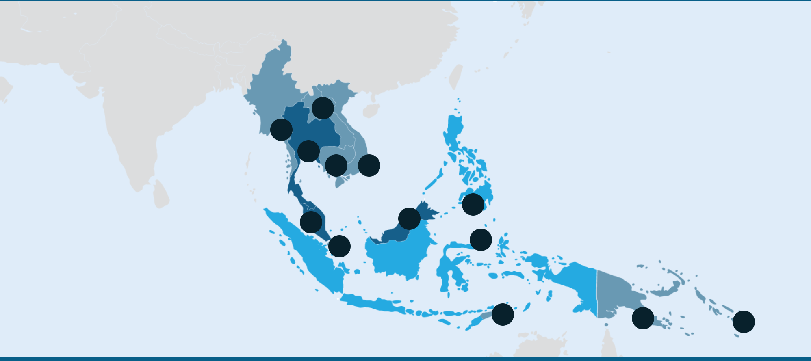
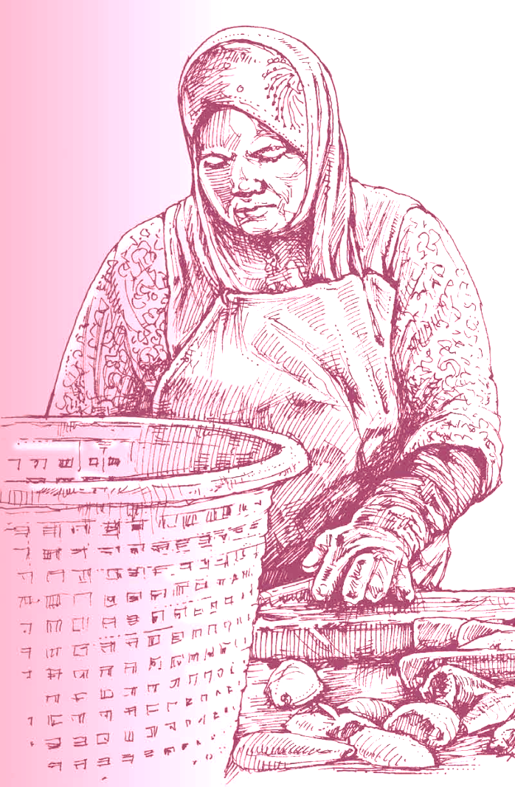
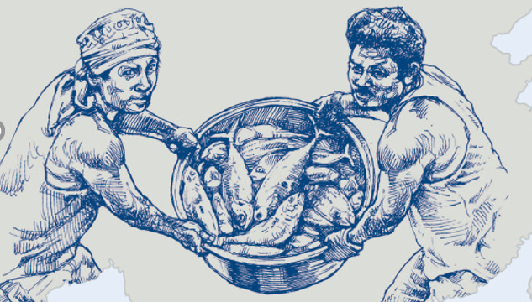
ASIA-PACIFIC WATERS
Provides daily food & income to > 200 M in Asia-Pacific
Employs 59.51 million people globally
85% (50.58M) in Asia
Great importance to food security, nutrition, livelihood development and overall economic and social development, & achievement of SDGs
Credit: USAID Oceans & Fisheries Partnership

Slide 8
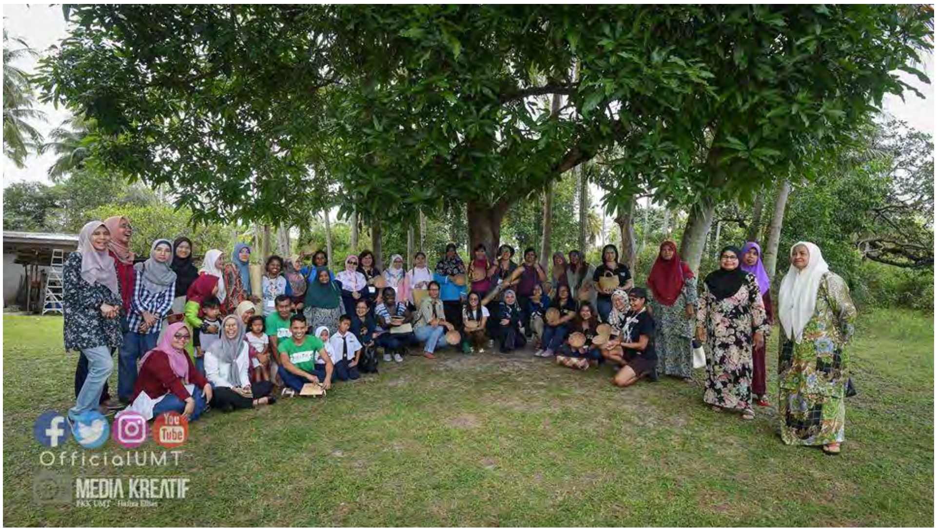
Who are the women in marine conservation?
Frontliners – communities, marine areas
Sectoral Fisheries
Marketing, Trade
Governance, leadership and management
Academe, research
Civil Society Organizations
Private sector / industry
Ecotourism
Formal and informal sectors
Many more …
How many?
Ages?
Position?
Education?
Origin?
Access?
Decision-making?
Voice?

Slide 9
CTI-CFF Women Leaders’ Forum
Photo: J.M. Saad
VISION:
Empowered women leaders driving positive change in protecting and managing marine and coastal ecosystems in the Coral Triangle region

Slide 10
Progress – what has been done so far?
CTI WLF
In a position to influence national policies of CT6 member countries
Able to work and seek opportunities with international organizations
Influenced regional policy (RPOA 2.0) focused on integrating gender considerations
BENEFICIARIES
Increased number of trained women (government and communities); e.g. MPA, fisheries management, etc.
In a position to influence national policies
Improved (project) planning capability
Increased motivation
Better visibility of gender programs
Improved knowledge and capability to seek / access to potential opportunities
Source: J. M. Saad, 2020. Regional Workshop on Gender Integration in Fisheries. USAID Oceans.

Slide 11
Progress – what has been done so far?
2019: Baseline Matrix and Stocktake on Gender-Related Policies and Legal Framework in the Coral Triangle
gender-related policies and legal frameworks from the CT6 countries
identified implementation challenges and gaps from a gender perspective.
outlined relevant gender-related policies for various CTI-CFF partners and other relevant stakeholders.
Reviewed by CT6 and partners
Reference for the development of a CTI-CFF Gender Equality and Social Inclusion (GESI) Policy (2020).
Supported by TNC

Slide 12
Progress – what has been done so far?
With the USAID Oceans and Fisheries Partnership (2015 -2020):
CTI-CFF was a regional partner
USAID Oceans supported the Women Leaders’ Forum
Capacity Building and Resources:
Gender Analysis and Research
Gender Integration in the Fisheries Workplace
Gender videos
Website: www.seafdec-oceanspartnership.org
Notes:
During the USAID Oceans and Fisheries Partnership implementation, CTI-CFF was a regional partner.
In parti

Slide 13
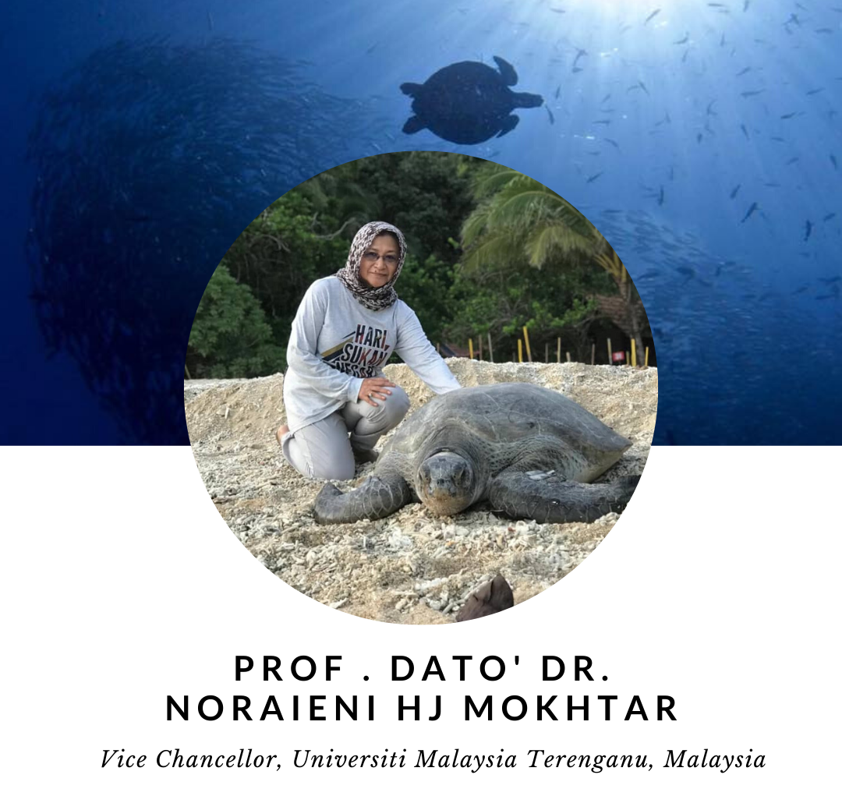
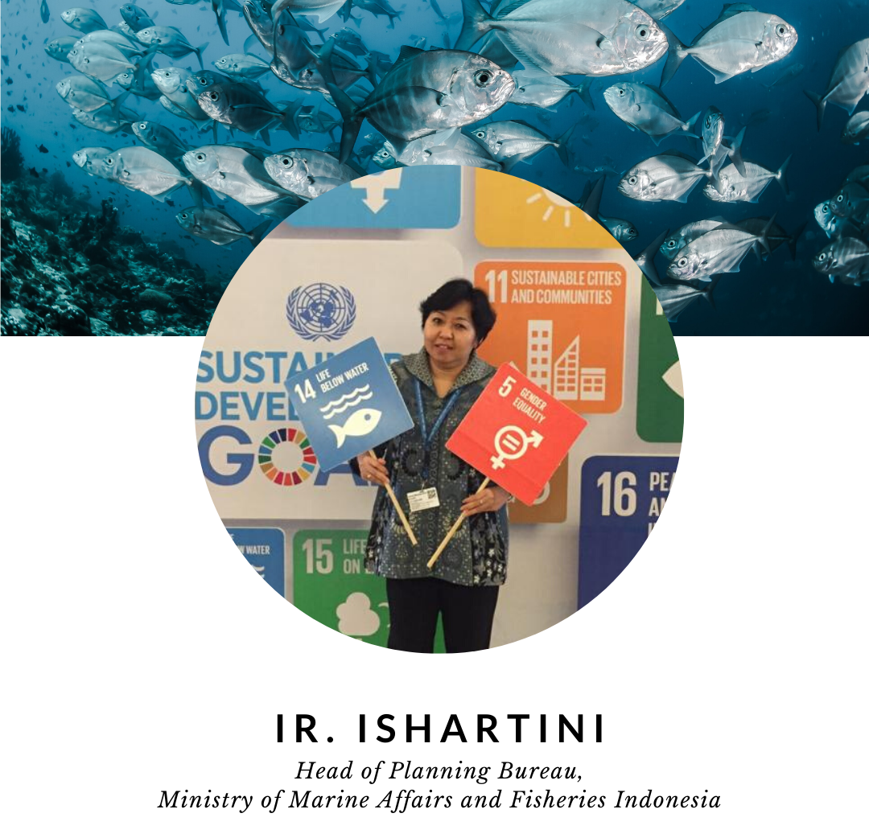
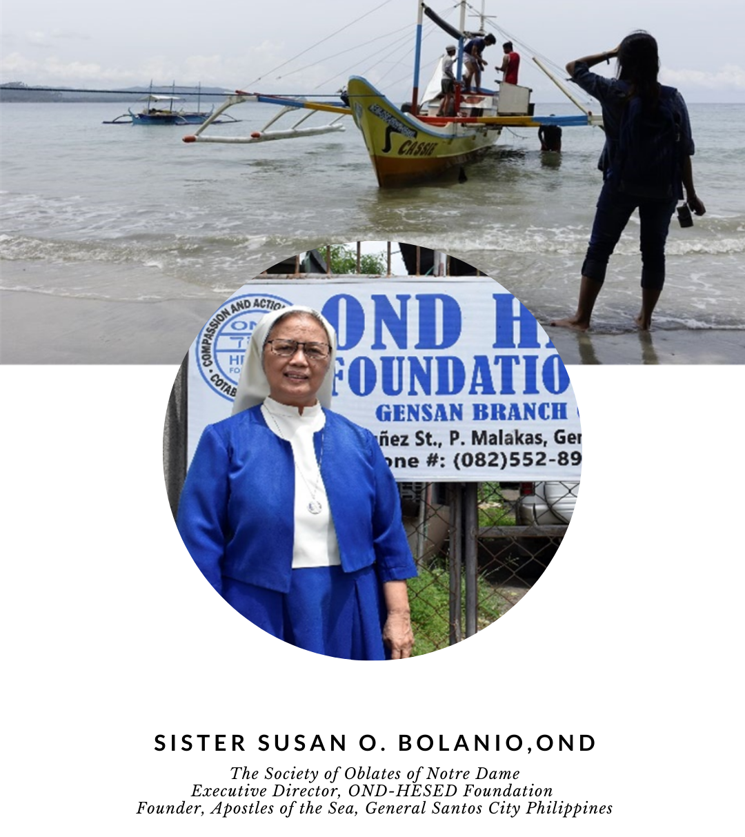
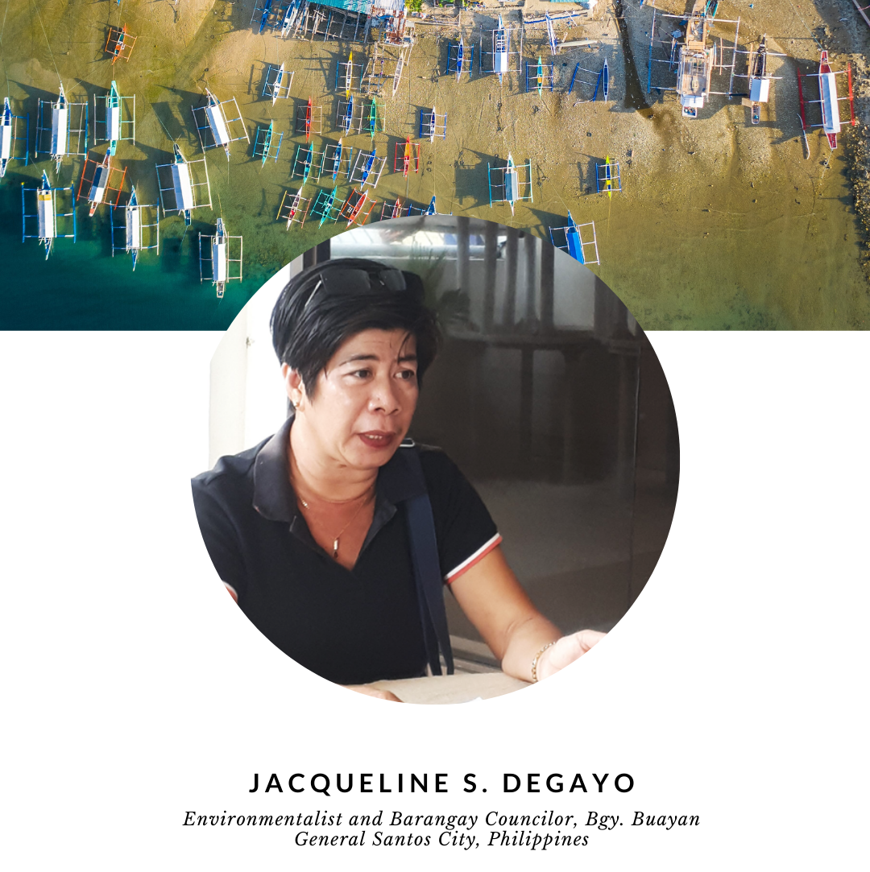
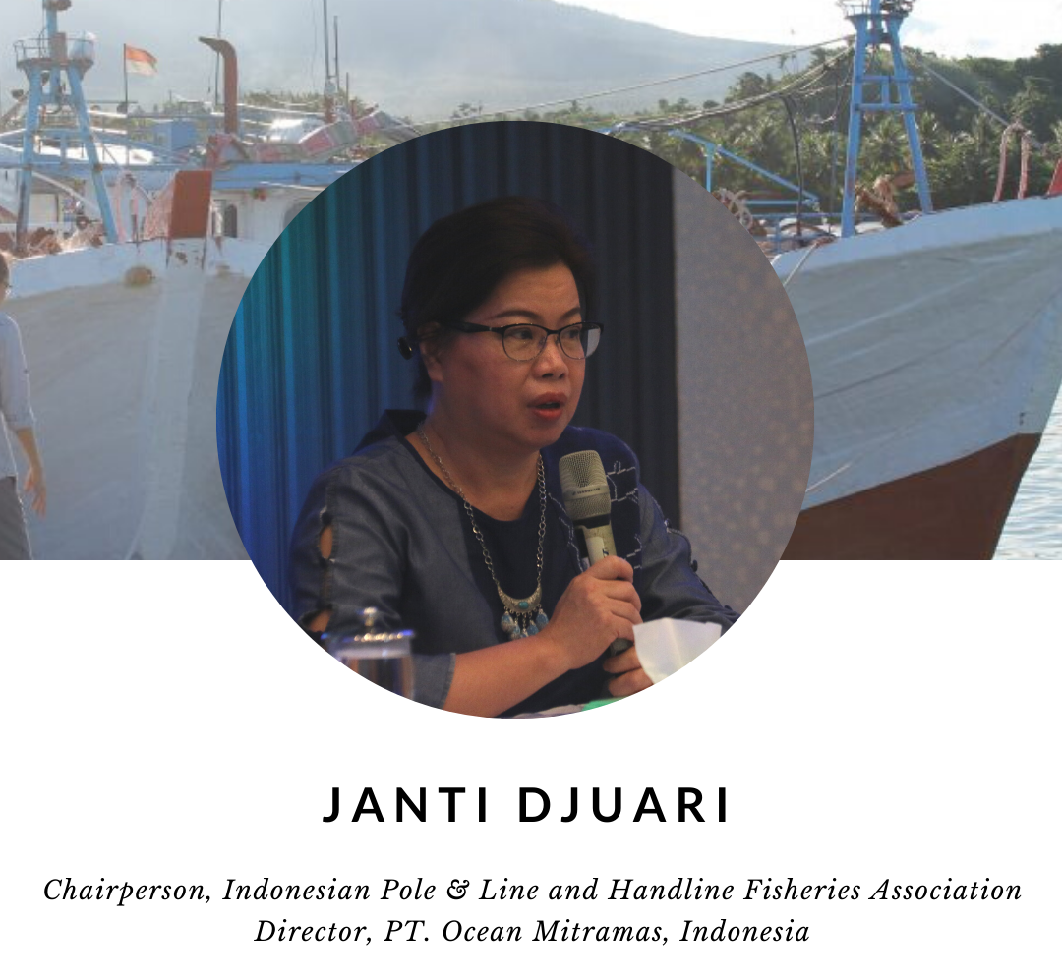
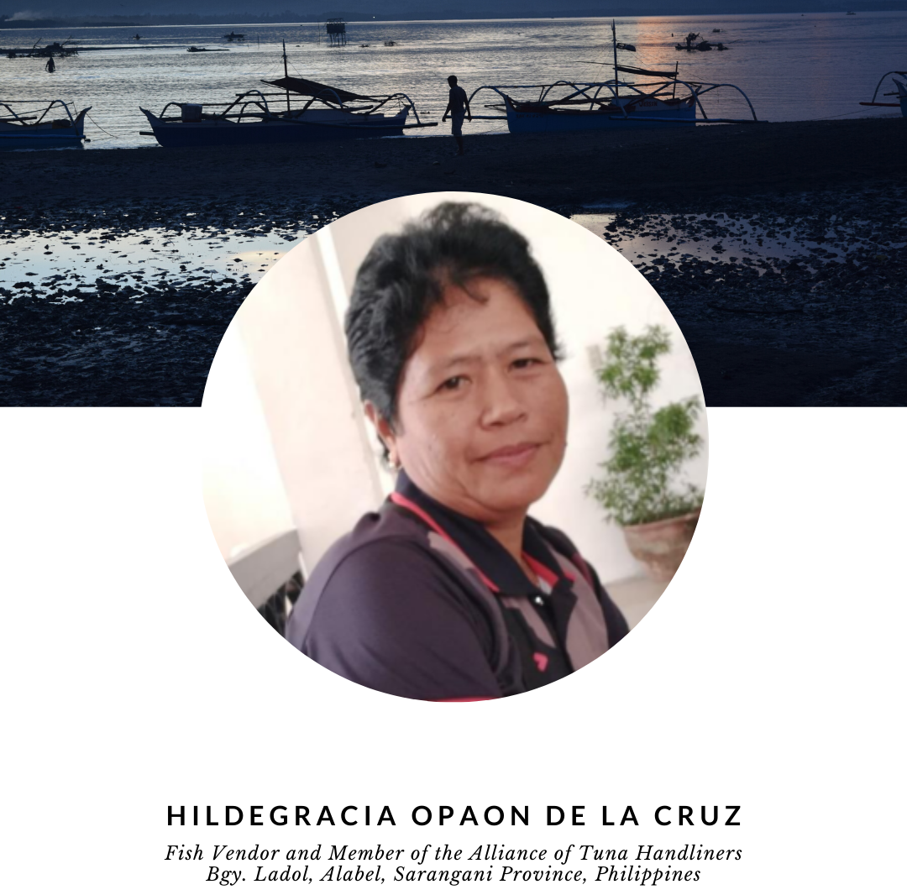
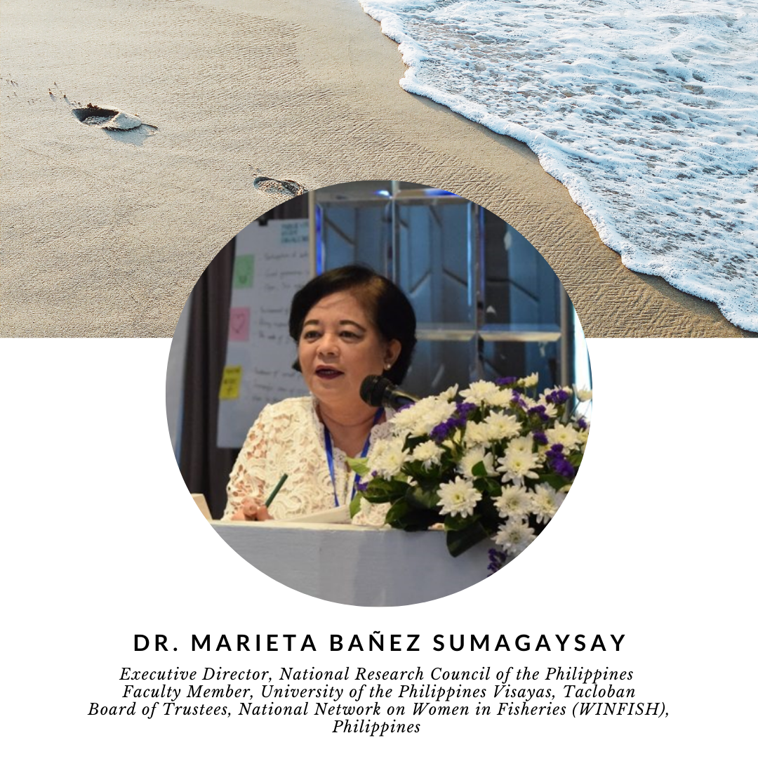
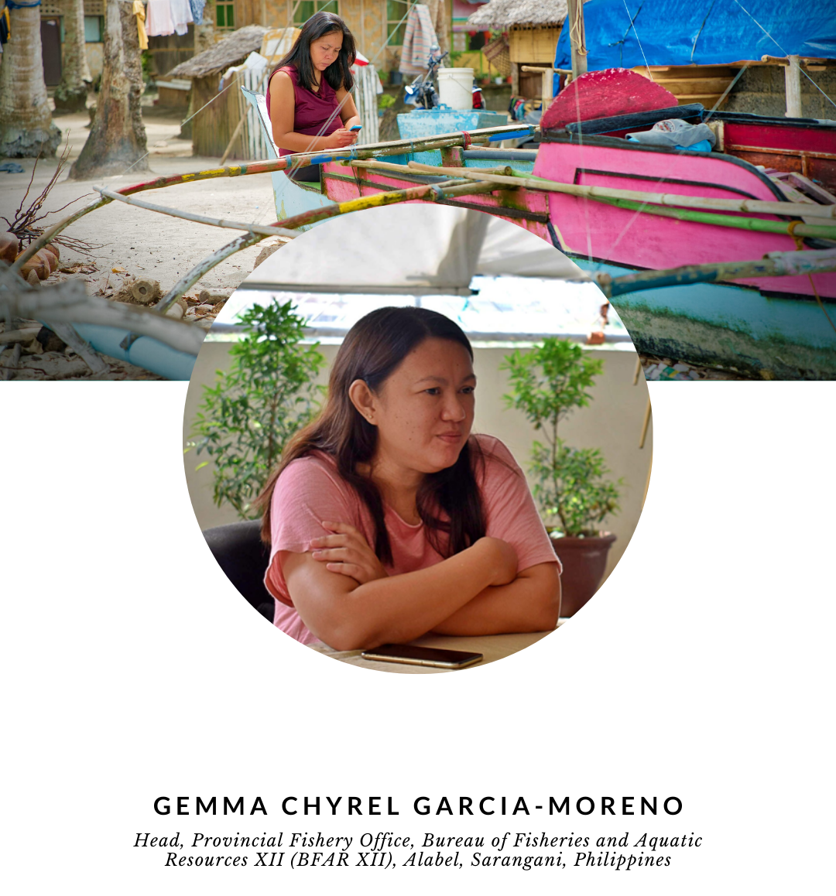
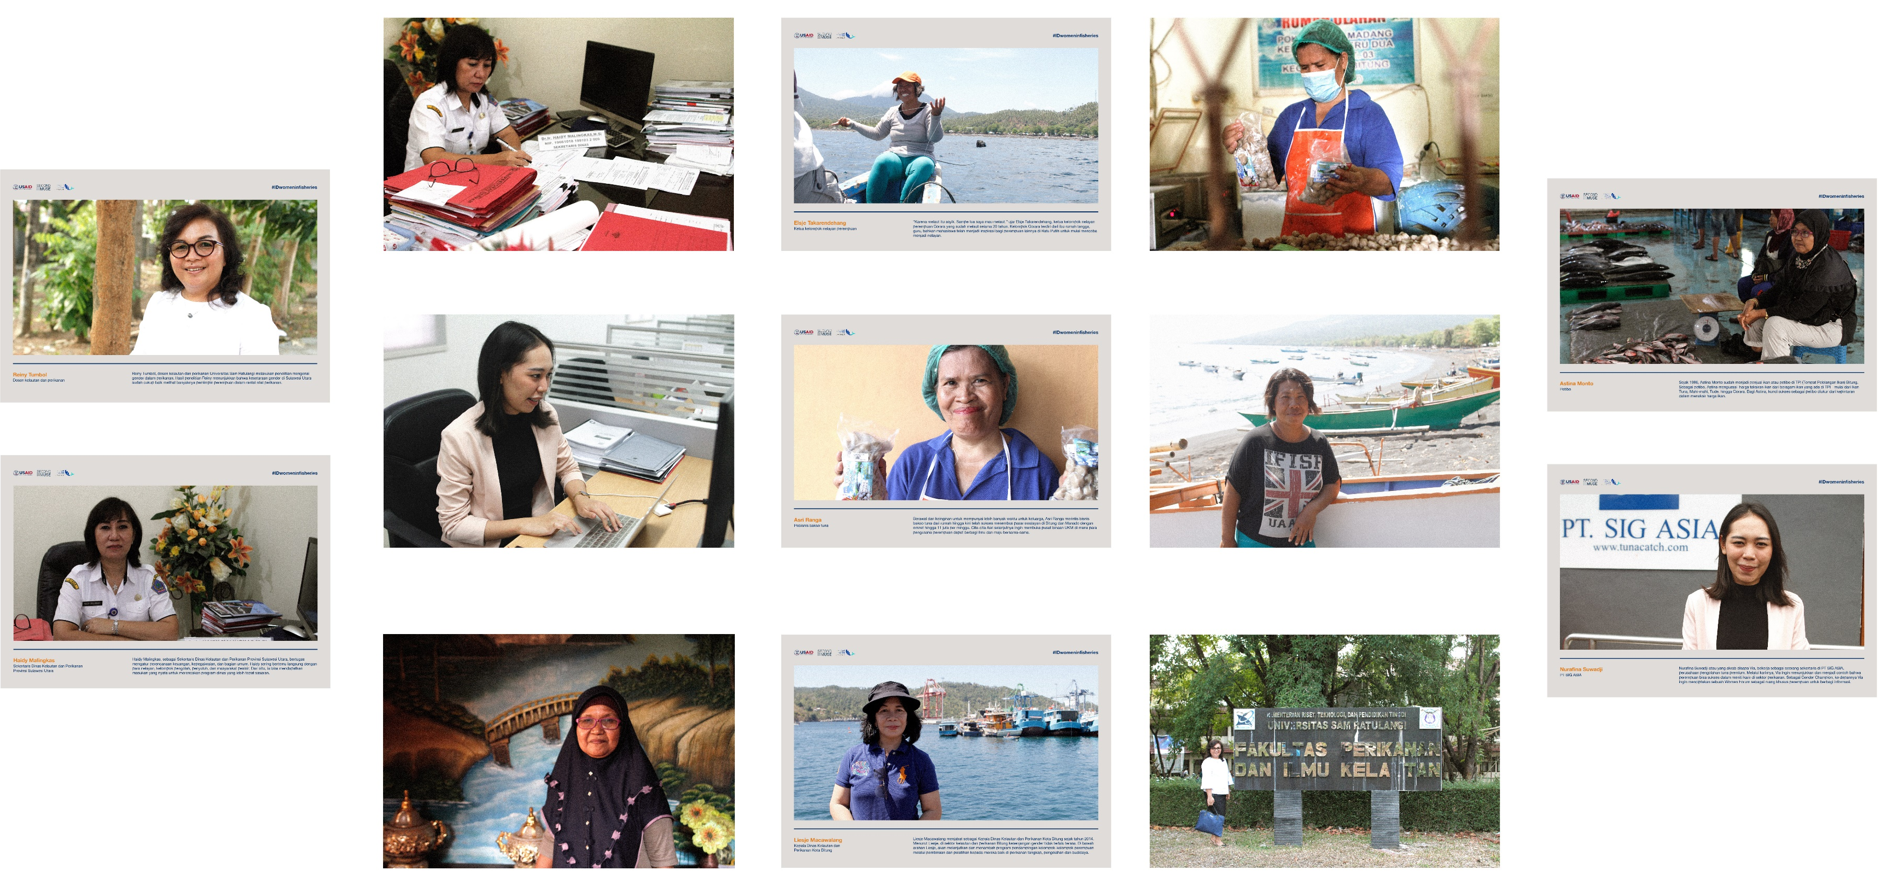
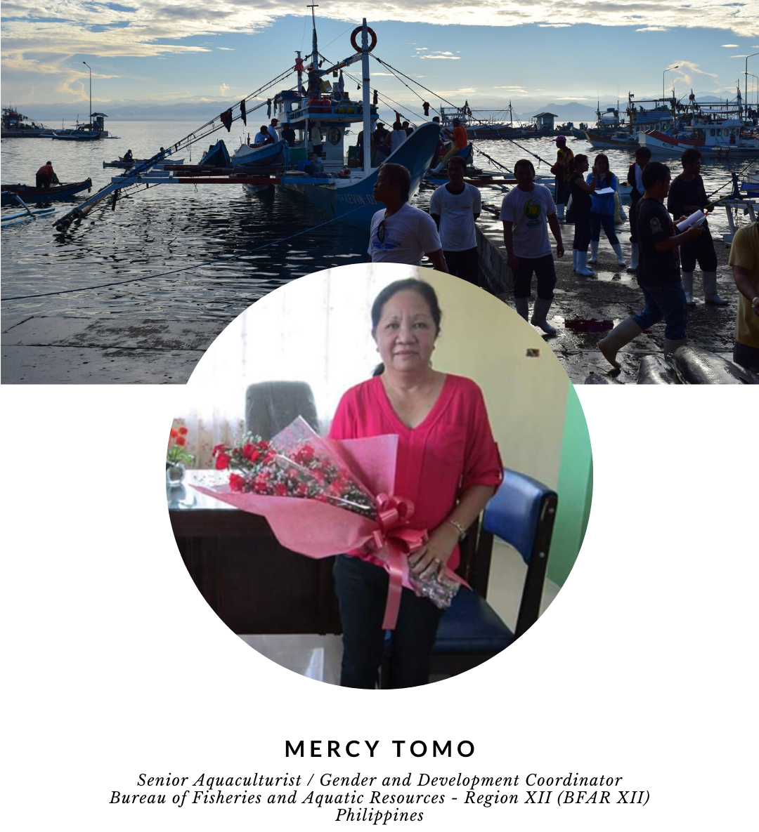
Recognizing Women Leaders

Slide 14
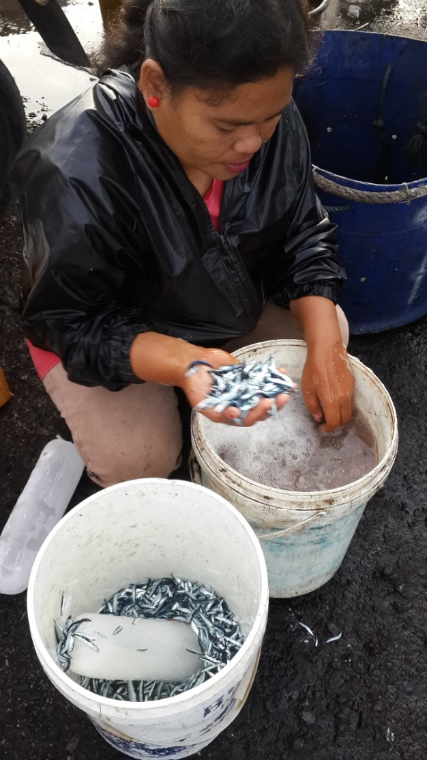
Challenges – women’s burdens
Productive work burden
Unpaid reproductive work burden within the household
Community-level work
Hinders women from having quality of life and realizing their full potential

Slide 15
Challenges – COVID 19
COVID 19 recognized as one of the greatest challenges
Women’s access to healthcare, employment, information, vulnerability to GBV
UN Women: 40 % of women in South-East Asia, and up to 68 % of women in the Pacific have experienced violence at the hands of their intimate partners.
Broader impact is on households: Loss of employment
Supplies issue more on logistics and delivery but also lack of cash on hand

Slide 16
Challenges - institutional
Absence of in-house dedicated gender coordinator to ensure gender considerations in regional programs/plans
Support and buy-in from men is critical
Beneficiaries
Absence of gender policy,
Partners (potential partners) continued support for WLF
Ongoing capacity building needed; more empowered/trained women needed
Maintaining momentum
Limited visibility due to lack of communications plan
Sustainability – what’s next?
Support for programming & budgeting
Cti – CFF wlf
Source: J. M. Saad, 2020. Regional Workshop on Gender Integration in Fisheries. USAID Oceans.

Slide 17
Future directions – recommendations for WLF
Continue working together with Development Partners and future partners
Gender integration in policies and programs
Establishment of a platform for a women network
Expanding partnerships to advance capacity building
Embracing men and boys as advocates / supporters
Investment in youth
Strengthening partnerships – private sector, other stakeholders
Source: J. M. Saad, 2017. ADB conference on Advancing Women’s Leadership in the CT.

Slide 18
Future directions – Recommendations
Mainstreaming SDG 5 into national plans, policies and budgets
Increasing public awareness and ownership
Engagement of civil society and the private sector, including academic and scientific communities
Improvement and availability of gender-inclusive data, statistics, performance indicators, and gender analysis
Providing adequate financing
Infrastructural changes
Capacity building on new skills (for e.g. digital, finance)

Slide 19
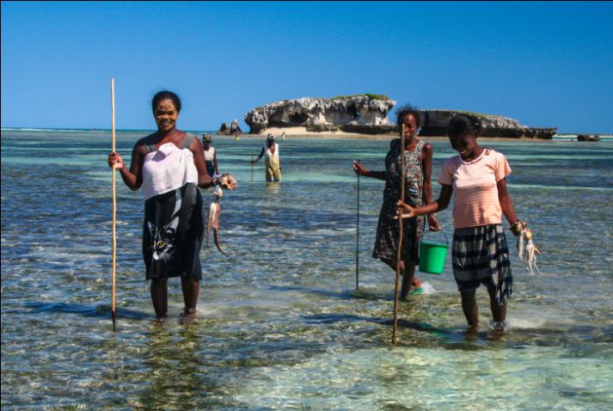
ACKNOWLEDGMENT
CTI-CFF Women Leaders’ Forum
CTI-CFF Regional Secretariat
USAID Oceans and Fisheries Partnership
UN Women Policy Paper on COVID 19
ASEAN Policy Paper on COVID 19
Ms. Jasmin Mohd Saad
Photo Credit: Mahona Na Dari Conservation Center

