Slide 1
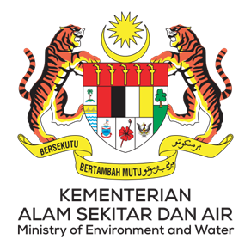
Country Report Malaysia
By
Jamalulail Bin Abu Bakar
Head Of Delegation Malaysia

Slide 2
Outline
Members (Agencies) of the National Coordination Committee
Progress/Accomplishments towards NPOA
Seascape, EAFM, MPA, CCA, Threatened Species
Challenges/Constraints Affecting Implementation
National Roadmap 2023
Seascape, EAFM, MPA, CCA, Threatened Species
Potential Regional Program and Support Required
Publications

Slide 3
Members (Agencies) of the NCC
Working Group | Focal Point
Seascape | Dr. Norasma Dacho, Principal Assistant Director for Resource Management and Conservation Office, Department of Fisheries Sabah Alternate: Ms. Sylvia Scholastica Michael Dalansing , Fisheries Officer, Department of Fisheries Sabah
Ecosystem Approach to Management of Fisheries (EAFM) | Dr. Norasma Dacho, Principal Assistant Director for Resource Management and Conservation Office, Department of Fisheries Sabah Alternate: Ms. Sylvia Scholastica Michael Dalansing , Fisheries Officer, Department of Fisheries Sabah
Marine Protected Areas (MPAs) | Ms. Rimi Repin, Principal Assistant Director of Research and Education Division, Sabah Park Alternate: Mr. Adam Malik bin Masidi, Marine Research Officer, Sabah Parks
Climate Change Adaptation (CCA) | Madam Noor Afifah Abdul Razak, Deputy Secretary General (Environment), Ministry of Environment and Water Alternate: Dr Ejria Saleh, Borneo Marine Research Institute, Universiti Malaysia Sabah
Threatened Species | Mr. Bohari Haji Leng, Senior Director of Fisheries Conservation and Protection, Department of Fisheries Alternate: Mr Azlan Md Noor, Head of Conservation, Ecosystem and Biodiversity, Department of Fisheries

Slide 5
Progress – Seascape
CTI-CFF National Programs:
Coral Triangle Initiative Workshop for Stakeholders
Date | No. of Participants | Location
16 June 2022 | 30 | Kota Kinabalu
30 August 2022 | 30 | Kudat

Slide 6
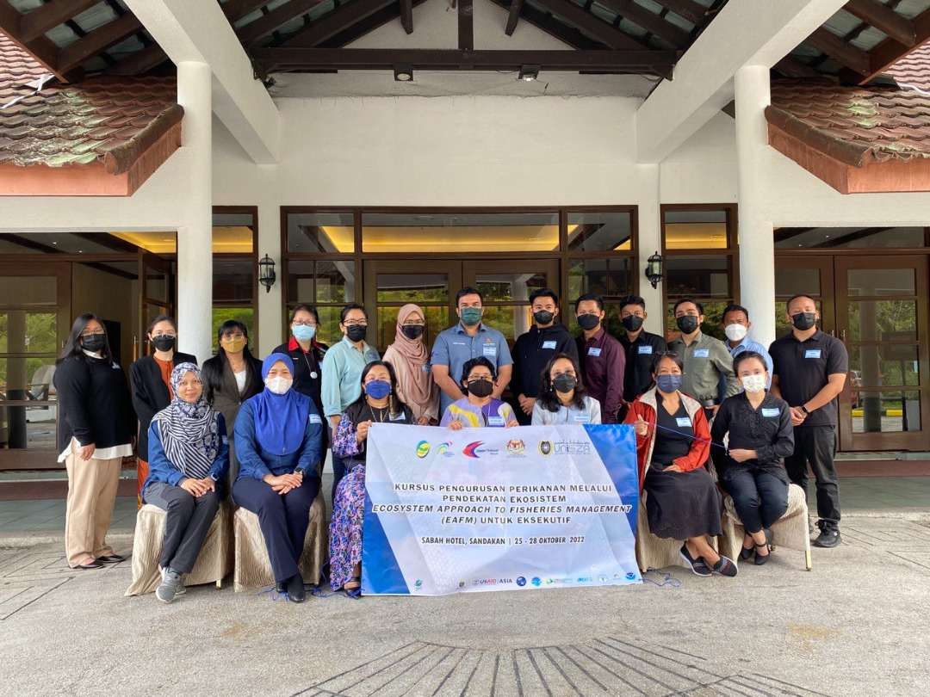
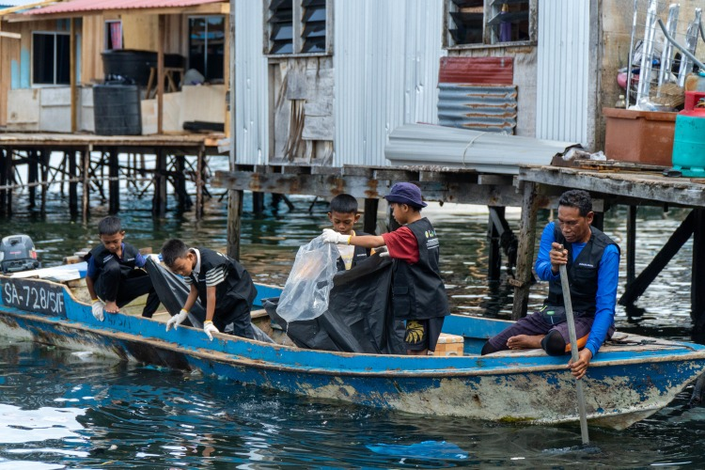
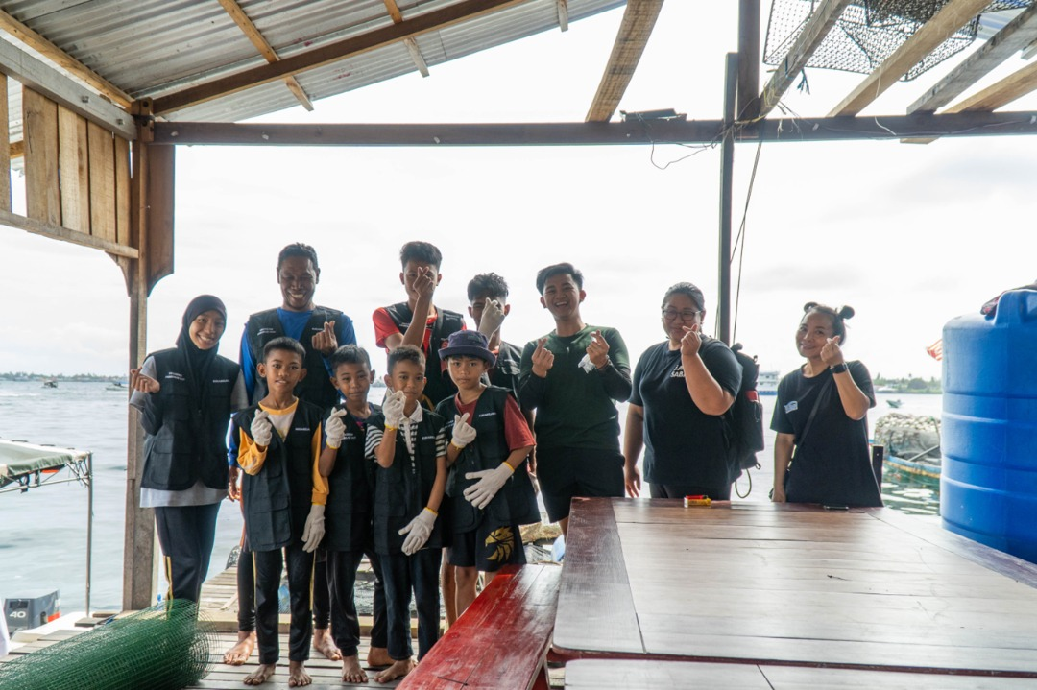
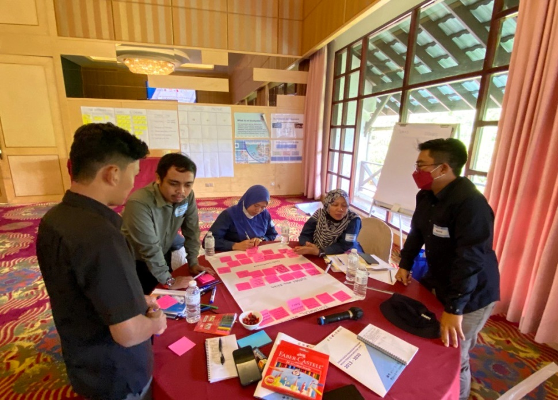
Progress – EAFM
CTI-CFF National Program
Capacity Building for EAFM
Conducted on 25 – 27 October 2022 (19 executive-level trainees)
2. “Program Pendekar Laut”
Program conducted on 27 – 28 September 2022 in Kg. Simunul, Semporna

Slide 7
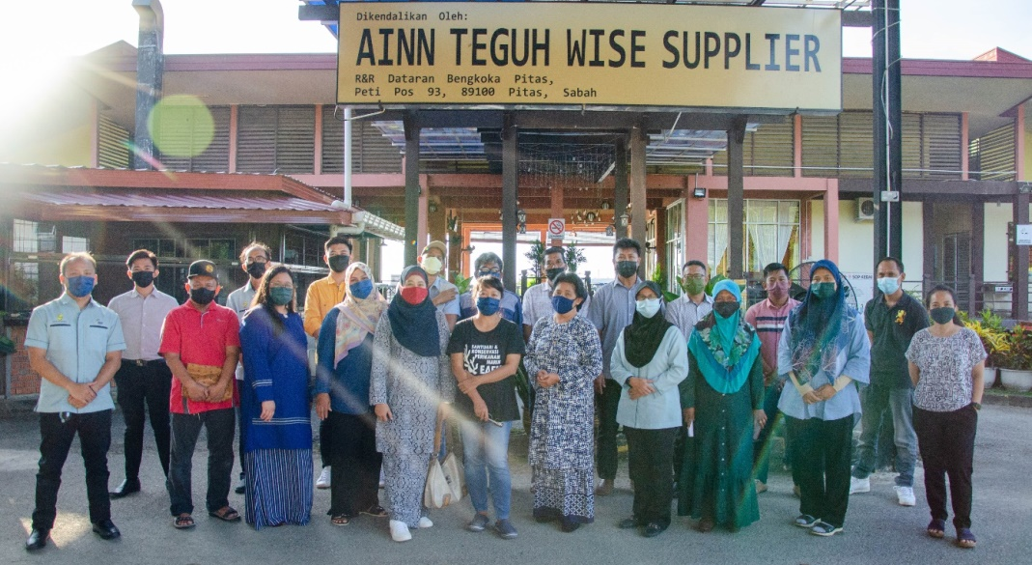
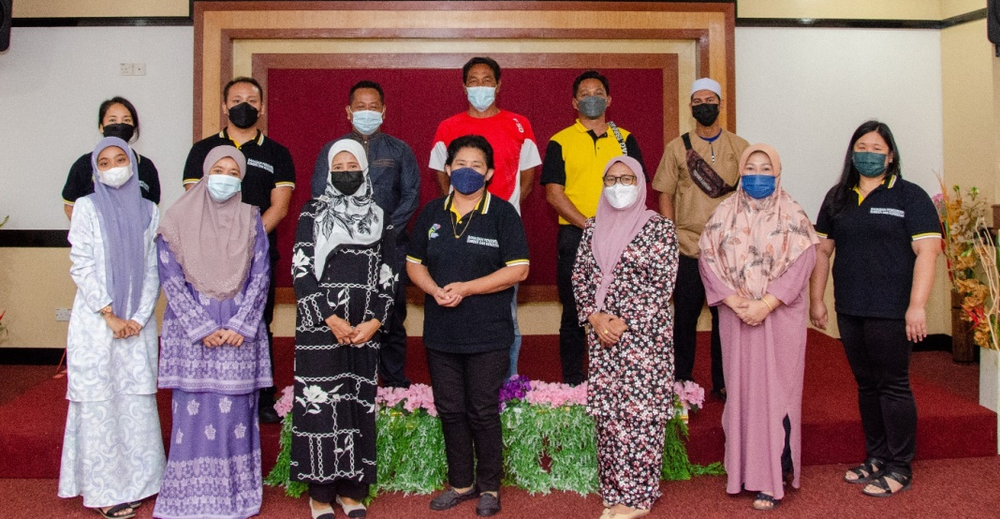
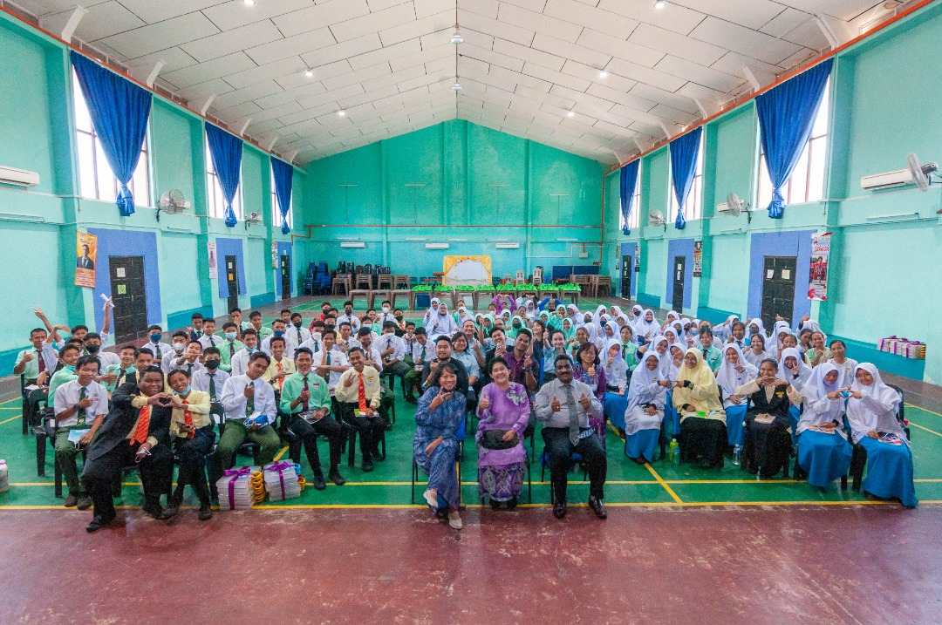
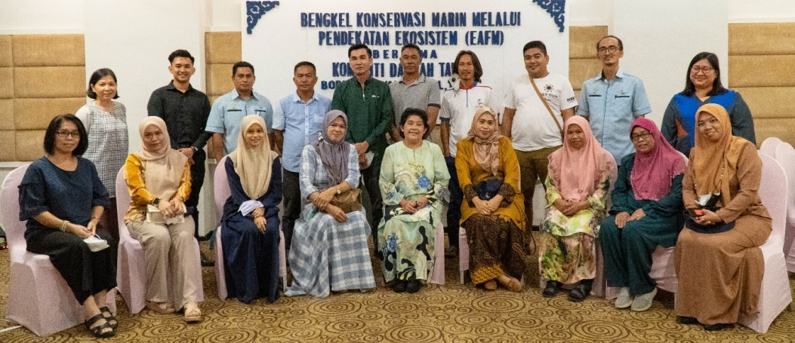
Progress – EAFM
Activities Related to CTI-CFF Goals with Different Budget
EAFM Marine Conservation Awareness Program for two (2) Secondary Schools
Three (3) EAFM Marine Conservation Workshop for Stakeholders
EAFM Global Classroom 2.0

Slide 8
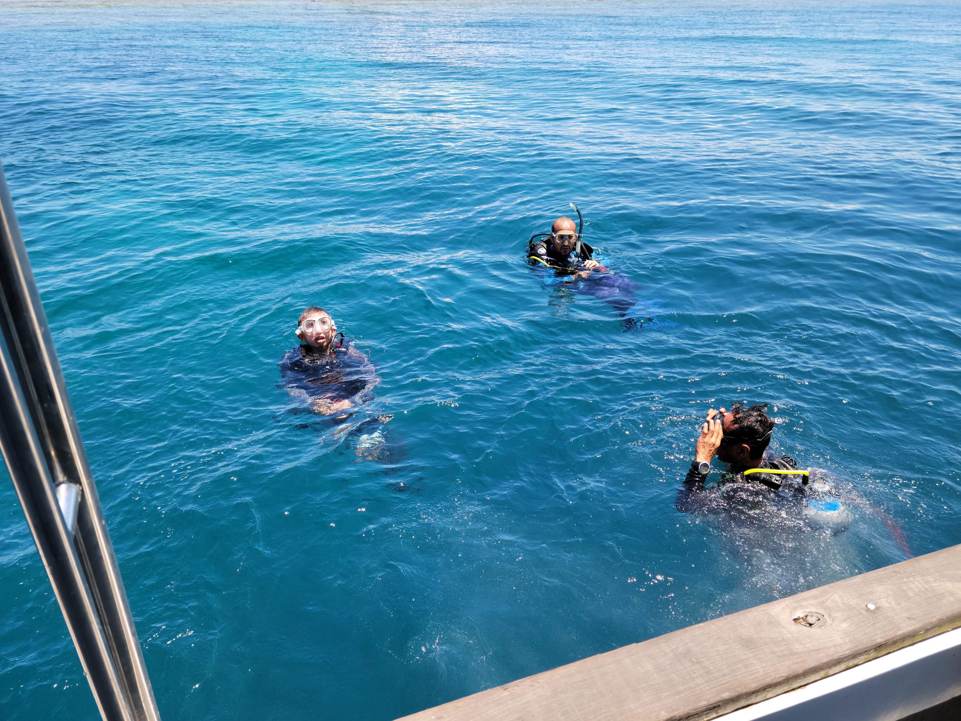
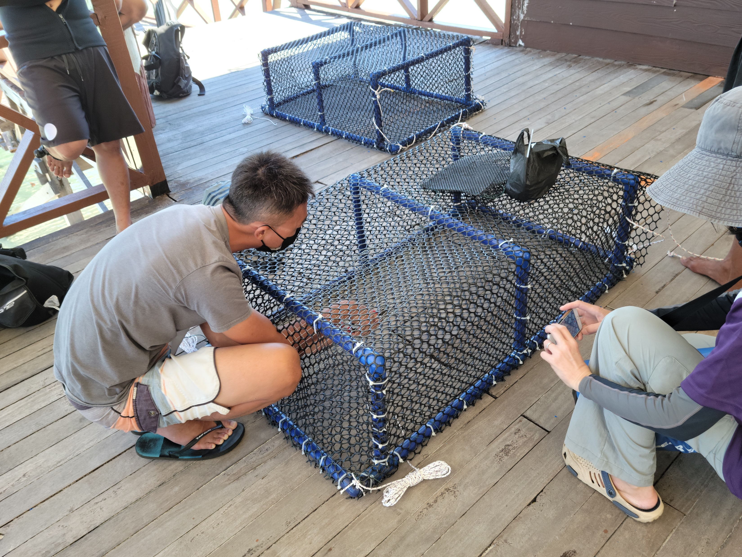
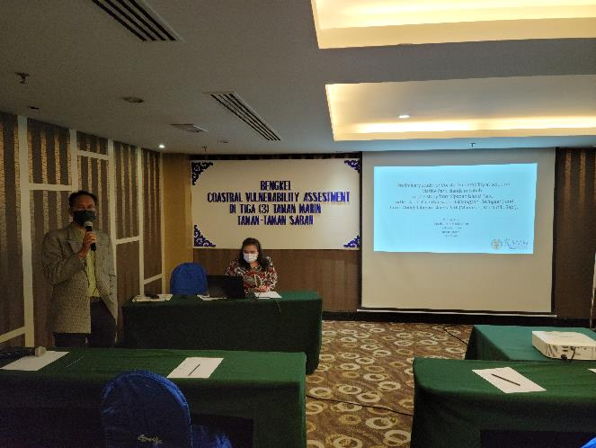
Progress – MPA
CTI-CFF National Programs:
Preliminary Study for Coastal Vulnerability at the Selected Marine Parks Islands of Sabah (Action 18)
Mobilization of state stakeholders to investigate reports of diseased sharks in Sipadan Island Park (Action 17 & 18)

Slide 9
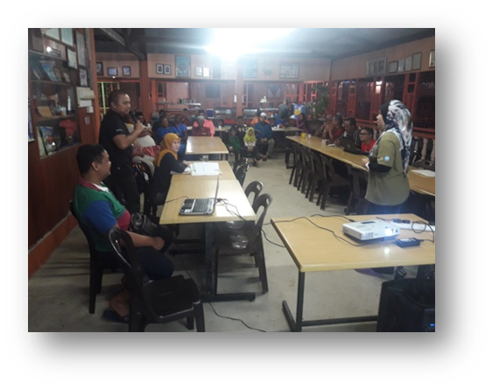
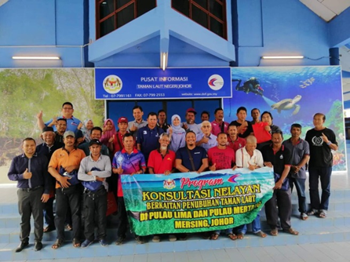
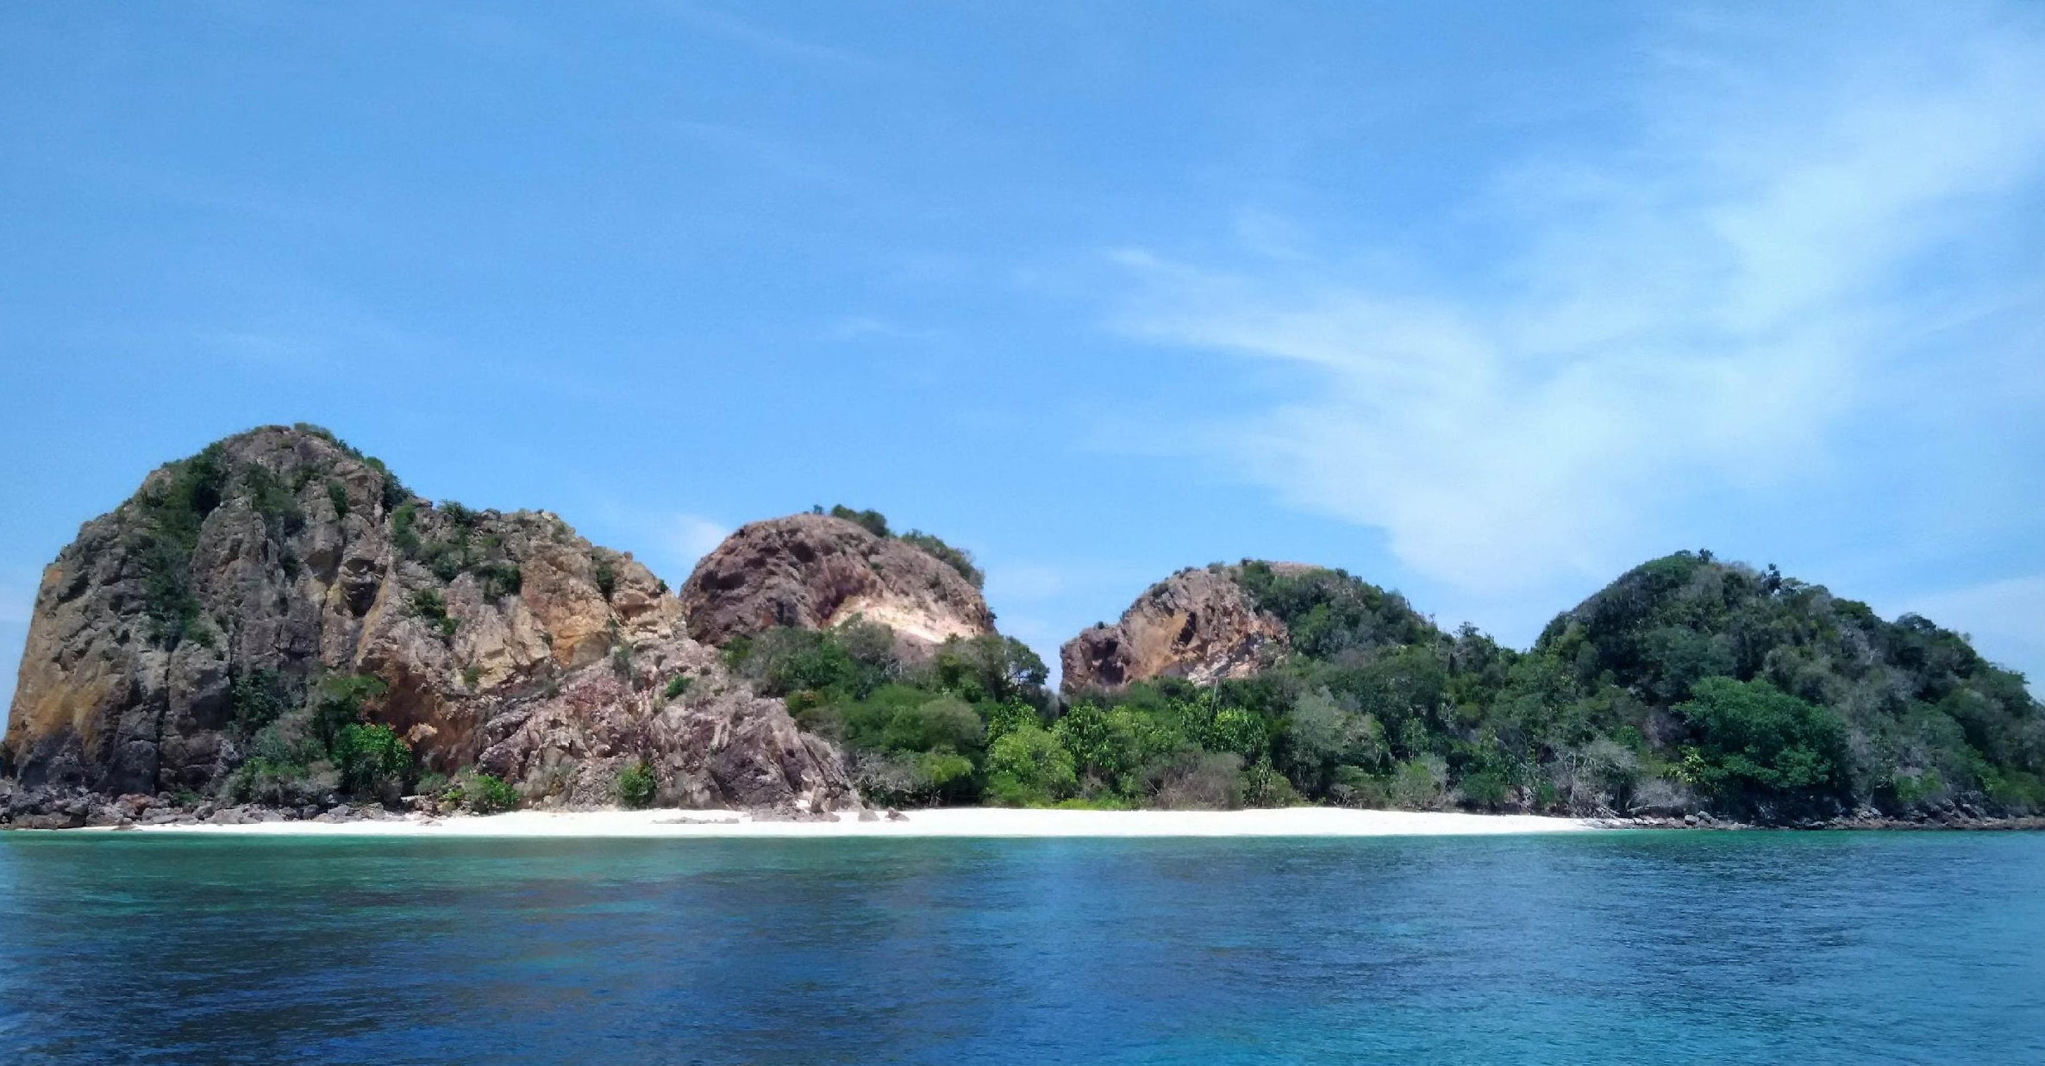
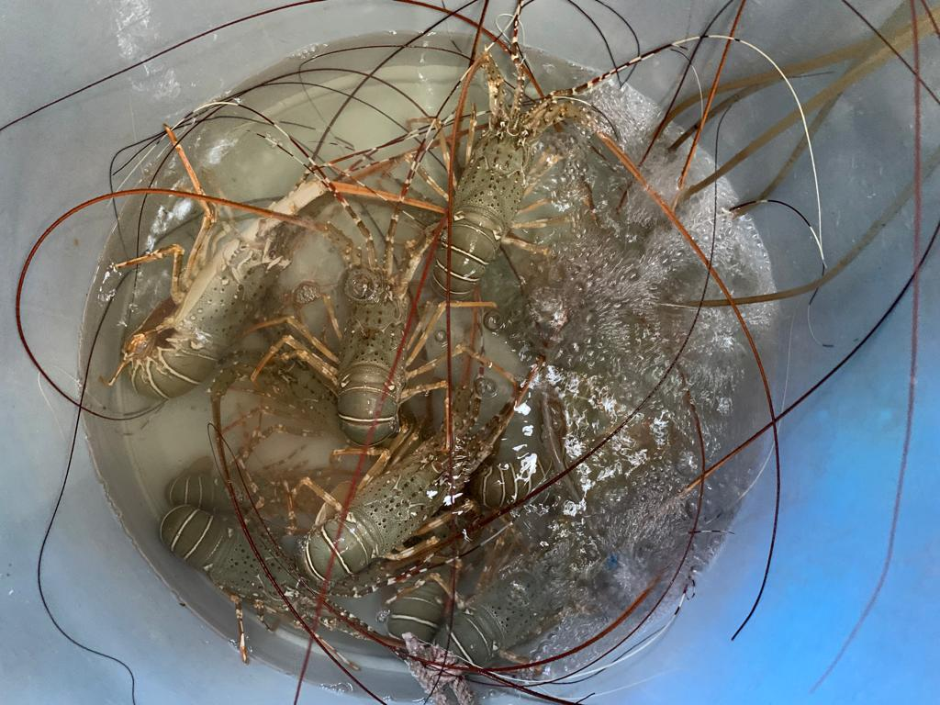
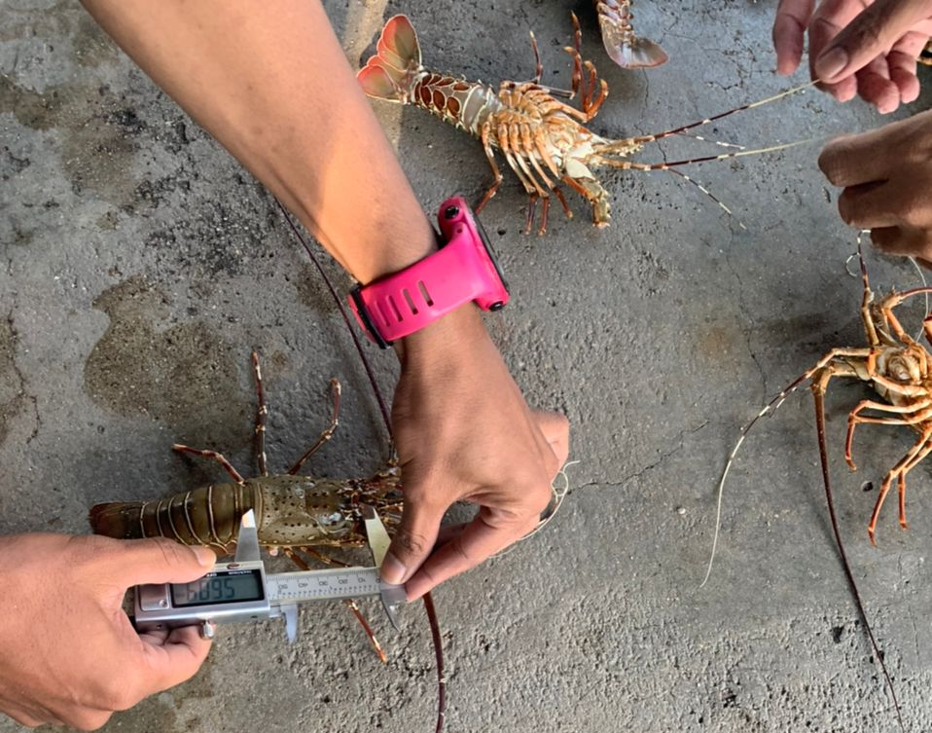
Activities Related to CTI-CFF Goals with Different Budget
Gazettement of Lima Group of Islands
Gazettement of Darvel Bay Park
Development of Labuan Marine Park Management Plan
The establishment of Fisheries Refugia Sites
P.Polyphagus refugia in Johor East
P.Monodon refugia in Kuala Baram, Sarawak

Slide 10
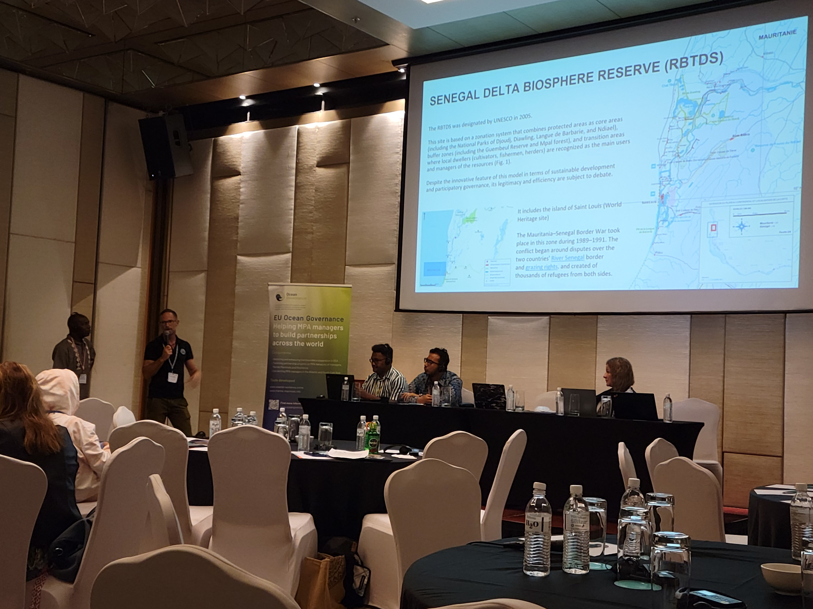
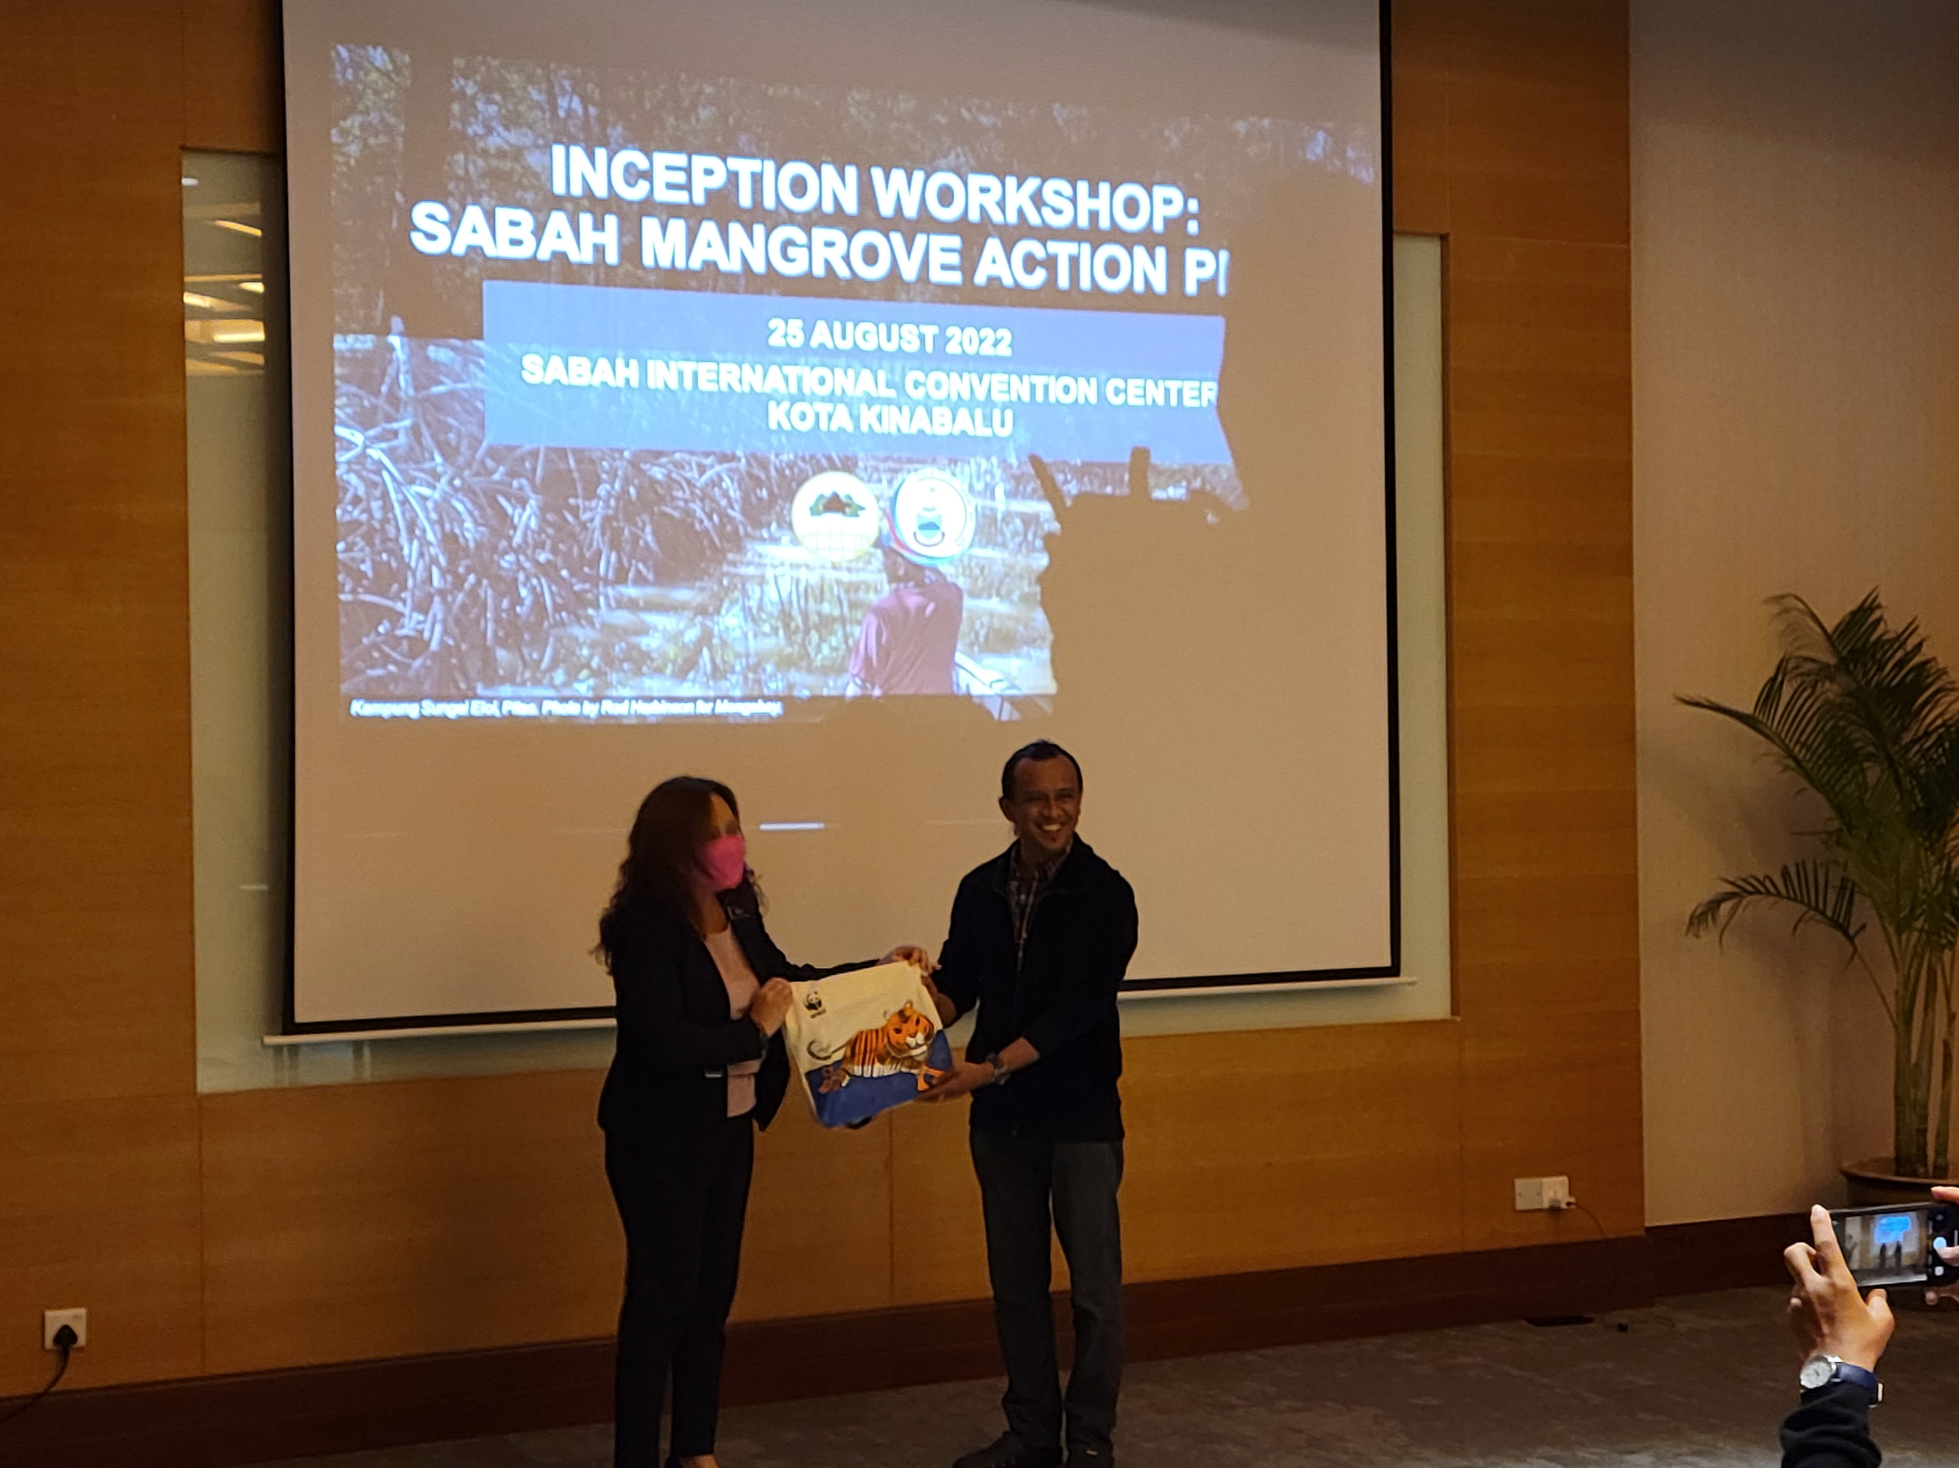
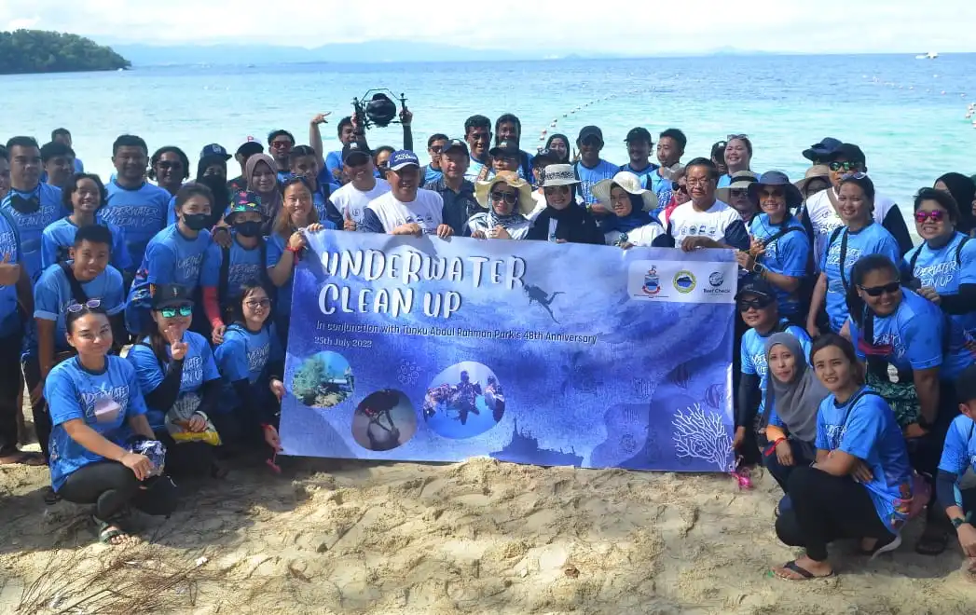
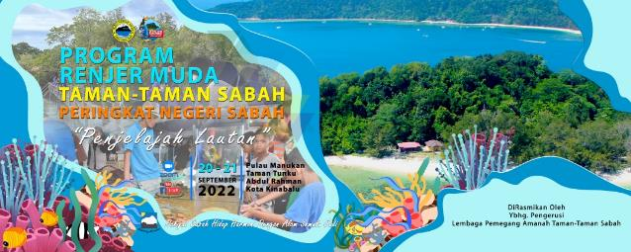
Activities Related to CTI-CFF Goals with Different Budget
Coral Frame Adoption Programme
Junior Park Ranger Series: Ocean Explorer
Inception Workshop: Sabah Mangrove Action Plan
Learning Exchange Workshop For CTI-CFF between MPAs of the Atlantic and Southeast Asia, Kota Kinabalu (Sabah-Malaysia)

Slide 11
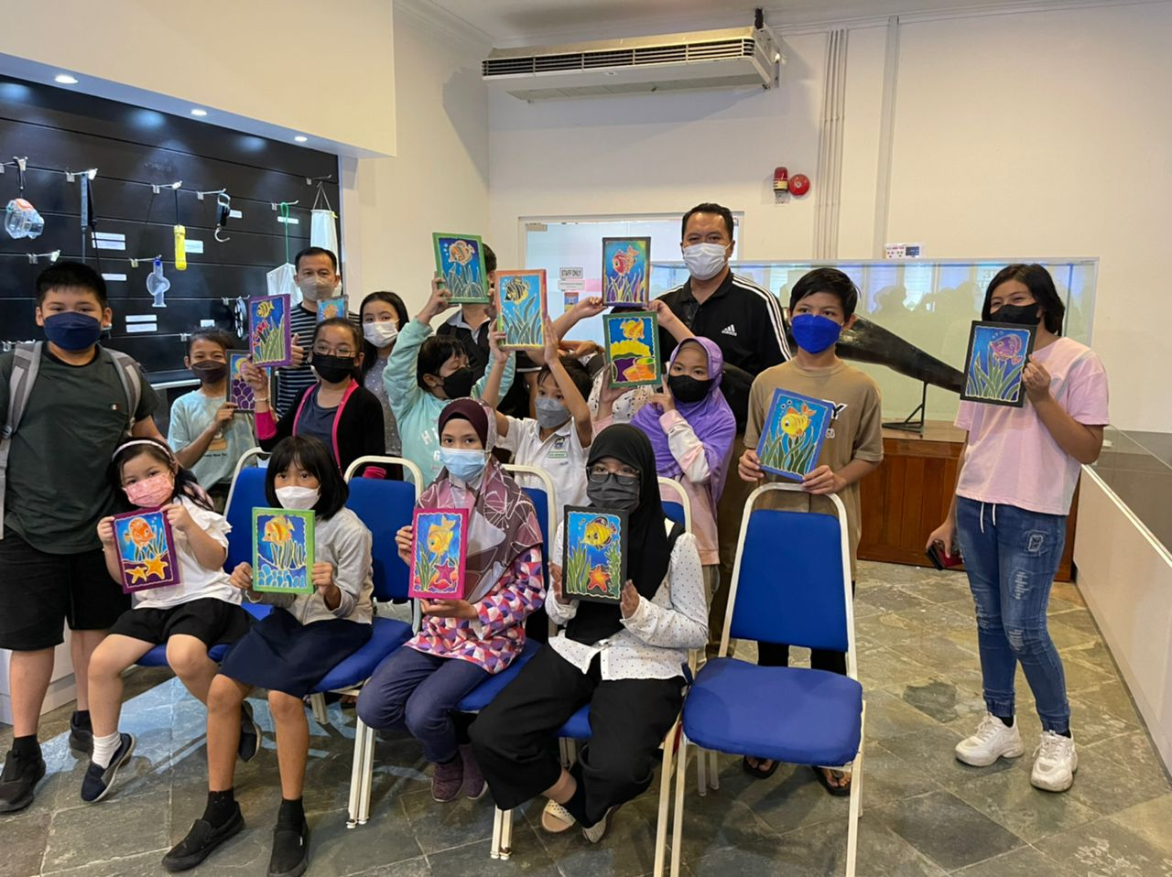
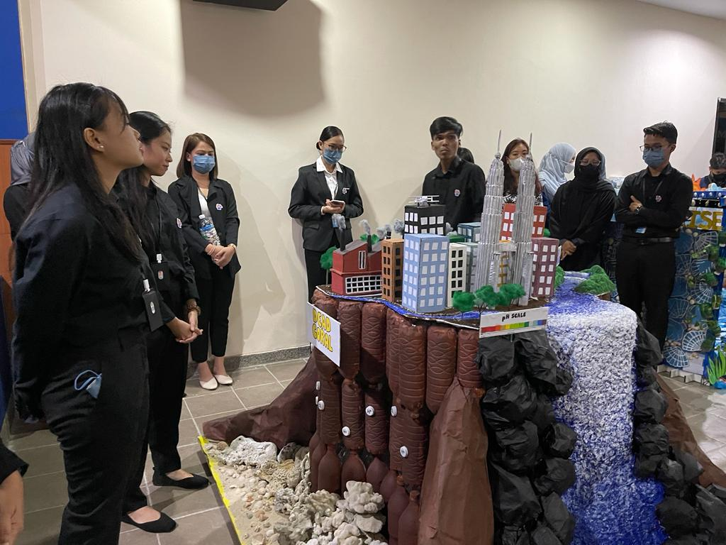
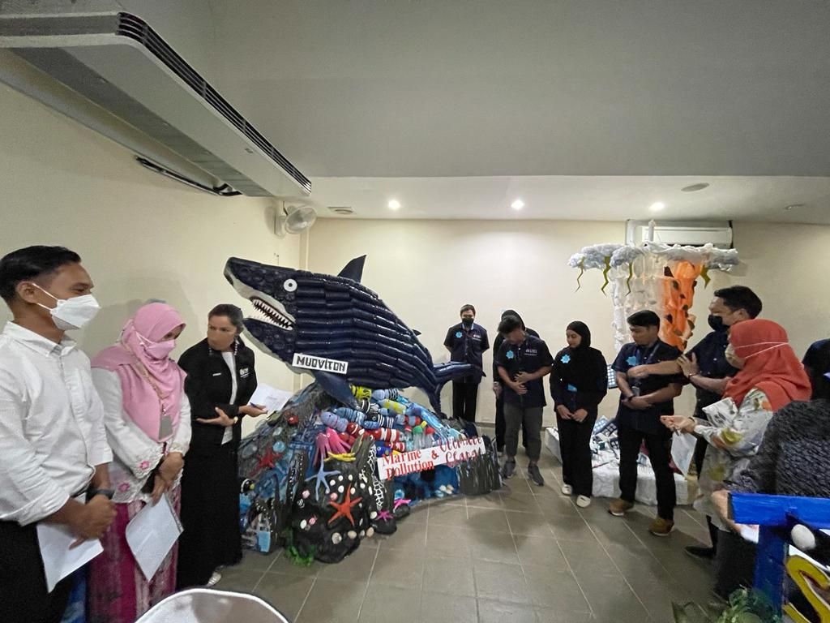
Progress – CCA
CTI-CFF National Programs:
World Oceans Celebration’ (World Oceans Day, Coral Triangle Day, World Sea Turtle Day) 2022
Ocean Health and Climate Change Exhibition
Blue Carbon: Kesedaran Rumput Laut
Webinar Coral Triangle Day: Blue carbon

Slide 12
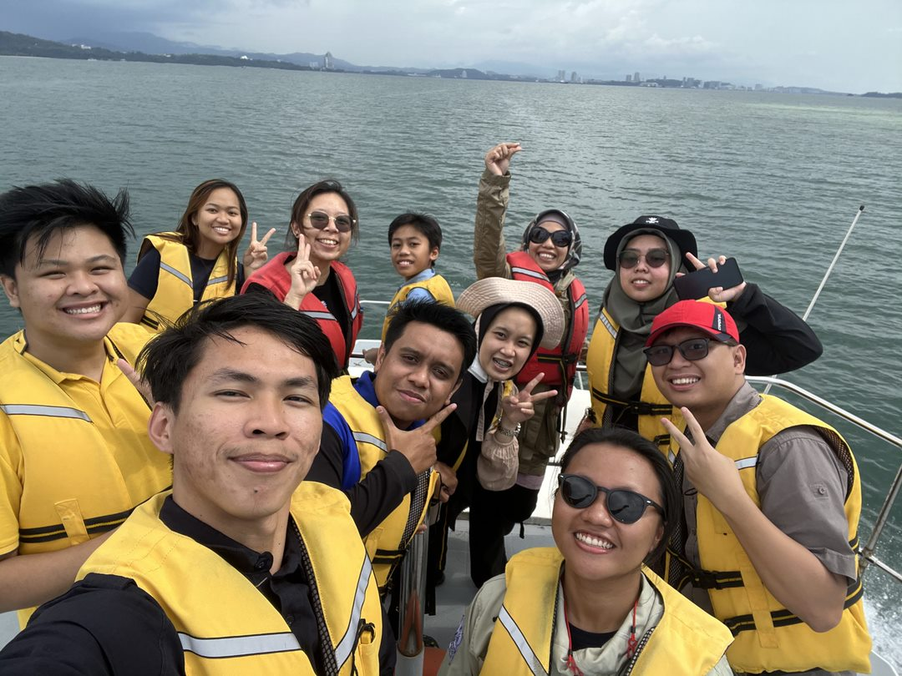
Progress – CCA
2. CTI University Partnership Program
Borneo Ocean Talks Webinar: climate change
Training: Marine optics and ocean color in changing climate
Borneo Ocean talks Webinar: Marine science and climate change

Slide 13
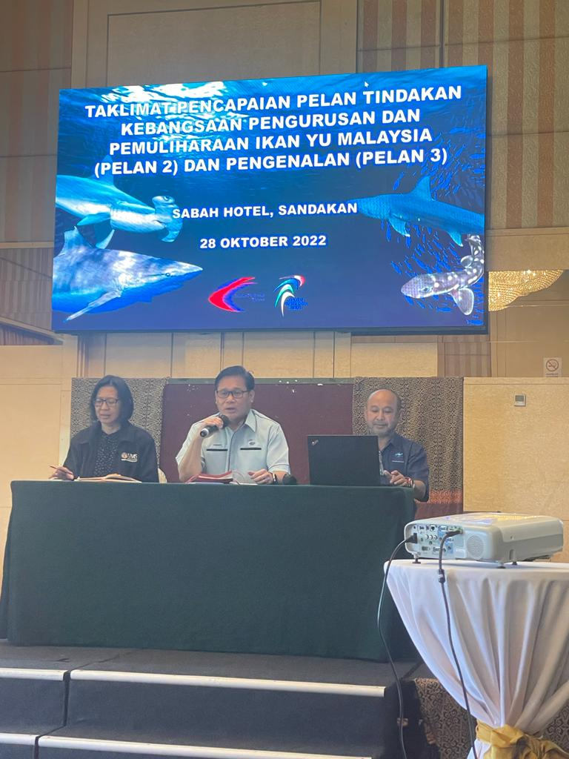
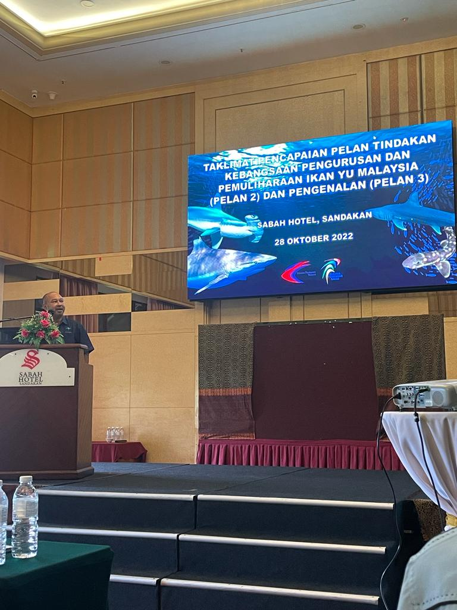
Progress – Threatened Species
CTI-CFF National Programs:
3rd NPOA of Shark Consultation and Engagement with local stakeholders in Sandakan, Sabah
Assessment of Threatened Species
Sharks and rays data collection
Updated study of the dugong population status
Sea turtle data collection (landing, egg hatchling) in Malaysia
Policies and management
NPOA Dugong Revision and drafting of NPOA Dugong Plan 2
NPOA Sea Turtle Plan 2 drafting
Finalize the draft of NPOA Sharks Plan 3
Review Standard of Procedure of Sea Turtle Management

Slide 14
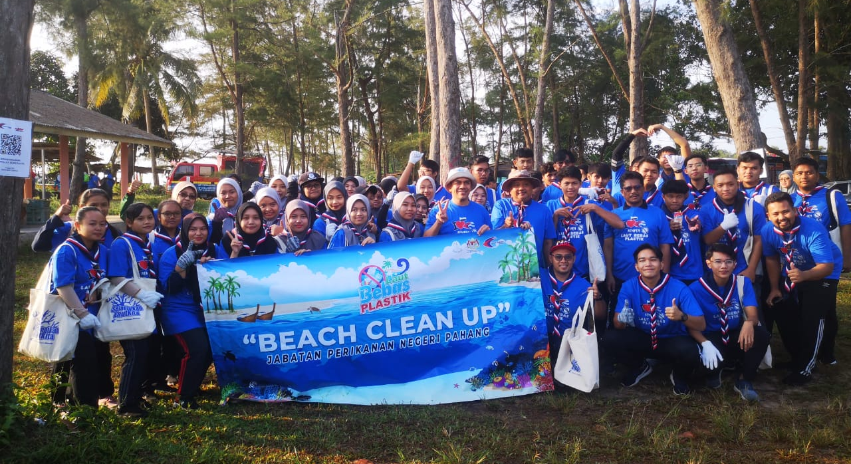
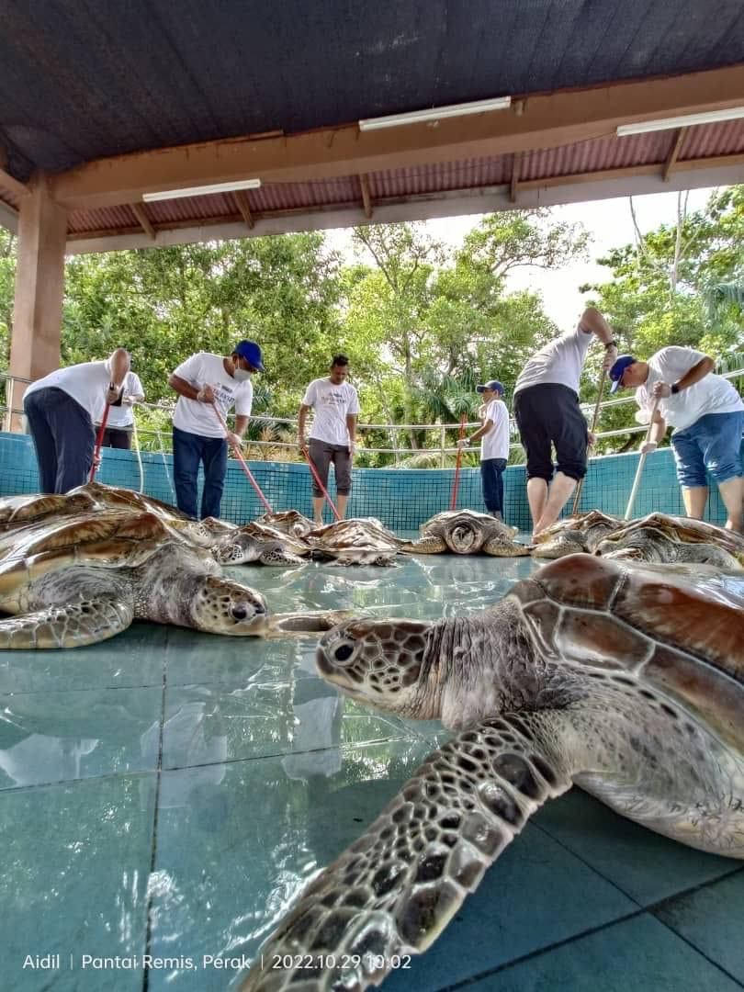
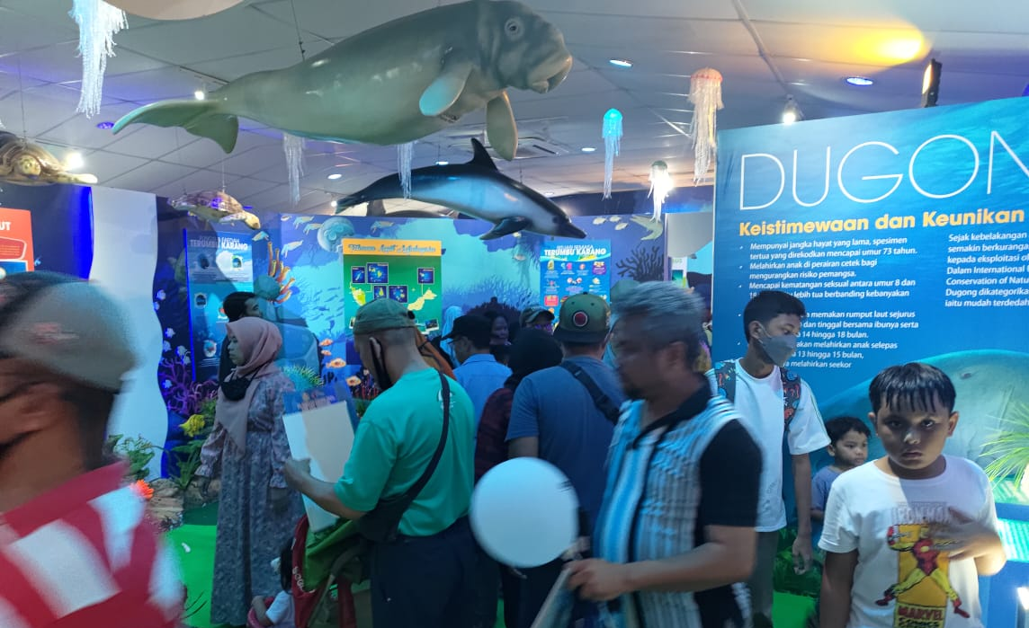
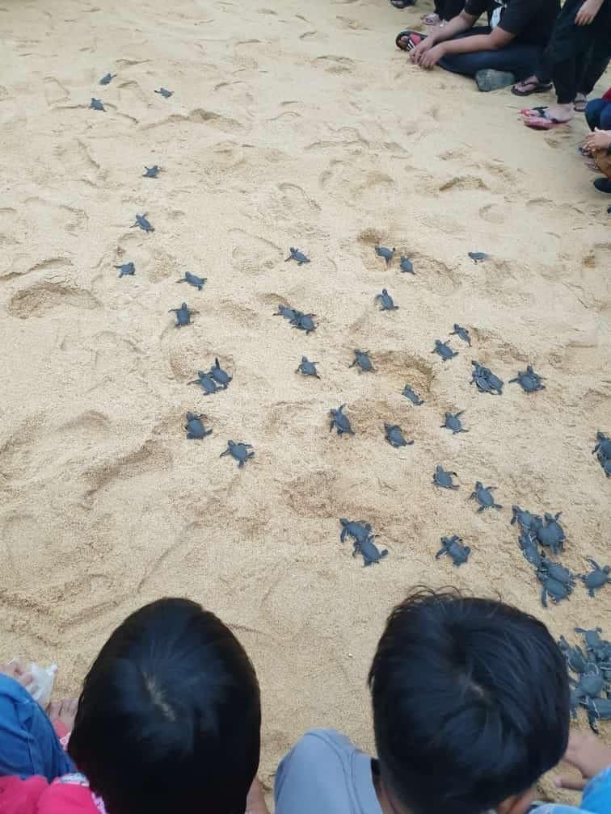
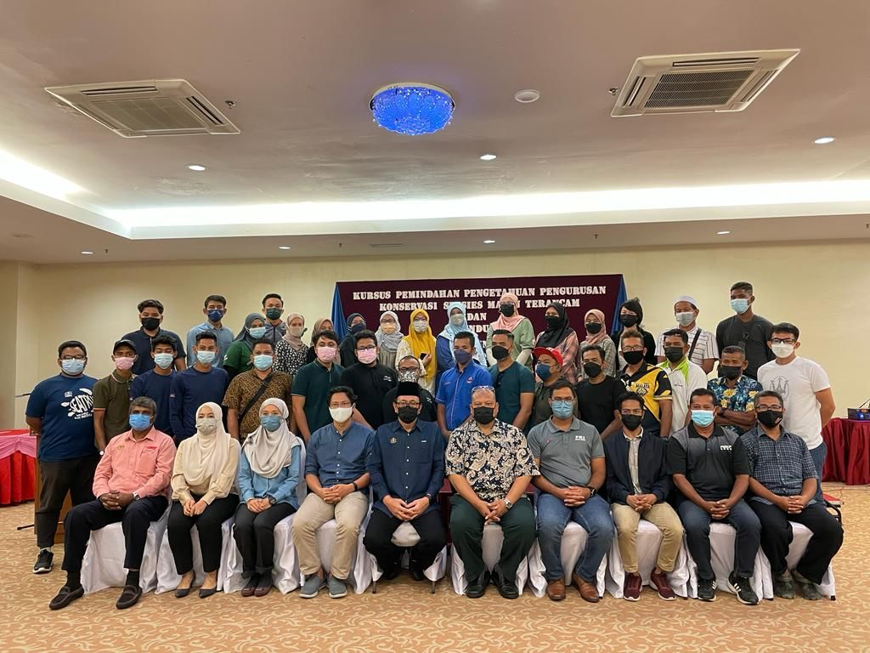
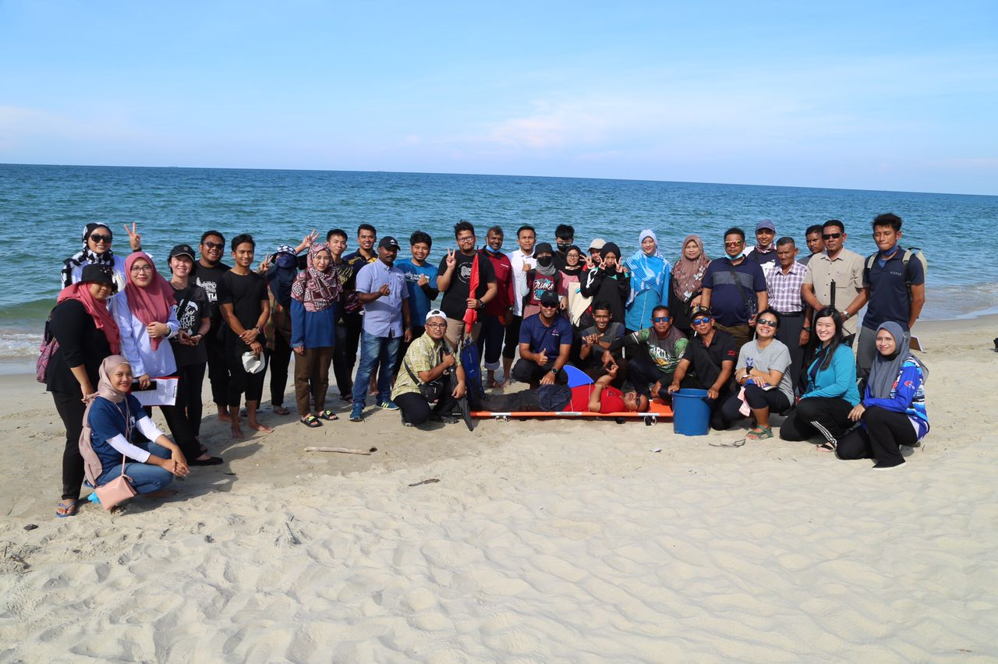
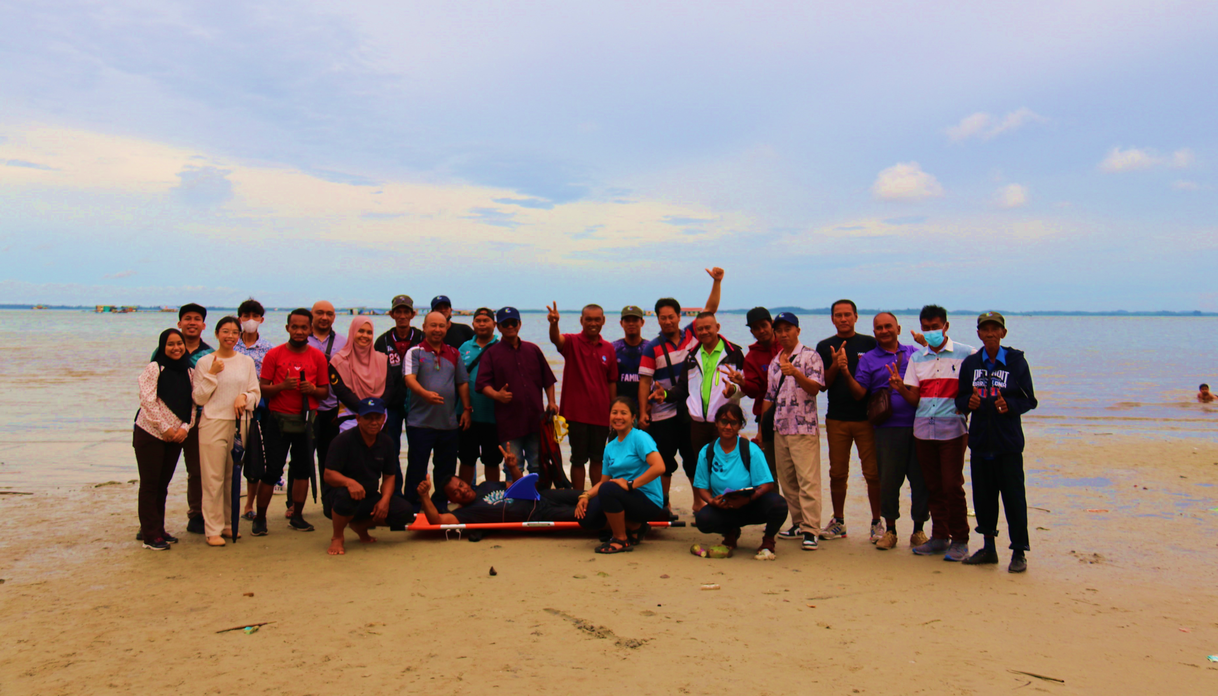
Progress – Threatened Species
Activities Related to CTI-CFF Goals with Different Budgets:
Awareness program
Conservation Talk
Beach Clean-Up Program
Sea Turtle Hatchling Release Program
Capacity building
Transfer of Management Knowledge about Marine Endangered Species Conservation Course for Fishermen

Slide 16
Challenges
Resources (financial, expertise)
Coordination, monitoring & evaluation of the implementation
Return of Investment (RoI) - Translating efforts into profits & social impact

Slide 18
Roadmap – Seascape
CTI-CFF National Programs
Seascape Workshop for Stakeholders (including SCC & TWG members & Coastal Communities) – 1 Workshop
National Integrated Planning Model for Seascapes Workshop to share modalities, success stories on the implementation of Seascape Projects – 2 Workshops
3. Seascape TWG Meeting – 4 series

Slide 19
Roadmap – EAFM
CTI-CFF National Programs
1. EEAFM Training for Stakeholders
2. EEAFM Training for Executives
3. EEAFM Training of Trainers
4. EAFM Marine Conservation Awareness Program for Secondary Schools
5. EAFM Marine Conservation Workshop for Stakeholders

Slide 20
Roadmap – MPA
CTI-CFF National Programs | Activities Related to CTI-CFF Goals with Different Budget
Management effectiveness assessment for CTMPAS nominations – marine parks in Sabah | Gazettement of Mantanani Island & Darvel Bay Park
 | Ligitan Reef Scientific Expedition
 | Whale Shark workshop & survey

Slide 21
Roadmap – CCA
CTI-CFF National Programs
1. Climate Coastal Vulnerability & Risk Profiling and Developing CEPA
2. Marine scientific Expedition to provide baseline data for policy makers
3. Celebrating Coral Triangle Day in conjunction to World Ocean Day
4. Organizing conference/Training/ workshop/ seminar on climate change, adaptation and mitigating measure

Slide 22
Roadmap – Threatened Species
CTI-CFF National Programs | Activities Related to CTI-CFF Goals with Different Budget
1. Consultation and Engagement of NPOA Shark 3rd Plan for stakeholders | Standard Operating Procedure of Sea Turtle Management Review Workshop
2. NPOA Shark 3rd Plan Editorial Workshop | 2. NPOA Turtle 2nd Plan Review Workshop
3. Printing and publication of NPOA Sharks 3rd Plan | 3. Awareness Program and Campaign on ‘Do Not Touch’ Marine Turtles for stakeholders (tourist boat operator)
 | 4. Review of NPOA Dugong

Slide 24
Potential Regional Program and Support Required
Capacity building program

Slide 26
Publications
.
A. Journal
Nurrul Fazlina Osman, Ejria Binti Saleh, Nurulain Binti Ismail, Justin Sentian, Madihah Jafar Sidek, 2022. Climate Change Impacts to Coastal Communities in Kudat, Sabah, Malaysia. Malaysian Journal of Social Sciences and Humanities,7(9)
Carolyn Melissa Payus, Justin Sentian, 2022. Extended air pollution index (API) as tool of sustainable indicator in the air quality assessment: El-Nino events with climate change driven. Global Journal of Environmental Science and Management, 8 (4)545-560.
Justin Sentian, Payus, Franky Herman, Vivian Wan Yee Kong, 2022. Climate change scenarios over Southeast Asia. APN Science Bulletin. Asia-Pacific Network for Global Change Research.
Foo Jurry, Marja Azlima Omar, Diana Demiyah Mohd Hamdan, Oliver Valentine Eboy, 2022. The Perception and Resilience of Bagang Community on Climate Change in Marine Protected Area, Pitas, Sabah, Malaysia Journal ASM Science Journal (17)
Mustafa, S. and Saad, S. (2021). Coral Triangle: Marine Biodiversity and Fisheries Sustainability. In: Leal Filho W., Azul A.M., Brandli L., Lange Salvia A., Wall T. (eds) Life Below Water. Encyclopedia of the UN Sustainable Development Goals. Springer, Cham, Switzerland.

Slide 27
Publications
Estim, A., Rossita, S., Muhamad Shaleh, S.R., Saufie, S., & Mustafa, S. (2023). Decarbonizing Aquatic Food Production Through Circular Bioeconomy of Aquaponic Systems. Aquaculture Studies, 23(4), AQUAST963. http://doi.org/10.4194/AQUAST963.
Mustafa, S., Muhamad Shaleh, S.R., S. Estim, A., Shapawi, R., Waheed, Z. Saleh, E. & Chen, C. A. (2022).The Smart Sea concept and its application for ocean management in a changing climate’. 'Marine & Life Sciences'.
Report: Preliminary study for Coastal Vulnerability at selected Marine Park Islands in Sabah: A case study from Sipadan Island Park, Turtle Islands Park (Gulisaan, Bakkungaan, Selingaan) and Tunku Abdul Rahman Islands Park (Manukan, Mamutik Sapi). Roslee, Rodeano et. al.
Report: Mobilization of state stakeholder to investigate reports of diseased sharks in Sipadan Island Park
A Study on Ecological Carrying Capacity Based on Tourism Impact in Marine Protected Area: A Cases Study of Tunku Abdul Rahman Park, Kota Kinabalu, Sabah. M. Nasrulhakim
Reproductive Biology of Sea Turtle Nesting in Sipadan Island, Sabah Malaysia. I. Irwan

Slide 28
Publications
.
B. Books
Saleh, E. dan Hussein, M.A. 2022. Segi Tiga Terumbu Karang: Pusat Kepelbagaian dan Limpahan Hidupan Marin Dunia.
Saleem et al, 2022. (likely to be published in December 2022). Chapter on: Marine biodiversity and climate change: multidimensional approaches for ‘The Ocean We Want’ by 2030 in a book: SDGs in the Asia - Pacific Region', Springer, Switzerland.

Slide 29
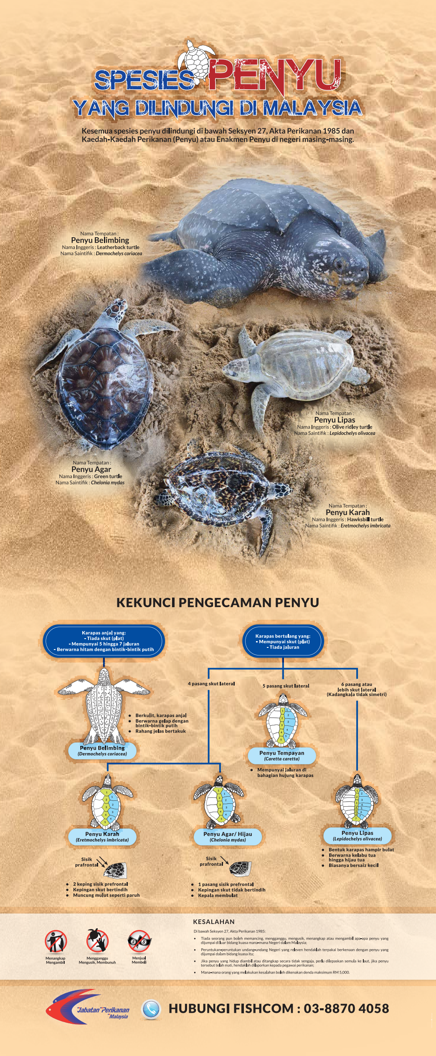
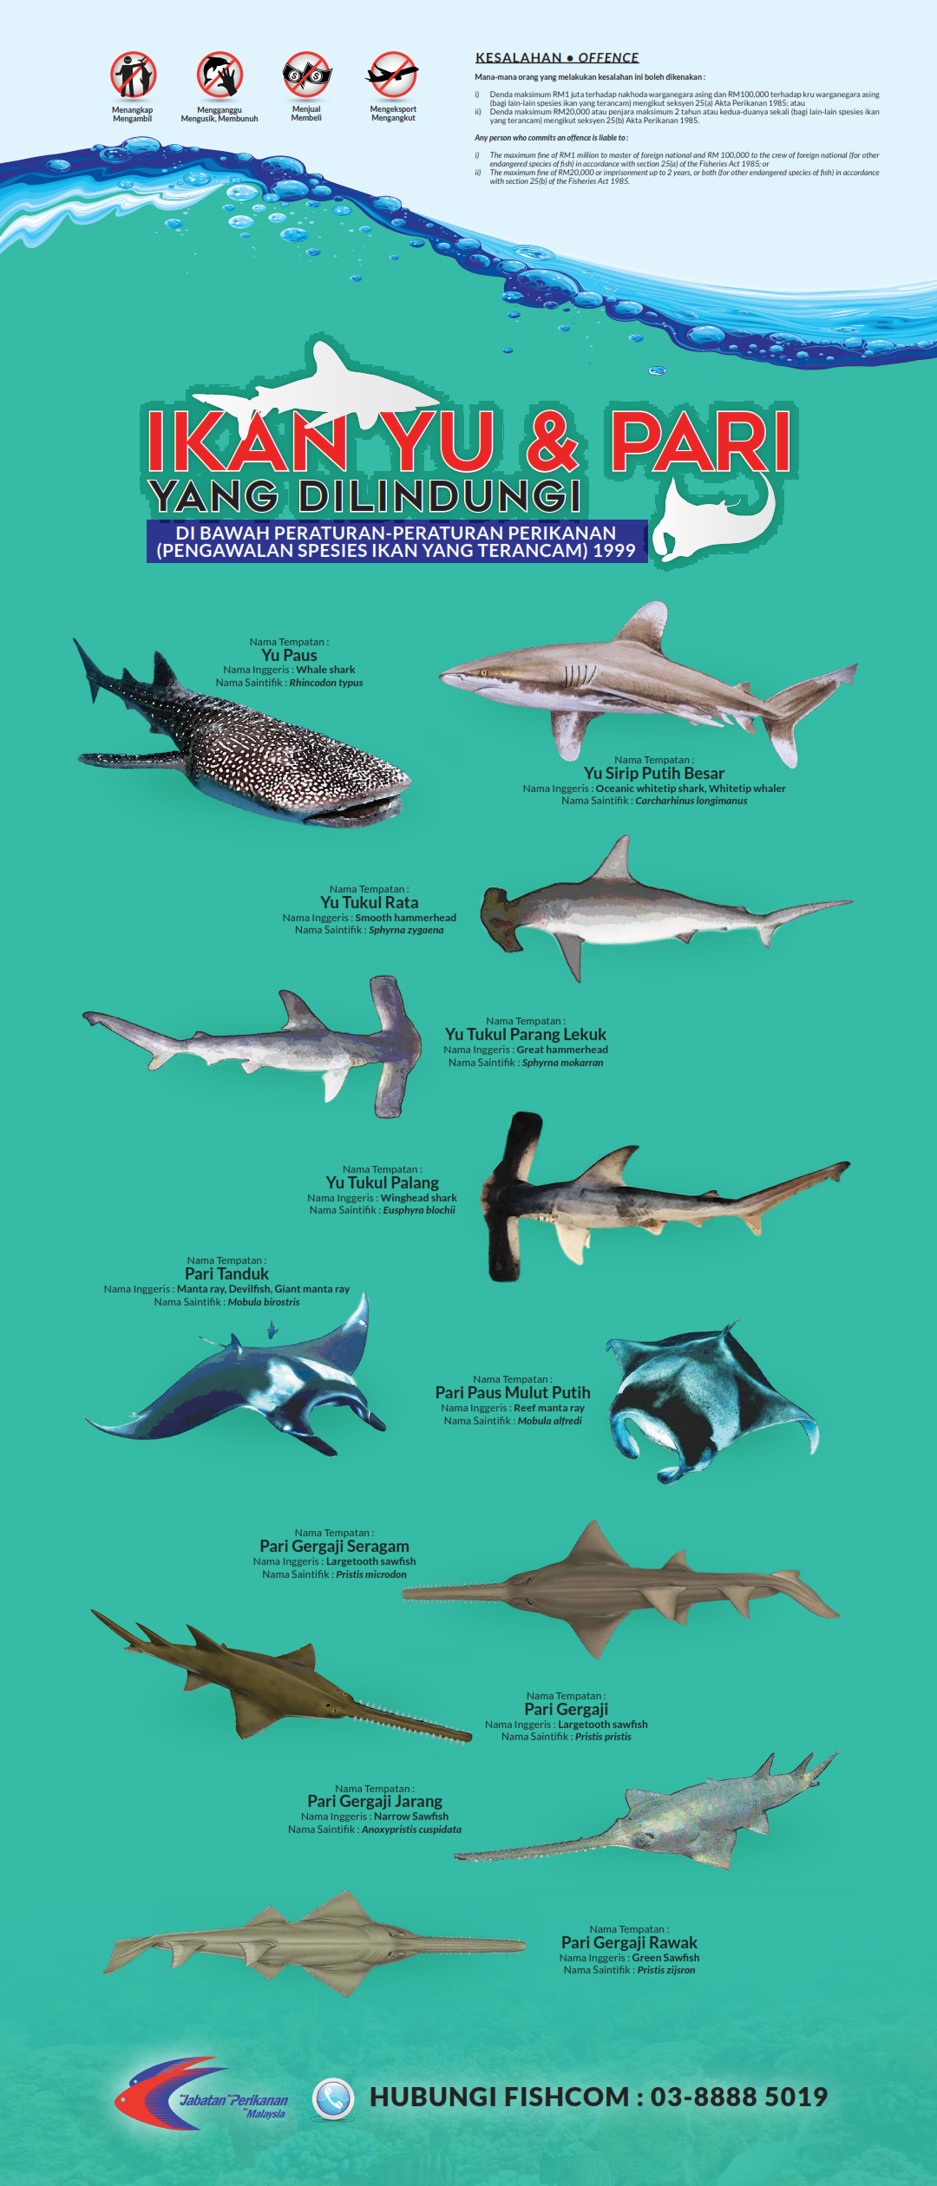
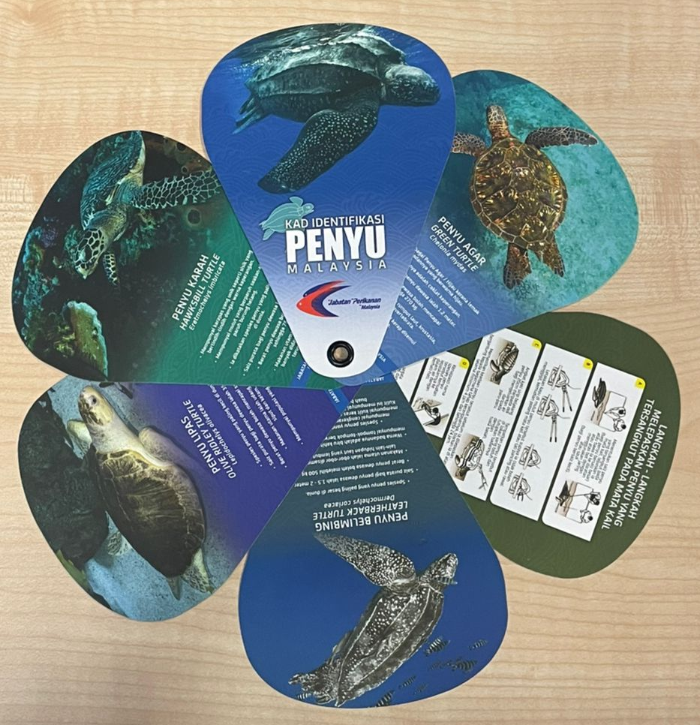
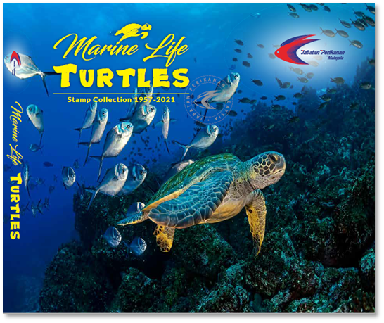
Publications
C. Others
Turtle Identification Card & Turtle Stamp Book
Endangered, Threatened and Protected Marine Species Posters

