Slide 1
Papua New Guinea
Dr John Balavu
High Commissioner-PNG Mission to the SI

Slide 2
Outline
I. Members of CTI-CFF NCC – TWG and GWG
II. Accomplishments & Progress towards NPOA: Thematic Goals
III. Challenges & Constraints affecting Implementation of activities
IV. National Roadmap 2020
V. Potential Regional Programs & support required
VI. Documentations & Publications
VII. Other Remarks

Slide 3
I. Members (Agencies) of the National CTI-CFF Coordinating Committees
Technical Working Groups
Seascapes: Focal Point is Conservation & Environment Protection Authority (CEPA) and supported by The Nature Conservancy (TNC)
Ecosystem Approach to Fisheries Management: Focal Point is National Fisheries Authority (NFA) and supported by CEPA
Marine Protected Areas: Focal Point is CEPA and supported by TNC and WCS
Climate Change Adaptation: Focal Point is Climate Change Development Authority CCDA)
Threatened Species: Focal Point is CEPA
Governance Working Groups
FRWG: Focal Point is CEPA supported by Dept. of Foreign Affairs and international Trade and Dept. of Treasury
CMWG: Focal Point is CEPA and supported by NFA and CCDA
MEWG: Focal Point is CEPA and supported by NFA and CCDA

Slide 4
II. Progress/Accomplishments towards National Plan of Action
SEASCAPES
CTI-CFF National Programs
Commitment from national, provincial and Local level governments and other stakeholders.
Development of maps showing environmental features and values.
Identification of Focal Points in respective provincial governments and other stakeholders.
Capacity building programs for provincial governments and other stakeholders.

Slide 5
II. Progress/Accomplishments towards National Plan of Action
SEASCAPES
Programs/projects/activities related to CTI-CFF goals (but not directly budgeted under CTI-CFF programs)
PNG has diligently been awaiting the resourcing for the progression of the Bismarck Solomon Seascape
PNG sees the progression of Solutions for Marine and Coastal Resilience in the Coral Triangle project proposal as the vehicle to progress this work.
Currently a priority area of work that in our view will be resourced through the International Climate Initiative funded Solutions for Marine and Coastal Resilience in the Coral Triangle project proposal
i.e.; Bismarck Solomon Seascapes

Slide 6
t
EAFM
CTI-CFF National Programs
Strengthening Local Capacity of Vulnerable Island Communities in PNG for an Ecosystem Based Approach to Resource Management – WCS/ADB
Build community and local partnerships
Strengthen local capacity to manage local resources
Strengthen management approaches
Implement livelihood and climate change adaptation initiatives

Slide 7
EAFM
Programs/projects/activities related to CTI-CFF goals (but not directly budgeted under CTI-CFF programs)
IFAD Program
Building Coral reef resilience
Food security for communities
Livelihood/Income generation
2. Clean Seascape Program
Coral reef rehabilitation
Mangrove reforestation
Waste Management
3. Trap Net Program- creating an alternative livelihood for communities
4. Seaweed farming- community livelihood/income generation
5. Sea cucumber mariculture (NIRF)- Sandfish restocking

Slide 8
MPAs
CTI-CFF National Programs
1. Strengthening Local Capacity of Vulnerable Island Communities in PNG for an Ecosystem Based Approach to Resource Management – WCS/ADB

Slide 9
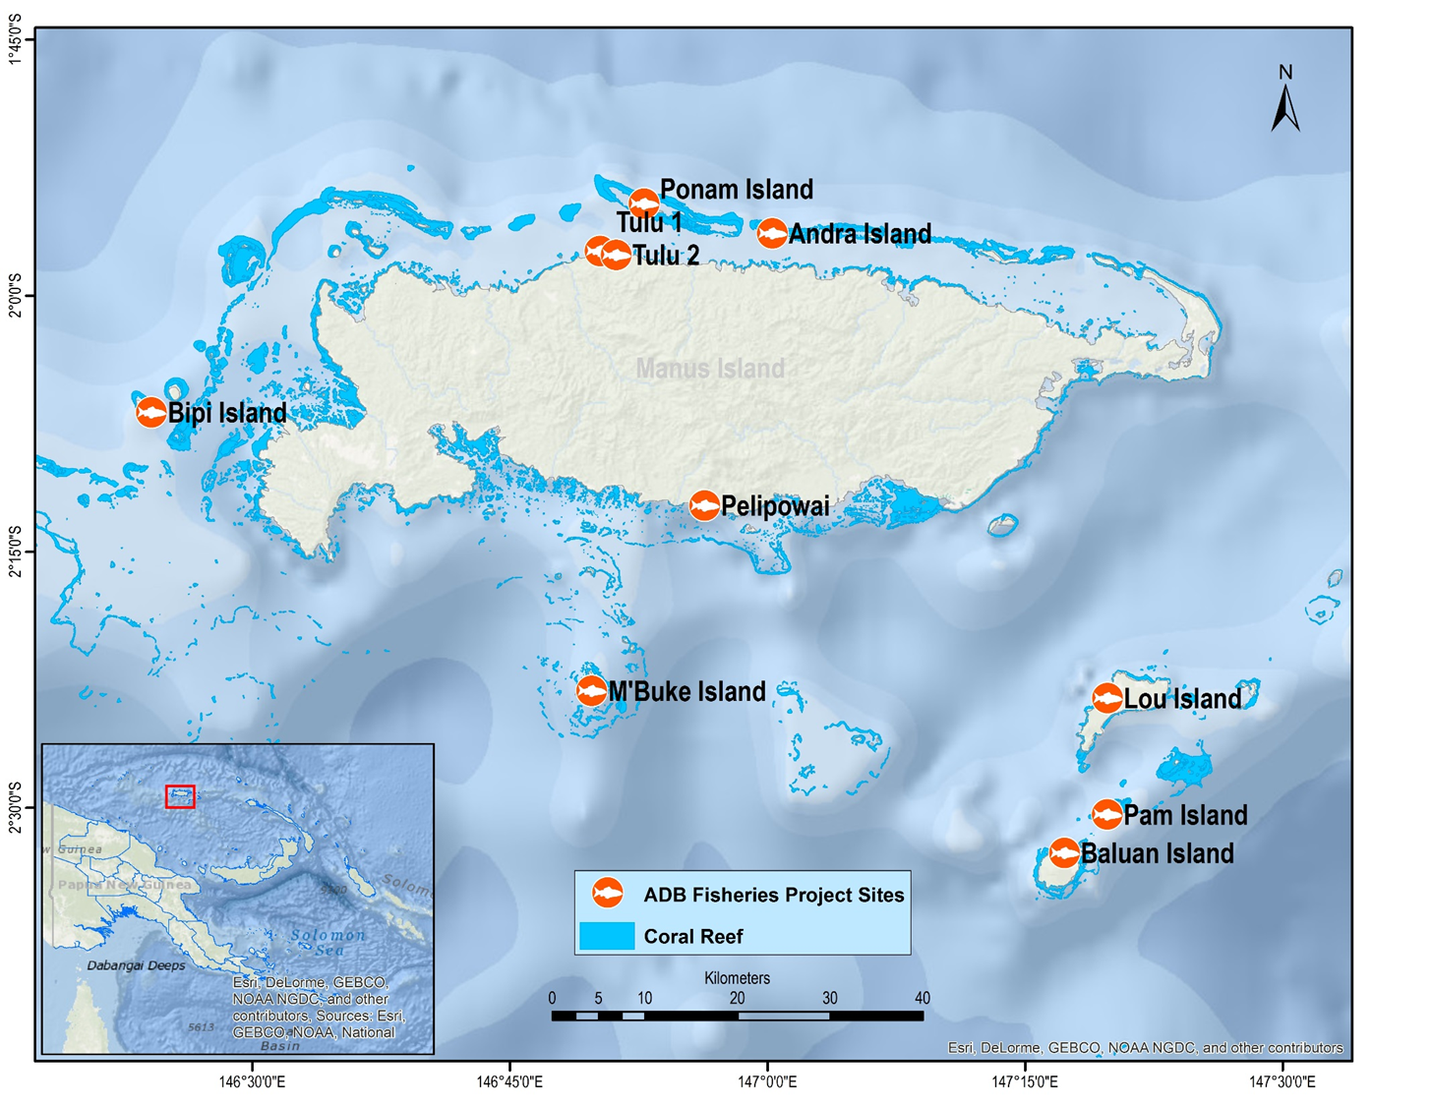
MANUS PROJECT SITE-WCS/ADB
MPAs
CTI-CFF National Programs
Progress/Accomplishments towards National Plan of Action

Slide 10
MPAs
Programs/projects/activities related to CTI-CFF goals (but not directly budgeted under CTI-CFF programs)
Bootless Bay – CEPA/JICA
Tribal Network, Manus, TNC
3. Kairuku LMMA- PNGCLMA
Milne Bay LMMA Network – Coral Sea Foundation
Coastal Plastic Campaign- CEPA

Slide 11
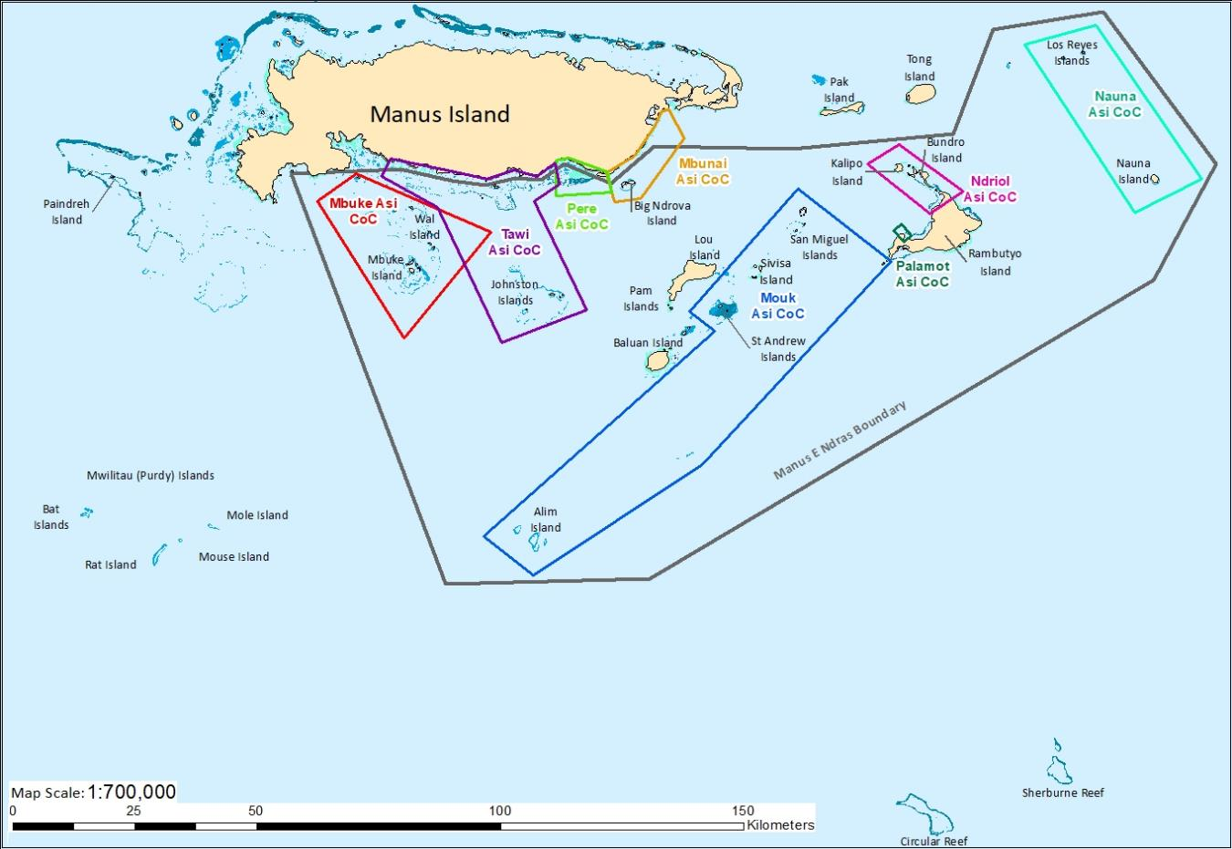

Slide 12
CLIMATE CHANGE ADAPTATION
CTI-CFF National Programs
Community-based Mangrove Planting Handbook for Papua New Guinea
(publication awaiting delivery from Manila)
(Funded under information, education and communications (IEC), component of the ADB technical assistance project for the Coral Triangle of the Pacific).

Slide 13
CLIMATE CHANGE ADAPTATION
Programs/projects/activities related to CTI-CFF
goals (but not directly budgeted under CTI-CFF programs
ADAPTATION PROJECT
Adaptation to coastal flooding-related risks and hazards for North Coast and Islands Region communities
Awareness raising and knowledge management
BUILDING RESILIENCE TO CLIMATE CHANGE IN PAPUA NEW GUINEA
Piloting Sustainable fishery eco-systems and food security in 9 vulnerable islands and atoll communities (includes LMMAs, mangrove rehabs, buffer, watersheds) – Morobe, AROB, Manus, Milne Bay and ENB
Climate Proofing of Alotau/Provincial wharf
Vulnerability mapping and Planning

Slide 14
THREATENED SPECIES
CTI-CFF National Programs
Threatened species and major boundaries listed and mapped
(Under PNG Marine Program: Goal 5 Target 1 Activities)
Component 1: Data collection and collation:
Commenced and ongoing. Dataset (current) has been submitted to RS to upload. Data collection is ongoing to enrich current database with partners
Component 2: Mapping of major boundaries/routes/distribution
Draft map of the sites and routes (distribution map) on TS currently been worked on.
Development of effective Management Plans
Maza Management Plan review
Commercial species management plans (NFA)
Raise public awareness and interest in TS
Started through CEPA led Coastal clean-up programs &
City market ban on sale of species such as turtles

Slide 15
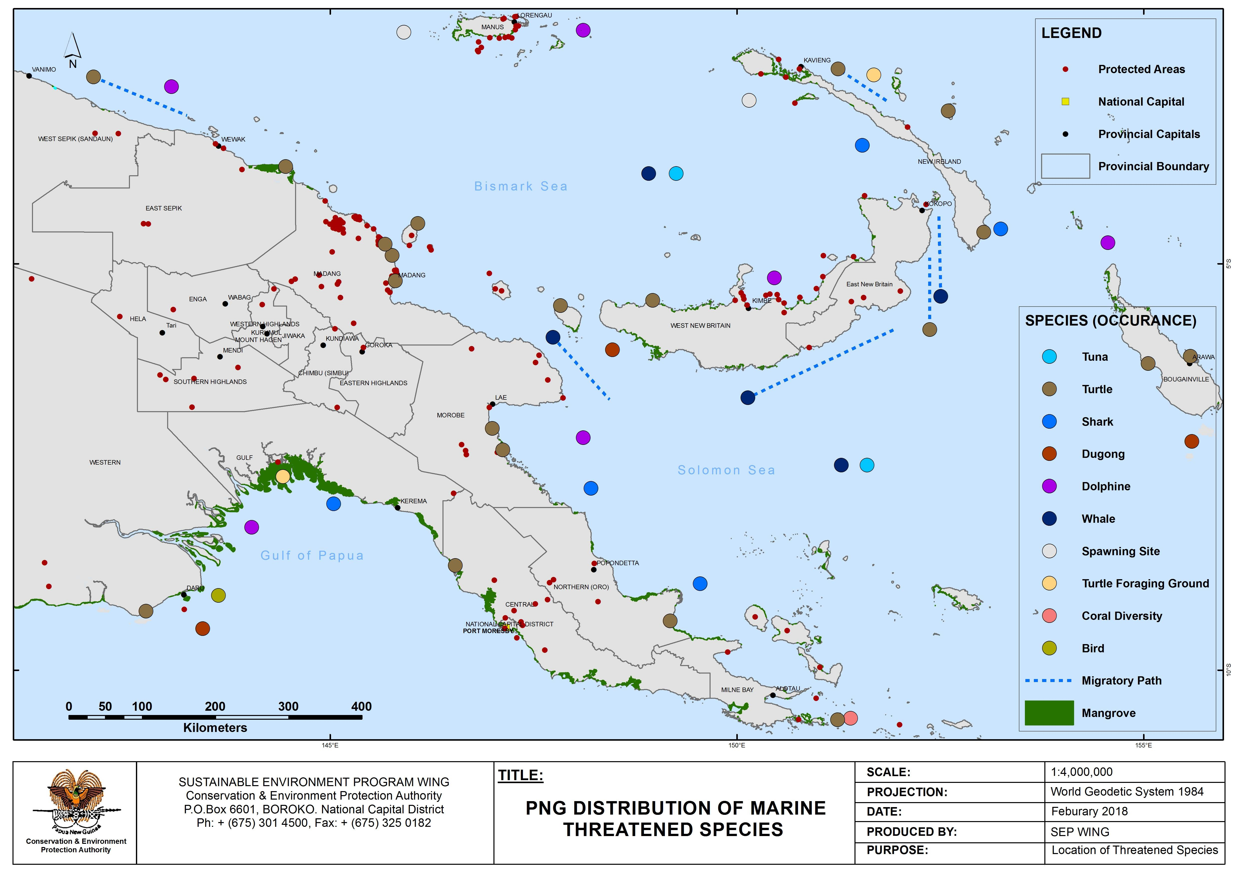
THREATENED SPECIES
Working map developed based on current data
CTI-CFF National Programs
Progress/Accomplishments towards National Plan of Action

Slide 16
THREATENED SPECIES
Programs/projects/activities related to CTI-CFF goals (but not directly budgeted under CTI-CFF programs
Satellite tracking-reef Manta Rays in PNG to inform Conservation Management
Columbia University/Milne Bay Provincial Government)
Understanding the movement of reef manta rays around Papua New Guinea using satellite telemetry.
Help justify the need for community-based marine protected areas; and
Explore opportunities to promote eco-tourism.
2. Marine turtle conservation initiatives including tagging
Milne Bay Province
Madang Province
Morobe Province
3. Bootless Bay Marine Protected Area Initiative (Sanctuary)

Slide 17
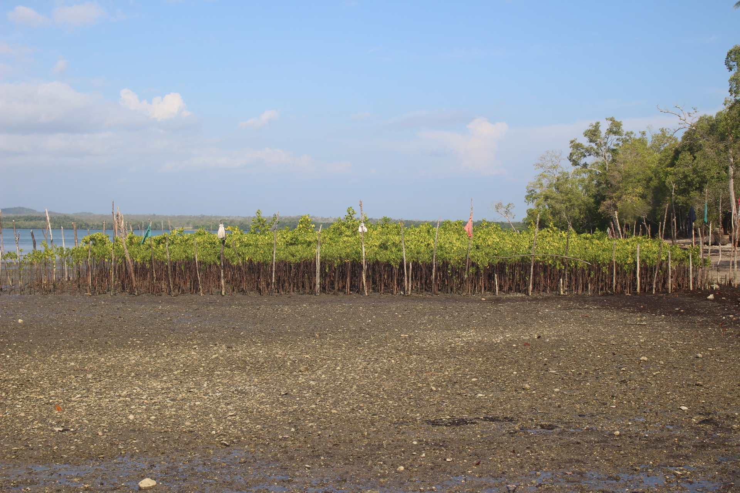
Others Activities conducted in Support of CTI-CFF
Coral Triangle Day celebration
Women Leadership Training, 20-21 August 2019, Port Moresby
Coastal clean up campaign in local communities in NCD & Central Province.
PNG Centre for Locally Managed Areas working in Central province connecting women to markets to sell their crabs while also leading mangrove rehabilitation programs in their villages. (USAID Pacam)

Slide 18
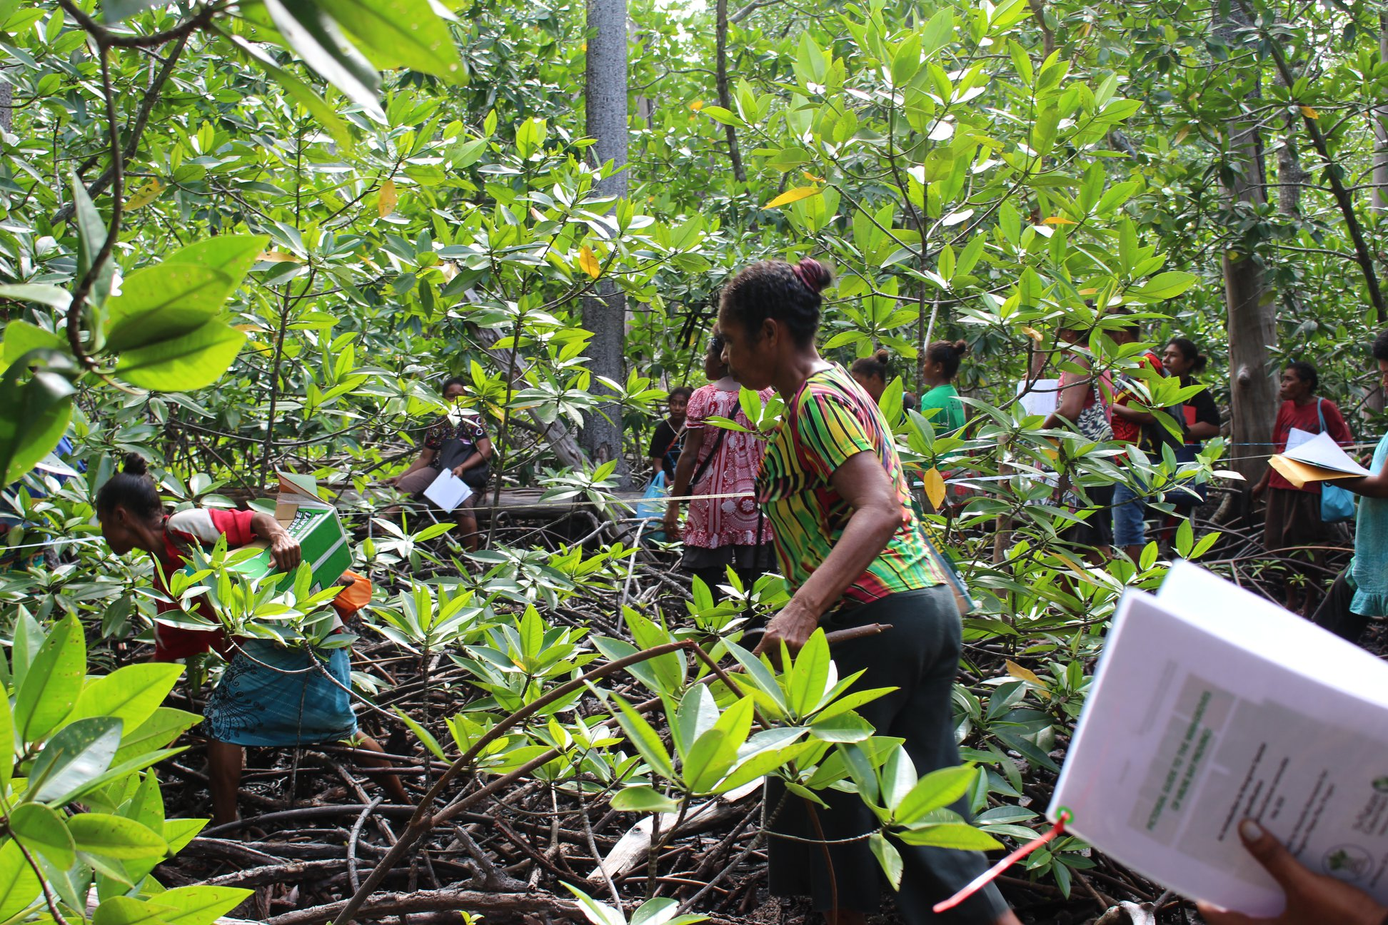
Others Activities conducted in Support of CTI-CFF
Women and Mangroves projects in PNG
TNC’s Mangoro Market Meri, (Aus DFAT supported)
July 2019 - Basic Mangrove Ecology in Milne Bay province, 45 women and men participants
August 2019, Supported a board meeting for newly established local women’s network organisation PEDF in Manus province to explore opportunities around women and blue carbon
October 2019, building a mangrove nursery in Milne Bay province
October 2019, Value Chain Analysis and Assessment in Milne Bay province
October 2019 , Mud Crab Handling & Packaging Training in Milne Bay province

Slide 19
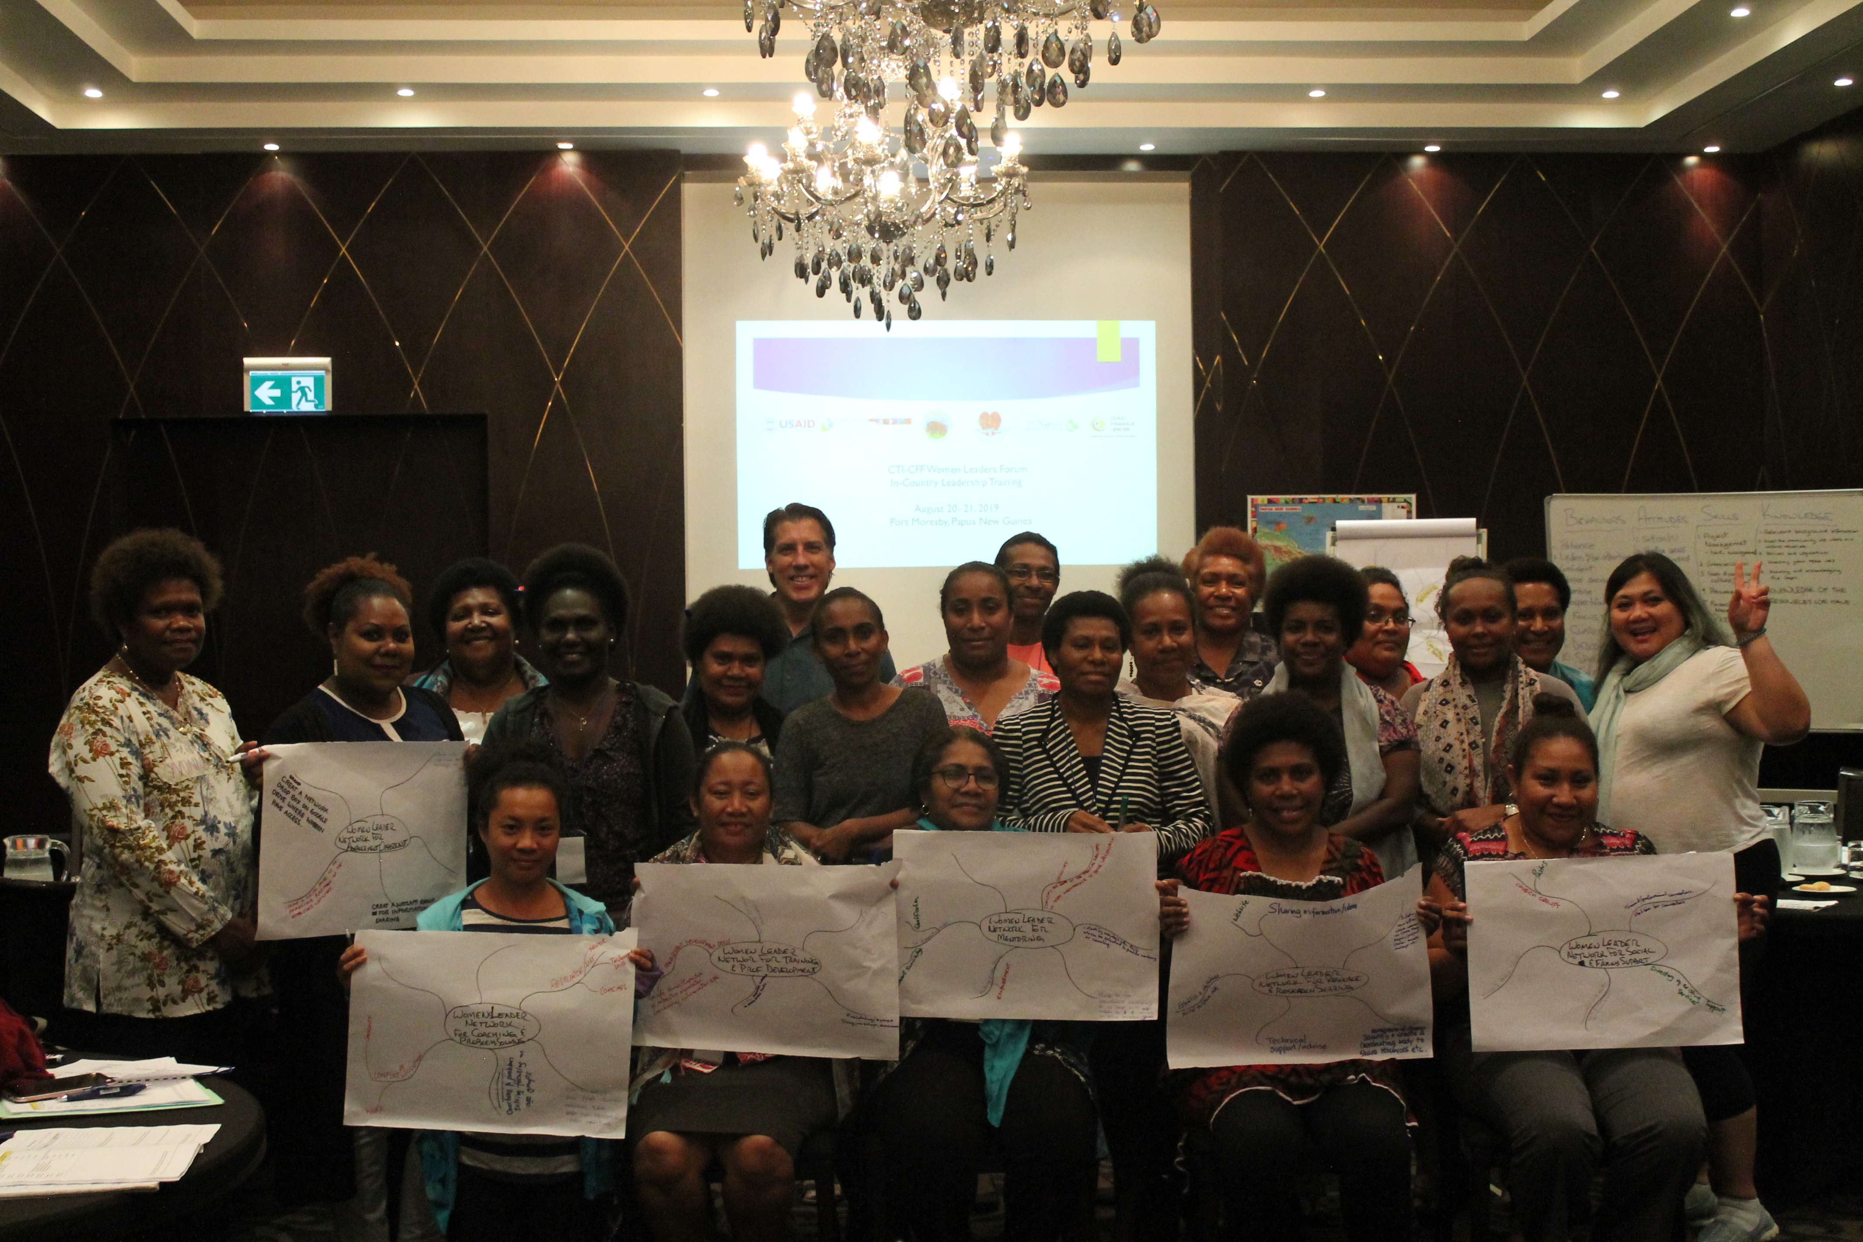
Others Activities conducted in Support of CTI-CFF
Women's’ Leadership Training (August 20-21, 2019
21 PNG women from Government agencies & partners participated in the delivered by CTC in Port Moresby.
September 24-26, 2019, Four PNG women participated in the Women’s Competency model development in Bali, Indonesia led by CTC.

Slide 20
II. Challenges/Constraints Affecting Implementation of Activities
Capacity within provinces to sustain implemented work programs
Lack of adequate resourcing for in country extensive consultation for RPOA 2
Prioritizing regional resource allocation for program implementation across all CT6 countries
Remoteness and accessibility of areas/site
Limited resources and short project timeframe for implememtation
Conservation vs Economic activities

Slide 21
IV. National Roadmap 2020
A. CTI-CFF National Programs
RPOA 2 finalization for implementation (2020-2030)
B. Programs/projects/activities related to CTI-CFF goals (but not directly budgeted under CTI-CFF programs)
Priority Seascapes (2019- 2023)
Bismarck Seascape – 8 provinces
Coral Seascape – 3 provincial governments
RCFMA for coastal fisheries and aquaculture 2017-2026
PNG Marine Program 2019-2023

Slide 22
IV. Potential Regional Program and Support Required
Seascape: Bismarck Solomon Sea requires partnership strengthening and resources
University Partnerships: Establish MoUs with 6 National Universities
MPA: twinning programs between SEAN and Pacific member countries
Sustainable Marine Tourism Pilot sites
CT Atlas training
Monitoring & Evaluation framework for all thematic areas

Slide 23
V. Documents/Publications
PNG Marine Program 2019-2023
Land and Sea Assessment report for PNG
National Marine Conservation Report
RCFMA for coastal fisheries and aquaculture 2017-2026

Slide 24
VI. Other Remarks
All CTI CFF meetings including trainings be hosted evenly on a rotational basis across ASEAN and Pacific CT member countries regardless of cost

